Slide 1
April 2021 Regional Team Briefing
[Region]

Slide 2
April Topics
NEW
NEED TO KNOW AND DO
Probation Reform Programme: NEW Unified Tiering Model
Probation Reform Programme: NEW Commissioned Rehabilitative Services + UPDATES
Probation Reform Programme: NEW Telephony Service + Tech Rollout
Probation Reform Programme (People): UPDATES Staff Transfers
Probation Workforce Programme: NEW Competency Based Framework + Equality, Diversity, Inclusion & Belonging Action Plan + Recruitment and Retention Strategy
Welcome Hub UPDATES and WHAT’s NEW
Persona Maps: NEW Impacts by Job Role (attachment to follow)
[Region] April Areas of Focus
Your Questions and Feedback
Thank You
NEW this month

Slide 3
Team Briefing Purpose
1
We’re aware of and informed about national and regional change from the Probation Reform, Probation Workforce and Recovery Programmes
2
Our opportunity to discuss how these changes might affect our team and any actions we might need to take to align with and support these changes
3
Clarify our region’s and team’s areas of focus for this month – what are our big deliverables?

Slide 4
Why Tiering Data is Important
Tiering data:
Tiering is how the NPS allocates staff resource to different types of cases
Tiering data informs the target staffing levels that we need to manage current and future organisational, team and individual caseloads, particularly how caseloads are weighted; it also provides the data underpinning caseload decisions
This means that tiering data impacts all current and future people on probation sentence management services
Additionally, tiering data informs case allocation decisions and is linked to our Workload Measurement Tool (WMT) to measure and compare staff workloads
Workload Measurement Tool Staff FAQ
Workload Measurement Tool Staff Guidance

Slide 5
What is the Unified Tiering Model?
The Unified Tiering Model calculates each individual person on probation’s level of risk and need
It combines available nDelius and OASys data and calibrates each people on probation’s tier, supporting the Probation Reform Programme’S Target Operating Model and mixed caseloads incorporating high, medium and low risk, including standalone unpaid work
The Unified Tiering Model also reflects our refreshed operating models for sentence management, resettlement and women’s services, in line with our new organisation’s operating model and culture
Developed by our Digital, Data & Technology team to support our new unified model

Slide 6
Unified Tiering Model
Reflecting the Probation Reform Programme’s designs for the Unified Model, it is proposed that tiering is revised to reflect Risk of Serious Harm (RoSH) and need
Change (Need) | High | 3
 | Medium | 2
 | Low | 1
 |  | 0
 |  |  | D | C | B | A
 |  |  | Low | Medium | High | Very High
 |  |  | Assess & Protect (Risk of Serious Harm)
Dynamic to reflect workload at start of sentence / release
Reflecting change work sought for low public protection
Adaptive to changes in circumstance
Reflect no change remit from court for standalone unpaid work with domestic violence

Slide 7
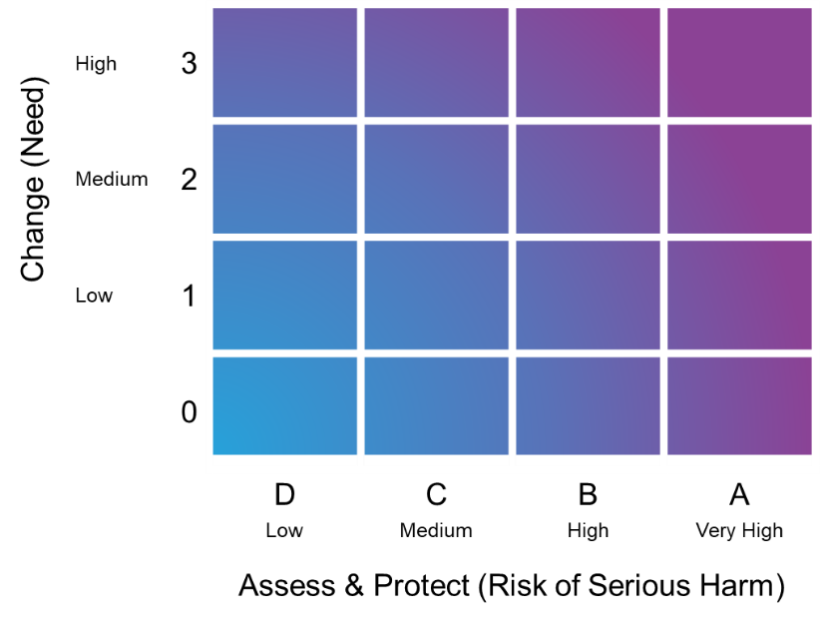
Unified Tiering Model Scoring Principles
Points based thresholds which broadly line up with the current NPS interim tiering model, supporting alignment with the offender management in custody (OMiC) model
A points based system to support future flexibility, rather than a system based on fixed rules
No Tier A cases in our current interim tiering model should be lower than Tier A cases in our Unified Tiering Model
Tiering is fully automated and changes automatically when a tiering event happens, continually reflecting a people on probation’s changing circumstances

Slide 8
Unified Tiering Model Benefits
Staff benefits
Staff will benefit from a fully utilised tiering framework that allocates cases to the right probation practitioner with the right skills and experience at the right time, to support each individual person on probation with a digital application that supports resource prioritisation and allocation and reflects workload implications at the start of sentence and release
The Unified Tiering Model is also an enabler of sentence management design to improve sentence management, which benefits staff in terms of risk management and change work
The Unified Tiering Model will target team resources more efficiently and effectively, because it allocates resource based on the Risk of Serious Harm (RoSH) and intensity of need
People on probation benefits – our new name for service users
Thanks to the introduction of the change axis, the Unified Tiering Model will provide people on probation with specific resources that meet their particular area/s of need, supporting rehabilitative change and consistent service provision
The Unified Tiering Model, aligned with sentence management, will facilitate more focussed, planned and structured sessions with probation practitioners and more responsive, desistance based contact

Slide 9
Unified Tiering Model Rollout and Support
The Unified Tiering Model is scheduled to be deployed from 4 May 2021
Performance and Quality team/s were briefed in March 2021 to support our transition to the Unified Tiering Model
Frontline staff will receive concise guidance calculating the Unified Tiering Model; this will be distributed through:
Unified Tiering Model Staff FAQ
Unified Tiering Model Staff Guidance document
The April Regional Team Briefing; links to this deck will appear in April issues of:
Probation News
The Senior Leader’s Bulletin
One Programme Newsletter
This information will also be available in EQuiP
Probation practitioners will receive guidance on the Unified Tiering Model as part of their sentence management training material

Slide 10
Commissioned Rehabilitative Services: Contract Awards Overview
As part of the new unified Probation Service there will be a range of services available from specialist external providers to meet key areas of rehabilitative services: Accommodation; Employment, Training and Education (ETE); Personal Wellbeing; and Women’s Services
Contracted providers of these commissioned rehabilitative services will work closely with probation practitioners and Community Interventions teams to ensure that the best outcomes are achieved for people on probation. People on probation with RARs and Licences / Post Sentence Supervision will be able to access these services
Contracts for ETE, Accommodation and Wellbeing have been awarded over the last few months – the full list is available on the NPS intranet and Welcome Hub
Women’s services contract awards have just been announced – see the table on the next slide
New Welcome Hub page has been developed
Jargon Buster
Commissioned Rehabilitative Services Commissioned rehabilitative services refer to all rehabilitative services which NPS funds and commissions but are delivered by organisations other than the NPS
Dynamic Framework Is the primary mechanism regions will use to commission those services, e.g. Accommodation
CRS Refer and Monitor Is the tool that practitioners will use for simple referrals and information exchange
Notes:
NOTE: links needed for content highlighted in yellow, pending: 1) document sign off and 2) HMPPS digital team links

Slide 11
Commissioned Rehabilitative Services: Contract Awards by Region
Region | PCC Regions | Awarded Women’s Provider
East Midlands | Derbyshire​ | Women’s Work Derbyshire​
 | Leicestershire​ | Changing Lives​
 | Lincolnshire​ | Lincolnshire Action Trust​
 | Nottinghamshire​ | Nottingham Women’s Centre​
East of England | Bedfordshire​ | Advance Charity​
 | Cambridgeshire​ | St Giles Wise Group​
 | Essex​ | Advance Charity ​
 | Hertfordshire​ | Advance Charity​
 | Norfolk​ | St Giles Wise Group​
 | Suffolk​ | St Giles Wise Group ​
 | Northamptonshire​
Kent, Surrey & Sussex | Kent​ | Advance Charity​
 | Surrey​ | Women In Prison​
 | Sussex​ | Brighton Women’s Centre​
London | London | Services being co-commissioned
Region | PCC Regions | Awarded Women’s Provider
North East | Cleveland​ | Changing Lives​
 | Durham​ | St Giles Wise Group​
 | Northumbria​ | Changing Lives ​
North West | Cheshire​ | PSS UK​
 | Lancashire​ | Lancashire Women’s​
 | Merseyside​ | PSS UK​
 | Cumbria​
South Central | Hampshire​ | Advance Charity ​
 | Thames Valley​
South West | Avon and Somerset​ | The Nelson Trust​
 | Devon and Cornwall​ | The Women’s Centre Cornwall​
 | Dorset​ | The Women’s Centre Cornwall​
 | Gloucestershire​ | The Nelson Trust​
 | Wiltshire​ | The Nelson Trust​
Wales | South Wales ​
 | Gwent​
 | Dyfed-Powys​
 | North Wales ​
West Midlands | Warwickshire​ | Changing Lives​
 | West Mercia​ | Willowdene​
 | West Midlands​ | Changing Lives​
 | Staffordshire​
Yorkshire and The Humber | Humberside​ | Together Women​
 | North Yorkshire​ | St Giles Wise Group​
 | South Yorkshire​ | Changing Lives​
 | West Yorkshire​ | Together Women​
Work to award contracts where no provider is currently listed is ongoing
Notes:
NOTE: links needed for content highlighted in yellow, pending: 1) document sign off and 2) HMPPS digital team links

Slide 12
Commissioned Rehabilitative Services: Refer and Monitor
We are committed to transforming the way we refer and manage interventions
This includes the processes of adding, finding and referring to an intervention; tracking progress; and receiving feedback on and evaluating an intervention
You will be able to find and refer individuals to an intervention through a single digital service, as opposed to currently switching between up to four systems
We will create a comprehensive, linked and high quality set of intervention data to be analysed and evaluated continuously on our analytical platform
You will be able to send supervised individuals on to the right intervention at the right time
Digital delivery: assessing risks and needs
We are creating a more dynamic, fluid way to assess risks and needs that uses data from case recording and interventions services to automatically update risk profiles and / or to trigger further questions for probation practitioners
This will ensure risk and needs assessment are more accurate at any given time
Digital delivery: people on probation engagement
A key area for transforming probation is the engagement of individuals in their sentence and rehabilitation
Digital has a significant part to play here, as the interface between probation and people on probation is increasingly expected to be web based
The second aim is to provide transparency in the process, so people on probation are able to see what has been decided, by whom and why
Lastly, we help deliver a sentence plan that supervised individuals can refer to, discuss and agree to follow
Notes:
NOTE: links needed for content highlighted in yellow, pending: 1) document sign off and 2) HMPPS digital team links

Slide 13
Commissioned Rehabilitative Services: Learning
What?
Ahead of the introduction of the Commissioned Rehabilitative Service we want probation practitioners to have trust and confidence in the Day 1 services overall and to know what will be available in their area
Learning resources are being designed that will support practitioners through the Rehabilitative Services referral journey, including selecting the right intervention, undertaking a referral and working together with the provider to ensure the person on probation experiences seamless support
How?
Learning resources for the Commissioned Rehabilitative Services will cover:
Broadly what services are available; more detail on specific services at a regional level
What staff will experience differently when referring individuals, e.g., assessment of risk, need and complexity, how to use the new digital system
How to work in partnership with service providers to get the best outcomes for people on probation
What ongoing support and help is available within their region for CRS
When?
The suite of learning resources and support will be made available to all staff via MyLearning in May, with relevant communications informing staff of how to access and encourage their completion of the required learning
Resources will also be available on the NPS intranet and Welcome Hub
CRS

Slide 14
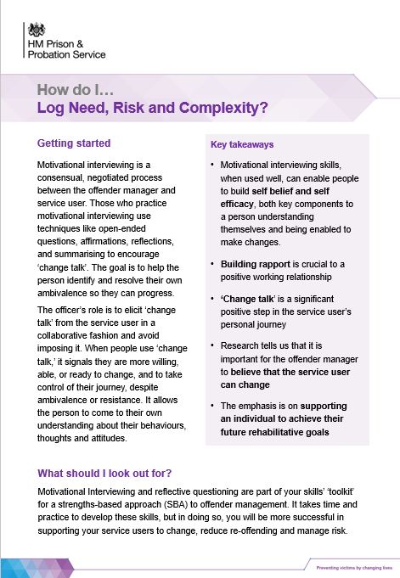
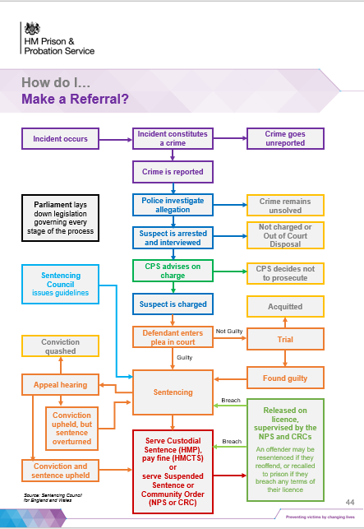
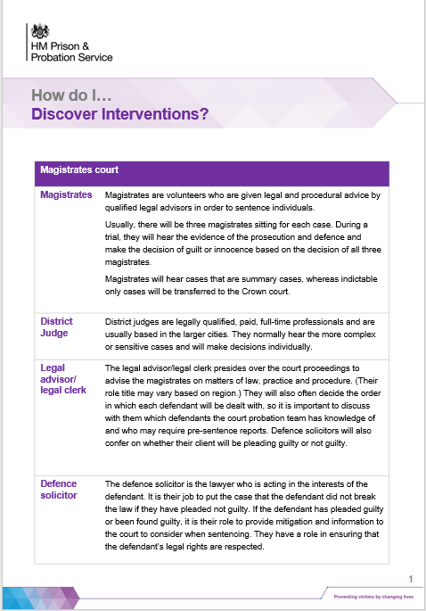
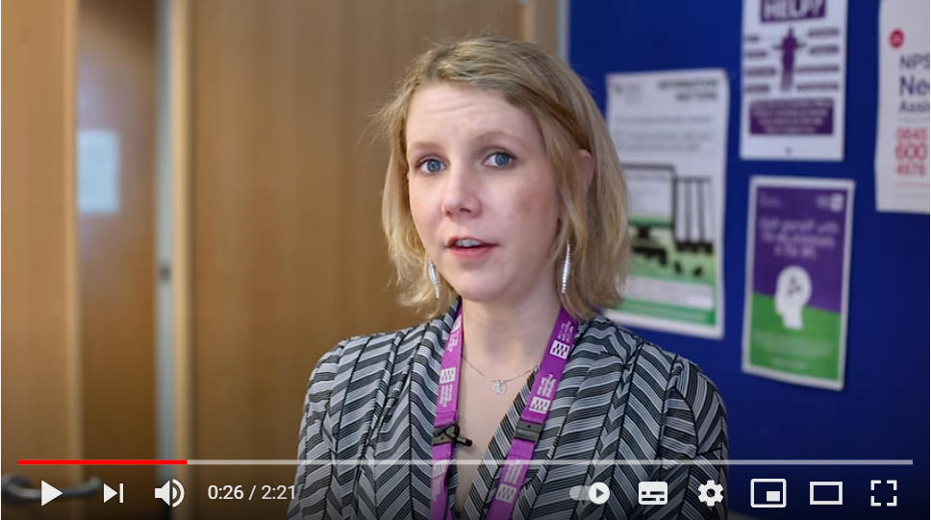
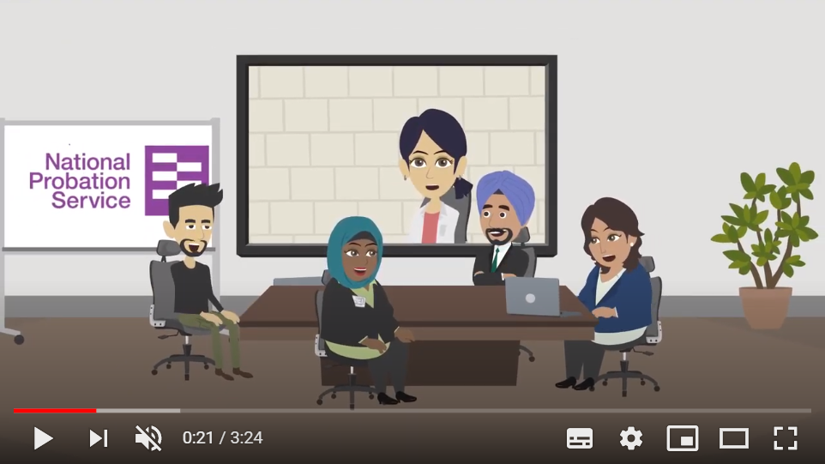
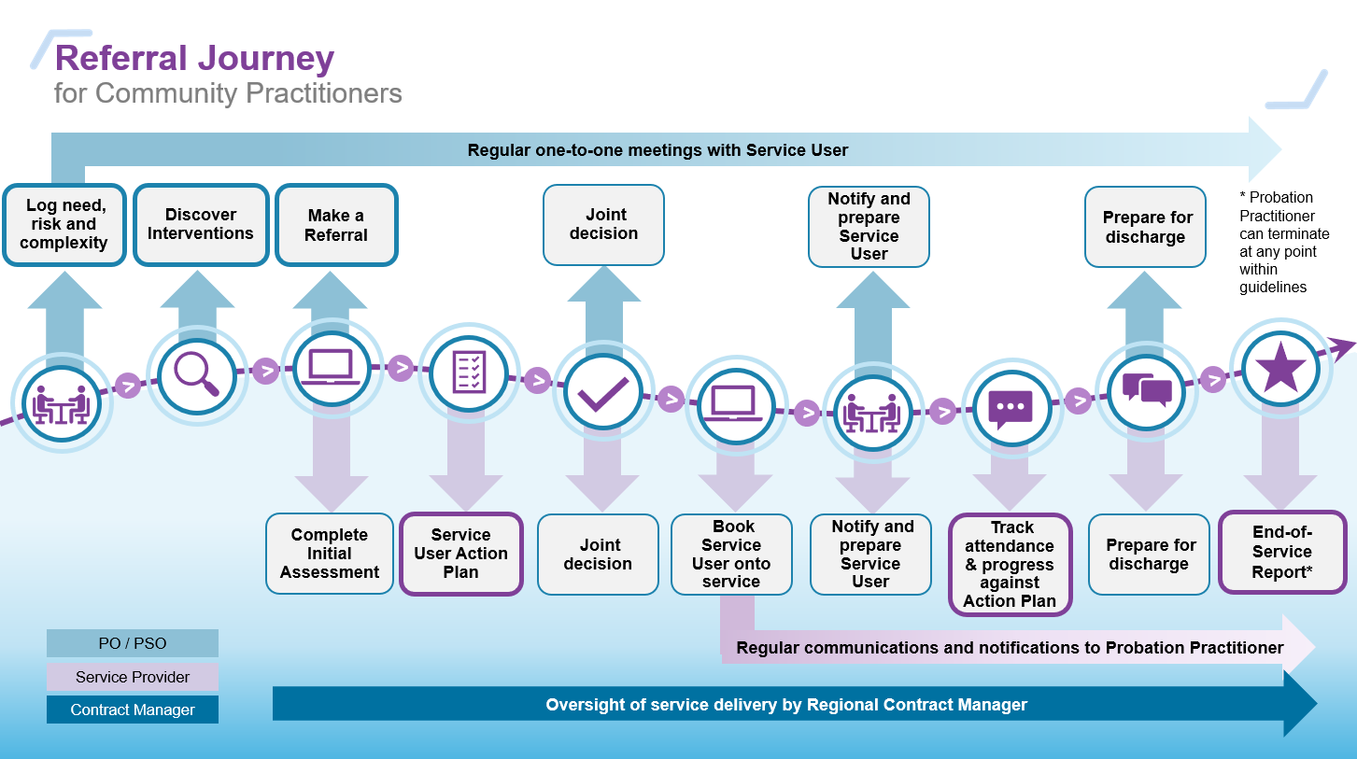
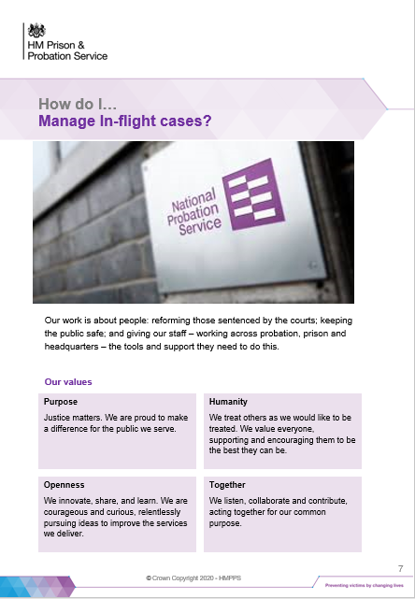
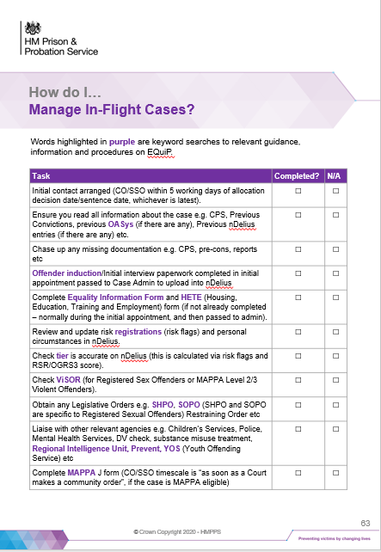
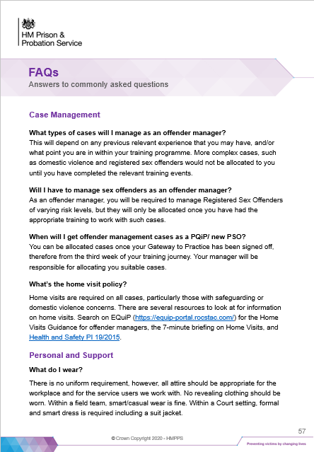
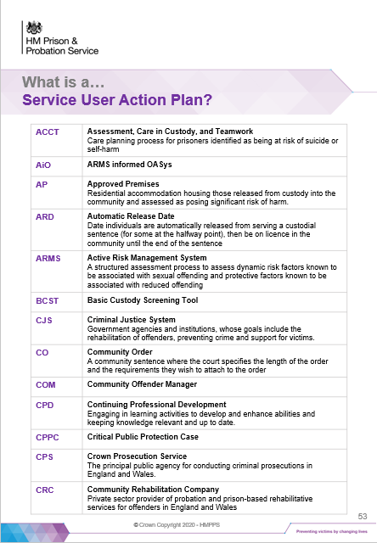
Commissioned Rehabilitative Services: Learning
The CRS Learning Toolkit is a blended approach that combines guidance on best practice along with practical resources on the process and the underlying digital platform. It allows busy practitioners to learn on the job – and to tailor their learning for their own needs and circumstances.
All will be asked to pass a ‘Knowledge Check’ before Day 1, demonstrating a clear understanding of the new expectations and processes before starting work in the unified organisation. This knowledge check can be taken more than once, allowing practitioners to correct misunderstandings and learn from mistakes.
3a
3b
3c
BITE SIZE GUIDES
linked to specific steps with screenshots:
How do I… Discover & Select Commissioned Rehab Services?
How do I… Make a referral?
What is a… People on Probation Action Plan?
How do I… Monitor attendance and progress against an Action Plan?
What can I expect… in a Post Session Feedback Form?
What can I expect… in an End of Service Report?
1
2
3
REFERRAL JOURNEY
A simple process map that guides practitioners and providers, aided by an intuitive digital platform
LEADER VIDEO
What’s my role in managing end to end sentences?
ANIMATED VIDEO
What’s in it for me and people on probation?
4
5
6
7
3d
3e
3f
BITE SIZE GUIDE
When should I…
Refer to external specialists?
BITE SIZE GUIDE
How do I…
Work effectively with service providers?
CHECKLIST
How do I…
Manage In Flight Cases?
FAQs
Answers to common questions

Slide 15
Digital, Data & Technology: New Telephony Service
Our commitment to give you the technology you need to succeed continues with Microsoft Teams telephony being phased in over the coming months
Your new Direct Dial In (DDI) contact number will give you access to a range of virtual calling features – in the office, at home, or on the move – using the Microsoft Teams app on your new laptop and smartphone
You’ll have the flexibly to quickly start a video call, share your screen, and add colleagues to turn a 121 call into a group video call
Along with fast and clear audio calls, you’ll have greater control with voicemail, do not disturb, delegation, pick up groups and the ability to look up a person from their number
We will also be adding Microsoft Teams / Office 365 handsets in reception areas, interview rooms and public areas where required
We will introduce this technology enhancement to all colleagues in CRCs, Parent and Supply Chain Organisations, using a phased approach aligned to us taking over responsibility for telephony services in these locations
See the Welcome Hub for more details
Collaborate with Calling for Microsoft Teams

Slide 16
Digital, Data & Technology: Tech Rollout
More than 1,000 colleagues in CRCs, Parent and Supply Chain Organisations have received new laptops, accessories, assisted technology and smartphones and have had their emails and data migrated to their new equipment
These colleagues can now be reached through @justice email accounts and the range of collaboration tools within Microsoft Teams:
People Plus: Warwickshire and West Mercia
Purple Futures: Cheshire and Greater Manchester, East and West Lincolnshire PDU’s which form part of the Humberside, Lincolnshire & North Yorkshire (HLNY) CRC, West Yorkshire and Hampshire and the Isle of Wight
Joining them in April will be more than 2,000 colleagues from:
Purple Futures: Merseyside and remaining colleagues in HLNY
Sodexo: South Yorkshire; Cumbria and Lancashire; Northumbria, Essex, Norfolk and Suffolk, and Beds, Northants, Cambridgeshire and Hertfordshire
Follow our tech rollout on the Welcome Hub
Tech rollout gathers pace

Slide 17
People workstream – Staff Transfer update and people related activity
Role alignment panels will commence from the 26th March and we expect there to be 11 days of panels.
Corporate services staff can read more about what role alignment will mean for them on these new Welcome Hub pages.
The pre-transfer ACO placement process - in early April, a selection process will begin in the 3 regions that have an over-supply situation. Following the selection process, all displaced staff will have an opportunity to apply for remaining vacancies.
Recruitment can now begin for vacant in-scope ACO roles - first preference for all in-scope roles will go to displaced ACO’s who do not secure a role following the selection interviews.
Recruitment - in order to fully realise our unified model and operate successfully after day 1, some permanent recruitment is likely to begin. This will only be for business critical roles where we expect there to be an undersupply of people.
Consultation discussions will continue with a focus on bringing consultation to an end at the end of March or as soon as possible thereafter.
Learning & Development – the IT systems learning (nDelius and OASys) is now live on the Welcome Hub. We are working to finalise the post-transfer learning plan over the coming month.
Transfer letters – it has been agreed that transfer letters will be sent out after 12th June (date TBC) using new @justice accounts. We will communicate to staff about what they can expect from their transfer letter in May / early June.

Slide 18
Probation Workforce Programme
Our Competency Based Framework (CBF) trial launches on 1 April
We’re holding a CBF Launch Event on 8 April from 11.00 – 11.30am to guide you through:
The CBF process and important dates during the year
How to identify a competence level
How to identify competence examples
Making a competence decision at the end of the year
Share the CBF Launch Event Outlook calendar invite with your teams
Add the invite to your Outlook calendar:
Double click ‘CBF Launch Event.ics’ icon to add the event to your calendar with the event link
Once the invite opens, click ‘Save & Close’ (top left) to save the invite to your calendar
Submit pre event questions to:
CBF-Enquiries@justice.gov.uk
For more info go to:
HMPPS Intranet & Welcome Hub
Notes:
CBF – key messages
CBF Pilot commencing in April 2021
Staff will trial the CBF for 12 months without it being linked to pay progression
The CBF will be linked to pay from 1 April 2022 for NPS staff, and the first pay progression decisions linked to the CBF will be made on 1 April 2023.
What we need managers and employees to do
Leaders to role model behaviours and kick start the process
Staff responsibility to complete the process
What we need from Leaders
The CBF conversation should become embedded in everyday routine meetings and one to one’s. The process is straightforward and does not represent an additional burden for staff and line managers.
Please role model engagement by completing the process with your direct reports and encourage them to do the same
You’ll see some communications on this in due course – keep an eye out for more in Probation News, on the intranet and webinars to talk employees and managers through this easy process.

Slide 19
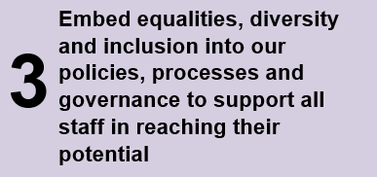
Probation Workforce Programme
Equality, Diversity, Inclusion & Belonging (EDIB) Action Plan
Our Unified Probation Service is about more than structural changes, it is about our staff and enabling them to deliver an excellent professional service
We will be setting out our strategic direction and commitments to progress Equalities, Diversity, Inclusion and Belonging in our ‘Action Plan’, due to be published on 26 April; Amy Rees will be communicating this to staff via a blog on the intranet
The EDIB Action Plan sets out a 12 month plan – including planned commitments for year two – focussing on the four key areas, below, and shares the initiatives we will implement to achieve our goals and deliver on our promise to our people
If you want to know more about the EDIB Action Plan please contact: Aisha.Ahmed3@justice.gov.uk
1
Attract and retain a diverse workforce that better reflects the diversity of our society and people on probation
Notes:
CBF – key messages
CBF Pilot commencing in April 2021
Staff will trial the CBF for 12 months without it being linked to pay progression
The CBF will be linked to pay from 1 April 2022 for NPS staff, and the first pay progression decisions linked to the CBF will be made on 1 April 2023.
What we need managers and employees to do
Leaders to role model behaviours and kick start the process
Staff responsibility to complete the process
What we need from Leaders
The CBF conversation should become embedded in everyday routine meetings and one to one’s. The process is straightforward and does not represent an additional burden for staff and line managers.
Please role model engagement by completing the process with your direct reports and encourage them to do the same
You’ll see some communications on this in due course – keep an eye out for more in Probation News, on the intranet and webinars to talk employees and managers through this easy process.

Slide 20
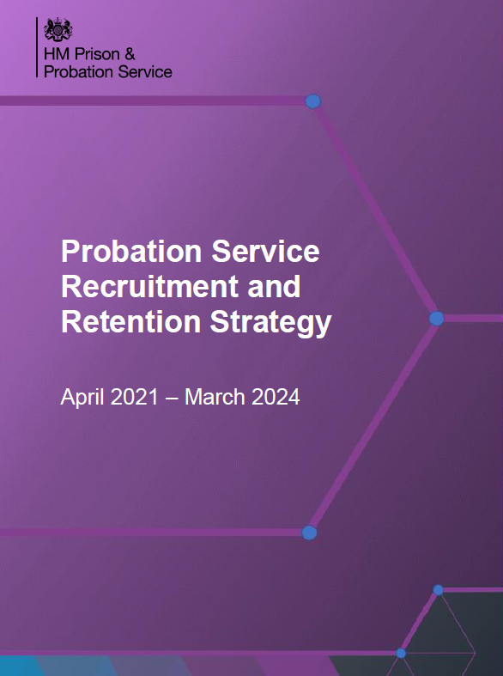
Probation Workforce Programme
Probation Service Recruitment & Retention Strategy
The Recruitment & Retention Strategy launches in early April
This strategy follows the publication of the Probation Workforce Strategy 2020-23 and supports the principles of the wider Her Majesty’s Prison and Probation Service (HMPPS) Business Strategy
The Probation Service is entering a period of important and significant change in June 2021 with the unification of NPS and CRC staff and there’s a lot of work to do to make sure that we have a clear path to achieve our future Target Operation Model (TOM)
This strategy sets out our vision for recruitment and retention for the unified team for the next three years
Annex 1 at the end of the document outlines our deliverables in years one and two with a planned review of progress in Spring 2022
The Recruitment & Retention Strategy underpins the five key pillars that support the overarching Workforce Strategy
If you want to know more about the Recruitment & Retention Strategy contact: PWPRecruitmentRetentionPolicy@justice.gov.uk
It is our ambition to broaden the focus of the strategy in future years to further reflect the needs of the whole workforce
Notes:
CBF – key messages
CBF Pilot commencing in April 2021
Staff will trial the CBF for 12 months without it being linked to pay progression
The CBF will be linked to pay from 1 April 2022 for NPS staff, and the first pay progression decisions linked to the CBF will be made on 1 April 2023.
What we need managers and employees to do
Leaders to role model behaviours and kick start the process
Staff responsibility to complete the process
What we need from Leaders
The CBF conversation should become embedded in everyday routine meetings and one to one’s. The process is straightforward and does not represent an additional burden for staff and line managers.
Please role model engagement by completing the process with your direct reports and encourage them to do the same
You’ll see some communications on this in due course – keep an eye out for more in Probation News, on the intranet and webinars to talk employees and managers through this easy process.

Slide 21
New on the Welcome Hub
There’s always something new to check out on the Welcome Hub
Recent updates:
Probation round up and Hub updates
IT Systems Learning
Role alignment for corporate and support services staff
Competency based framework
How you’ll be paid in June
Understanding pay assimilation
Commissioned Rehabilitative Services – everything you need to know
Please keep your feedback coming via the ‘Contact’ section on the Welcome Hub – we’d love to hear what you like about the Hub and how we can make it work better for you

Slide 22
Persona Mapping: Overview (attachment to follow)
DRAFT: For Discussion
A Persona Mapping exercise conducted by the Business Change team over the course of this year has identified potential impacts from the Reform Programme between now and Day One for operational and non-operational (corporate services) staff.
Split into two cohorts (ops and non-ops), the documents capture what is changing for a number of roles between now and ‘Day One’ 26 June 2021. It also highlights issues that may need to be considered ahead of Day One to ensure the management of the change is effective, smooth and inclusive for those involved. It should be noted not all roles will be covered, with mapping focused on larger staff populations experiencing the greatest impact of change.
This is shared to support regions to manage change locally, as well as communicate what change will look and feel like for Day One for staff groups.
Within your region, you may want to use documents and/or content to inform local change management activity or use to simply communicate with certain staff groups what changes are anticipated between now and Day One for their part of probation.
Business Change Team plan to do more detailed work to understand the impacts from a post-Day One perspective and will also build in a more detailed understanding of the impact of the workforce programme key activity as part of our approach to post-Day One planning. Updates to follow

Slide 23
Region April Areas of Focus
Content to be inserted by region
[Region]

Slide 24
Team Impacts
How might today’s Team Briefing topics affect our team?
Are we clear on our individual and team next steps and delivery?
How are we managing change? Do we need support?

Slide 25
Your Feedback and Questions

Slide 26
THANK YOU

