Slide 1
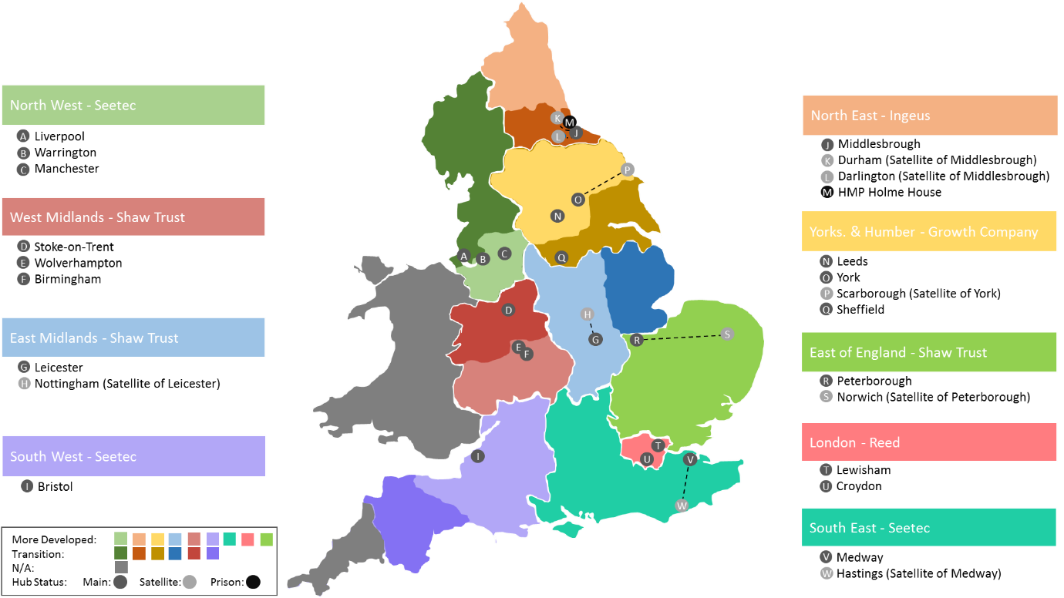
CFO Activity Hub Locations

