Slide 1
February 2021 Regional Team Briefing
[Region]

Slide 2
Team Briefing Purpose
1
Ensure you are aware of and informed about changes being delivered at a national and regional level through the Probation Reform, Probation Workforce and Probation Recovery Programmes
2
Provide us with an opportunity to discuss how these changes might affect our team and any actions we might need to take to align with and support these changes
3
Clarify our region’s and team’s areas of focus for next month

Slide 3
February Topics
Probation Reform Programme: NEW Prepare a Case for Sentence Service
Probation Reform Programme: NEW Dynamic Framework contracts for education, training and employment services
Reform and Workforce Programmes: NEW Change Map
Reform & Workforce Programmes: NEW Welcome Hub for CTC staff joining the new unified probation service
Reform Programme: UPDATE Changes to current NPS teams in authority systems to reflect future probation delivery unit structures
[Region] February Areas of Focus
Your Questions and Feedback
Thank You
[Region]

Slide 4
NEW Prepare a Case for Sentence Service
We are improving local and national court liaison arrangements so that sentencers are:
Confident about probation services and the delivery of community sentences
Aware of the range of effective interventions being delivered or commissioned by probation;
Assured of the quality and effectiveness of those services
Improving the quality of our advice to court and pre sentence reports will ensure that our proposals target specific interventions and treatment requirements, supporting reduced reoffending
Background

Slide 5
NEW Prepare a Case for Sentence Service
A new digital service for probation practitioners and administrators in magistrates’ courts
Provides an overview of all defendants attending court on a given day, including:
Their probation status and probation record
Information about any current orders
Offender manager details, requirements and attendance information
Our Staff FAQ provide you with full details
By providing this information in a more accessible and usable format, our staff will be able to provide better advice to the court with less effort and minimise avoidable adjournments
Service
Description

Slide 6
NEW Prepare a Case for Sentence Service
Benefits for court staff
Quick identification of potential probation cases of interest
Time saved identifying defendants known to probation and gathering case information, such as offender manager details and current order information
Significant reduction in the number of clicks, screens and systems staff have to move between when preparing cases
Rollout plan and timings
Currently being trialled in North Tyneside and Sheffield
The trial will expand to around 10 courts in January and February, including Hull, Highbury Corner and Cardiff and involve 200 staff through May
A rollout plan will be developed which will see this service gradually introduced to all magistrates’ courts across England and Wales
We expect all court staff to have adopted the service by the second half of 2021
Your regional operational leadership team will need to know and do information to support this service launch

Slide 7
Commissioned Rehabilitation Services (Dynamic Framework Update)
What’s changing – a reminder
Regions will be able to commission a greater range of specialist resettlement and rehabilitative services from Commissioned Rehabilitation Services organisations
For 26 June, there will be a range of services available to meet key areas of need including: Accommodation; Employment, Training and Education; Personal Wellbeing, and Women’s Services. Providers of these services will work closely with you to ensure that the best outcomes are achieved for service users
Benefits for staff
These services are designed to be responsive, flexible and to support Probation Practitioners to provide Service Users with better, more effective support and enable a focus on promoting change and encouraging desistance.
You will
Be able to access interventions easily through accessible information about the range of activities and interventions available and a simplified referral form;
Be able to liaise with the providers about what is needed for each Service User, agreeing an action plan;
Have confidence in the activity that is being undertaken with clear timescales so interventions can start promptly
Have a new digital recording system for recording all activity (replacing NSIs);
Benefit from the work undertaken by those with expertise in relation to specific issues.

Slide 8
Commissioned Rehabilitation Services (Dynamic Framework Update)
Update – Employment Training Education Contracts awarded
The first contracts for commissioned rehabilitative services under the new Dynamic Framework have been awarded. From 26 June 2021, Employment, Training and Education services will be delivered by:
Maximus - North West, Wales, West Midlands and London regions,
Ingeus - North East and East Midlands;
The Growth Company - Yorkshire and the Humber
Seetec - East of England, South West, Kent Surrey & Sussex
For South Central, none of the bids met the high quality threshold, so the competition will be re-run shortly.
Contracts are also being awarded over the next three months for Accommodation; Personal Wellbeing and Women’s Services
In Greater Manchester, the programme team is working with the Greater Manchester Combined Authority to co-commission rehabilitative services.
Next steps
The programme team is now working with the successful bidders to ensure they are ready to deliver services from day 1 of the new NPS organisation.
There are CRC and supply chain provider staff who will be joining the Dynamic Framework organisations on day 1 of our new unified probation service. If you are unsure whether this applies to you, please talk to your current employer who can confirm whether you are assigned to transfer to a DF organisation or not.
Plans for workforce mobilisation will now be agreed between new and incumbent providers and will be owned by new providers. Mobilisation Managers will have oversight of mobilisation plans and completion of key implementation milestones in preparation for the transfer of in-scope staff to the newly commissioned rehabilitative services.
Workforce mobilisation plans will include (not exhaustive): the approach to the transfer information and consultation process, the provision and migration of employee data and payroll preparation and assurance.
Learning and Development
Comprehensive learning and support on how to refer service users to external providers is being developed and will be provided to all staff before day 1 of the new Probation Service

Slide 9
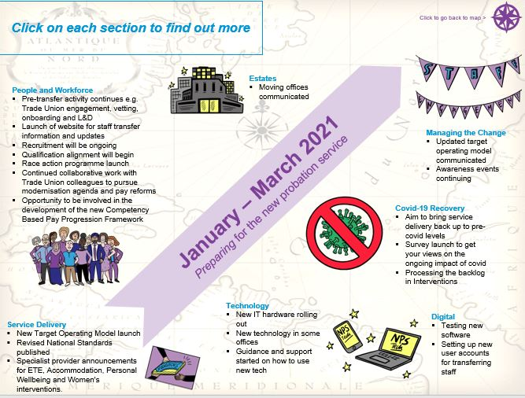
The Change Map
What is it?
The National Change Map is a document that articulates the changes happening across the three probation programmes: Reform, Recovery and Workforce. It is divided into quarterly time periods and written in clear language accessible to all staff.
The document is purposely visual to make it engaging, simplify complex information; and can either be used as a direct communication tool with staff, or it can inform regional communication methods you already have in place such as newsletters, events, etc.
Why is it needed?
The aim of the Change Map is to support your regions to understand what their working worlds will look and feel like at various stages over the next 12 months, to enable you to prepare and be engaged in those changes.

Slide 10
The Change Map
How does it work?
The Change Map has many embedded links, enabling staff to click on time periods and change drivers most relevant / interesting to them; providing an informative and interesting way of learning about the changes to be expected within the probation system.
As an interactive document, it will be shared with Change Leaders (Heads of BSC, Programme Transition Leads, CRC/NPS Transition Leads) in editable and ‘live’ presentation versions; the latter with embedded links for staff to click through and find the information they are most interested in.
Change Leaders can then choose to:
Produce regional versions of the document,
Use the document to inform existing regional change products (i.e. newsletters),
Share the national document directly with staff,
or a combination of the above options.
The regional use of the Map can be confirmed via Regional Transition Boards/Sub-Groups. There are also workbook activities to support this regional cascade.
What next?
The Business Change Team will provide an updated National Change Map version on a quarterly basis – with the next version (v2) being shared in March. The Business Change ask Change Leaders to share their feedback or updates they think relevant, to help inform future versions and ensure the content is useful for our frontline probation practitioners.
For more information on the National Change Map, contact Caroline Sharp or Steph Smart.

Slide 11
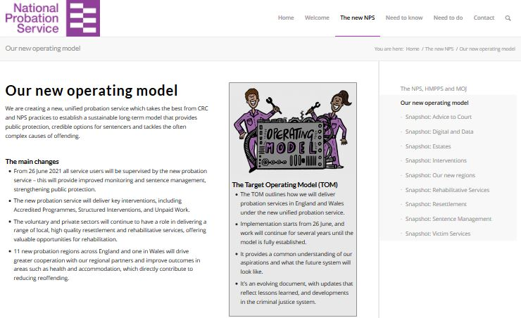
New Welcome Hub for CTC staff joining the new unified probation service
Have a look here: hmppsintranet.org.uk/welcome-hub
https://welcome-hub.hmppsintranet.org.uk/
Welcome Hub - a new one-stop-shop of information
Our Welcome Hub, launched this Wednesday, is a fresh one-stop-shop of information on what it means to be part of the probation service at this exciting time.
Content is primarily aimed at helping colleagues feel part of the team ahead of their move from CRCs, Supply Chain and Parent Organisations, but there’s plenty of information that will be of interest to current NPS colleagues too.
As it continues to develop, our aim is to replicate relevant information in the Hub on the NPS intranet, to provide more choice for everyone.
To get the most out of Welcome Hub, we recommend accessing it using Edge, Chrome or Firefox web browsers.
Some CRC colleagues may have issues accessing the Hub through their corporate IT and we are working with these organisations to fix this as soon as possible.

Slide 12
Changes to current NPS teams in authority systems to reflect future probation delivery unit structures
At the end of October 2020, final changes were made to NDelius, OASys and other Authority applications to recognise the new 11 NPS regions in England. The next phase is to ensure that these Authority applications recognise the new Probation Delivery Unit (PDU) and other team structures in those regions.
When will this happen?
The reform programme team assessed several options for when and how to make these changes. To ensure a smooth transition to the future structures of the unified model, the team will first make changes to Authority systems that move NPS existing team structures to the future PDU and team structures. This has started with NPS KSS teams being changed on the 9th January 2021. All other existing NPS teams are being changed this coming weekend, 30th January 2021.
What does this change mean?
This change during January will only impact current NPS teams in Authority Systems. After the changes have been made staff will see minor changes, for example: NDelius drop downs will include new NPS team names NPS reporting will be amended to reflect new teams etc.
This activity is driven by ensuring we have a digital structure in place and does not pre-empt any staff placement decisions. As staff placement activity occurs, staff will be moved onto appropriate digital team structures. Wherever possible, disruption will be kept to a minimum.

Slide 13
Changes to current NPS teams in authority systems to reflect future probation delivery unit structures
Why are we doing this?
This approach will lay the strongest foundation for the transition of CRC teams and caseloads from June 2021.
Taking this incremental approach enables: -
lessons to be learned from those initial January changes
avoids further impact on CRC operations prior to June 2021
best management of digital capacity
sequencing of digital changes in a logical and structured way and
enables Regional Probation Directors to have baseline new structures in place on Authority systems for the first day of the new organisation
What do I need to do?
PLEASE CASCADE INFORMATION TO STAFF THROUGH MOST APPROPRIATE LOCAL CHANNELS
We will issue further updates through existing digital channels.
For further information please contact tracy.curtis@justice.gov.uk and jus.kooner@justice.gov.uk

Slide 14
Region February Areas of Focus
Content to be inserted by region
[Region]

Slide 15
Your Questions and Feedback
Please email [insert your region’s preferred transition / change Outlook account] – thank you

Slide 16
Thank You

