Slide 1
March 2021 Regional Team Briefing
[Region]

Slide 2
March Topics
4-5 National Standards
6-11 Commissioned Rehabilitative Services
12-13 In-house Interventions overview
14-15 Accredited Programmes
16-17 Structured Interventions
18-19 Unpaid Work
20 Senior Attendance Centres
21-22 In House Interventions Day 1 to end state changes and further info
23-29 Estates
30 Digital, Data and technology
31-33 PQip; Competency Based Framework
34 Staff Transfer
35 Corporate and Support Services Roles
36 Welcome Hub Update
[Region] March Areas of Focus
Your Questions and Feedback
Thank You
This month on
Reform and Workforce Programmes

Slide 3
Team Briefing Purpose
1
Ensure you are aware of and informed about changes being delivered at a national and regional level through the Probation Reform and Workforce Programmes
2
Provide you with an opportunity to discuss how these changes might affect our team and any actions we might need to take to align with and support these changes
3
Clarify our region’s and team’s areas of focus for next month

Slide 4
National Standards (1 of 2)
National Standards published with the Target Operating Model
Transition National Standards are being implemented to provide a greater level of direction to staff during the period of transition and stabilisation and will be mandatory from 26th June 2021. The standards will be reviewed and evaluated during Spring/Summer 2022
In defining the future operating model, the foundations to be able to achieve this have distilled it into a simpler description of ‘Assess, Protect and Change’
Standards set out minimum expectations for practitioners working with supervised individuals.
Designed to assist practitioners to effectively carry out the tasks involved in sentence management
The implementation of the Unified Model presents not only the requirement to revise National Standards to support a robust position for minimum level standards, but also an opportunity to set the direction for a longer-term view of how national standards should be defined.
Notes:
NOTE: links needed for content highlighted in yellow, pending: 1) document sign off and 2) HMPPS digital team links

Slide 5
National Standards (2 of 2)
A consistent format which is easily accessible to practitioners.
Against each standard, is a brief rationale followed by additional guidance and direct links to more detailed documents including relevant probation instructions, processes and practice guidance held within EQUiP
As much as possible the National Standards are defined in terms of intended outcomes, rather than as inputs and process tasks.
They are primarily focussed on the work of practitioners with supervised individuals in the community (who are subject to a Community Order/Suspended Sentence Order and those released from a custodial sentence on licence or during the post sentence supervision period)
They refer to work with supervised individuals before sentence and during the course of a custodial period.
A full copy of draft standards can be accessed on GOV.UK
Notes:
NOTE: links needed for content highlighted in yellow, pending: 1) document sign off and 2) HMPPS digital team links

Slide 6
Commissioned Rehabilitative Services (1 of 6)
The Dynamic Framework is the sourcing mechanism to commission rehabilitative services
This will enable the delivery of services that can be tailored to respond to the diverse backgrounds and needs of individuals to effect positive outcomes as well as maximise opportunities for collaboration with local partners, including VCSE organisations, local authorities and Police and Crime Commissioners
Commissioned Rehabilitative Services are one of a range of services to support the ‘Change’ element of Assess, Protect and Change
Target for day 1 of the new Unified Model
Be able to secure services which meet key needs in relation to: Accommodation; Employment, Training and Education; Personal Wellbeing, and Women’s Services
Both regional and PCC level contracts will be locally-delivered
Specification based on evidence and SME/ operational input
Our future ambition
Additional categories to support post-Day 1 commissioning
The Dynamic Framework has a range of providers qualified onto it who can be approached for future competitions
Commissioned Rehabilitative Services (CRS) in Sentence Management and Resettlement
Commissioned Rehabilitative Services are designed to supplement and not overlap with: Accredited Programmes, Structured Interventions and Toolkits.
They will be available to those with a RAR and on Licence For Day 1, accommodation and mentoring will be available pre-release
Notes:
NOTE: links needed for content highlighted in yellow, pending: 1) document sign off and 2) HMPPS digital team links

Slide 7
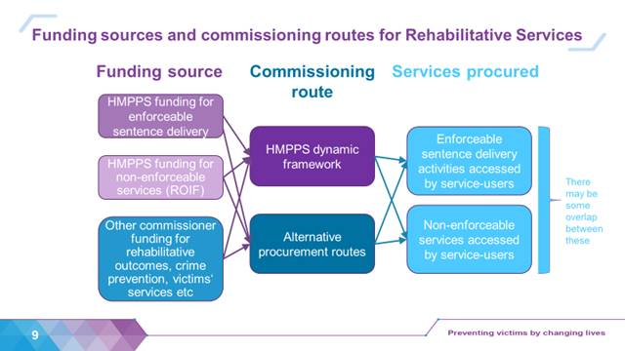
Commissioned Rehabilitative Services (2 of 6)
We are using CRS to refer to any rehab services which are commissioned from external providers, rather than delivered in-house by NPS
When we are the lead commissioner, we will use the DF as a procurement / contract route
Co-commissioned services could use the DF, or they could use the other commissioner’s procurement / contract route
Enforceable sentence delivery services are only being commissioned nationally for Accommodation, ETE, wellbeing and women’s for the first 3-4 years
Replacement enforceable services after the 3-4 years will be commissioned regionally by your commissioning team
Any enforceable FBD or D&R services that we as a region choose to commission will also be commissioned regionally rather than nationally
Notes:
NOTE: links needed for content highlighted in yellow, pending: 1) document sign off and 2) HMPPS digital team links

Slide 8
Commissioned Rehabilitative Services (3 of 6)
Learning and development
What?
Ahead of the introduction of the Commissioned Rehabilitative Services we want probation practitioners to feel trust and confidence in the Day 1 services overall and to know what will be available in their area.
Learning resources are being designed that will support practitioners through the Rehabilitative Services referral journey including selecting the right intervention, undertaking a referral and working together with the provider to ensure the Service User experiences seamless support.
In line with the other learning that has been designed to support transition to the new NPS, we are making greater use of digital resources (e.g., FAQs, checklists, videos etc.) to enable staff to access learning and support when it’s convenient for them, so they can learn at their own pace.
How?
Learning resources for the Commissioned Rehabilitative Services will cover:
Broadly what services are available (more detail on specific services at regional level)
What staff will experience differently when referring individuals (e.g. assessment of risk, need and complexity, how to use the new digital system)
Helpful insights and advice from key individuals involved in the Rehabilitative Services, e.g. Contract Managers, Service Providers
How to work in partnership with service providers to get the best outcomes for service users; and
What ongoing support and help is available within their region for CRS
When?
Communications will be planned throughout March and April to raise awareness of the new Commissioned Rehabilitative Services and increase practitioner’s awareness of the new way of working in June. A number of bitesize videos will be shared very soon.
The suite of learning resources and support will be made available to all staff via MyLearning in May, with relevant communications informing staff of how to access and encourage their completion of the required learning
Regional strategies to build sustained practice in the regions from Day 1
CRS

Slide 9
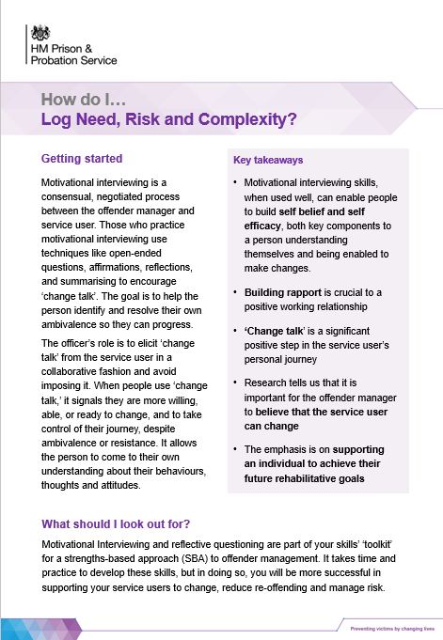
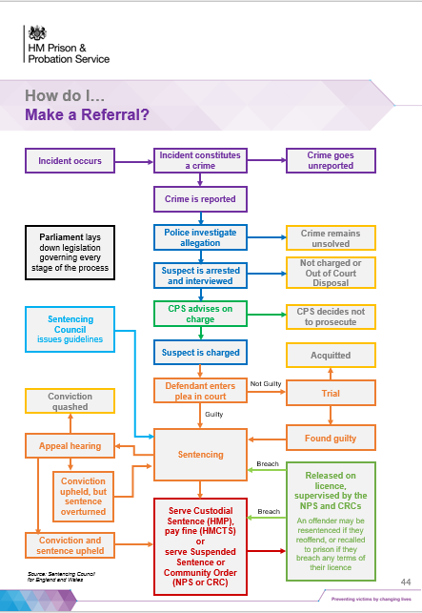
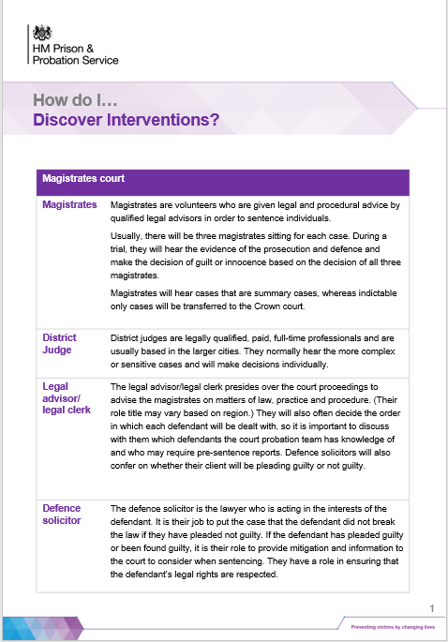
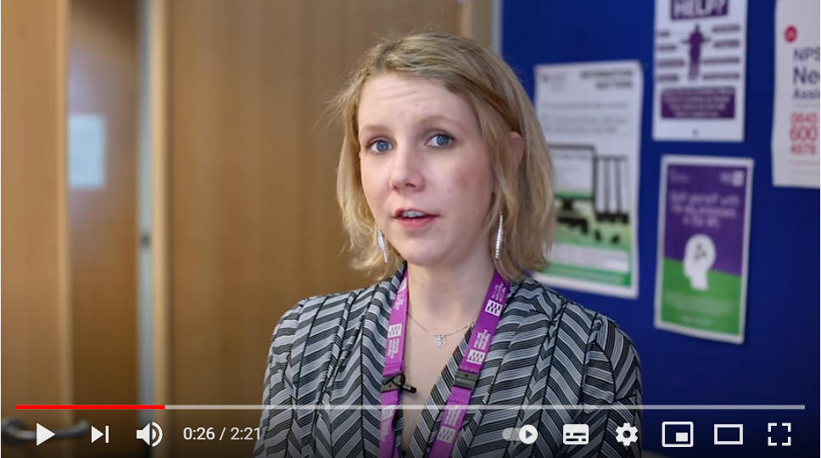
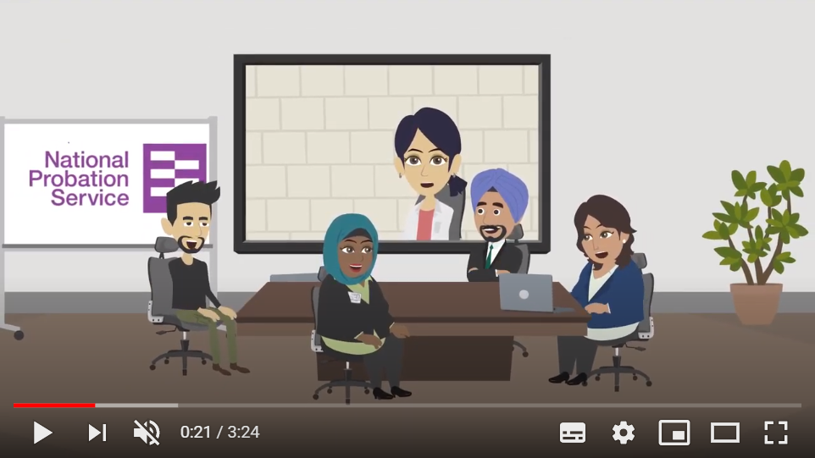
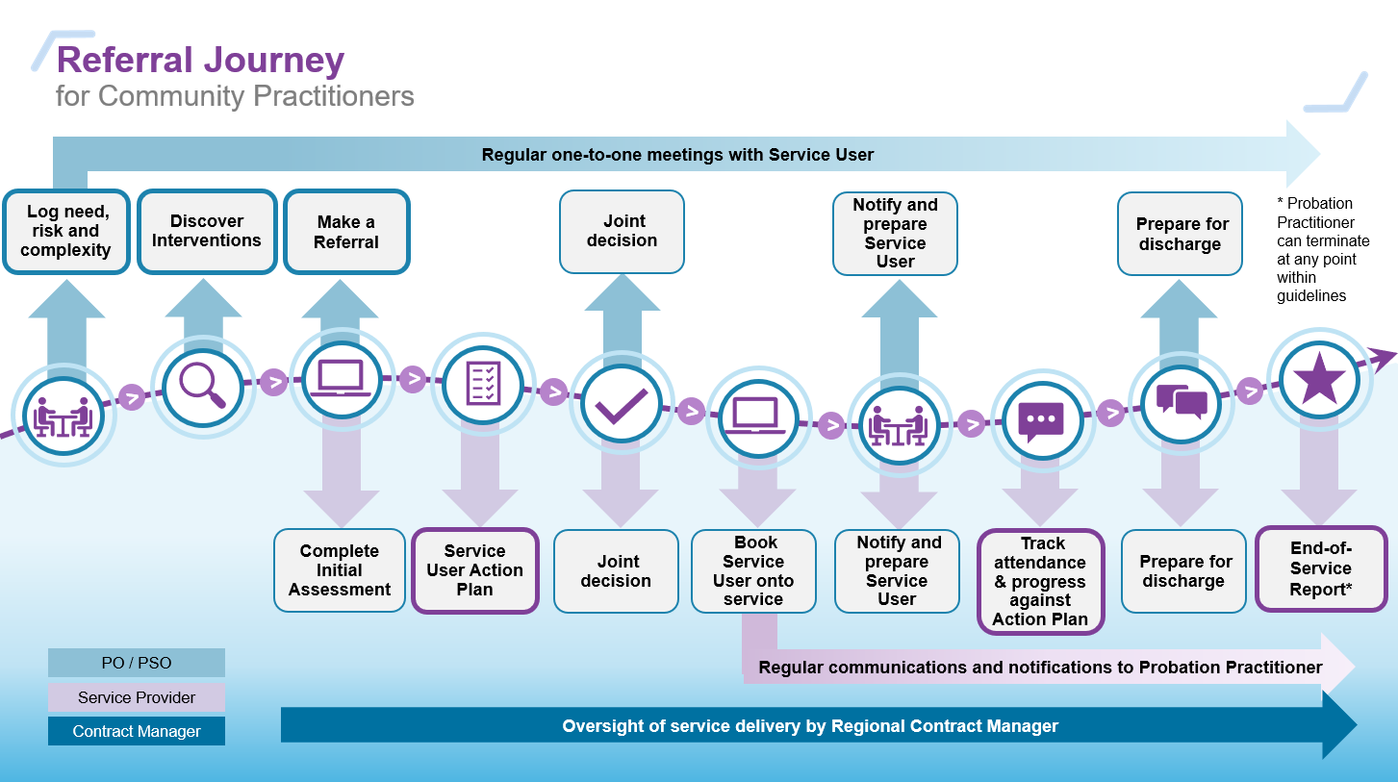
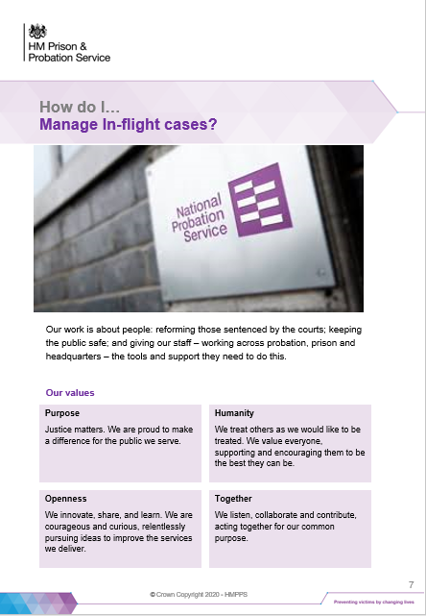
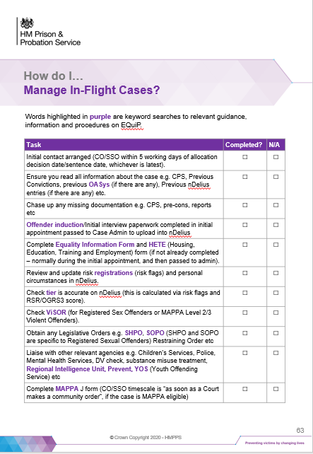
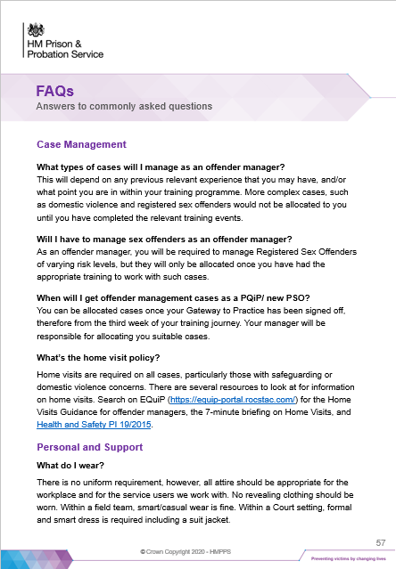
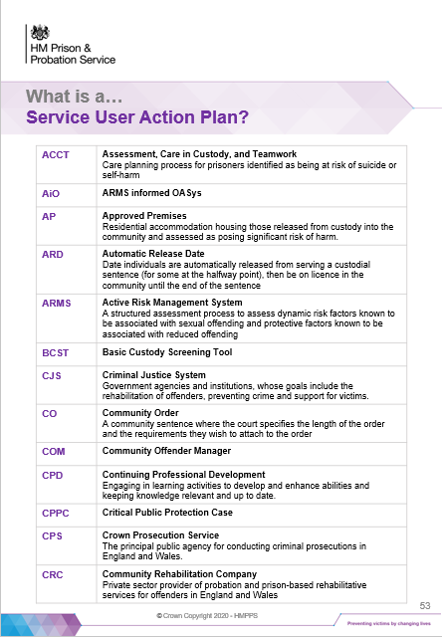
Practitioners will have a comprehensive toolkit to start referring from Day 1
Commissioned Rehabilitative Services (4 of 6)
The CRS Learning Toolkit is a blended approach that combines guidance on best practice along with practical resources on the process and the underlying digital platform. It allows busy practitioners to learn on the job – and to tailor their learning for their own needs and circumstances.
All will be asked to pass a ‘Knowledge Check’ before Day 1, demonstrating a clear understanding of the new expectations and processes before starting work in the unified organisation. This knowledge check can be taken more than once, allowing practitioners to correct misunderstandings and learn from mistakes.
3a
3b
3c
BITE-SIZE GUIDES linked to specific steps (complete with screenshots):
How do I… Discover & Select Commissioned Rehab Services?
How do I… Make a referral?
What is a… Service User Action Plan?
How do I… Monitor attendance and progress against an Action Plan?
What can I expect… in a Post-Session Feedback Form?
What can I expect… in an End-of-Service Report?
1
2
3
REFERRAL JOURNEY
A simple process map that guides practitioners and providers, aided by an intuitive digital platform
LEADER VIDEO
What’s my role in managing end-to-end sentences?
ANIMATED VIDEO
What’s in it for me – and my Service User?
4
5
6
7
3d
3e
3f
BITE-SIZE GUIDE
When should I…
Refer to external specialists?
BITE-SIZE GUIDE
How do I…
Work effectively with service providers?
CHECKLIST
How do I…
Manage In-Flight Cases?
FAQs
Answers to common questions

Slide 10
Commissioned Rehabilitative Services (5 of 6)
L&D Approach - Benefits
Most effective solution for Day 1 – raises awareness of what’s different and what’s expected, and provides practical tools and guidance to support learning on the job
Minimises time away from work, allowing practitioners to learn when and where is most useful for them and their caseload.
Delivers a national level of understanding and capability, assessed through a ‘knowledge check’ test that must be passed before Day 1. This knowledge check can be taken more than once, allowing practitioners to correct misunderstandings and learn from mistakes.
Responds to varying levels of learning need. Practitioners who are new to this way of working get detailed guidance and time to explore. Those who are already referring in this way won’t need to spend extra time in a training course.
Lays the groundwork for Regional plans. National learning toolkit can be used on the job to embed new processes and relationships with their own local teams and Service Providers.
Notes:
NOTE: links needed for content highlighted in yellow, pending: 1) document sign off and 2) HMPPS digital team links

Slide 11
Commissioned Rehabilitative Services (6 of 6)
CRS: Referrals by an intuitive digital platform, ‘Refer and Monitor’
We are committed to transform the way we refer and manage interventions. This includes the processes of adding, finding and referring to an intervention, tracking progress and receiving feedback on and evaluating an intervention.
You will be able to find and refer individuals on to an intervention through a single digital service, as opposed to needing to switch between up to four systems currently.
This will enable these processes and create a comprehensive, linked and high-quality set of intervention data to be analysed and evaluated continuously on our analytical platform.
You will be able to send supervised individuals onto the right intervention at the right time
Digital Delivery: Assessing risks and needs
We are creating a more dynamic, fluid way to assess risks and needs that uses data from case recording and interventions services to automatically update risk profiles and/or to trigger further questions for the Probation Practitioner. This will ensure risk and needs assessment are more accurate at any given time.
Digital Delivery: Service user engagement
A key area for transforming probation is the engagement of individuals in their sentence and rehabilitation. Digital has a significant part to play here, as the interface between probation and the service user is increasingly expected to be web-based.
The second aim is to provide transparency in the process, so those subject to probation services are able to see what has been decided by whom and why.
Lastly, we help deliver a sentence plan that supervised individuals can refer to, discuss and agree to follow
Notes:
NOTE: links needed for content highlighted in yellow, pending: 1) document sign off and 2) HMPPS digital team links

Slide 12
In House Interventions Overview
To support effective service user desistance and rehabilitation, the National Probation Service will manage and deliver Accredited Programmes, Structured Interventions, Unpaid Work and Senior Attendance Centres from Day 1, 26 June 2021
Probation Practitioners will have a variety of statutory services available to them
There will be clear boundaries between rehabilitative interventions delivered by NPS Intervention Team colleagues, 1-2-1 work delivered by Probation Practitioners and specialist Commissioned Rehabilitative Services through the Dynamic Framework
Service user change activity undertaken by Probation Practitioners will be underpinned by a nationally approved toolkit to supplement and support delivery of other interventions
Post sentence, Probation Practitioners will allocate the Rehabilitation Activity Requirement days and select and sequence specific interventions that address the most significant areas of need linked to a service user’s reoffending
Overview
Notes:
NOTE: links needed for content highlighted in yellow, pending: 1) document sign off and 2) HMPPS digital team links

Slide 13
NEW Toolkits, Interventions and Programmes
Probation Practitioner direct delivery
Underpinned by Probation Practitioner toolkits
In house Interventions Team delivery
Accredited Programmes
Structured Interventions
Unpaid Work: community payback
Senior Attendance Centres
Dynamic Framework
Commissioned Rehabilitative Services
Signpost service users
Universal statutory services
Overview

Slide 14
Accredited Programmes (1 of 2)
HMPPS’ intervention of choice, based on robust international evidence
Available as a sentence of the court under the Criminal Justice Act 2003; three statutory purposes – sentencing reform, offender rehabilitation, public protection
May be added as licence conditions to all types of prison licences and post sentence supervision
Sufficient number of appropriately trained interventions staff to deliver both Accredited Programmes and Structured Interventions, providing greater operational resilience in meeting changing demands and reducing the likelihood of burnout; additional sessional staff as required
Delivered by two trained facilitators in a group setting for up to 12 service users
Alternate delivery format, developed in response to Covid-19, available in exceptional cases to meet diverse needs
All regions to deliver as a minimum: Thinking Skills Programme, Building Better Relationships and Sexual Offending programmes
Delivery of other programmes flexible, based on regional need, at the discretion of each Regional Probation Director
The NPS will also deliver Accredited Programmes for external organisations such as the Children and Family Court Advisory and Support Service, where required
Accredited ProgrammesOverview

Slide 15
Accredited Programmes: Day 1 (2 of 2)
All staff delivering Accredited Programmes, including our Divisional Sex Offender Unit teams, will work in new Intervention Teams in our 11 regions and Wales
Processes in place to: 1) allocate Accredited Programme requirements to the regional delivery team within set timescales, 2) notify Programmes Teams of sentence requirements, 3) produce and share summary of attendance notes, three way meetings and post programme reports, and 4) deal with transfers in and out to other regions, and in from youth services
Additional eligibility and suitability checks in place to ensure the right service users are on the right programmes
New timeliness checks at six and three months from end of sentence, to ensure requirements are completed in time and improve Sentencer confidence
Resolve will be delivered where it is currently delivered for Day 1
Referral and management of Accredited Programmes will be through existing NPS systems
The NPS will deliver the Partner Link Worker service
Accredited ProgrammesDay 1

Slide 16
Structured Interventions (1 of 2)
Available as a sentence of the court via a Rehabilitation Activity Requirement under the Offender Rehabilitation Act 2014; fall under the sentencing purposes reform and rehabilitation of offenders, public protection
May be added as licence conditions, including Release on Temporary Licence and Post Sentence Supervision
Based on evidence of effectiveness and a consistent delivery model in three key need areas: emotional management, domestic abuse and attitudes, thinking and behaviour; four session minimum
Targeted at lower risk service users and those ineligible or unsuitable for Accredited Programmes
Primary aim is to secure cognitive and behavioural change; delivered in a group setting, 1-2-1 or remotely, to meet specific diverse needs
Meet the Correctional Services Accreditation and Advice Panel endorsed principles for effective interventions
A register of approved Structured Interventions will be centrally maintained and available to Regional Probation Directors for delivery in their region
Structured Interventions Overview

Slide 17
Structured Interventions: Day 1 (2 of 2)
Current delivery of Structured Interventions will be maintained as far as possible
Probation Practitioners will refer service users through existing NPS systems
Structured Interventions currently delivered by CRCs will continue to be delivered in the need areas of: Emotional Management, Domestic Abuse and Attitudes, Thinking and Behaviour
All staff delivering Structured Interventions will work in our new Interventions Teams
A national Effective Interventions Panel will review Structured Interventions and approve those which meet the Correctional Services Accreditation and Advice Panel effectiveness principles
Regional Probation Directors will choose the suite of Structured Interventions to be delivered in their region
Post Day 1 roll out of approved Structured Interventions will take place and roll down those not approved
Structured Interventions Day 1

Slide 18
Unpaid Work (1 of 1)
Primarily a punishment, with rehabilitation an important additional consideration
Investing in training to ensure public, staff and service user safety
Increased time to allow for a comprehensive pre placement assessment and induction
Supports rehabilitation through skill development in a practical work environment, delivered by sufficient numbers of appropriately trained staff
20% of hours can be used to develop employment skills for those with an identified need
Placements local to service users, with a maximum travel time of 90 minutes each way, from home to the initial worksite
Community groups will engage in nominating work projects; the provision of high numbers of good quality placements will enable local community payback
Updated Unpaid Work Probation Instruction and Community Payback Operating Manual
Unpaid Work Overview

Slide 19
Unpaid Work: Day 1 (1 of 2)
All placements currently being delivered will continue
Core staff delivering Unpaid Work will work in the new probation service; staff learning and development needs will be assessed and training arranged
Probation Practitioners will complete a minimum layer 1 OASys, which the Placement Coordinator will use to identify the most appropriate placement
Increased focus on completions within 12 months of sentence, supported by management information and six and nine month progress reviews
nDelius used as the case management system for service user scheduling; scheduling supervisors on to Unpaid Work projects will be done through spreadsheets
Nominations for Unpaid Work schemes will continue through the national Gov.uk website
Arrangements in place to ensure availability of vehicles, tools, equipment, PPE, mobile phones, laptops and access to petty cash for essential project needs
Unpaid Work Day 1

Slide 20
Senior Attendance Centres
Overview
The Senior Attendance Centre requirement is available as a sentence of the court under the Criminal Justice Act 2003
One of 12 requirements that can be imposed as part of a community sentence or a suspended sentence; can be imposed as a consequence of non payment of fines
Senior Attendance Centres regimes can accommodate male and female service users aged 18 to 24
Offer young women provision through separate facilities and separate female only reporting times and instructions
Service users historically required to attend three hour sessions, generally on a Saturday; no statutory specification, good practice to trial different delivery patterns
Minimum number of hours for the total requirement within a community sentence is 12; 36 hour maximum
Day 1
All existing Senior Attendance Centres will continue as before
Senior Attendance Centre staff will continue in the same roles at the same centres
Sessional staff will be offered the opportunity to continue with an agency registered with the NPS
All staff will have access to the same equipment and resources
SAC
Overview & Day 1

Slide 21
In House Interventions: Day 1 to End State Changes
NPS
Our current > 21 operating models will be transitioned to our Accredited Programme, Unpaid Work, Structured Interventions and Senior Attendance Centre end state operating models
Regional Probation Directors will identify the suite of Accredited Programmes and Structured Interventions to be delivered in their region
Unpaid Work national placement agreements will enable regions to engage with charities at a regional level
We plan to move from Covid-19 recovery to business as usual, while retaining positive recovery initiatives
We will develop a new scheduling tool
Staff
Staff recruitment will be undertaken as needed to fulfil the roles identified in our operating model
Staff will be trained as required for their roles
Service users
Service users will not travel > 60 minutes to attend a programme or an Unpaid Work induction
Cases will be reviewed at six and nine months post sentence for Unpaid Work, and six and three months prior to order end for Accredited Programmes and Structured Interventions
Workshops and welfare vans will be implemented, to support a wider range of education, training and employment placements, including outside placements where amenities are required

Slide 22
In House Interventions: more information
Detailed information is available to you:
Accredited Programmes Operating Model March 2021
Structured Interventions Operating Model March 2021
Unpaid Work Operating Model March 2021
Senior Attendance Centres Operating Model March 2021
Please speak with your manager on how your role might be affected
For questions / clarifications from the Probation Reform Programme In House Interventions team, contact Ali Searle at alison.searle@justice.gov.uk

Slide 23
2021 Estates Project Delivery To Day 1
Our Estates team is scheduled to complete the following projects before, or on, Day 1 of our unified model, 26 June:
Acquisitions: Beverley, Burnley, Caernarfon, Chesterfield, Manchester, Newtown, Richmond, Skegness, Taunton and Warrington
Refurbishments and renovations: Accrington, Kings Lynn, Stoke-on-Trent, Swansea, Wakefield, Walsall, Yeovil and York
These sites will:
Provide an effective environment that promotes service user engagement
Specify the core requirements that promote a safe working environment by mitigating the risk of violent or intimidating behaviour
Create a comfortable, flexible working environment with the space and facilities to promote good working practices and staff wellbeing
Support our HMPPS values of Togetherness and Humanity
Delivery to Day 1

Slide 24
Transferring Property Update
We are transferring 256 CRC property holdings in to the NPS estate; this will take our unified estate to 556 holdings
Of these, 96 were transferred in on 4 January 2021; properties requiring IT enabling works were prioritised
These properties were then sub licenced back to the original CRCs until CRC contracts end on 25 June, to ensure business continuity
The remainder of the CRC properties will be transferred in to the NPS estate on 26 June, Day 1 of our unified model
In some locations there will be further estates changes that will take place at the point of transfer or afterwards
Details of any further changes are included in the information provided by the programme to inform the consultation arrangements led by your current employer
These consultations started in January (for most) and will be ongoing till approximately March
We will be able to provide more information after the consultation process has completed; if you have any queries, please contact your line manager in the first instance
Unifying Our Estate

Slide 25
Improving Facilities Management for Our Staff / 1
Current Facilities Management
The NPS and CRCs currently have a range of facilities management (FM) partners
We will onboard the new properties transferring from CRCs to current NPS FM suppliers, with KBR providing nationwide facilities Help Desk and job coordination services for the new NPS estate
Our Estates FM transition team is working with our current suppliers to ensure we smoothly transition to our new suppliers, including ensuring all sites have enhanced Covid-19 cleaning
We are adding extra resource to our current FM team to ensure we are ready to support an increased number of properties in our 11 regions and Wales as a new combined NPS estate
Working For You

Slide 26
Improving Facilities Management for Our Staff / 2
Future Facilities Management
On 5 April 51 properties in the North and 31 properties in the South will move from current CRC FM suppliers to MoJ FM suppliers
On 25 June the remaining 30 properties in the North and 26 properties in the South will move from current CRC FM suppliers to MoJ suppliers:
Mitie (hard FM) and Sodexo (soft FM) will provide FM services for the North
Kier (hard FM) and OCS (soft FM) will provide FM services for the South
Hard FM covers things like air conditioning and heating maintenance and soft FM covers things like cleaning
Working For You
Information will be provided to all staff to ensure you know both how to engage with our new suppliers and with who

Slide 27
Smarter Working – What’s Changing in Our Estate?
Smarter Working is a necessity and an opportunity to significantly change the way our probation service operates in the future
Our Estates team is delivering physical changes to our local environments such as new office layouts, new reception areas, buying new furniture and changing the digital solutions delivered on our sites, all of which will help embed Smarter Working across the NPS
Our Estates team is working with our 12 regional leadership teams to prioritise Smarter Working projects across England and Wales
The biggest change that most people will experience is that, in our new collaborative workspaces, there will be different work settings for different types of work that people flex between during the day, depending on their activity, rather than being allocated one specific space to work from
This means that long stay desks, touchdown settings, quiet and confidential areas, breakout spaces, formal and informal meeting options, locker / filing and printer / copy spaces will be important new features of our refurbished offices and new builds
Positive Change

Slide 28
Estates 2021/22 Areas of Focus
1. Delivering capital projects
We have an allocation of £37.5m and are working in collaboration with the business to confirm the projects we will deliver
2. Continued CRC engagement
Until contracts end on Day 1 of our unified model, 26 June
3. 160 property transfers
Successfully managing the remaining transfers
4. Onboarding facilities management
Embedding FM services into CRC properties transferring in to the NPS
5. Planning
Business as usual planning for how our estate will be managed and resourced when the Probation Reform Programme ends
This Year’s Big Estates Deliverables

Slide 29
More information on our Estates strategy and delivery?
Please see our September 2020, December 2020 and March 2021 Estates Staff FAQ, which address different Estates topics
If you have a question that isn’t covered in these documents, please email: ProbationReformEstatesPMO@justice.gov.uk – thank you

Slide 30
Digital, Data & Technology – supporting you
Colleagues at PeoplePlus Warwickshire and West Mercia CRC are now fully operational with MoJ technology, systems and services
The first part of the rollout process saw the team set up with new MoJ laptops, smart phones, system access and justice.gov.uk email addresses in early February
Assisted by their MoJ tech support buddies, the team completed their tech transfer in mid February, when their emails and data were automatically migrated to their new equipment
More than 7,500 colleagues will be moving over to MoJ tech between now and June
Over 1,000 Purple futures colleagues will make the switch in March
Discover how we’re modernising our technology and follow our rollout on our Welcome Hub
PeoplePlus completes tech transfer

Slide 31
Workforce Programme (page 1 of 3)
PQiP Recruitment Campaign
Our next PQiP recruitment campaign commences in 6th April 2021
A refreshed Recruitment Toolkit will soon be shared with HRBPs, providing guidance and materials for sites to use, including key messages, poster and leaflet designs, and social media content.
Tell your friends & family!
You may know people who would be interested in a career in the Probation Service, so tell your colleagues, friends and family!
Here’s our website for more information https://www.traintobeaprobationofficer.com/.
Notes:
Recruitment & Retention Strategy
We will be publishing the first NPS Recruitment & Retention Strategy in Spring 2021. At the centre of this strategy is our commitment to make sure we have great people, in the right roles, with the resources they need to do their jobs in the probation service.
Our focus has been on the immediate challenges we face across offender management operational roles with the greatest staffing gaps, but we will look to widen our focus when we refresh the strategy post-transition.
In developing the strategy we wanted to hear from as many of you as possible, across a wide range of different roles, grades and levels of responsibility, and backgrounds and experiences. And, the strategy has been designed using data and insights from a series of surveys (including bespoke surveys and the staff survey) and focus groups undertaken in Autumn 2020 with staff in the NPS and CRCs, and in collaboration with senior leaders and partners across Her Majesty’s Prison and Probation Service (HMPPS).

Slide 32
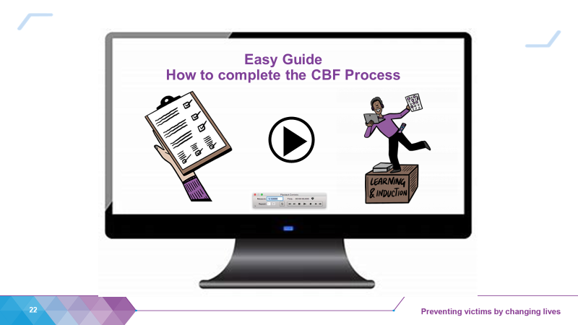
Workforce Programme (page 2 of 3)
Competency Based Framework (CBF)
CBF trial goes live on the 1st April 2021
Staff will trial the CBF for 12 months without it being linked to pay progression
The CBF will be linked to pay from 1 April 2022 for NPS staff, and the first pay progression decisions linked to the CBF will be made on 1 April 2023.
The CBF conversation should become embedded in everyday routine meetings and one to one’s.
The process is straightforward and does not represent an additional burden for staff and line managers.
Staff have a responsibility to complete the process
Your engagement
Please role model behaviours and kick start this initiative by completing the process for yourselves and your direct reports.
You’ll see more communications on this in due course – keep an eye out for more in Probation News, on the intranet, webinars to talk employees and managers through this easy process and our step-by-step animation.
Notes:
CBF – key messages
CBF Pilot commencing in April 2021
Staff will trial the CBF for 12 months without it being linked to pay progression
The CBF will be linked to pay from 1 April 2022 for NPS staff, and the first pay progression decisions linked to the CBF will be made on 1 April 2023.
What we need managers and employees to do
Leaders to role model behaviours and kick start the process
Staff responsibility to complete the process
What we need from Leaders
The CBF conversation should become embedded in everyday routine meetings and one to one’s. The process is straightforward and does not represent an additional burden for staff and line managers.
Please role model engagement by completing the process with your direct reports and encourage them to do the same
You’ll see some communications on this in due course – keep an eye out for more in Probation News, on the intranet and webinars to talk employees and managers through this easy process.

Slide 33
Workforce Programme (page 3 of 3)
Three new PQiP & PSO learning modules
As part of the Probation Service’s refreshed approach to learning, this month saw the first of three re-designed learning modules go live for PQiPs and new PSOs:
Module 1 – Core Concepts and Key Skills
Module 2 – Risk Assessment and Management
Module 4 – Working with People Convicted of Sexual Offences
These are just some of the new learning products and experiences being
designed and developed in line with the new Learning & Development
(L&D) model for the NPS.
The remainder of the PQiP learning modules will follow.
“The session is very interactive which is better than the previous training.” Learner
“It’s been really good and really beneficial. PLEASE KEEP TRAINING THIS WAY GOING FORWARD” Learner
“Got so much more engagement back because it’s interactive. Learners really like the breakout rooms” Learning Coach
More information
PTAs and SPOs have guidance documents for each new module so that they can coach and support their learners to embed the key performance outcomes from these modules.
For more information, please contact Molly O’Connor.
Double click this image for more detail
Notes:
CBF – key messages
CBF Pilot commencing in April 2021
Staff will trial the CBF for 12 months without it being linked to pay progression
The CBF will be linked to pay from 1 April 2022 for NPS staff, and the first pay progression decisions linked to the CBF will be made on 1 April 2023.
What we need managers and employees to do
Leaders to role model behaviours and kick start the process
Staff responsibility to complete the process
What we need from Leaders
The CBF conversation should become embedded in everyday routine meetings and one to one’s. The process is straightforward and does not represent an additional burden for staff and line managers.
Please role model engagement by completing the process with your direct reports and encourage them to do the same
You’ll see some communications on this in due course – keep an eye out for more in Probation News, on the intranet and webinars to talk employees and managers through this easy process.

Slide 34
People workstream (1 of 2)
Update on the staff transfer and other people related activity
Aligning people to roles within the NPS remains a key priority. Some roles will align easily to roles within the NPS whereas other roles will need to be reviewed. The programme is working to finalise the list of nationally ‘accepted’ role matches and the approach for the panel reviews. Staff can read more about role alignment on the Welcome Hub.
Staff began submitting their vetting documentation online in some organisations.
Pre-transfer placement process (for some operational NPS ACO staff and their CRC counterparts) – the programme is now working through the preference responses from in scope staff. The programme aims to send outcome letters to in-scope staff early March.
The programme is continuing to support measures consultations and answer queries (over 700 received to date).
Comms will be added to the Welcome Hub about pay assimilation and how people will be paid in June the coming month.
Information about evidencing qualifications is already up on the Hub here.
We understand that there is a desire for more messaging for staff in corporate and support services roles (see next slide)
Notes:
CBF – key messages
CBF Pilot commencing in April 2021
Staff will trial the CBF for 12 months without it being linked to pay progression
The CBF will be linked to pay from 1 April 2022 for NPS staff, and the first pay progression decisions linked to the CBF will be made on 1 April 2023.
What we need managers and employees to do
Leaders to role model behaviours and kick start the process
Staff responsibility to complete the process
What we need from Leaders
The CBF conversation should become embedded in everyday routine meetings and one to one’s. The process is straightforward and does not represent an additional burden for staff and line managers.
Please role model engagement by completing the process with your direct reports and encourage them to do the same
You’ll see some communications on this in due course – keep an eye out for more in Probation News, on the intranet and webinars to talk employees and managers through this easy process.

Slide 35
People workstream (2 of 2)
Key lines for staff in corporate and support services roles
‘Corporate and support services’ is a term that is used to describe a variety of non-operational facing roles. This means that there is no one size fits all approach for staff in these roles. We understand that there is some anxiety amongst staff in these groups and as soon as we can communicate more than what is in this update, we will do so.
Many corporate and support services roles will align in a straightforward way to roles within the new Probation Service and others will align to areas within the HMPPS or MOJ. There are four different areas that we believe staff in corporate services roles could be aligned to.
NPS regions
NPS National
HMPPS HQ
MOJ HQ
The role alignment process is what will help us to determine which roles align to which of these areas.
Some corporate services staff will remain in the NPS.
Some corporate services staff will align to roles in the HMPPS or MOJ.
At the moment, we are unable to communicate which roles will align to which of these four areas. This is because we are still collecting all the role descriptions from current employers and working with the relevant teams in the NPS, HMPPS and MOJ to review the role description data.
We are currently finalising the list of roles that will align on an accepted basis, some of these roles will be corporate and support services roles. We expect to be able to communicate this list to current employers in March.
Roles where there isn't a straightforward alignment will be handled on a case by case basis, including an assessment by a panel. Staff will have the opportunity to appeal their role alignment decision if their role was reviewed by a panel and the relevant criteria haven’t been met.
We expect that the majority of role alignment panels will occur in late March and outcomes will be communicated via current employers in April.
You can read more about the role alignment process on the Welcome Hub.
Notes:
CBF – key messages
CBF Pilot commencing in April 2021
Staff will trial the CBF for 12 months without it being linked to pay progression
The CBF will be linked to pay from 1 April 2022 for NPS staff, and the first pay progression decisions linked to the CBF will be made on 1 April 2023.
What we need managers and employees to do
Leaders to role model behaviours and kick start the process
Staff responsibility to complete the process
What we need from Leaders
The CBF conversation should become embedded in everyday routine meetings and one to one’s. The process is straightforward and does not represent an additional burden for staff and line managers.
Please role model engagement by completing the process with your direct reports and encourage them to do the same
You’ll see some communications on this in due course – keep an eye out for more in Probation News, on the intranet and webinars to talk employees and managers through this easy process.

Slide 36
What’s new on the Welcome Hub this month
Live now:
Role alignment: Understanding the role alignment process
Technology rollout: Timeline
Technology rollout: What’s in the delivery bag
Evidencing your qualifications: What you need to do
Mid qualifications: What you need to do
Our future operating model: Snapshots and Message from Jo Farrar and Amy Rees
Coming next:
A message from your Regional Probation Director
Round up of probation highlights
Pay assimilation and how you’ll be paid in June
Something for everyone in probation

Slide 37
Region March Areas of Focus
Content to be inserted by region
[Region]

Slide 38
Team Impacts
How does what we’ve just discussed affect our team?
Are we clear about our roles and responsibilities?
What are our next steps?
Do we need support?
What opportunities does this open up for our team?
How can we improve our delivery and outcomes?

Slide 39
Thank You

