Slide 1
May 2021 Regional Team Briefing
[Region]

Slide 2
Regional Team Briefing purpose
1
We’re aware of and informed about national and regional change from the Probation Reform, Probation Workforce and Recovery Programmes
2
Our opportunity to discuss how these changes might affect our team and any actions we might need to take to align with and support these changes
3
Clarify our region’s and team’s areas of focus for this month – what are our big deliverables?

Slide 3
Today’s conversation
Probation Reform Programme: Estates – Videos to Experience Our New Probation Contact Centres + Lone Worker Safety Devices, Panic Alarms and ID Badges
Probation Reform Programme: Sentence Management in Our Unified Model
Probation Reform Programme: Unpaid Work Probation Instruction and Community Payback Operations Manual + Reporting Accidents, Incidents and Near Misses
Probation Workforce Programme: Qualification Alignment + Career Pathways for Staff Approaching Retirement + National L&D Transfer and Transition Plan + L&D May and June Initiatives + Competency Based Framework Manager and Staff Briefings
Probation Reform Programme: Digital, Data & Technology Rollout
Mental Health Allies Programme: Interested in Becoming a Volunteer?
CRC Staff: Staff Transfer Update
[Region] May Areas of Focus
Your Questions and Feedback
Thank You
NEW in May

Slide 4
Experience our new probation contact centres
The Probation Reform Programme’s Estates team has created an outstanding workspace for our staff, people on probation and colleagues from partner organisations in Skegness, based on our new Probation Contact Centre Design Guide, as part of our four year Estates modernisation programme
You can experience how our new probation contact centres across the UK will look and feel by clicking on these two short videos – Skegness experience 1 and Skegness experience 2
The project team was led by Helen Chatterton, project manager, and Jenna Titley, BSC head
Work began on 12 October 2020 and NPS staff moved in on 19 April 2021
Martin Davies, RPD East Midlands, opens our Skegness probation contact centre

Slide 5
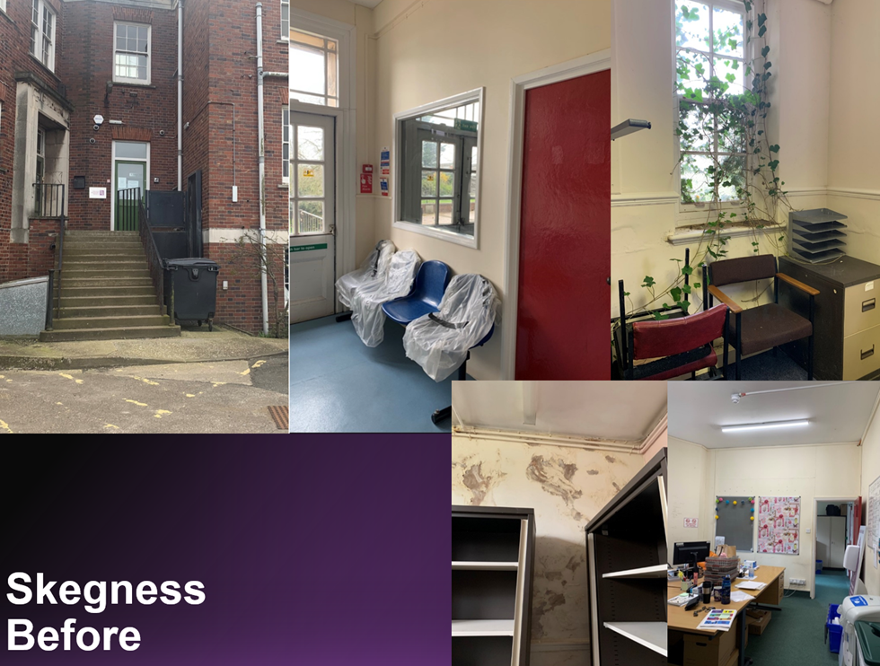
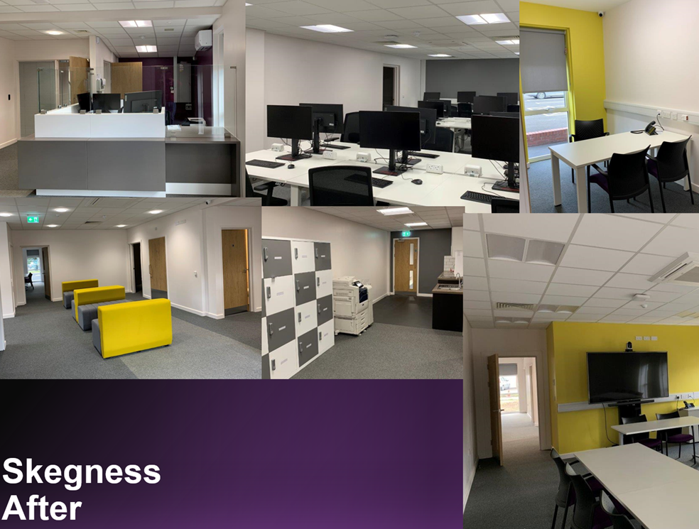
Living our ‘humanity’ value through our estate design
As part of our modernisation programme, many of our sites will be renovated over a four year period to this new interior design standard, which goes beyond rooms, acoustics and lighting to create welcoming, professional spaces that support positive experiences for people on probation from the moment they enter our reception areas, where the furniture isn’t bolted down and staff are tangibly accessible
This is also about living our ‘humanity’ value, treating others as we would like to be treated, valuing everyone, supporting and encouraging them to be the best they can be
Our new probation contact centre design also fosters enabling environments, keeps staff and service users safe, promotes staff wellbeing and creates inclusive and accessible environments through a universal design through the flexible, effective use of space

Slide 6
Lone worker safety devices, panic alarms and ID badges
We are rolling out lone worker safety devices more widely across more roles in the probation service, including Probation Practitioners and Unpaid Work practitioners
On Day 1, Victim Liaison Officers will receive individual devices
From Day 1, Sentence Management staff, including Probation Officers and Probation Service Officers, Unpaid Work Supervisors, Partner Link Workers, Unpaid Work Co-ordinators and Designated National Security Division staff will receive a range of pooled and individual devices; full training will be provided
Most NPS sites currently have fixed panic alarms, while a small number of CRC sites transferring over to HMPPS estate do not
All sites without panic alarms will have them in place before mixed caseloads are introduced
We are prioritising the issue of ID badges for Day 1, for staff who are transferring in to the NPS and new staff
Full details are available in our new Lone Worker Safety Devices, Panic Alarms and ID Badges Notice

Slide 7
Sentence Management in our unified model
Manage the sentence and change work
Key building blocks

Slide 8
Our unified model offers improved risk management, sentence management and public protection

Slide 9
Probation operational delivery model
Sentence Management will have an integrated Probation Operational Delivery structure in PDUs, with:
Embedded administration, including Management Coordination Hubs to support SPOs
Management oversight by SPOs
Agreed national principles to provide consistency and allow for some regional flexibility in interpretation and implementation
PO:PSO mix to support combined caseloads and continuity for people on probation
This structure will enable Probation Practitioners to work collaboratively and support the person on probation through to the completion of their sentence
Management oversight touchpoints
Effective working relationships
Embedded Admin support
Probation Practitioner
Person on probation
Regional Flexibility
National Principles

Slide 10
Probation operational delivery model national principles

Slide 11
Approved suite of Probation Practitioner Toolkits

Slide 12
Toolkits and other available interventions

Slide 13
Interventions considerations
Some Toolkits might specify preliminary or core material and / or suggest how to navigate content and when using it might be best sequenced within the wider sentence.
Some Toolkits may have been designed for specific offence cohorts and/or associated with certain Accredited Programmes whilst others will be designed for more generic global use but have the potential to reinforce the skills and learning developed in other interventions.
Toolkits are not intended to be delivered from cover to cover but rather to provide materials within them that the PP selects to support addressing the needs of individuals, as assessed and can continue to be used throughout the lifetime of a sentence.
Staff guidance on the use of toolkits as part of PP practice will be issued to support the launch of the Approved Suite of Toolkits in June.
Assessment by PP
Format
When to use it?
Toolkits
1:1 session
Flexible delivery of content
Cover range of need areas-suitable for everyone
Introduce, supplement and build on work carried out in other interventions
Need areas that cannot be met through AP , SI or DF -either due to suitability, resources / availability.
Helpful for service users who are unable to participate in group sessions where 1;1 intervention is not available.
Deliver to support change work undertaken in supervision.
Based on PPs Professional judgement
Using the Toolkit…
Moderate/High Risk and Specific Need
Accredited
Programmes
Largely Group based
Prescribed structure
Very specific target audience
SUs that align to the specific criteria re risk and need..
For SUs that will benefit from group delivery
Some APs available 1:1 delivery
Use toolkit material to motivate, prepare, support and build on APs before , during and afterwards as required.
Some APs have an associated toolkit
Desistance
focused
change
work
Lower Risk and Specific Need (not in scope or unsuitable for AP)
Structured
Intervention
Largely Group based
Prescribed structure
Specific target audience
For SUs that align to the specific criteria and outcomes were the level of risk and need does not a match an accredited programme
For SUs that will benefit from group sessions or 1:1 input.
Use the toolkits to motivate, prepare, support and build on SIs before, during and afterwards as required.
Bespoke Need (not met by AP/SI)
Commissioned Rehabilitative services
Tailored activities which address need based on complexity
Pathways addressing key rehabilitative needs
Complimentary to AcP/SI / CSTR.
Varied delivery methods, group-work, 1-1, mentoring / advocacy, specialist intervention / referrals.
Use the toolkits to motivate, support and build on CRS engagement.

Slide 14
Day 1 Probation Practitioner Toolkits
Identifying potential material:
Sentence Management Design has requested via regional workbooks all 1:1 PP Toolkits / materials be submitted by CRC and NPS regions
The Probation Recovery Programme has produced guidance identifying several suggested toolkits to support PPs in delivering effective supervision
Materials out of scope for Structured Interventions and / or suggested by Structured Interventions Effective Interventions Panel (EIP) as potential toolkits
Materials endorsed by Correctional Services Advice and Accreditation Panel aligned to Accredited Programme offers
Approving material:
Toolkit Governance sits under the Accredited Programme Interventions Delivery Strategy Board (APIDSB)
Sentence Management Design are pre screening and filtering all received materials using approved Effective Intervention Panel principles; selected materials will be put forward to National Toolkit EIPs for provisional approval
National Toolkit EIPs are being held in April and May 2021 as per the Terms of Reference and Panel Member Guidance, adapted from previously held Structured Interventions EIPs
A recommendation paper will be submitted to APIDSB ahead of Day 1, to secure final sign off for provisionally approved toolkits to be included in the Approved Suite of Probation Practitioner toolkits
Toolkits will initially be available in EQUIP; work is ongoing to ensure there is consistency in branding, communication to staff and provision of practitioner guidance in June 2021

Slide 15
Implementing the Core Quality Management Framework (CQMF)

Slide 16
Probation Instruction and Community Payback Operations Manual
An updated Unpaid Work Probation Instruction and Community Payback Operations Manual have been prepared to inform Day 1 planning and delivery of the Unpaid Work Requirement.
These documents describe the changes in practice resulting from the unification of probation providers in June 2021. They provide detailed guidance on the new operating model, mandatory requirements and good practice for delivering the Unpaid Work Requirement.
The Unpaid Work Probation Instruction will be published on 26 June.
The Community Payback Operations Manual is available now.
The Operations Manual is aimed at staff who manage and deliver the Unpaid Work Requirement and is intended to establish a common understanding of the new operating model.
A smooth transition from CRC to Probation Service delivery is an HMPPS priority and Day 1 changes are being minimised to ensure continuity for supervised individuals, staff and stakeholders.
To discuss further, please contact: Simon.Cope@justice.gov.uk, Senior Policy Manager, Reform Programme.
Unpaid Work

Slide 17
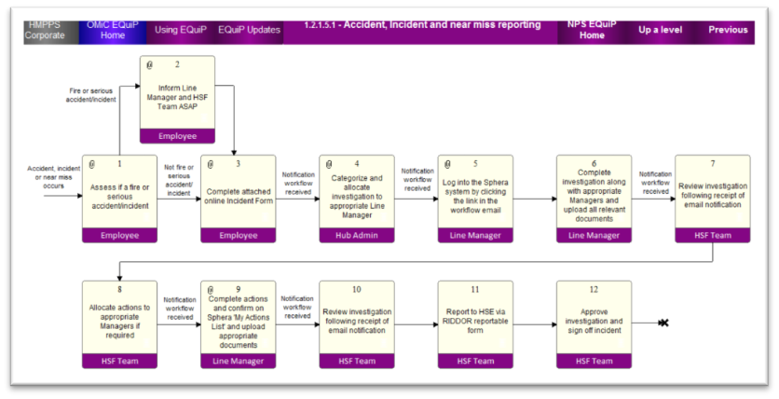
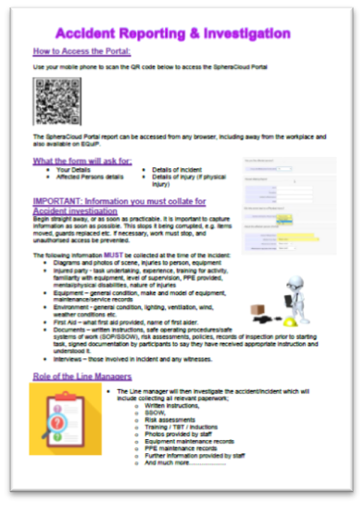
Reporting accidents, incidents and near misses
From Day 1, Unpaid Work supervisors will be required to record and report all accidents, incidents and near misses that occur on an Unpaid Work placement using a new process. The full process is set out in EQuiP; see image, L.*
Once an incident has occurred, and when it is safe and appropriate to do so, the Accident, Incident and Near Miss form needs to be filled in. This is done electronically, using either a laptop or a smartphone.
The form may be opened by cutting and pasting this link into a web browser or by using your MoJ smartphone: https://www.rivosafeguard.com/tools/portal/accidents/LogAnonymous.aspx?4741D7A7F73B43FDB983
To open the form using a smartphone:
Open the Camera app from the Home screen or Lock screen
Select the rear facing camera and hold your device so that the QR code appears in the viewfinder
A notification message will appear; tap the notification to open the form
The form should be printed out and carried by Supervisors to provide support from Day 1.
To ensure that incidents are recorded clearly and fully, the report should be submitted within 24 hours of it taking place. This will allow for the form to be completed at the end of the working day if there is no wifi or mobile data signal available on the project. The reporting process is not onerous and should be able to be completed in 10 to 15 minutes.
To discuss further, please contact Paul.Hughes@justice.gov.uk, Divisional Lead Health Safety Fire.
*Accidents, incidents and near misses must not be reported using this form before Day 1, 26 June

Slide 18
Probation Workforce Programme: Qualification Alignment
Qualification Alignment
Qualification Alignment was launched in November 2020 following extensive consultation. It aims to ensure staff working in roles where the Probation Officer qualification is required in statutory guidance can achieve this in a fair and proportionate way. Staff without the required Probation Officer qualification for their role are being offered a route to qualification that is based on their current position, experience in post and capability. There are a number of historic reasons for staff practicing in post without the qualification and alignment presents an opportunity to ensure the new Probation service can be confident it is practicing within the statutory guidelines going forward.
There are three potential outcomes for the alignment of qualification : 1) Sign off as professionally qualified 2) Qualification Alignment course 3) PQiP.
Full details of the alignment process are available on EQuiP
Qualification Alignment update
We currently have 81 staff who have been scoped for qualification alignment: of these, 25 have completed the process, 36 are currently undertaking the alignment course, 11 are awaiting enrolment in the July intake and four will be completing the PQiP. The first cohort have successfully completed the academic component of the alignment course.
The data suggests we have up to 150 staff across the NPS and CRCs who may require alignment and therefore we are working closely with PRP and probation regions to identify these individuals. We are supporting the gathering of certificates for the NPS and CRC to ensure we can offer support to staff at the earliest opportunity.
Any questions on alignment can be addressed to: NPS-qualifications@justice.gov.uk
Notes:
CBF – key messages
CBF Pilot commencing in April 2021
Staff will trial the CBF for 12 months without it being linked to pay progression
The CBF will be linked to pay from 1 April 2022 for NPS staff, and the first pay progression decisions linked to the CBF will be made on 1 April 2023.
What we need managers and employees to do
Leaders to role model behaviours and kick start the process
Staff responsibility to complete the process
What we need from Leaders
The CBF conversation should become embedded in everyday routine meetings and one to one’s. The process is straightforward and does not represent an additional burden for staff and line managers.
Please role model engagement by completing the process with your direct reports and encourage them to do the same
You’ll see some communications on this in due course – keep an eye out for more in Probation News, on the intranet and webinars to talk employees and managers through this easy process.

Slide 19
Career pathways for staff approaching retirement
The NPS values the lived experience and technical skills of staff throughout their careers
We are working on options available to colleagues considering their future retirement plans
Three career pathways have been developed for staff who want to continue in service, but step away from a frontline role, or continue in an operational capacity, but move into a non standard working arrangement
These pathways include:
Training to become a Practice Tutor Assessor (PTA)
Moving into Learning & Development roles in our new L&D model
Staying in current roles and exploring changes to working patterns
We always advise staff to seek advice from their pension provider before making any commitments to changing role: https://www.lgpsmember.org/tol/thinking-leaving-when.php
More information is available on the Retirement and extension of service intranet page
Please email the Recruitment & Retention team PWPRecruitmentRetentionPolicy@justice.gov.uk if you have a specific question

Slide 20
L&D: new national transfer and transition plan
National transfer and transition plan
Our national L&D transfer and transition plan was recently shared with Probation Learning Leads and Transition Leads
It sets out the national learning and development offering available to CRC and NPS staff to support our transition to the new Target Operating Model
Regional post transfer L&D plans are being developed
Accessing learning not provided through the NPS L&D model
Learning that is currently available through other providers such as CSL, HMPPS Talent & Capability teams and Interventions services will not be delivered through the NPS L&D model
This learning may be commissioned and / or procured directly by regions

Slide 21
L&D: May and June initiatives
Post Day 1 learning
An overview of the post transfer learning offer, including learning to support our move to mixed caseloads, will be available via the Welcome Hub
Probation Learning Leads will define, share and manage regional L&D delivery at a local level
Regional L&D delivery will include core operational learning offered through the NPS L&D model and learning provided through other routes, such as CSL, Interventions Services, etc.
New non learning requirements
The Probation Reform Programme Communications and Change Plan captures new requirements to support staff awareness of how current and future change may impact their roles, such as guidance provision and changes to policy frameworks and processes
Delivery is now under way, including scoping post Day 1 requirements

Slide 22
L&D: May and June initiatives
Commissioned Rehabilitative Services
What do staff need to do in preparation?
Staff will need to Register on myLearning in advance of mid-May (if not already registered).
https://mydevelopment.org.uk/login/index.php
CRC staff moving into the probation service will be required to access the Non-Directly Employed (NDE) Section of myLearning in advance of June 26 to access the CRS Learning. (See Document)
Further information
Further information on Commissioned Rehabilitative Service can be found On the HMPPS Intranet and Unified NPS Welcome Hub
What?
Ahead of the introduction of the Commissioned Rehabilitative Service we want probation practitioners to have trust and confidence in the Day 1 services overall and to know what will be available in their area
Learning resources are being designed that will support practitioners through the Rehabilitative Services referral journey, including selecting the right intervention, undertaking a referral and working together with the provider to ensure the person on probation experiences seamless support
Who?
The following staff groups will be required to complete the learning:
Probation Service Officers
Probation Officers
Senior Probation Officers
Prison based ETTG staff (Community Offender Managers)
Court Staff
Learning Access
Learning should be accessible via My Learning from mid-May with probation staff required to complete it before June 26.
Probation Practitioners will have access to a new Refer and Monitor digital system from 12 June. You may wish to take this section of the training before then, but the benefits in terms of ease of use will be more apparent once you can log in.

Slide 23
Competency Based Framework (CBF) manager and staff briefing events
The Competency Based Framework is now live
Over 1,200 attendees joined the CBF 8 April launch
Thank you to everyone who attended
Q&As generated on the day are available on the intranet
Coming up: CBF Manager Briefings – please attend
Two Manager briefings on 13 and 20 May to guide Managers through the Competency Based Framework process and their responsibilities
Though the sessions are aimed at Managers, all staff are welcome to attend
These two sessions are identical, so you only need to attend one of them
Submit pre event questions to
CBF-Enquiries@justice.gov.uk
For more information
SSCL My Hub (full guidance)
HMPPS Intranet and Welcome Hub
Add a calendar invite to Outlook automatically
Once the invite opens, click ‘Save & Close’ (top left) to save the invite to your calendar
Download the calendar invite for 13 May
Download the calendar invite for 20 May
Notes:
CBF – key messages
CBF Pilot commencing in April 2021
Staff will trial the CBF for 12 months without it being linked to pay progression
The CBF will be linked to pay from 1 April 2022 for NPS staff, and the first pay progression decisions linked to the CBF will be made on 1 April 2023.
What we need managers and employees to do
Leaders to role model behaviours and kick start the process
Staff responsibility to complete the process
What we need from Leaders
The CBF conversation should become embedded in everyday routine meetings and one to one’s. The process is straightforward and does not represent an additional burden for staff and line managers.
Please role model engagement by completing the process with your direct reports and encourage them to do the same
You’ll see some communications on this in due course – keep an eye out for more in Probation News, on the intranet and webinars to talk employees and managers through this easy process.

Slide 24
Digital, Data & Technology: May technology rollout
More than 3,000 colleagues in CRCs, parent and supply chain organisations have received their new laptops, accessories, assisted technology and smartphones and have had their emails and data migrated to their new equipment
Colleagues at People Plus, Purple Futures and Sodexo can now be reached through @justice email accounts and our collaboration tools in Microsoft Teams
Colleagues at Seetec and RRP will complete their technology transition this month
Colleagues at ARCC and MTC will cut over in June, successfully closing out a complex rollout that will have provided more than 7,500 colleagues with the tools they need to succeed in our new probation service
More than 3,000 complete technology transitions
See the Welcome Hub for:
Tech rollout overview
Rollout timeline
Details of your new kit

Slide 25
Mental Health Allies Programme – interested in becoming a volunteer?
We are keen to ensure all staff, particularly those transferring to the new Probation Service, are aware of our Mental Health Allies Programme
Mental Health Allies are a staff led group of volunteers trained to be a source of information and support for staff and managers. They can offer confidential support, raise awareness of mental health and challenge the stigma surrounding mental ill health. They can provide reassurance and signpost to appropriate professional support and other information.
Allies’ support to managers can include providing a greater understanding of mental ill health; the benefits of workplace adjustments; sources of information and professional support that may be relevant to individual circumstances.
Each probation region within the Probation Service will have a Single Point of Contact (SPOC), working with a team of mental health allies to support managers and staff. The Mental Health Allies intranet page contains more information and guidance on how to contact an ally in your region for support.
Staff transferring to the service in June who may be interested in becoming a mental health ally: please contact the Mental Health Allies central mailbox so you can be linked in with the Single Point Of Contact in your region for more information mentalhealthallies@justice.gov.uk

Slide 26
CRC Staff: staff transfer update
Primarily applicable to CRC, Parent Org and Supply Chain staff
Summary update on staff transfer activities
We are making good progress on our work to transfer our colleagues from CRCs, Parent orgs and supply chain orgs in to the new Probation Service.
Role alignment remains an ongoing priority. The list of roles that map easily to existing roles has now been shared with current employers to communicate to staff. If your role isn’t on this list then it will need to be reviewed to determine where it aligns, these reviews are ongoing and we expect these outcomes to be communicated by current employers in late April / early May. You can read a recent Role Alignment update here and on the next slide. New FAQs on role alignment for corporate services staff are now on the Welcome Hub here.
Vetting - If you haven’t already done so, please can you provide us with the relevant documentation and information required to support your employee checks and vetting. It is important we have this information as soon as possible before transfer to ensure we meet our legal employment obligations, especially on Civil Service Nationality Rules. We also want to remind staff that in addition to the provision of your documents you will be sent links to complete your security questionnaire. Please complete these as soon as possible. More information can be found on the Welcome Hub vetting pages.
Communications - Look out for communications coming soon on the National Agreement as well as specific support information and checklists for line managers who are transferring in to the Probation Service. Information on the layers of ‘induction’ has now been added to the Welcome Hub.
Post transition learning has been developed and built into national learning plan. This will be shared on the Welcome Hub shortly.

Slide 27
CRC Staff: staff transfer update
Primarily applicable to CRC, Parent Org and Supply Chain staff
Role alignment
The role alignment process is an important part of the transfer process. Not only will it give people clarity on their job title and description upon transfer, it also gives us important data that ensures everyone is paid correctly and on time when they transition.
Most roles will align easily with roles in the NPS.
The list of accepted matched roles was shared with current employers in early April (these are the roles that align easily to existing roles)
Other roles are being reviewed by panels and these panels are taking place throughout April. Outcomes from the panel reviews will be communicated to current employers in late April / early May
Some roles will need to be reviewed to determine where they align.
Corporate and support services staff
New FAQs have been added to the corporate services pages on the Welcome Hub, you can read them here.
If you are aligned to a role within HMPPS or MOJ HQ then you will still transfer in to the Probation Service in June, but you will work to your team within the HMPPS or MOJ from day 1.
A small number of roles won’t align to an existing role. We will work with these people on a 1-1 basis to find a suitable solution for them.
We will be working with the teams within the MOJ / HMPPS who will be receiving staff to help them support and welcome their incoming staff.
Read more about role alignment on the Welcome Hub
A small number of roles won’t align.

Slide 28
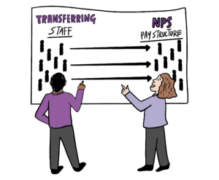
CRC Staff: staff transfer update
Primarily applicable to CRC, Parent Org and Supply Chain staff
Some of you will have your pay ‘assimilated’ to the NPS pay scales upon transfer. Others will be transferring on their current pay.
‘Pay assimilation’ is part of the process of implementing the National agreement.
The National Agreement only applies to those of you who are directly employed by a CRC.
If the National Agreement applies to you, then pay assimilation will enable the NPS to see how your pay aligns to NPS pay scales. This will ensure you are paid correctly when you transfer.
There is a lot of information on the Welcome Hub about pay assimilation, including worked examples. Take a look here.
Pay assimilation
Staff transfer letters
Transferring staff will receive a transfer letter in mid – late June. This letter will give you key information about your employment such as your pay assimilation calculation (for directly employed CRC staff only). Communications will be added to the Welcome Hub in May to help people understand what they can expect from these letters.
Read more about pay assimilation on the Welcome Hub

Slide 29
CRC Staff: staff transfer update
Primarily applicable to CRC, Parent Org and Supply Chain staff
Onboarding and induction
There are a range of colleagues who will be joining our new Probation Service in June. Some are existing NPS staff and others will be transferring in from CRCs, parent organisations and supply chain organisations (with varying experience of being in the Civil Service. Being considerate of this, there are 4 layers of induction that is available to staff:
Your Probation Service Induction – primarily available through the Welcome Hub
Your regional induction (if you are joining a region) – this will look different for each region
Your MOJ induction – some MOJ materials are available on the Welcome Hub and can be accessed on the intranet after you get your new technology. If you are joining a team in the HMPPS or MOJ you will receive a welcome and induction from your team
Your Civil Service induction – after transfer you can access the Civil Service induction portal
Supporting line managers
We recognise that line managers who are joining the new Probation Service will need support to enable them to line manage effectively using new tools and processes. To support you we are creating an interactive line manager toolkit and checklist highlighting what you need to know and do before and after the transfer.
The toolkit will cover topics like using SOP and EQUIP (NPS systems), pay, vetting, qualifications and more.
It will highlight where there are things you need to do as a manager as well as where there are things you need to ask your team to do.
The first iteration of the manager toolkit will come in late April/early May and will be available on the Welcome Hub. You will receive another version just after transfer that explains the post-transfer activities that you will need to do as a manager.
More information and links to induction material can be found on the Welcome Hub.

Slide 30
Region May areas of focus
Content to be inserted by region
[Region]

Slide 31
Team impacts
How might today’s Team Briefing topics affect our team?
Are we clear on our individual and team next steps and delivery?
How are we managing change? Do we need support?

Slide 32
Your feedback and questions

Slide 33
THANK YOU

