Slide 1
August 2021 Regional Team Briefing
[Region]

Slide 2
Our team’s opportunity to talk
We celebrate our people and our successes
We’re aware of and informed about national and regional changes
We talk about how these changes might affect our team
We agree our team’s big deliverables each month

Slide 3
Today’s conversation – new this month
Join a national Probation Day event
BBC video on Sam Gildersleeve, Probation Officer
Interested in becoming a trainee Probation Officer?
Pay award 2021/22 update
Technology update
People update
Staff transfer update
Competency Based Pay Progression Framework
Govt Beating Crime Plan and Unpaid Work
Resettlement
[Region] August area/s of focus
Team August deliverables

Slide 4
Join a National Probation Day event
Monday 16 August, 14:00 to 15:00
Launching our week of celebrations
Hear more about the week ahead, why there’s lots to celebrate and some memorable milestones from our history. We are pleased to welcome Minister Chalk, Antonia Romeo, Jo Farrar, Amy Rees, Kilvinder Vigurs and Roz Hamilton to this session
Click here to join the event
Note: we are holding time until 15:00 but anticipate we may finish by 14:50
Wednesday 18 August, 10:30 to 11:15
Celebrating our staff
Jo Farrar and Amy Rees will recognise some great examples of the work of our probation staff
Click here to join the event
Thursday 19 August, 10:30 to 11:30
Hear from Justin Russell, Chief Inspector of HMI Probation
Hear reflections on HMI Probation inspection work and learn more about products the Inspectorate has developed to support probation practice
Click here to join the event
Friday 20 August, 10:00 to 10:30
Working in partnership
Hear more about our work with partners through Commissioned Rehabilitative Services and how to get the best outcomes for people on probation
Click here to join the event

Slide 5
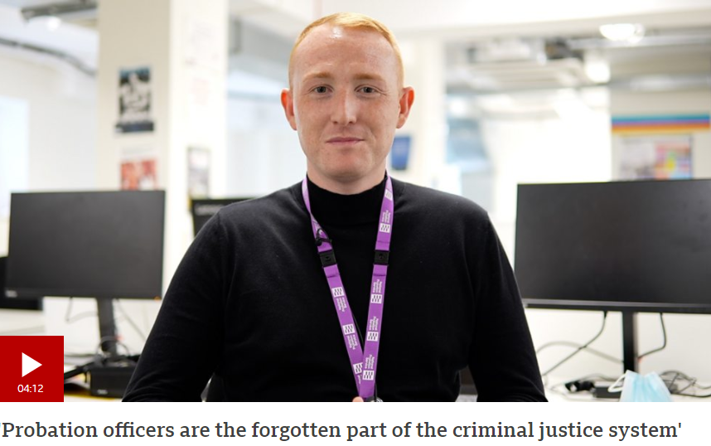
BBC: ‘Probation Officers are the forgotten part of the criminal justice system’
Following our unification, the BBC published a video shadowing Probation Officer Sam Gildersleeve as he goes about his day
The package also features an interview with an offender on license, who Sam has helped into accommodation and employment
The package ends with a quote from the Lord Chancellor, highlighting how unification and increased investment will lead to even less crime
Watch the four minute video: https://www.bbc.co.uk/news/av/uk-57688735

Slide 6
Interested in becoming a trainee Probation Officer?
Recruitment for trainee probation officers opened to staff on 26 July and closes on 15 August
Open to employees first, prior to extending to external applicants
Two new internal pathways designed specifically for internal applications:
New PSO Progression for candidates with and without degrees, graduate and non graduate
Part time Programme
Click here to register your interest and join our webinar on Thursday 5 August at 12pm where we’ll provide guidance on completing the application process and answer any questions
We have committed to onboarding 1,500 trainee probation officers in 2021/22 and offering opportunities to existing staff to apply is an important part of this commitment
Visit our website to find out more and register your interest in training to be a probation officer: PSO PQiP Applications and Other PQiP Applications (other grades/wider MoJ)
Part of our Workforce Strategy’s commitment to attract and retain talented people

Slide 7
Pay award 2021/22 update
What’s happening?
This process of securing the pay award for 2021/22 is currently underway, although these things can take some time
We know that the delays to this year’s pay award and progression payments are frustrating to staff
Pay is important, but it’s also complex and we need to make sure we’re getting it right
Although pay progression is a contractual entitlement, as it forms part of the overall pay award we must follow Civil Service processes for approval
This includes negotiation with HM Treasury, Cabinet Office and the Probation Service Trade Unions
In response to the economic challenges presented by COVID-19, we are working under a public sector pay pause
While this will be disappointing to staff, it is important that we respect what the Government considers necessary for COVID-19 recovery
As part of our wider reforms, we are in the process of reviewing pay band 1 and are engaging Trade Unions with our proposals
We will keep staff updated as we move forward
What’s next?
Once agreed, progression payments will be backdated to 1 April 2021
We will keep staff informed as we progress our negotiations through Probation News, the intranet (first blog post early August) and regional communication channels

Slide 8
Technology update
Please check your security – two factor authentication
Staff enter a mobile phone number for Microsoft Office 365 accounts for security reasons, to ensure the system has a way of confirming your identity
We’re asking all colleagues to check and confirm their numbers are current – thank you
A guide is available here or on the Welcome Hub Laptop and smartphone guides page
New MS Teams handset user guides
New video guides for Yealink T55 and T56 handsets are on the MS Teams Voice user guides page on the Welcome Hub
If you are an MS Teams telephony user, please view these quick clips to discover more about your desk device/s and their key functions

Slide 9
Welcome Hub updates
New on the Welcome Hub:
Transfer letter Q&A
Mandatory Civil Service learning
Your learning
Your post transition learning
IT systems learning
How to access myLearning
National Standards

Slide 10
Update on other people related activity
How to claim expenses if you are not covered by the National Agreement
If you transferred from a Parent Organisation or Supply Chain where the National Agreement doesn’t apply to you, the process to claim your expenses is different to the automated iExpenses process on SOP; below explains how you make a claim
A bespoke form has been provided to each region which will need to collate your expenses claim details and send them to SSCL for payment
Your claim information should include your employee number, full name, line manager name, expenses rate, unit for your claim, i.e., number of days/hours/miles, your bank account sort code and account number
You will need to send this information to regions to complete mailbox details here no later than enter date of the month here
You must ensure your information is correct to avoid any delay in payment
Mileage buyout appeals for transferred CRC staff
If you transferred from a CRC and were eligible for a mileage buyout scheme payment because you held essential car user status prior to transfer, you should have received your payment in your July pay and this would have appeared on your July pay slip
You can find out more about the mileage buyout scheme and the eligibility criteria on the Welcome Hub
If you did not receive a payment and believe you were entitled to one, you can submit an appeal between 30 July and 20 August 2021
Details of the appeals form you need to complete, accepted supporting evidence and the functional mailbox to where you submit your appeal are available on the Mileage Buyout page on the Welcome Hub

Slide 11
Summary update on staff transfer activities
We are now in our sixth week as the Probation Service and we are moving through a period of stabilisation as our new unified service embeds
In the mean time, we continue to develop the next phase of the change to align to our organisational structures and work toward achieving our Target Operating Model
We understand there are still some outstanding issues and concerns that remain our top priority to address; these include:
Responding to Transfer letter queries into the mailbox, particularly those around pay
Ensuring our new staff support pages remain up to date with key information
Other updates for transferred staff
You will receive instructions from your region on how to claim expenses if you have transferred and are not covered by the National Agreement and are unable to use SOP to make a claim
Mileage buyout payments have now been paid as part of the July payroll
If you have not received a payment but believe you are entitled to one, you can submit an appeal up until 20 August
Below are some of the new and updated communications available on the Welcome Hub
Updated Post Transfer Learning pages
Annual Leave Calculator for transferred CRC staff

Slide 12
Updated post transition learning pathways
The post transfer learning offer on the Welcome Hub has been updated to reflect the learning you will start to complete now we are a unified Probation Service
There isn’t an expectation that all the learning is completed in one go; you will receive guidance on the timelines and additional requirements that you will need to undertake from regional Probation Learning Leads
There are differing Post Transition learning pathways for different roles and now includes a pathway for all staff who need to complete the Mandatory Civil Service Learning courses
Any previous learning that you have completed will be recognised, so you will only need to complete what is outstanding
As part of the update we have added links to some of the learning that will take you directly to the relevant platform for you to complete it
For SPOs, we have also added an Assurance Checklist to assist and support you in assessing a staff members’ readiness to move to a mixed caseload
It is not mandatory for SPOs to complete the checklist, but regions may choose to ask their SPOs to do so
The checklist is available on the Welcome Hub here

Slide 13
Annual leave calculator for staff transferred from a CRC
If you transferred from a CRC on 26 June, you will retain your CRC annual leave entitlement until 28 February 2022
From 1 March 2022, CRC entitlements will cease to apply and the Probation Service (NPS) Annual Leave entitlements will apply as set out in the National Agreement
To help you to calculate your annual leave entitlement up until 28th February 2022, a transitional annual leave calculator and guidance is available for you on the Welcome Hub to pro rata your entitlement and should only be used for this transitional period
If you transferred from a Parent or Supply Chain organisation, the transitional calculator does not apply to you
Your annual leave entitlement will be considered as part of the harmonisation with the Probation Service terms at a later date, subject to negotiation with Trade Unions
Access the transitional annual leave calculator HERE

Slide 14
Competency Based Pay Progression Framework (CBF)
The CBF is a simple way to move eligible staff through their pay points and is the agreed replacement for automatic pay progression, agreed as part of the 2018 Pay Modernisation Agreement
Staff who recently joined from a CRC to hold ‘opening conversations’ by 31 August
During this conversation, agree your level of competence and discuss potential examples of your work that you could record during the year to evidence your competence
Your manager will then update SOP
More information
Go to the CBF pages on MyHub for a short video on how the process works and more including worked examples
If you have any questions, email cbf-enquiries@justice.gov.uk or take a look at the key CBF documents on My Hub

Slide 15
Competency Based Pay Progression Framework (CBF)
The CBF is a simple way to move eligible staff through their pay points and is the agreed replacement for automatic pay progression, agreed as part of the 2018 Pay Modernisation Agreement
Staff who recently joined from a CRC to hold ‘opening conversations’ by 31 August
During this conversation, agree your level of competence and discuss potential examples of your work that you could record during the year to evidence your competence
Your manager will then update SOP
More information
Go to the CBF pages on MyHub for a short video on how the process works and more including worked examples
If you have any questions, email cbf-enquiries@justice.gov.uk or take a look at the key CBF documents on My Hub

Slide 16
Beating Crime Plan and Relaunch of Unpaid Work – key messages
Beating Crime Plan
Unpaid Work can support the rehabilitative aspects of a community-based order and making reparation to local communities for the damage caused by crime is a key part of this.
Therefore, improving the quality of Unpaid Work placements has an important part to play in the rehabilitative process, helping to reduce the risk of reoffending.
Through the PCSC Bill we are introducing a new statutory duty requiring probation officials to consult key local and regional stakeholders on the delivery of Unpaid Work in the community.
There is currently no legal requirement on probation officials to consult stakeholders on the delivery of Unpaid Work. As a result, those who are best placed to understand the impact of crime and the needs of their local area, do not have a guaranteed say in the projects delivered there
The creation of a statutory duty will address this gap, helping to ensure that Unpaid Work requirements are responsive to local need and placements benefit the communities in which they are served.
Cutting crime is central to the government’s mission of levelling up the country. The Beating Crime Plan sets out the strategic approach to cutting crime and how efforts will be focussed on places where crimes occur, measures to drive down crime and tackling the causes of repeat offending.
Part of the plan highlights how appropriate punishment in the community will be ensured and the plan to revitalise unpaid work to ensure offenders are visibly and publicly making reparations for their crimes by undertaking work that is valuable to their local areas, such as cleaning the streets, estates, alleyways and open spaces of litter and other visible signs of disorder in local neighbourhoods.
We are currently developing wide-reaching agreements with national charities and organisations to deliver local projects across England and Wales. These include the Canal and River Trust, Forestry England and Highways England. This work will allow us to deliver Unpaid Work placements at scale, whilst helping to support the Government’s wider priorities such as sustainability objectives and cleaning up high streets.

Slide 17
Resettlement – Release Planning Guidance (attachment included)
A new guidance document is available to help former eTTG staff who are continuing to deliver immediate resettlement needs and pre-release activity in prisons.
This provision is currently being delivered to the requirements set out in the Immediate Resettlement Needs and Pre-Release Exceptional Delivery Model (EDM). The guide supports the EDM providing more detail specific to day to day activities as we move from the ‘Recovery’ stages towards the implementation of National Standards later this year.
The guide explains what activity remains the same and what activity has changed following unification on the 26th June, describing the longer-term changes that will be introduced as part of the journey to End State in 2022.
The Annexes at the end of the guide set out the roles and responsibilities across the Resettlement Pathways and provide supporting information relating to Finance, Benefit and Debt to help staff understand what their role is and how they can support people in prison.
There is also a section targeted towards prison staff so they can easily understand the changes.
This document is designed to provides interim guidance pending the drafting and publication of a Release Planning Probation Instruction which will be produced as part of the Resettlement TOM Implementation project.
Guidance will be making the guidance available on the Welcome Hub and also via the senior leader`s bulletin for Prison Governors and Prisons staff. The welcome hub, version will be separated into sections for easier accessibility and to download, print out and share with colleagues.
The guidance document will also be sent out directly to Prison Group Director`s.

Slide 18
[Region] August area/s of focus
Team leader to fill in
Team leader to fill in
Team leader to fill in
Team leader to fill in

Slide 19
Team August deliverables
Team leader to fill in
Team leader to fill in
Team leader to fill in
Team leader to fill in

Slide 20
Team discussion
How might these changes affect our team?
Are we clear on our individual and team next steps and delivery?
How are we managing change? Do we need support?

Slide 21
Your thoughts, questions and feedback
Please email [insert your region’s preferred Outlook account]

Slide 22
Thank you

