Slide 1
Ministry of Justice
Functional Leadership Onboarding Pack
Your Welcome Guide
May 2021

Slide 2


Contents
2
2
Page | Content
Page 3 | Welcome from Gina Gill
Page 5 | MoJ Overview
Page 11 | MoJ Function Overview
Page 17 Page 23 Page 25 Page 27 | Induction Materials Other useful information Learning & Development Wellbeing, Health & Safety

Slide 3
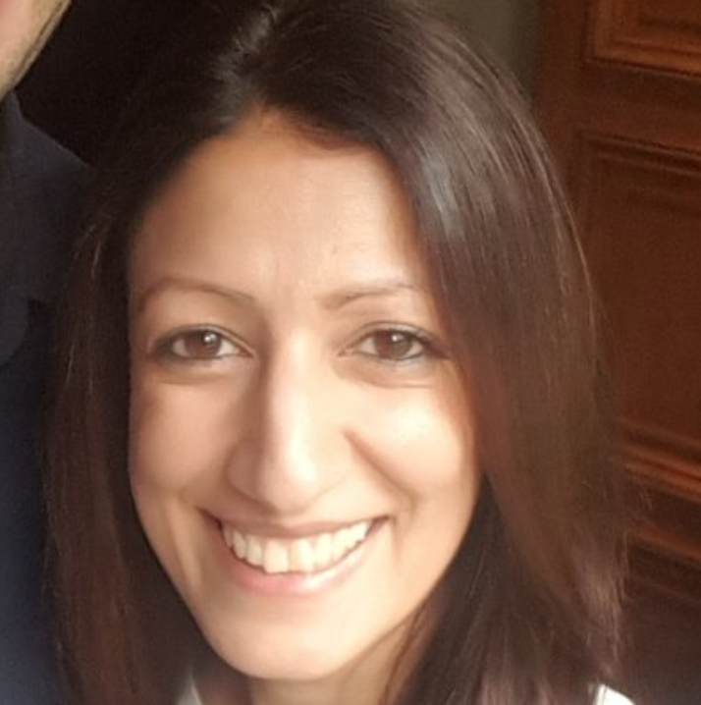
Welcome
3
3
Message from Gina Gill,
Interim Chief Digital & Information Officer
MoJ Digital and Technology
Firstly, hello and welcome to MoJ Digital and Technology.
I am really pleased to welcome you to our team. I wanted to take the opportunity to talk a little about our purpose, culture and building our team.
Our Purpose
So first and foremost our purpose is to provide digital & technology services that protect and advance the principles of justice. We are around 1100 specialists spread across the UK and we:
Support the 70,000+ staff working in courts, prisons, probation services and across other smaller agencies by providing simple, intuitive technology solutions and automating basic tasks.
Build and run digital services that make it easier for the public to get access to justice. Things like check if you can get legal aid, and get help with child funeral arrangements.
Work closely with policy teams to ensure that new initiatives are designed with the user in mind.
Protect our people, systems and information from threats to security by providing specialist cyber security and data protection advice and expertise.
Our culture
It is important to us we continue to build a diverse and inclusive workplace where everyone feels welcome and has a great experience. We want our people to feel proud to work here, to be doing meaningful work and continue to stay and grow with us.
We want to support a culture of listening and acting on the feedback we receive. That is why we use Peakon, our fortnightly short survey, which gives everybody the opportunity to anonymously provide feedback and for that feedback to be considered upwardly, across teams and also professions. We all have a role to play in making our experience and the experiences of those around us a good one. So I ask you to play your part and bring our values to life in the way you do things.

Slide 4
Welcome
4
4
Building our team
We want to build diverse, inclusive, and highly skilled teams and this latter part means investing in people in order for them to be the best they can be, either in their present role or in preparing for progression or a change of career path going forward.
To make sure our people have this opportunity, we are building clear career paths and supportive professional communities, alongside tools for our people to be able to manage and develop their skills. We have a host of great Learning and development courses available and we have a great selection of vocational development programmes ranging from career entry right through to degree and master's level. All of this underpinned by a commitment of 10% of your time being allocated to learning and development. These are just some of the opportunities available to you once you join and have a development discussion with your line manager.
I really look forward to working with you and hope you continue your rewarding career working on great things meaningful to you. My parting comment is I really want you to feel supported through this process and try to alleviate any worries you may have. Hopefully this pack will help answer some of your questions but if there is something further you wish to know please contact John Mckie or Mayko Polka in the team who will be happy to help.
Gina Gill

Slide 5

MoJ overview
The Justice Story
Our Ministers
Our Values
Our Executive Committee
MoJ strategy

Slide 6

7
The Justice Story
We are the Ministry of Justice.
We believe justice is the foundation of a safe, fair and prosperous society. It enables people to plan their futures, do business with confidence and go about their lives in safety. We are proud of our country’s reputation for justice. Its powerful principles run deep through our shared history and across our nation, underpinning how we all live and work together. Principles like the rule of law and the independence of our judiciary; accessibility, openness and fairness.
We are at the heart of the justice system, an organisation working together to bring the principles of justice to life for everyone in society. From our civil courts, tribunals and family law hearings, to criminal justice, prison and probation services. From seeing to it that sentences are served and offenders are encouraged to turn around their lives and become law-abiding citizens, keeping the public safe. From safeguarding victims and the vulnerable to regulating our legal services.
We believe the principles of justice are pivotal and we are steadfast in our shared commitment to uphold them. It is up to all of us across the justice system to use our experience and expertise, our empathy and judgement, our energy and determination, to bring to life the principles of justice, every day, without fear or favour.
We are the guardians of our justice system and of its global reputation for being fair, open and dynamic. Our justice system has led the world thanks to the strength of its institutions, its professionals and our common law itself. We will uphold this reputation by responding to changing times and attitudes, being bold, outward-looking, and committed to keeping the principles of justice alive and vibrant.
Together we create the circumstances for our country to prosper and for our citizens to thrive. This has never been more important than it is today. We live in an age of extraordinary change. New global opportunities and national responsibilities. New technologies, new lifestyles, new public needs. We recognise the challenges set by the pace and scale of this change.
We know that advances and innovations can help us make justice more accessible and resilient. We will advance the principles of justice, building a system that puts citizens and their needs first, inspiring our people and our partners to join together to find ever more effective ways to uphold the principles of justice. To make sure justice works for everyone today and in the future.
Protecting and advancing the principles of justice
We will deliver a modern courts and justice system; create a prison and probation service that reforms offenders; promote Global Britain and protect the rule of law; and create a transformed department that delivers excellent services.
Watch the animation and see how the Justice Story has been brought to life.

Slide 7


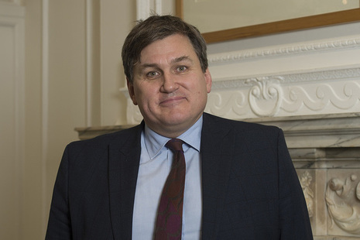
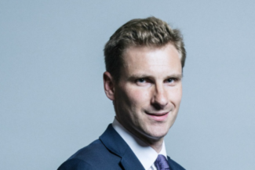
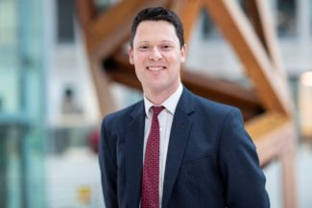
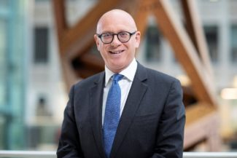
8
Our Ministers
Here are our Ministers in office, details on their responsibilities can be found on the Intranet.
Lord Chancellor and Secretary State for Justice
Robert Buckland QC MP
Kit Malthouse MP
Minister of State
Parliamentary under Secretary of State
Chris Philp MP
Alex Chalk MP
Alex Chalk
Parliamentary under Secretary of State
Lord David Wolfson of Tredegar, QC
Parliamentary under Secretary of State
Lucy Frazer QC MP

Slide 8
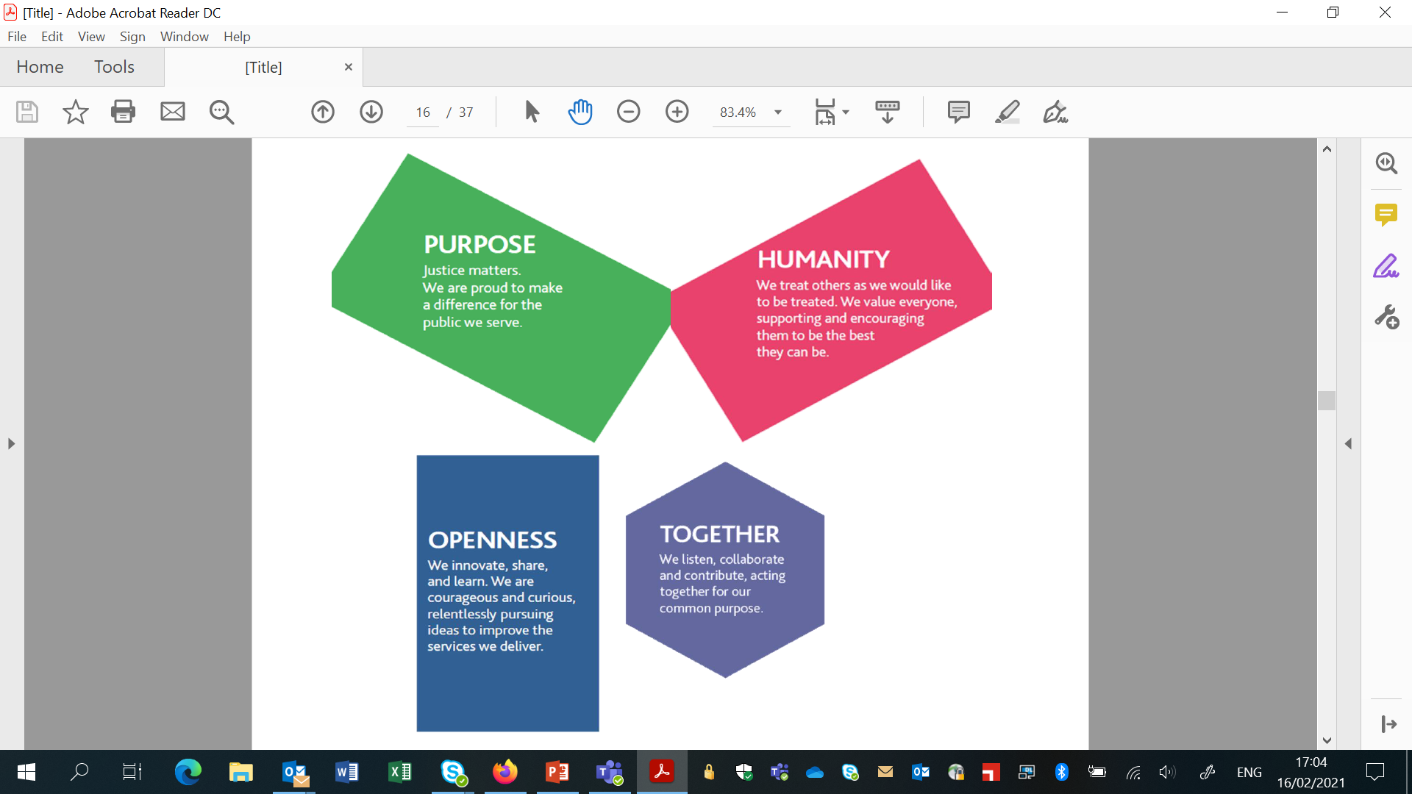
MoJ vision & core values
Our vision is to deliver a world-class justice system that works for everyone in our society and our values are how we bring principles of justice to life. We defined our values together – they can unite us as we fulfil our shared purpose. They will guide our actions as individuals and inspire us to be the best we can be, as we deliver excellent public services.
5
Civil Service Values
The Civil Service Code sets out our core values and the standards of behaviour expected of all Civil Servants in upholding these values:
‘integrity’ is putting the obligations of public service above your own personal interests
‘honesty’ is being truthful and open
‘objectivity’ is basing your advice and decisions on rigorous analysis of the evidence
‘impartiality’ is acting solely according to the merits of the case and serving equally well governments of different political persuasions
The Leadership Statement explicitly sets out the behaviour that is expected from all leaders across the Civil Service.

Slide 9
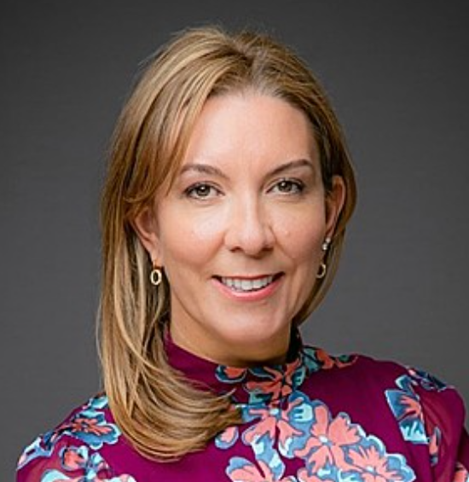
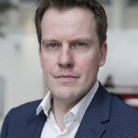

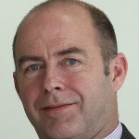
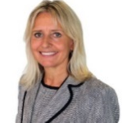
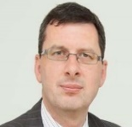
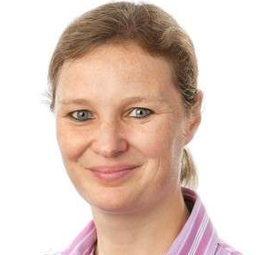
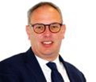
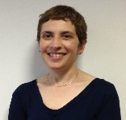
9
Our Executive Committee
Purpose and Authority
The Executive Committee is the senior executive leadership team for the Ministry of Justice. It also supports the Permanent Secretary in his duties as principal adviser to the Secretary of State and as the department’s Principal Accounting Officer. Its remit is:
- Develop and maintain the department’s strategy and plans for the future.
- Take a balanced view of the department’s approach to managing opportunity and risk.
- Prioritise and allocate financial and other resources.
- Provide assurance that internal controls operate properly.
- Provide support and assurance for major policies and projects.
- Develop and promote the department’s culture, values, approach to diversity & inclusion.
Full members:
Permanent Secretary (Chair)
Director General, Prisons
Chief Executive Officer, HM Prison & Probation Service
Interim Director General, Policy and Strategy Group
Director, MoJ Legal Advisers
Interim Chief Financial Officer
Director General, Probation and Wales
Interim CEO, HM Courts and Tribunals Service
Chief People Officer
Executive Committee
Antonia Romeo
Permanent Secretary
James McEwen
Interim Chief Financial Officer
Jerome Glass
Interim Director General
Policy and Strategy Group
Kevin Sadler
Acting Chief Executive
Her Majesty’s Courts and Tribunals Service
Jo Farrar
Second Permanent Secretary & Chief Executive
Her Majesty’s Prison and Probation Service
Phil Copple
Director General Prisons
Her Majesty’s Prison and Probation Service
Amy Rees
Director General, Probation and Wales
Her Majesty’s Prison and Probation Service
Mark Adam
Interim Chief People Officer
Naomi Mallick
Director
MoJ Legal Advisors

Slide 10
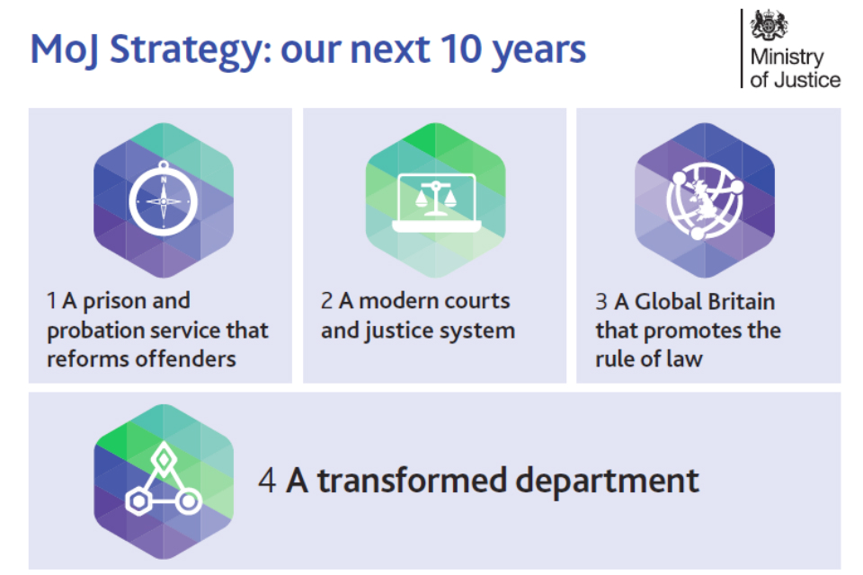
10
Strategy for the next 10 years
We are at the heart of the justice system, an organisation working together to bring the principles of justice to life for everyone in society. From our civil courts, tribunals and family law hearings, to criminal justice, prison and probation services. From seeing to it that sentences are served and offenders are encouraged to turn around their lives and become law-abiding citizens, keeping the public safe. From safeguarding victims and the vulnerable to regulating our legal services.
We will
- deliver a modern courts and justice system
- create a prison and probation service that reforms offenders
- promote Global Britain and protect the rule of law, and
- create a transformed department that delivers excellent services.

Slide 11
Function Overview
11
Senior Leadership Structure
Organogram
D&T Business Plan
D&T Mission

Slide 12

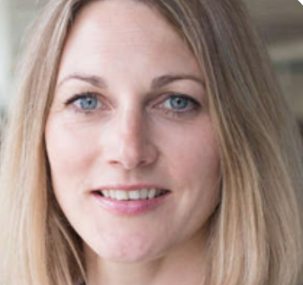


12
MoJ Digital and Technology Senior Leadership Team (SLT)
“Priorities at a glance”
Gina Gill - Interim Chief Digital & Information Officer
“Focus on improving delivery and building stakeholder confidence in D&T. Alongside business as usual, continue to invest in technology debt, providing new end user technology for HMPS; improving security; continuing to exit our legacy applications and contracts; and decommissioning the local infrastructure that is most likely to fail. Continue to deliver new and innovative services across the organisation, including in-cell technology in 13 prisons, a sustainable prison video visit service, and new service desk channels. Finally, expand and build capability particularly in technical, cyber and accessibility roles.'
Mark Robinson - Director of Technology Services
"Alongside ensuring our currently out-sourced IT Service contracts deliver the best possible service for MoJ staff, FY21/22 in Technology Services is about building plans and evolving our capability, structure and processes to make us fit for our post FITS contract future. We are building Service Owner, Technology Operations and Technology Support capability to enable our strategy of disaggregating our large out-sourced contracts and delivering services with in house teams where appropriate. In the near term we’ll be taking ownership of the new systems that the Prison Technology Transformation Programme is implementing."
Amie Alekna - Chief Security Officer
"Identify, manage and mitigate security, privacy and service operation risks with the aim of protecting and supporting the MoJ's information, IT systems, people and buildings against incidents and the threats we face."
Lee Noon - Director of Digital Strategy
“The priority in 21/22 will be to focus on aligning our digital activities to support the delivery of our strategic outcomes and priority programmes whilst maturing our digital capabilities across a number of key areas including digital delivery, digital KPIs, risk management, and digital standards, policies and governance.”
Nabeeha Ahmed - Head of Central Digital
"In 21/22 we will renew our focus on providing the frameworks and tools to strengthen our digital teams, enabling them to work smarter and at pace. We will also continue to partner with MoJ teams to improve and transform employee and general-public user experiences by facilitating the design, selection and development of policy, processes and digital services"

Slide 13
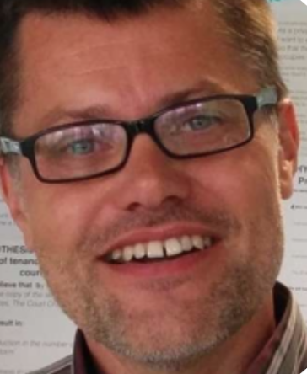
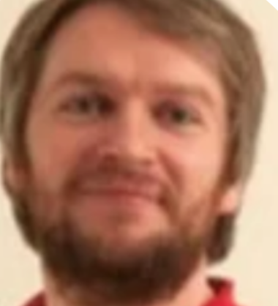
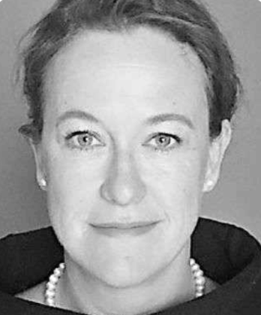

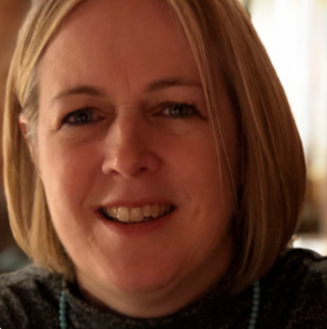
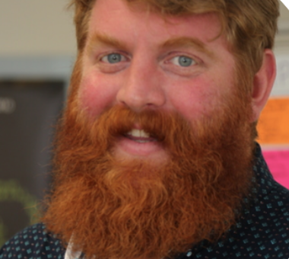
13
MoJ Digital and Technology Senior Leadership Team (SLT)
“Priorities at a glance”
Jake Barlow - Head of Justice Services
"It’s important to continue to sustain and operate business critical systems across LAA, OPG and CICA so vulnerable people can access essential services. Our big priority is to build digital services for citizens and legal providers that are simpler, quicker, safer and improve access to Justice. Understanding the whole user journey, we will build new digital services for caseworkers that simplify business processes, remove paper and save time.
Martyn Inglis - Chief Technology Officer
"The priority of Platforms and Architecture is to reduce technical risk and increase the speed of service delivery by providing shared platforms and technical expertise. We want to expand our existing products, add new features to our data platform and add a new cloud hosting solution to help address issues around the hosting of our legacy technology."
Sophie Otter - Head of Prisons Digital
"My priorities for next year are to continue to mature as an organisation by developing a clear strategy for replacing NOMIS; really focusing on delivering great products and services; and to deepen our understanding and engagement with colleagues across HMPPS."
Mark Stanley - Head of Probation Digital
"My priority is to deliver transition of the CRCs by the end of June this year and then continue at pace transforming services, which pave the way to retire Delius and OASys in the next three years. This is mostly funded by the Probation Reform Programme. With MoJ funding my priority is to sustain and improve live services - principally Delius and OASys - and start work on the first service for people under supervision in the community"
Sarah Brooks - Deputy Director, People & Capability
"Delivering the MoJ Priority Outcome of Great People by attracting, building, developing and retaining a sustainable and diverse pool of DDAT professionals. Ensuring we have the capability we need to deliver MoJ priorities and further reducing our dependence on 3rd party suppliers. To be the department of choice for growing digital talent through apprenticeship and graduate routes."
Rob Stirling - Deputy Director, Portfolio & Controls
“To further equip MoJ Digital and Technology to be the best DDaT function in government by establishing a better understanding of our capacity and demand, risk, financial spending and the value we are delivering so that we are prioritising the right work and supporting the delivery of the MoJ's strategic goals"

Slide 14

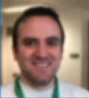
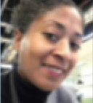
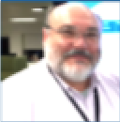
14
High Level Organisation Chart
Gina Gill
Chief Digital & Information Officer
Mark Robinson
Director of Technology Services
Vacant
Director of Strategy and Operations
Amie Alekna
Chief Security Officer
Lee Noon
Director of Digital Strategy
Nabeeha Ahmed
Head of Central Digital
Martyn Inglis
Chief Technology Officer
Jake Barlow
Head of Justice Services
Mark Stanley
Head of Probation Digital
Sophie Otter
Head of Prisons Digital
Fiona Moore
Head of End User Compute
Sarah Brooks
Deputy Director,
People & Capability
Jon Lawrence
Deputy Director
Chief Information Security Officer
Vacant
Head Network, Voice and Video Services
Senior Civil Servant - Pay band 2 (Director)
Vacant
Head of Technology Operations and Infrastructure
Senior Civil Servant - Pay band 1 (Deputy Director)
Rob Stirling
Deputy Director, Portfolio & Controls
Yinka Williams
Deputy Director
Data Protection Officer
David Booth
Deputy Director
Head of Service Operations
Kate Burns
Head of Information Services Division

Slide 15
Business Plan 2021-22 - MoJ Digital and Technology
Our Purpose
So what is it we are here to do? We lead the digital transformation of services for over 1 million users and develop digital services to support the Ministry of Justice priorities and improve access to services. We drive a culture of access and use of data and work with policy and operational teams to develop a user-centred approach to policy design across the department. We aim for all technology used in the MoJ to be supported, secure and compliant with data protection laws.
Our Strategy
Our strategy is the MoJ strategy.
We talk a lot about the fact that we shouldn’t be seen as a back office function, but an integral part of the organisation. So why should we have or do we need a separate strategy? By creating our own strategy, aren’t we separating ourselves from the organisation or calling out that we are enabling the strategy and not a core part of it?
I firmly believe that our overarching strategy should be the MoJ strategy, which is:
Protecting the public from serious offenders and improving the safety & security of prisons
Reducing reoffending
Delivering swift access to justice
You can read more about our 2021/22 priorities here.
Our Mission
In a nutshell our Mission is to ‘Build Confidence and Create Simplicity’. This year, the Outcome Delivery Plan for the MoJ sets out its mission as “Rebuild public confidence in the justice system”.
Our D&T mission absolutely needs to support and deliver this mission. In order to rebuild public confidence in the justice system, there needs to be confidence in both the new and existing digital and technology services upon which that system operates. So, the first part of our mission for this year is Building Confidence.
The second part is Creating Simplicity. Why? We have one of the most complex digital and technology estates in government. It’s hard to have confidence and trust in an estate that has this level of complexity and often seems to be on fire. Simplicity has been shown to foster confidence - people have trust in things that are straightforward and easy to understand. We also have some very complex problems to solve at the MoJ - protecting the public, improving safety and security in prisons, reducing reoffending, and swift access to justice. In order to solve these complex problems in an incremental and iterative way we need to simplify and break them down.
INSERT HERE
XXX
Provide modern, fit-for-purpose XXX
XXXX
XXXX
Improving efficiency and maximising value
Meeting user needs

Slide 16
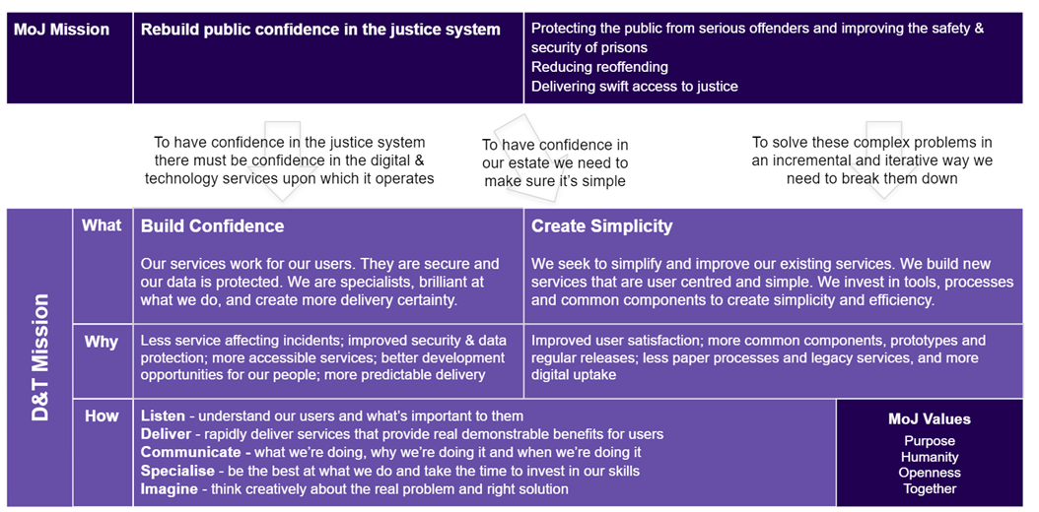
What about how we deliver?
So that’s the what - what about the how? What is our culture, who are we, how do we operate? We should all seek to embody the MoJ values: Purpose, Humanity, Openness and Together. But we need to (and do) do more than that. Our culture and ways of working can be summed up as, we:
Listen - understand our users and what’s important to them
Deliver - rapidly deliver services that affect real demonstrable benefits for users
Communicate - what we’re doing, why we’re doing it and when we’re doing it
Specialise - being the best at what we do and taking the time to invest in our skills
Imagine - think creatively about the real problem and right solution

Slide 17
Induction Materials
17
All information for you are on the following slides.

Slide 18

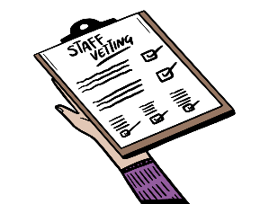


18
Your key Information
A mixture of tools and guidance have been provided to you to support your transition.
 | By 21st June you will have received new MoJ IT kit, SMART phones, access to our Intranet, SOP systems and Justice email accounts. This will allow access to email communications and the opportunity to start familiarising yourself with our key systems and learning. More information is set out here: Technology rollout – Welcome Hub (hmppsintranet.org.uk) Preliminary employee checks and security vetting will be completed before Day 1 of transfer. HRBP’s will work with areas of the business where any further actions are required following this stage. Further information including FAQ’s can be found here: Vetting – Welcome Hub (hmppsintranet.org.uk) The Welcome Hub induction pages cover some of the high level induction materials and information that you will need. This information is already available to all and widely used. The hub contains information on: Your Probation Service Induction Your MoJ Induction – this includes a corporate induction guide Your Civil Service induction The Welcome Hub contains a wealth of other information about the staff transfer and about the new Probation Service. The New Starter Checklist is available on the Welcome Hub to ensure you understand the important actions that they should complete before and after your transition. These are the actions that are relevant to you and doesn’t cover any actions that may be specific to your team.
Equipment
Employee checks & security vetting
Induction & information
Checklist of actions

Slide 19
19
Your key Information
A mixture of tools and guidance have been provided to you to support your transition.
 | All employees have access to SOP employee or manager self-service. SOP holds your absence records and personal details, such as emergency contacts and next of kin. It is a fast and accurate way to make pay claims for overtime or expenses. Line Managers can also process actions online via SOP such as absence, temporary promotion and changes of line management. Any diversity information entered is not visible to your line manager – it will remain confidential. You will be able to access SOP after transfer, using your Ministry of Justice technology. You can find guidance for how to log into SOP on myHub (on the Intranet) by searching for ‘SOP Log in and set up.’ myHub is an information portal which holds advice and guidance, such as job aids, process advice and forms used in conjunction with Shared Service transactions and SOP. myHub also includes ‘How To’ guidance and full contact details – telephone and email – for the SSCL Contact Centre and all transactional teams. You will be able access myhub here: https://hmpps.myhub.sscl.com/ when you receive your ministry of justice technology. Please familiarise yourself with it so you know where to go for information and we recommend we save it to your favourites.
SOP & MyHub
Should you need to travel for work purposes you can book rail, accommodation, air travel, car hire etc through Digital Travel Solution (DigiTS), our online travel booking system. You will need to register for an account using your work email address (if you do not already have one, and you will need to know the correct centre code which you can get from the business manager in your area.
Booking travel

Slide 20


20
Your key Information
A mixture of tools and guidance have been provided to you to support your transition.
Due to the current outbreak of COVID and the unprecedented times we are all living through, the position related to working from home continues to be updated in line with the Government’s roadmap for lifting lockdown. You may wish to visit the COVID guidelines and familiarise yourself with the latest guidance and policies in place.
Staff Locations
Staff in the MoJ D&T Function work flexibly following the Smarter Working principles. Our staff are based all over the country and colleagues regularly travel to different locations for their work. For a list of all MoJ buildings including our 4 HQ buildings (102 Petty France, 10 South Colonnade (at Canary Wharf), Southern House (Croydon) and 5 Wellington Place (leeds), and details of our Commuter Hubs (shared spaces in Government property where you can work from) visit out Buildings and Facilities wen pages. The MoJ D&T Function works flexibly and has multiple office locations - its current main HQ locations are:
102 Petty France, London and we are located on the 10th & 11th floors
10 South Colonnade and we are located on the 2nd floor
Before your arrival, arrangements will be made to ensure you are added to the relevant ZZ email distribution lists - this will ensure you receive all appropriate team and corporate news and invites. If you think you have not been added please contact the engagement team who will ensure that you are added straight away.
The MoJ D&T Function have various channels and ways to communicate information about what’s going on in the Function that you will have access to when you join;
Know the thing
Fortnightly Q&A with Gina Gill
Slack
Weeknote
D&T Bulletin
Show the thing
Communication

Slide 21

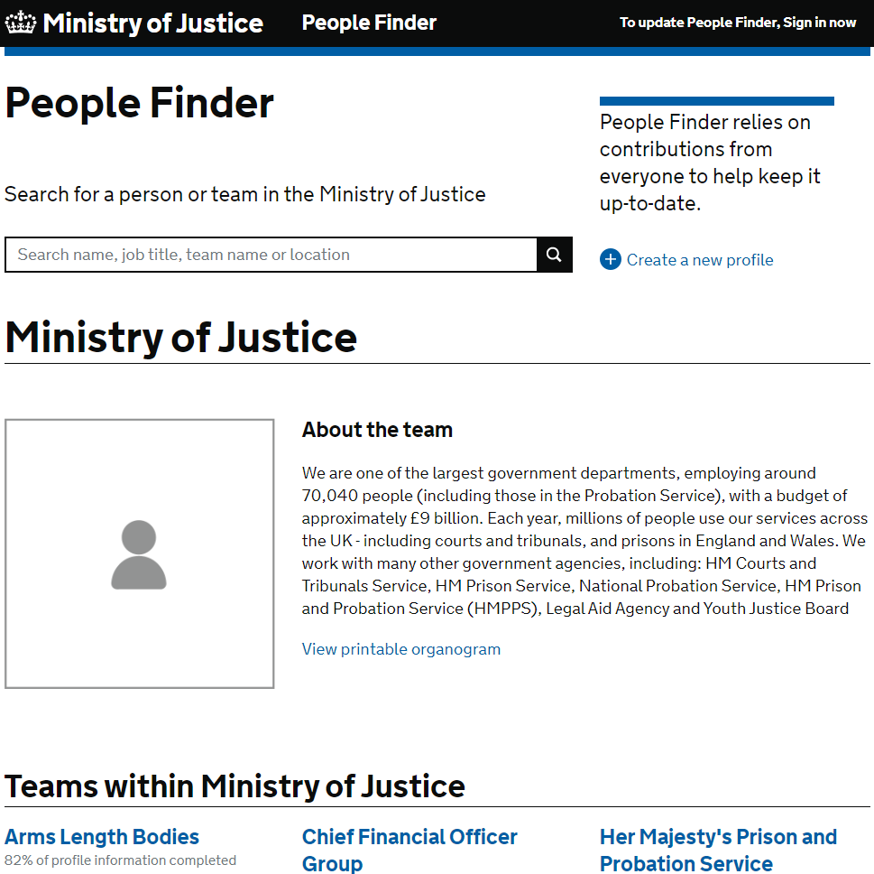
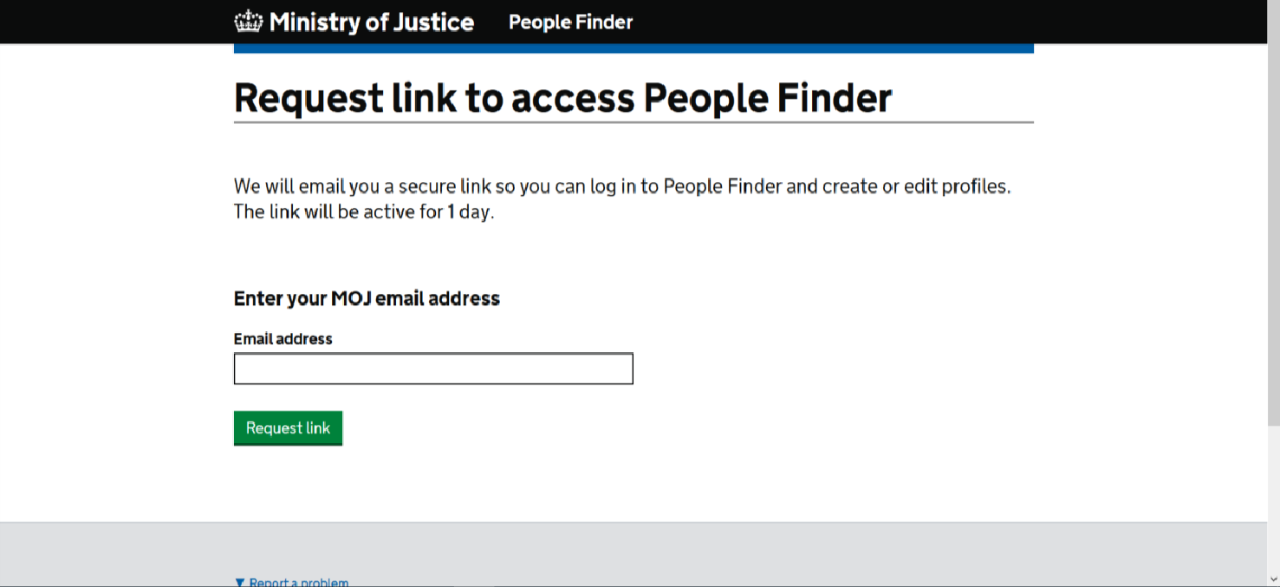
21
Your key Information
A mixture of tools and guidance have been provided to you to support your transition.
 | People Finder is a tool for MoJ family colleagues to be able to find and contact you. It is an enabling tool to support us to make connections and it is important that all staff keep their profiles updated. You can make changes here: https://peoplefinder.service.gov.uk/
People Finder

Slide 22
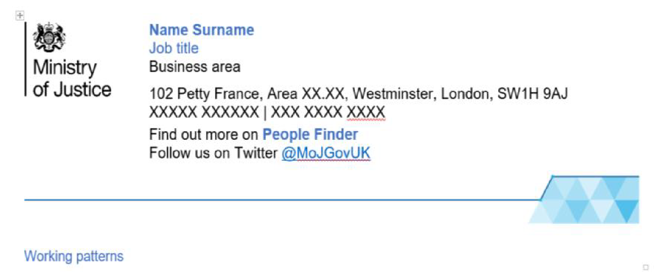
22
Your key Information
A mixture of tools and guidance have been provided to you to support your transition.
 | New email signature templates can be found on the Intranet
E-Mail Signature
To create your own email signature:
1. Edit the contact details in the right-hand column of the table above: give your name, job title, team name or other business area, your address, your work mobile phone number and/or your work landline number, and your working patterns (deleting options that are not applicable).
Also link to your People Finder profile: highlight ‘People Finder’, right-click, select ‘Hyperlink…’, enter your People Finder link into the Address field and click on OK. Visit People Finder to get the link to your own profile. Enter your name into the search box and click on your name to go to your profile. Once in your profile copy the URL and paste it into the hyperlink field. If you don’t yet have a People Finder profile you first need to create one.
2. Once your details have been added above, select the table which holds the signature by clicking on the crosshairs icon on the top left of the table (this appears when you hover the mouse over the table), and copy the table by selecting ‘Ctrl’ and ‘C’ on your keyboard.
3. Go to Outlook and on the Home ribbon click on ‘New Email’.
4. In the new email, on the Message ribbon click on the Signatures drop-down menu and select ‘Signatures…’
5. Click ‘New’ to create a new signature, type in a name for the signature and click on ‘OK’.
6. Right-click in the text field at the bottom of the Signatures and Stationery window and select Paste Options: Keep Source Formatting (the second icon from the left).
7. Click OK
8. To select the new email signature as the default for future emails, select it using the ‘New messages’ drop-down menu
9. Click OK

Slide 23
Useful Links to Important Information
23
National Agreement
Pension
Pay
Role Alignment process
Induction

Slide 24

Further information about the transfer that you may find useful
The Welcome Hub was created as a channel to enable the Probation Service to communicate with incoming staff before the 26th June 2021. It has been a popular resource with many staff having accessed it to date.
In particular we suggest you refer to the following information:
The staff transfer explained
Understanding the role alignment process
Understanding role alignment for corporate and support service staff
Understanding the National Agreement
Employee checks and security vetting
Pre-transfer learning requirements
Induction for incoming staff
Checklist of actions for staff
Actions for transferring line managers
Changes to pension
Understanding pay

Slide 25
Learning and Development
25
Learning and development
Mandatory training

Slide 26
26
Your key Information
A mixture of tools and guidance have been provided to you to support your transition.
 | The MoJ values learning and development and offers all employees a Minimum of 5 Days learning. You and your line manager should discuss your personal development at monthly touch point meetings and develop a learning plan using your Training Contract. Your line manager should also give you reasonable time to complete your training. We strongly encourage you to prioritise your development Some of you will already have myLearning accounts and you should continue to use those accounts. If you need to sign up for a new account, it is important that you DO NOT use your @justice email address but continue to use your current organisation emails to create the account. There is training that our organisation requires us to complete. The training is available on Civil Service Learning. If you don’t have an account already, you will need to create one using your work email address. You are required to complete the following online modules and refresh them yearly : (AI) Responsibility for Information Health & Safety Awareness for Managers or Health Safety Awareness, for all Non-Managers Wellbeing, Resilience and Stress Basic Fire Awareness Equality and Diversity Essentials Counter Fraud, Bribery and Corruption Diversity & Inclusion
Learning

Slide 27
Wellbeing, Health and Safety
27
Health and Safety
Health and Safety Co-Ordinator
Emergency evacuations
First aid assistance
Employee Assistance
Occupational Health
Staff Wellbeing
Unions
Staff Networks
D&I
Useful Contacts

Slide 28


28
Your key Wellbeing Information
A mixture of tools and guidance have been provided to you to support your transition.
Please read and familiarise yourself with the Fire Health & Safety Policies. Local HMPPS Fire, Health and Safety Policies will apply to Establishments.
Health & Safety
 | For details on emergency evacuations and in-house evacuations you should refer to the relevant building on the Buildings and Facilities web page. If you think you may need assistance during an emergency evacuation, please fill out a Personal Emergency Escape Plan (PEEP) and share it with your line manager straight away. This will detail the procedures for your safe evacuation. Details about accessing first aid assistance for the building you are based in can also be found on the Buildings and Facilities Details about accessing first aid assistance for the building you are based in can also be found on the Buildings and Facilities page. Please advise your line manager if you have a medical condition that may impact you at work, for example, if you suffer from allergies and carry an epi pen. Such conditions can be conveyed in written/electronic format as “Workplace Adjustment Passports” (WAP), and individuals can carry them forward between different jobs. The HMPPS and MoJ Employee Assistance provider (EAP) is PAM Assist. EAP services will continue to offer a wide range of support to staff including confidential advice on personal, social or work-related problems. Please visit the Intranet for further details. Relevant information on Occupational Health can be found on MyHub: Her Majesty's Prison and Probation Service | Occupational Health (HMPPS Connect) (sscl.com)
Emergency Evacuations
First Aid Assistance
Employee Assistance & Occupational Health

Slide 29

29
Your key Wellbeing Information
A mixture of tools and guidance have been provided to you to support your transition.
 | The MoJ aims to create a work environment that supports employee health and wellbeing. Please visit the MoJ's wellbeing pages. The MoJ aims to create a work environment that supports employee health and wellbeing. Please visit the MoJ's wellbeing pages to find out about the support that is on offer. You can find additional information about other benefits available to staff such as the ‘cycle to work’ scheme and deals on travel, food and entertainment here.
Staff wellbeing
 | Further information on the recognised Trade Unions can be found here: NPS: Learning about our Trade Unions – Welcome Hub (hmppsintranet.org.uk) An overview of all staff networks can be found here: MOJ and HMPPS staff networks – Welcome Hub (hmppsintranet.org.uk) MoJ is striving to build a world class organisation that is open and inclusive and truly values and celebrates the diversity of its workforce and can understand and serve the needs of the diverse society of which we are a part. This is regardless of social background, gender, age, ethnicity, sexual orientation, beliefs, disabilities or long-term illness or caring responsibilities. Our aim is to build a strong and successful workplace with a workforce that at every level reflects the diversity of the society in which we deliver our services. Further information can be found here: https://intranet.justice.gov.uk/guidance/equality-and-diversity/
Unions
Staff Networks
Diversity & Inclusion

Slide 30
30
Useful Contacts
Issue | Contact
Link to all SSCL contacts (HR, Finance etc.) | Ministry of Justice | Contacting Shared Services Connected Limited (SSCL)
FAQ | FAQs – Welcome Hub (hmppsintranet.org.uk)
Where can you direct questions, comments or concerns?
Please email:
John Mckie - john.mckie@digital.justice.gov.uk
Mayko Polka - mayko.polka@digital.justice.gov.uk

Slide 31

6
Staff Checklist
Checklist of actions for their first day and beyond
Check that you have received your MoJ equipment and that you are comfortable with accessing the intranet, SOP & MyHub – information on these systems is part of your central induction but it is always good to check.
Ensure you have access to any systems required to carry out your role
Ensure you are aware of your cost centre
Complete the workstation assessments if necessary
Allocate time to read your teams Corporate Services Onboarding Pack & complete any essential learning
Ensure your New Starter Induction Checklist is completed within your initial induction period (Welcome Hub will host the latest staff checklist)
If you are an EU National and have not applied for the pre-settled/settled status, to do so before 30 June 2021 to be able to continue to live and work in the UK.

Slide 32


32

