Slide 1
July 2021 Regional Team Briefing
[Region]

Slide 2
Regional Team Briefing purpose
1
We’re aware of and informed about national and regional change from the Probation Reform, Probation Workforce and Recovery Programmes
3
Clarify our region’s and team’s areas of focus for this month – what are our big deliverables?
1
We’re aware of and informed about national and regional changes
2
We talk about how these changes might affect our team
3
We clarify our team’s areas of focus for this month – what are our big deliverables?

Slide 3
Today’s conversation – new this month
Celebrating our new Probation Service
Day 1 top 20 changes
Unified Tiering Model calculation change
Flagship Manchester site gets colleague approval
New on the Welcome Hub
New joiner information
[Region] July areas of focus
Team impacts
Your questions and feedback
Thank you

Slide 4
Celebrating our new Probation Service
Our unified Probation Service
On 26 June we came together as a new unified Probation Service
Discover more from Amy Rees and Jo Farrar about our unification, our new operating model, and our new name for our newly unified service
Watch a new video welcoming you to our Probation Service
Read about our new operating model and what is changing from Day 1

Slide 5
Lord Chancellor celebrates our new Probation Service
See the Lord Chancellor and Secretary of State for Justice’s Twitter threads on our new Probation Service, including his recent visit to Chippenham Probation Service to and videos featuring seven Probation Officers

Slide 6
Day 1 top 20 changes
Probation Services to Court
1. New digital service to identify people on probation in court
Custodial sentencing
2. New Commissioned Rehabilitative Services for accommodation and mentoring
3. Basic Custody Screening Tool 2; BCST-2 part 2 pre release resettlement plans are no longer used for high risk people on probation
4. Handover reports shared with Enhanced Through the Gate staff
5. New Short Sentence function in some regions
Case allocation
6. New Unified Tiering Model
7. Optional: former CRCs move to Workload Measurement Tool, remove their tiering processes

Slide 7
Day 1 top 20 changes
Sentence planning
8. New process to find Commissioned Rehabilitative Services
9. New referral process for new Commissioned Rehabilitative Services
10. New digital service to support new processes – Refer and Monitor an Intervention
Sentence management
11. Probation practitioners delivering change work
12. New induction pack
13. Revised transfers process
14. Revised recall sign off process

Slide 8
Day 1 top 20 changes
Intervention delivery
15. Unpaid Work delivered in house
16. Removal of CRC Unpaid Work nomination processes
17. Accredited Programmes and Structured Interventions delivered in house
18. New Commissioned Rehabilitative Services
19. New Commissioned Rehabilitative Services Providers
20. New target to review Accredited Programmes and Structured Interventions cases

Slide 9
Unified Tiering Model calculation change
We have refined the way in which tiering calculations are done in our Unified Tiering Model
This has resulted in a small number of cases which were initially incorrectly scored Tier A being changed to Tier B
These changes were applied on 28 May 2021 and were reflected in the Workload Measurement Tool for 1 June
Relevant Unified Tiering Model guidance has been amended to reflect the Assess and Protect calculation to ensure that only Tier A includes Very High RoSH and / or MAPPA level 2 / 3 cases
Please see our Staff Guidance and Tiering / Case Allocation Framework in EQuiP

Slide 10
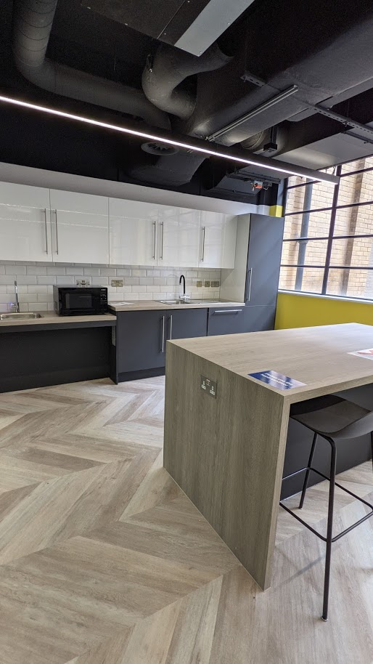
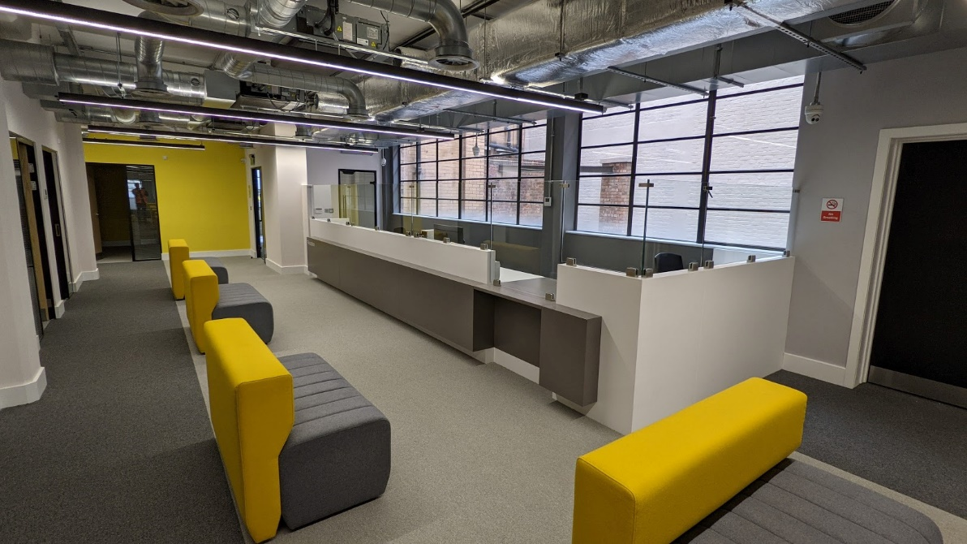
Estates Case Study: Flagship Manchester site gets colleague approval
Our new probation flagship site, in Redfern in Manchester’s northern quarter, opened on 17 May
The listed building – close to excellent public transport links – provides easy access for our colleagues, people on probation and colleagues from partner organisations
The office is fitted out in line with our Probation Design Guide, which goes beyond rooms, acoustics and lighting to create welcoming, professional spaces that support positive experiences for people on probation from the moment they arrive

Slide 11
Flagship Manchester site gets colleague approval
Feels great
Robert Donald, Probation Officer, gives it the thumbs up: “Settling in to Redfern has been a really positive experience. Firstly, it’s a beautiful building and our workspaces are clean and modern. I’ve enjoyed getting to know lots of PS and CRC colleagues better and it makes me feel more positive about my day to day. Previously I have only communicated with some colleagues by email – seeing people face to face allows for greater understanding and collaboration, which has been ace. People on probation appear to be responding well, too, and seem to be much more positive. The interview rooms are much more welcoming and relaxing for both them and probation staff alike.”
Exactly what we wanted
Chris Edwards, Greater Manchester Regional Director, said: “While the reform of probation applies across the whole of Greater Manchester, Redfern is our most high profile symbol of a new organisation. Having seen it develop over the months, I am so grateful to all the staff who have engaged in this process. The end product is just what I’d hoped it would be: a modern working space with excellent interview and group room facilities, easily accessible in Greater Manchester and a venue where we can host stakeholders with pride.”

Slide 12
New on the Welcome Hub
The Welcome Hub is a great source of new information for you – recent updates include:
The journey to achieving our Target Operating Model
Commissioned Rehabilitative Services and Monitor video
Actions and support for line managers
Q&A from staff engagement events
Understanding Authority Systems
Ways of purchasing and paying
Transfer letter Q&A
Get the latest updates on our New on the Welcome Hub page

Slide 13
The following section is primarily applicable to new joiners from the NPS, CRCs, parent organisations and supply chain organisations
Competency Based Framework (CBF)
Transition learning
Staff transfer activity summary

Slide 14
Competency Based Framework (CBF) for new joiners
Need to know
New joiners who have transferred on to Probation Service terms and conditions have the opportunity to work with the CBF in the same way as existing staff
Under the National Agreement, new joiners will pay progress without reference to the CBF for 12 months, from June 2021 to June 2022
This means that pay progression on 1 April 2022 will remain a contractual entitlement, without reference to the CBF for all existing and unifying Probation Service staff
Need to do
The CBF requires all new joiners, including unifying staff, to hold their opening conversation within their first eight weeks of being in post, recording the date of their conversation and the level of competence on SOP
Managers should complete their SOP records by 31 August 2021
Look out for our live summer sessions, where staff and managers can learn more about the CBF

Slide 15
Competency Based Framework (CBF) trial year milestones
Opening conversation
Quality conversations
Closing conversation
Over 40% of staff completed their opening conversations in June – there’s still time for you to take part
You have told us that you are clear about the CBF process for you and / or the people you manage
You have said that your opening conversations have not taken much time and that our CBF products are useful, clear and concise
Many of you have raised queries via the CBF inbox
We are refining our processes to respond to your queries faster and with as much information as you need to support your engagement with the CBF
Keep an eye out for our live events in the autumn, which will support you in forming your competence examples

Slide 16
Transition learning
Pre transition learning
If you haven’t completed your pre transition learning, please refer to the welcome hub > what you need to do > pre-transition learning
If you have any queries about how to use nDelius, OASys or any of the new SOP (HR) systems, please refer to the Welcome Hub
Post transition learning
There are different learning pathways for different roles, which means that learning will be made available to you as and when you need it for your role
Please refer to the welcome hub > what you need to do > your learning > your post-transition learning for further information on learning in the Probation Service
Regional Probation Leads (formerly Divisional Training Managers) will provide you with further details on when and how our Learning & Development transition plan is being implemented in your region

Slide 17
Learning records
myLearning
All previous learning will be recognised
This means that you only need to complete what is outstanding in your learning pathway
Staff with existing myLearning records should continue using their existing username and password
Staff without an existing myLearning account will be sent an email with a new username and password
Help and queries
Guidance videos and job aids are available on myLearning under the Help section
Further information about myLearning can be found on myHub at myLearning
Please email training-services-delegate-management@gov.sscl.com if you have any questions about accessing myLearning

Slide 18
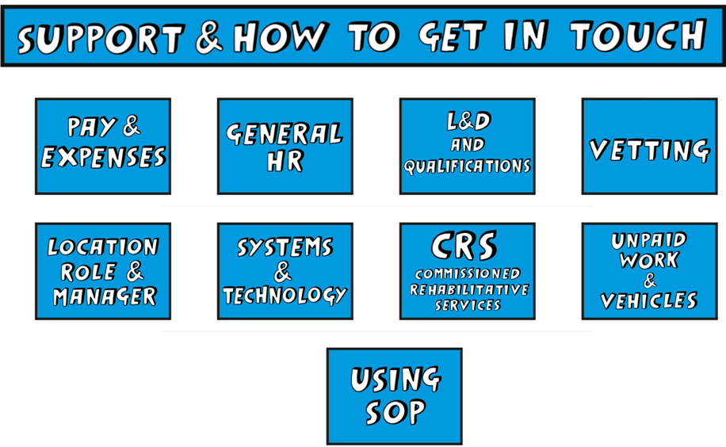
Summary update on staff transfer activities
Welcome to all colleagues who have joined from the NPS, CRCs, and parent and supply chain organisations – we are now a new, unified organisation
We understand there are some outstanding issues and concerns which remain our top priority to address, including:
Responding to Transfer letter queries in to the mailbox
Continuing with role alignment appeals
Ensuring our new staff support pages remain up to date with key information
Support questions and how to get in touch
How to login to SOP
FAQs on Transfer Letters and how to report errors
Update and FAQs on the Job Evaluation outcomes
Q&A outputs from the events on:
Pay, CBF & the NA
Staff not covered by the National Agreement
Updated actions for line managers
A number of new communications and induction materials are available on the Welcome Hub

Slide 19
Supporting transferring staff through the transition
We know that there will be questions from transferring staff within the first few weeks and months of our unification
A new section has been created on the Welcome Hub to provide this support
We are asking staff to browse this self service information and talk to their line manager or colleagues before escalating their query in to their region or team – thank you
Staff support pages can be found here
Escalation points within the regions and teams can be found here
We hope that this information helps staff to feel supported during their transition

Slide 23
FAQs on the Transfer letters
Ensuring staff receive their Transfer letters with the correct information is an absolute priority
We have received a large number of queries into the functional mailbox transferletterqueries@justice.gov.uk related to a number of issues, including hours, role title and pay inaccuracies
We have prioritised pay related queries and have now responded to the vast majority of queries
We expect to respond to all other queries by 2 July
Please do not send duplicate queries to the mailbox, as this slows down the response process
Queries not directly related to your Transfer letter, such as the Job Evaluation Scheme (JES), role alignment appeals, or general queries about your transfer, should not be sent into the Staff Transfer Letter mailbox
You can find lots of information on our support and how to get in touch page, including queries on SOP, your location and technology
View the transfer FAQs here

Slide 24
Logging in to SOP
You can access your employee information, including details of your salary, working hours and of any staff you may manage, on our Single Operating Platform, SOP
You will receive a letter via your Justice email containing your staff number and instructions on how you log in to SOP
To log in, your user name will need to have the three character prefix ‘NMS,’ followed by your staff number – for example, NMS123456
Your SOP user name is not the same as your network ID, which you use to log in to your HMPPS computer or laptop
The first time you log in to SOP, your password will be your National Insurance number; however, if your National Insurance number contains any repeating characters, for example ab123455A, then the repeating character will need to be replaced with an asterisk *, for example ab12345*A
Your NI number should be all in lowercase for your password to access SOP
Discover more about SOP on the Welcome Hub:
Understanding SOP; Using SOP support page; Your Induction checklist

Slide 25
Supporting line managers through the transition
We launched the line managers toolkit on the Welcome Hub in April, to provide guidance and support to line managers with the tasks and activities they needed to do in preparation for transfer to our new Probation Service in June
The toolkit has now been updated with additional actions and information covering topics such as SOP, staff benefits and much more
All the topics covered in the toolkit will be useful to all managers who have joined our unified Probation Service from the NPS, CRC, and parent or supply chain organisations
It is important that all line managers have accessed and read through the toolkit to understand the actions that are required of them to support their teams throughout our transition
View the new toolkit here.

Slide 26
Support for HR/ people queries
Self service support
(e.g. Welcome Hub, Intranet, IT helpdesk, EQUIP, Transfer Letter, Measures Statement, SSCL)
Line manager support
(e.g. LM Briefing pack, Measures, SSCL)
Regional or Functional SPoC
(Transition / Functional SPoC)
Where do I go for support?
Regional / Functional Support (e.g. HR)
Regional / Functional Support (e.g. HR)
Escalate to Programme

Slide 27
Aligning to our new organisational structures
Our Target Operating Model explains the new, unified organisation that we are all working towards
While Day 1, 26 June, was a hugely important milestone for us, it isn’t the end of the change journey for our organisation
A key part of the next phase of our change will be aligning to our new organisational structures, to ensure we have the right number of people, in the right roles and locations, to effectively deliver our services; discover more here
We will be reviewing the size and shape of our new workforce against the target staff numbers that we need to deliver our services effectively
In some cases, we will have the right number of people to deliver our work
In a few cases, we might have too many people compared to the available posts, and we may need to address this
In other cases, we may need to recruit as we will have too few people
A certain amount of local movement of people is a normal part of workforce planning to ensure people are in the right place; this may happen even when we don’t have too many people compared to the number of roles
Where applicable, this phase will apply equally to all Probation Service staff, whether they are existing NPS staff or transferring in from a CRC, PO or SC organisation.

Slide 28
Region July areas of focus
Content to be inserted by region
[Region]

Slide 29
Team impacts
How might these changes affect our team?
Are we clear on our individual and team next steps and delivery?
How are we managing change? Do we need support?

Slide 30
Thoughts, feedback and questions
Please email [insert your region’s preferred Outlook account]

Slide 31
Thank you

