Slide 1
June 2021 Regional Team Briefing
[Region]

Slide 2
Regional Team Briefing purpose
1
We’re aware of and informed about national and regional change from the Probation Reform, Probation Workforce and Recovery Programmes
3
Clarify our region’s and team’s areas of focus for this month – what are our big deliverables?
1
We’re aware of and informed about national and regional changes
2
Discuss how these changes might affect our team
3
Clarify our team’s areas of focus for this month – what are our big deliverables?

Slide 3
Today’s conversation – new this month
Welcome Hub Updates overview
Change Map / Ops Roles / Non-Ops Roles
Day 1 Probation Instructions and Policy Changes in EQuiP
National Standards, Performance and Quality
Competency Based Framework trial year + staff research
Information for CRC, parent organisation and supply chain staff inc: Role Alignment & appeals; Vetting; Events; Learning Pathways; CRC Staff Equality Diversity Declarations
[Region] June Areas of focus
Team impacts
Your questions and feedback
Thank you
Day 1 of our new Probation Service: what it means; all staff event 28 June
Commissioned Rehabilitative Services – Training Go Live!
Purchasing and Payment in the Unified Model
Estates Update including Facilities Management
New Workload Measurement Tool online tutorial and Unified Tiering Model video
Sentence Management Design: Induction pack
Interim Guidance on Case Allocation Processes
Structured Interventions Guidance Manual
Probation Reform Programme: Digital, Data & Technology update

Slide 4
Day 1: what it means
26 June 2021 is Day 1 of our new Probation Service – this means:
People
CRC colleagues join the new unified Probation Service or transition to one of our specialist intervention providers
From this point on, we will begin implementing our planned reforms, including:
Developing a professional register, underpinned by ethical and training standards
Delivering the training, qualifications and professional recognition for probation practitioners that they need and deserve for long and effective careers
Organisation
We are simplifying probation delivery, making it easier for those we work with and giving us greater control of staff and resources to deliver reform
We begin to move to our Target Operating Model, which sets out our intentions for the future system

Slide 5
Day 1: what it means
Operations
CRC contracts end
All offender management services in England and Wales sit within our new Probation Service, structured as 11 regions and Wales
Sentence management will be the responsibility of our new Probation Service, along with Accredited Programmes, Unpaid Work and Structured Interventions
Other interventions that meet rehabilitative and resettlement needs will be delivered by Commissioned Rehabilitative Service providers, with cases managed according to the risk, need and sentence type
For resettlement, we have created an enhanced pre release system. A community responsible officer will lead on all the pre release activities, undertaking a comprehensive assessment and developing a sentence plan aligned to need, risk, and victim issues. This will increase to individuals prior to release during the final phase of prison, through to transition and post release
We have welcomed a number of partners to support us in Employment, Training & Education, Accommodation and Personal Wellbeing and Women’s Services, who have been awarded around £200m of Government funding to help cut crime in our new probation system
These changes will deliver a stronger, more stable probation system that will reduce reoffending, support victims of crime and keep the public safe

Slide 6
Day 1: get involved in a national all staff event
26 June 2021 is Day 1 of our new unified Probation Service
Jo Farrar and Amy Rees are hosting an all staff event on 28 June at 4.00pm to welcome everyone to our new Probation Service
To join this live event, please click on this link: all staff event with Jo Farrar and Amy Rees
This will be an informal session to bring us all together on the first working day of our new unified Probation Service and will complement what we have going on regionally
During the event we will hear from Jo and Amy on why unification is so important for the future of probation, what they’re excited about for the future and what it means for you.
Please join if you are able and spread the word. Details on how to join will be made available nearer the time.

Slide 7
Day 1: get involved in our regional event/s
Regions to insert their local staff events

Slide 8
Commissioned Rehabilitative Services Training Goes Live!
OVERVIEW
From 26 June there will be a range of services available from specialist external providers to meet key areas of rehabilitative services. Contracted providers of these services will work closely with probation practitioners and community interventions teams to ensure the best outcomes for people on probation.
A new ‘Refer and Monitor an Intervention’ digital service will enable Commissioned Rehabilitative Services (CRS) to be searched and selected for referrals.
YOUR L&D
A new CRS Learning Pack highlights what is new, what is expected and includes practical tools and guidance.
Resources have been divided into two sections: Best Practice around Commissioned Rehabilitative Services (CRS) and How to use the new Digital system (Refer and Monitor) to support CRS delivery
Learning will involve familiarisation with these resources and for OM Staff, Court Staff and ETTG Staff, completion of a Knowledge Check. This Check can be taken multiple times until passed
OM staff, ETTG Staff and CRS Change Champions will need to access the full learning content.
Court, Administrators, Interventions, UPW and various other non-operational staff will need to access a select blend of the learning products. This includes for UPW Staff, Interventions Staff and various other non-operational staff a CRS general overview course.
A full list of non-operational staff and requirements are listed on the Welcome Hub and a more detailed breakdown of what you will need to complete is available in MyLearning.
Staff in Greater Manchester region are not required to take this learning package and will be contacted separately on the bespoke training designed for Greater Manchester Integrated Rehabilitative Services (GMIRS) roll out.

Slide 9
Commissioned Rehabilitative Services Training Goes Live!
Next steps and availability
The learning package is now accessible via My Learning with staff groups required to complete it before 26 June.
Current NPS staff will need to Register on myLearning and can access the learning here
CRC staff moving to the Unified Probation Service will be required to access the Non-Directly Employed (NDE) Section of myLearning. Follow the online instructions.
Probation Practitioners will have access to the Refer and Monitor digital system from 12 June. You may wish to take this section of the training before then, but the benefits in terms of ease of use will be more apparent once you can log in.
Further information
Further information on Commissioned Rehabilitative Service can be found on the HMPPS Intranet and Welcome Hub
Read an interview with Deborah James, one of the Programme Team who brought operational experience to help shape CRS and the Refer and Monitor Service. We asked what benefits staff should expect to see.

Slide 10
Ways of purchasing and paying in the Probation Unified Model
FOR TRANSFERRING CRCs STAFF
Some transferring staff – particularly UPW staff and staff who administer petty cash– will need to be aware of ways of purchasing and paying in the Probation Unified Model including the use of Government Procurement Cards (GPC), fuel cards, petty cash, travel warrants and the Travel for persons on Probation policy
To help, briefing sessions will be held in June and guidance published on the welcome hub
Government Procurement Cards (GPC) are used for adhoc low value purchasing (for items such as tools, materials for project in a box, owned UPW vehicle repairs etc). GPC cards will be rolled out to named individuals during June and July 2021 (once those individuals have a Probation Service employee number). Petty cash will be able to be used from 26 June until GPC cards are fully in place.
Fuel cards are used to fuel vehicles owned and leased by Probation. Fuel cards are being rolled out during June to be used from 26 June 2021 onwards. Fuel cards are predominantly linked to vehicle registrations but can also be used to purchase fuel for lawn mowers.
Petty Cash will be available from 26 June 2021 in transferring sites that currently use petty cash. Petty cash will be obtained locally by cashing MoJ cheques from a bank account and will be delivered to some locations (delivery will only be made where it is essential due to location of bank branches etc). Petty cash will need to be managed in line with MOJ policy/cashiers guidance.
When withdrawing cash from the bank, the cheque should be written before leaving the office, and only the single cheque should be taken, not the whole cheque book. The cheque amount should be for the minimum amount required to keep the office running until the next visit to the bank. The bank run should not be completed at the same day/time each week.

Slide 11
Ways of purchasing and paying in the Probation Unified Model
FOR TRANSFERRING CRCs STAFF
Travel warrants for people on probation
Travel warrants will be available in transferring sites early June. For appointments scheduled for 26 June 2021 or after, these travel warrants should be issued to people on probation who are eligible for travel (in line with current CRC policy).
The Probation Service policy for “Travel for persons on Probation” will be available during June. Transferring staff should be aware of the content of this policy for use beyond the 26 June 2021.
Where there are differences between legacy CRC Travel for Persons on probation policies and the PS policy, staff will have the flexibility to extend the period of implementation past Day 1 to allow for conversations to take place with those individuals who may be affected by the changes. However, full implementation of the PS Travel for Persons on Probation PI will be expected by 1st October 2021
A poster is included in this pack
Day 1 of the Unified Service - 26 June 2021
Transferring staff will continue to work to existing CRC fares to report policies
Practitioners should start to make people on probation aware of how the new Probation service policy impacts them (a poster will also be issued to be displayed in offices)
All Processes for GPC card use and fuel cards will be held on Equip for ongoing reference, and the Travel for Persons on Probation will be stored and accessed as per all PI’s.
Prior to Day 1 - Learning Requirements
During June, MS Teams engagement events will be held to brief transferring staff who are particularly affected by new ways of purchasing and paying (predominantly Unpaid work staff, staff who manage petty cash, corporate and support administrators etc).
A guidance document will also be available to all staff via the Welcome Hub during June.

Slide 12
Estates: Day 1 change
Signage reflecting our name change to the Probation Service
A temporary sign will be distributed to all sites during the week commencing 14 June, to reflect our name change to the Probation Service
Signage templates will also be provided by email
A scoping exercise starts in June to determine when and how permanent signage will be rolled out across our estate
CRC site transfer
On Day 1, the remainder of CRC sites will transfer in to the Probation Service estate
We are undertaking identified security works at a small number of CRC sites in advance of Day 1
Our Day 1 unified estate will encompass > 677 holdings
See our new June 2021 Estates Staff FAQ for full details

Slide 13
Estates: safe, secure sites
We are planning to issue new ID badges to all Probation Service staff; we are prioritising issuing ID badges for Day 1 to staff who are transferring to the Probation Service and new staff
Key risks related to the physical security status of incoming CRC buildings have been identified and assessed; mitigating works will be completed
We are delivering lone worker safety devices, panic alarms and staff ID badges in a timely manner to support staff and site safety and security; full details: Lone Worker Safety Devices, Panic Alarms and ID Badges Notice
Most NPS sites currently have fixed panic alarms, while a small number of CRC sites transferring over to HMPPS estate do not; we are developing a contingency for sites that require an interim panic alarm solution
All sites without panic alarms will have them in place before mixed caseloads are introduced
We have a new Physical Security Working Group developing a new set of security standards for our estate
Our unified model means that the delivery of services remains ‘as is’ for Day 1; in line with this, no estates work has been undertaken in CRC buildings to support our future move to mixed caseloads

Slide 14
Facilities management
CRC sites transferring in to the new Probation Service are being onboarded to existing MoJ Facilities Management (FM) suppliers
All of our sites have enhanced Covid-19 cleaning services, with arrangements to ensure this applies to incoming CRC sites
Full details are available in our NPS Employee Facilities Management Guide; details on site transition dates are available in the NPS FM Change Regional Spreadsheet
Employees will be informed of the FM change at their site through two advance emails and posters and desk drops on the day of change; the next, final onboarding of sites, takes place on 25 June
If you have a question about the Facilities Management transition that isn’t covered in these documents, please contact Damien Daniel, Facilities Management Transition Lead
The Estates Helpdesk is your contact point for all Facilities Management issues 24 hours a day, 365 days of the year. Employees should log all FM issues, follow up outstanding faults, request new works, or raise a complaint or compliment through the Estates Helpdesk:
Estates Helpdesk telephone: 0333 300 2016
Estates Helpdesk email: edfmhelpdesk@fmassurance.co.uk

Slide 15
Estates: key post Day 1 delivery
Continued delivery of the Estates Strategy, which encompasses the modernisation of our new unified estate and critical spending on, and delivery of, maintenance projects
Improving accessibility and security through the development and application of new tools to help identify requirements at an individual site level and support any future move to mixed caseloads
Permanent signage for our unified estate

Slide 16
New Workload Measurement Tool online tutorial + Unified Tiering Model video
A new, 20 minute Workload Measurement Tool online tutorial is now available on the Welcome Hub for all HMPPS staff and CRC colleagues who are transferring in to the Probation Service, plus a new five minute video introducing our Unified Tiering Model
The Workload Measurement Tool (WMT) is a helpful mechanism for managing workloads, reflecting the very different workloads associated with cases of different complexity through the Unified Tiering Model
The WMT tool assists Senior Probation Officers in allocating cases to Probation Officers, Probation Service Officers and PQiPs – people in our trainee probation officer programme in sentence management roles – by showing their current workload, available capacity and balancing workload out among their teams
The Unified Tiering Model was launched in early May to introduce methodology to represent probation’s role to assess, protect and change
The WMT is updated daily from Monday to Friday, taking the sentence and tier details from nDelius and exporting this data to the WMT
Each case within the WMT is automatically allocated points, dependant on the sentence and tier; this accrues to the Probation Practitioner’s overall caseload and capacity at that point in time
The WMT is a supportive tool for Senior Probation Practitioners to enable allocation decisions and balance workloads across their teams; it is also used at a strategic management level to inform workforce planning and key decisions
Discover more through EQuiP and:
Workload Measurement Tool Staff FAQ
Workload Measurement Tool User Guidance
Unified Tiering Model April Regional Team Briefing
Unified Tiering Model Staff FAQ
Unified Tiering Model Staff Guidance Document

Slide 17
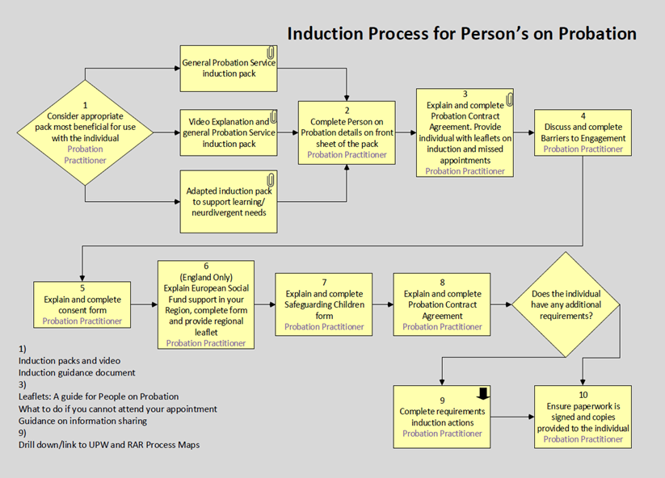
Sentence Management Design: induction pack
Sentence Management will have a single, nationally used induction pack for Day 1, offering:
A generic streamlined induction pack
Links to EQuiP to individualise to the specific Person on Probation (PoP) and their sentence
GDPR compliant material
A pictorial adapted and large font version
Leaflets to support provision of additional information
A PowerPoint video to offer a more visual explanation
While this pack offers some improvements to previous material and provides nationally consistent materials and process, this work will be continued with ongoing refinements and digital innovation to further improve and streamline the induction process
This is to ensure that there is a focus on engagement and desistance from the outset of the PoP journey, while retaining legal requirements for enforcement and GDPR
Process map for induction: basis of updated EQuiP process which will be available from Day 1

Slide 18
New Interim Guidance on Case Allocation Processes
We have new Interim Guidance on Case Allocation Processes – please review this document for full details
There is also a supporting flow chart

Slide 19
New Structured Interventions Guidance Manual
The Structured Interventions Practice Manual supports practice alignment with our end state Structured Interventions Operating Model
This manual was circulated for consultation in April and incorporates consultation feedback and a list of Structured Interventions agreed for delivery in each region up to Day 1 and beyond
Click on a new video to discover how Structured Interventions sit alongside other interventions
The Structured Interventions Practice Manual will be supported by a Delius advice note that provides more detailed referral and monitoring guidance and pre Day 1 steps to re refer cases from existing non statutory interventions to new non statutory interventions
Probation practitioners will receive information on the Delius advice note from their Regional Operational Leads before Day 1
A revised version of the Structured Interventions Practice Manual will be released in January 2022
This document will provide more information about a consolidated Approved Suite of Structured Interventions developed in collaboration with regional representatives
It will also contain details about new performance and quality frameworks for Structured Interventions which will take effect from April 2022
EQuiP is the portal for all technical, professional and guidance documents, including all documents and advice notes related to our In House Interventions
Please contact Jason Morris if you have any queries about Structured Interventions

Slide 20
Digital, Data & Technology: Technology rollout
More than 70% of colleagues in CRCs, parent and supply chain organisations have received their new laptops, accessories, assisted technology and smartphones and have had their emails and data migrated to their new equipment
Colleagues at People Plus, Purple Futures, Sodexo, Seetec and RRP can now be reached through @justice email accounts and Microsoft Teams.
Colleagues at ARCC and MTC will cut over in June, closing out a complex rollout that will have provided more than 7,500 colleagues with the tools to succeed in our new probation service
Visit the Welcome Hub for more information, including:
User guides for laptops and smartphones

Slide 21
Digital, Data & Technology: Telephony rollout
Colleagues in Purple Futures and RRP now have access to a range of telephony enhancements, working in the office, at home, or on the move, using their new laptops, smartphones or office equipment.
ARCC and Seetec will be the next parent organisations to fully switch over to this latest collaboration technology, followed by Sodexo in the coming weeks.
The roll out of this collaboration tool will continue across all CRC premises transferring into the Probation Service estate.
The phased introduction will run beyond 26 June 2021, so we minimize any impact to our staff and people on probation, and ensure we effectively communicate the change of contact numbers at local and national levels.
Visit the Welcome Hub for more information, including:
User guides for MS Teams Voice

Slide 22
Welcome Hub
Thousands of colleagues have discovered there’s something for everyone on the Welcome Hub.
Here’s a selection of recent updates you may like to check out:
Understanding the changes
Your induction checklist
Your post transition learning
What to expect from your transfer letter
Understanding how your pension will change
Shaping Commissioned Rehabilitative Services
Information Assurance actions
Staff engagement events schedule
Keep up with the latest updates on our New on the Welcome Hub page

Slide 23
Understanding change impact
We all know that change affects everyone differently and at different times. We now have a welcome hub page that highlights some of the ways changes to the service may impact you over the coming months.
It includes some examples of how the changes may impact on operational roles and non-operational roles. Each one looks at how an individual in that role may think, feel or do things differently as a result.
Understanding the changes – Welcome Hub (hmppsintranet.org.uk)
Includes:
Latest Change Map
Operational Role Change Impacts
Operation Role Change Impacts

Slide 24
Day 1 Probation Instructions and Policy Changes in EQuiP
Our focus for Day 1 of our unified Probation Service is to maintain operational stability
On 26 June 2021, 25 policy changes will be published in EQuiP:
20 policies will have new administrative changes, with no discernible impact upon mandatory actions
Five policies will have some changes or clarifications (attached with email)
As we deliver our Target Operating Model, further policy revisions will be needed
Planning for these changes will be made in full consultation with operational colleagues and stakeholders
All Probation Service staff should use our published policies on EQuiP to inform practice decisions without the risk of confusion

Slide 25
Joining the Dots: National Standards, Performance and Quality
Transitional National Standards are being agreed for implementation following the end of CRC contracts on the 25th June 21. However, these will remain suspended (as current ones are now) for as long as Exceptional Delivery Models (EDMs) are in place. After the 26th June (Day 1), once the EDMs end, National Standards will come into effect, appreciating that a period of time will be necessary post-unification to embed and apply these consistently across the business. The Performance Framework for the Unified Model consists of existing and new metrics and specific parts of the new performance framework will be switched on to support the unified model from July 2021.
The Performance Framework and National Standards do not apply whilst the EDMs are in place. When the EDMs cease and National Standards come into effect, the Performance Framework sets out targets that ramp up over time acknowledging that these will take some time to embed. These are baselined from the 20-21 performance year, taking account of the impact of Covid 19 and progress with the Recovery journey. A briefing note on the Unified Performance Framework will be placed on Equip, and the link shared with staff. The note explains how measures will be implemented, as well as the targets and metrics that will apply.

Slide 26
Joining the Dots: National Standards, Performance and Quality
In terms of the approach to blended supervision, the expectation is one of continuation whilst the EDMs are in place. As part of the Unified Model, a Blended Supervision Model framework and guidance has been developed, with a view to introduce this as EDMs close down. The Blended Supervision Model sets out the expectations and provides the guidance about different contact levels aligned to the Unified Tiering Model (above the minimum contact expectations included the National Standards).
The Probation Operational Delivery (POD) model is a way of structuring operational teams to effectively and efficiently facilitate working with People on Probation (PoPs) and is a flexible element of design. The POD model will be implemented after Day 1, with implementation timescales differing across regions to account for local variation. The POD model is not a Day 1 expectation and neither is there a fixed Post Day 1 date for implementation
The Approved Suite of Probation Practitioner Toolkits will be available from Day 1. Rolldown of non-approved materials will commence from Day 1, with new cases and relevant change activity utilising ASPPT. As the organisation will still be in an EDM on Day 1, some Toolkits in use by Recovery (but not approved at an Effective Intervention Panel) will continue to be used until the end of the EDM. Inflight cases will be managed using professional judgement, with SPO endorsement if they continue to use non-approved materials.
A staff guidance document is being developed and will be available from Day 1, on how to use NSIs to record toolkit RAR delivery toolkits - there will be an NSI for each of the toolkits within the ASPPT and the Recovery toolkits. There will be a separate NSI available to record any delivery from the non-approved toolkits during the transition period.

Slide 27
Competency Based Framework (CBF) trial year
NPS staff: managers to hold initial CBF conversations and update SOP by
14 June 2021
CRC staff: managers to hold initial CBF conversations after 26 June and update SOP by 31 August 2021
NPS staff – more information:
Watch the CBF Launch Event on MyLearning: CBF launch event (NPS access link)
Download the CBF Guide and the CBF Record on the SSCL MyHub
Read FAQs on the SSCL MyHub
Managers’ information:
Watch the CBF Manager Briefing here – a Q&A will be circulated soon
Read Opening Conversations for Line Managers
Download this guide to updating SOP
CRC staff – more information:
Watch the CBF Launch Event on MyLearning: CBF launch event (CRC access link)
Discover more on the Welcome Hub

Slide 28
Competency Based Framework Research: have your say
Have your say to help us improve and develop our Competency Based Framework process based on your feedback
We are conducting staff research during our trial year, to ensure the Competency Based Framework is fit for purpose
Staff research will be light touch and won’t take much of your time
Your feedback will help ensure the CBF is rolled out in an efficient and effective way for all staff
If you’re interested in getting involved and sharing your experience, please contact:
Rita Quigley, Senior User Researcher - rita.quigley@digital.justice.gov.uk
Sign up to take part at https://eu.surveymonkey.com/r/CBFRound2
Everyone’s feedback is important

Slide 29
The following section is primarily applicable to CRC, parent organisation and supply chain staff
Summary update on staff transfer activities
Role alignment – discussions with staff
Role alignment – appeals
Vetting update
Engagement event for transferring staff
Post transition learning pathways now available
New communications and induction materials
CRC staff declaration of equality protected characteristics

Slide 30
Probation Reform Programme: people workstream
Summary update on staff transfer activities
We are making good progress on the work to transfer our colleagues from CRCs, parent organisations and supply chain organisations in to the new Probation Service.
Role alignment is our key priority activity. Role alignment outcomes have now been shared with current employers for cascade to staff. Whilst most staff have been aligned to a specific role, some people have not yet been matched to a role within the NPS or wider organisation. We will be working with the teams in the NPS, HMPPS and MOJ to reach out to all staff who haven’t been matched to a role. We know that this is a worrying time for some staff. Jim Barton and Sonia Flynn shared a letter to staff seeking to reassure those staff who are not yet clear on their future role that there is a place for them in the Probation Service, this is available on the Welcome Hub. Discover more about role alignment appeals and discussions on the next slide.
The post transition learning pathways are now available – these pathways show the learning pathways for existing NPS staff as well as those who will be transferring in, including the support for the move to mixed caseloads. You can read about them on the Welcome Hub now, although the learning won’t be available until a later date.
Vetting – If you haven’t already done so, please can you provide us with the relevant documentation and information required to support your employee checks and vetting. It is important we have this information as soon as possible before transfer to ensure we meet our legal employment obligations, especially on Civil Service Nationality Rules. We also want to remind staff that in addition to the provision of your documents you will be sent links to complete your security questionnaire. Please complete these as soon as possible. More information can be found on the Welcome Hub vetting pages.

Slide 31
Probation Reform Programme: people workstream
Role alignment – discussions with staff
The regions and teams want to engage with some groups of staff, depending on their role alignment outcome. The objective of these conversations will be to provide you with clarity on your role upon transfer. The timescales for this will vary depending on the area that you are aligned to.
Who will be approached for a conversation?
Teams in the NPS and HMPPS wish to engage directly with staff who have received a ‘no match’ role alignment outcome. We expect these conversations will happen before 16 June. This includes some people aligned to these areas:
Regional operational and support staff (administrative roles)
HMPPS Corporate services staff (Health and Safety, Contract Management)
NPS National Business Strategy and Change Team
Teams in the MOJ wish to engage directly with all staff who align to the various MOJ functions/business areas. We expect these conversations will happen before 11 June. This includes people aligned to:
Why are we having discussions about role alignment with some staff?
A direct conversation with you is the best way for us to understand your role, skills and experience and help us give you clarity on your role for day 1. If your role alignment outcome letter gave you a clear match to a role then you will not be asked to have a direct conversation as your outcome has already been agreed. The exception to this is staff aligned to teams within the MOJ, all staff in this position will have a direct conversation.
If you are invited to a discussion, then there is no need to prepare in advance, it will be an exploratory conversation. The representative from your future region or team will ask you some questions to learn about you, your role and your skillset and experience. The aim is to explore what role you can do upon transfer. This could be a temporary arrangement until you are found a substantive role that is appropriate for your skills, knowledge and experience.
Communications
Commercial
Digital & Technology
Finance
Property
People Group, including HR and L&D
Project Delivery

Slide 32
Probation Reform Programme: people workstream
Role alignment – appeals
We know that there has been some confusion about the role alignment appeals process and the appeals windows have been changed, based on feedback. We hope that this will help to clarity the criteria and dates.
Role alignment appeals
If your role was reviewed by a panel then you have the right to appeal.
Appeals should be because there is new or additional information that you believe should be considered. For example, your job description could have been incorrect or there may be an updated version.
Your appeal should be based only on the information used to confirm your role alignment. This means that appealing against the confirmed pay band is not considered grounds for appeal. Don’t forget that you will receive pay protection that covers any difference between your salary and the pay band of the role if you are covered by the National Agreement. If you’re not covered by the National Agreement you’ll transfer on your current pay.
Please remember that if you are on secondment, all alignment decisions are made based on your substantive role.
Appeals timeline
There have been some recent changes, based on your feedback, to the role alignment appeals deadlines.
Staff aligned to the NPS and HMPPS have the right to appeal their role alignment by 4 June at the latest. This includes:
Regional operational and support staff (administrative roles)
HMPPS Corporate services staff (Health and Safety, Contract Management)
NPS National Business Strategy and Change Team
Staff aligned to MOJ functional teams have the right to appeal their role alignment outcome following the outcome letter and by 9 July. This includes:
Communications
Commercial
Digital & Technology
Finance
Property
People Group, including HR and L&D
Project Delivery

Slide 33
Probation Reform Programme: people workstream
Vetting update
We know some of you are worried about the progress of your Employee Checks and Security Vetting because you have not received a response or acknowledgement since submitting your documents for the vetting checks.
If you have sent your documents as outlined in the guidance on the Welcome Hub, please be reassured that we are working our way through a current backlog of submissions and you do not need to resend your documents, unless specifically asked to by a member of our vetting team. You will receive an email inviting you to complete a security questionnaire once your documents are reviewed.
We are prioritising the Employee checks to make sure that all employees have the right to work in the UK and that they meet the Civil Service Nationality requirements. If you believe you do not meet the Civil Service Nationality requirements, please discuss this with your current employer; information about the Civil Service Nationality requirements can be found here Civil Service Nationality rules
While we focus on the Employee Checks, this may mean that your security vetting is completed after transfer – if this happens, please don’t worry as this will not prevent you from transferring into the new Probation Service on 26 June, the security vetting outcome of each case will be considered individually when checks are completed.

Slide 34
Probation Reform Programme: people workstream
Engagement events for transferring staff
We are running some engagement events covering key people topics in June. Invitations will be sent from current employers or you can join using these links.
Event name​ | Event description and audience ​ | Date / Time​ | Join link​
Pay, competency based pay progression (CBF) and the National Agreement​ Transferring staff covered by the National Agreement​ | If you are a CRC member of staff and transferring under the National Agreement, this event is for you, covering Pay, competency based pay progression and the National Agreement.​ | Tue 8 June​ 10 – 11am ​ | Click here to join​
What the Transfer Means for me?​ Transferring staff not covered by the National Agreement ​ | If you are a Parent Org or Supply Chain member of staff, this event is for you. It aims to help you understand what the National Agreement means and doesn’t mean, and why you are not covered by it, incl. what this means for pay, T&Cs, hours of work and MoJ policies. ​ | Wed 9 June​ 10 – 10.30am ​ | Click here to join​
Transferring Line Managers ​ | Roll up for the Line Manager event. If you are transferring with staff, join us in an event that supports the Line Manager Checklist. It will explain the actions you need to take prior to transfer and explain some in more depth, e.g., SOP. ​ | Mon 14 June​ 2 – 2.30pm ​ | Click here to join​
The schedule of events is available on the Welcome Hub

Slide 35
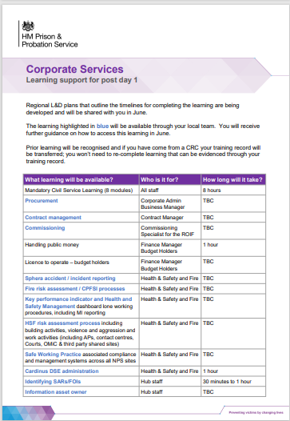
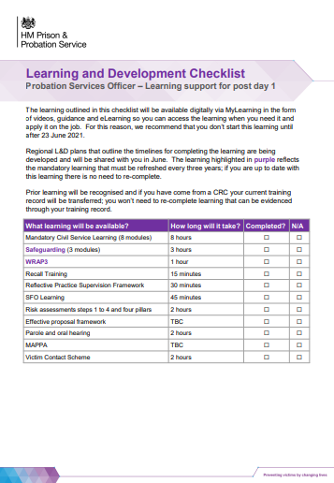
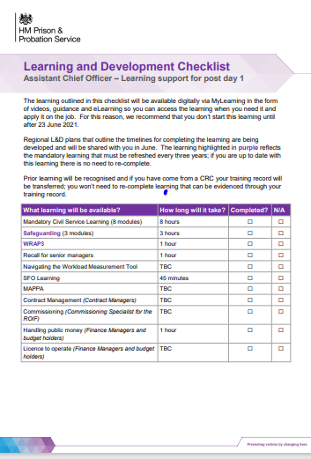
Probation Reform Programme: people workstream
Post transition learning pathways are now available
An overview of the post transfer learning offer, which includes learning to support the move to mixed caseloads, has now been made available to staff via the Welcome Hub.
There are differing Post Transition learning pathways for different roles. These pathways outline what learning you will need to undertake, post transition. Any previous learning that you have completed will be recognised, so you will only need to complete what is outstanding.
We’re changing the way learning is designed and delivered by implementing a new L&D model for the new Probation Service. This refreshed approach means we are making greater use of digital resources, e.g. FAQs, checklists, videos, etc., to enable you to access learning and support when it’s convenient for you, so you can learn at your own pace.
Learning pathways have been identified for Sentence Management, Interventions Management, Case Administration, Unpaid Work, Corporate Services, Resettlement roles and ACOs. The details of the learning can be found on the Welcome Hub here.
The learning materials will not be available until after transition.

Slide 36
Probation Reform Programme: people workstream
New communications and induction materials
A number of new communications and induction materials are now available on the Welcome Hub
Transferring staff induction checklist
What you can expect from your transfer email
Role alignment update for people who are not aligned to a role
Actions for transferring line managers
Understanding how your pension will change

Slide 37
CRC Staff only: Equality, Diversity, Inclusion & Belonging
CRC Staff Declaration of Equality Protected Characteristics
CRC staff: once you have access to your HR record on SOP,
please complete your staff declaration of equality protected characteristics
Attracting and retaining a diverse workforce that better reflects the diversity of our society and people on probation is one of the key objective of the PW EDI&B Action Plan
UK GDPR regulations have prevented diversity data from being provided to HMPPS as part of the CRC staff transition
The Staff induction checklist and line manager’s induction checklist on the Welcome Hub explains what you need to do and why this self declaration is important
Managers and senior leaders: please ensure staff are given time and support to update their details on SOP
Questions & Support
Regional Equality Managers and regional staff network leads can provide support if required
Monthly reports will be shared with RPDs
Any questions, please email the team at: PW.EDIB@justice.gov.uk

Slide 38
Region June areas of focus
Content to be inserted by region
[Region]

Slide 39
Team impacts
How might these changes affect our team?
Are we clear on our individual and team next steps and delivery?
How are we managing change? Do we need support?

Slide 40
Your feedback and questions
Please email [insert your region’s preferred transition / change Outlook account]

Slide 41
THANK YOU

