Slide 1
Ministry of Justice
Functional Leadership Onboarding Pack
Your Welcome Guide
May 2021

Slide 2



Contents
2
Page | Content
Page 3 | Welcome
Page 4 | MoJ Overview
Page 10 | MoJ Function Overview
Page 16 Page 22 Page 24 Page 26 | Induction Materials Other useful information Learning & Development Wellbeing, Health & Safety

Slide 3
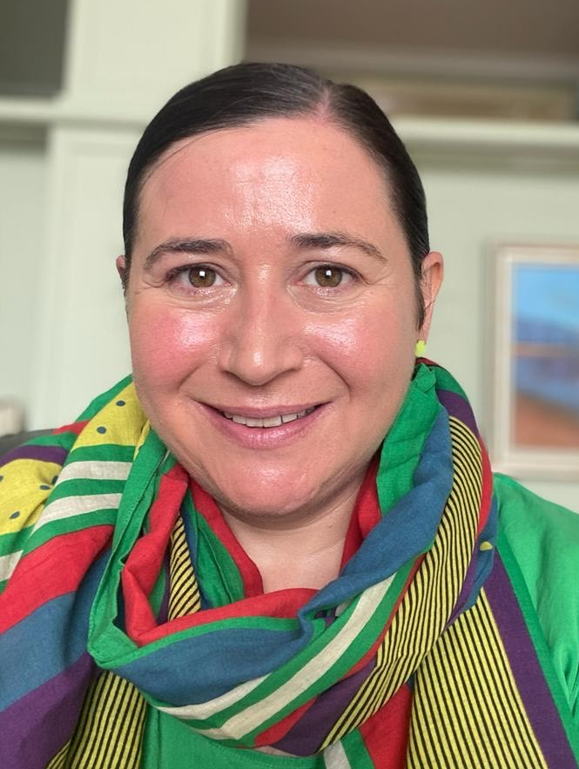
Welcome
to the Project Delivery Function
Message from Jenni Borg,
Interim Director of MoJ Project Delivery
Welcome to the Ministry of Justice and the Project Delivery Function.
Thank you for joining us with the Ministry of Justice Project Delivery Function. A project delivery role within the MoJ will see you joining one of the most ambitious reform agendas in Whitehall.
If we are to have safe and secure prisons, a modern and efficient courts system and a smaller, smarter organisation, the department needs to be great at delivering change.
Your role within the MoJ will be challenging, rewarding as well as an opportunity for you to contribute to some of the largest National projects currently taking place within the Civil Service.
The projects we have to offer will give you numerous opportunities to develop your skills.
This is an exciting time to be involved in projects.
Jenni

Slide 4

MoJ overview
The Justice Story
Our Ministers
Our Values
Our Executive Committee
MoJ strategy

Slide 5

7
The Justice Story
We are the Ministry of Justice.
We believe justice is the foundation of a safe, fair and prosperous society. It enables people to plan their futures, do business with confidence and go about their lives in safety. We are proud of our country’s reputation for justice. Its powerful principles run deep through our shared history and across our nation, underpinning how we all live and work together. Principles like the rule of law and the independence of our judiciary; accessibility, openness and fairness.
We are at the heart of the justice system, an organisation working together to bring the principles of justice to life for everyone in society. From our civil courts, tribunals and family law hearings, to criminal justice, prison and probation services. From seeing to it that sentences are served and offenders are encouraged to turn around their lives and become law-abiding citizens, keeping the public safe. From safeguarding victims and the vulnerable to regulating our legal services.
We believe the principles of justice are pivotal and we are steadfast in our shared commitment to uphold them. It is up to all of us across the justice system to use our experience and expertise, our empathy and judgement, our energy and determination, to bring to life the principles of justice, every day, without fear or favour.
We are the guardians of our justice system and of its global reputation for being fair, open and dynamic. Our justice system has led the world thanks to the strength of its institutions, its professionals and our common law itself. We will uphold this reputation by responding to changing times and attitudes, being bold, outward-looking, and committed to keeping the principles of justice alive and vibrant.
Together we create the circumstances for our country to prosper and for our citizens to thrive. This has never been more important than it is today. We live in an age of extraordinary change. New global opportunities and national responsibilities. New technologies, new lifestyles, new public needs. We recognise the challenges set by the pace and scale of this change.
We know that advances and innovations can help us make justice more accessible and resilient. We will advance the principles of justice, building a system that puts citizens and their needs first, inspiring our people and our partners to join together to find ever more effective ways to uphold the principles of justice. To make sure justice works for everyone today and in the future.
Protecting and advancing the principles of justice
We will deliver a modern courts and justice system; create a prison and probation service that reforms offenders; promote Global Britain and protect the rule of law; and create a transformed department that delivers excellent services.
Watch the animation and see how the Justice Story has been brought to life.

Slide 6


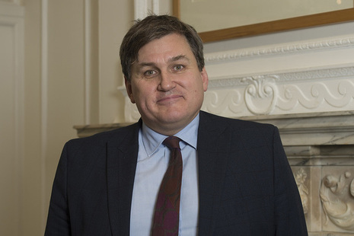



8
Our Ministers
Here are our Ministers in office, details on their responsibilities can be found on the Intranet.
Lord Chancellor and Secretary State for Justice
Robert Buckland QC MP
Kit Malthouse MP
Minister of State
Parliamentary under Secretary of State
Chris Philp MP
Alex Chalk MP
Alex Chalk
Parliamentary under Secretary of State
Lord David Wolfson of Tredegar, QC
Parliamentary under Secretary of State
Lucy Frazer QC MP

Slide 7
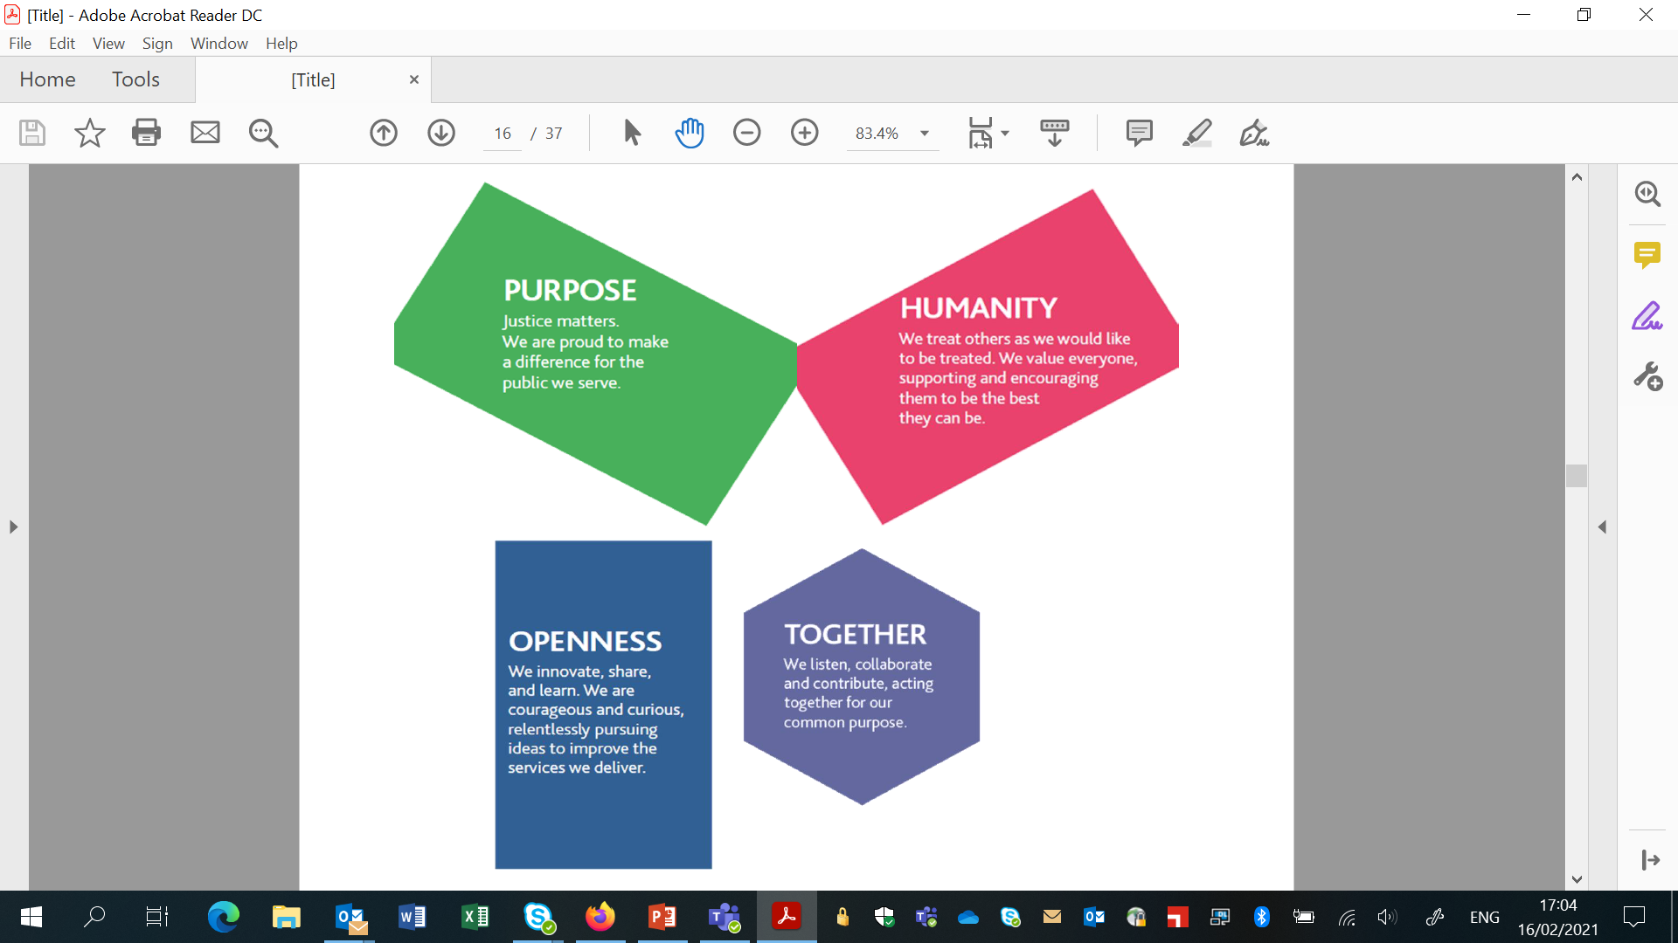
MoJ vision & core values
Our vision is to deliver a world-class justice system that works for everyone in our society and our values are how we bring principles of justice to life. We defined our values together – they can unite us as we fulfil our shared purpose. They will guide our actions as individuals and inspire us to be the best we can be, as we deliver excellent public services.
5
Civil Service Values
The Civil Service Code sets out our core values and the standards of behaviour expected of all Civil Servants in upholding these values:
‘integrity’ is putting the obligations of public service above your own personal interests
‘honesty’ is being truthful and open
‘objectivity’ is basing your advice and decisions on rigorous analysis of the evidence
‘impartiality’ is acting solely according to the merits of the case and serving equally well governments of different political persuasions
The Leadership Statement explicitly sets out the behaviour that is expected from all leaders across the Civil Service.

Slide 8
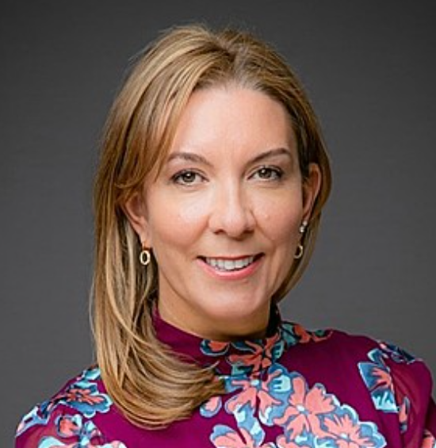


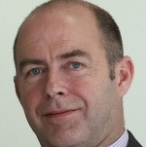

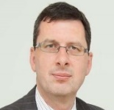


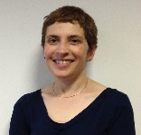
Our Executive Committee
Purpose and Authority
The Executive Committee is the senior executive leadership team for the Ministry of Justice. It also supports the Permanent Secretary in his duties as principal adviser to the Secretary of State and as the department’s Principal Accounting Officer. Its remit is:
- Develop and maintain the department’s strategy and plans for the future.
- Take a balanced view of the department’s approach to managing opportunity and risk.
- Prioritise and allocate financial and other resources.
- Provide assurance that internal controls operate properly.
- Provide support and assurance for major policies and projects.
- Develop and promote the department’s culture, values, approach to diversity & inclusion.
Full members:
Permanent Secretary (Chair)
Director General, Prisons
Chief Executive Officer, HM Prison & Probation Service
Interim Director General, Policy and Strategy Group
Director, MoJ Legal Advisers
Interim Chief Financial Officer
Director General, Probation and Wales
Interim CEO, HM Courts and Tribunals Service
Chief People Officer
Executive Committee
Antonia Romeo
Permanent Secretary
James McEwen
Interim Chief Financial Officer
Jerome Glass
Interim Director General
Policy and Strategy Group
Kevin Sadler
Acting Chief Executive
Her Majesty’s Courts and Tribunals Service
Jo Farrar
Second Permanent Secretary & Chief Executive
Her Majesty’s Prison and Probation Service
Phil Copple
Director General Prisons
Her Majesty’s Prison and Probation Service
Amy Rees
Director General, Probation and Wales
Her Majesty’s Prison and Probation Service
Mark Adam
Interim Chief People Officer
Naomi Mallick
Director
MoJ Legal Advisors

Slide 9
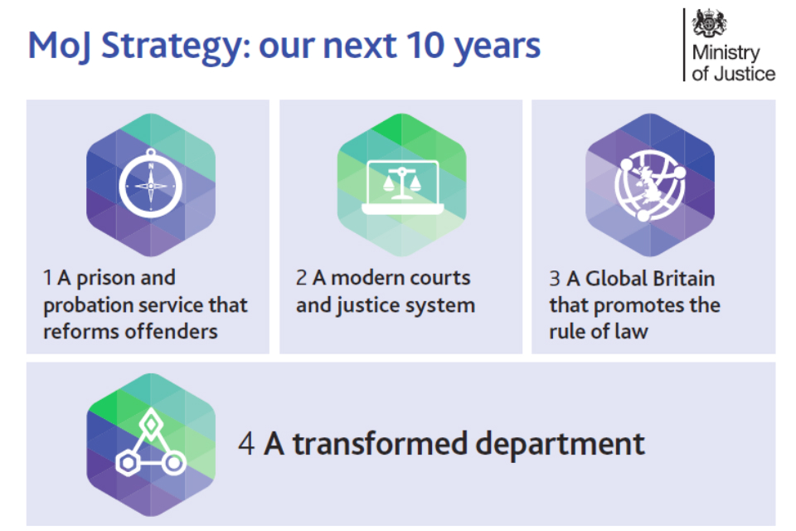
Strategy for the next 10 years
We are at the heart of the justice system, an organisation working together to bring the principles of justice to life for everyone in society. From our civil courts, tribunals and family law hearings, to criminal justice, prison and probation services. From seeing to it that sentences are served and offenders are encouraged to turn around their lives and become law-abiding citizens, keeping the public safe. From safeguarding victims and the vulnerable to regulating our legal services.
We will
- deliver a modern courts and justice system
- create a prison and probation service that reforms offenders
- promote Global Britain and protect the rule of law, and
- create a transformed department that delivers excellent services.

Slide 10
Function Overview
Senior Management Structure
Organogram
Function Business Plan

Slide 11
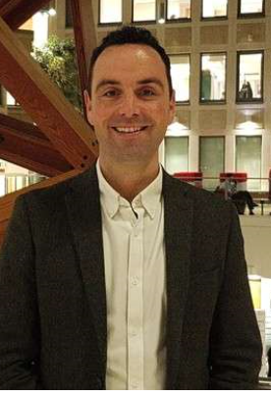
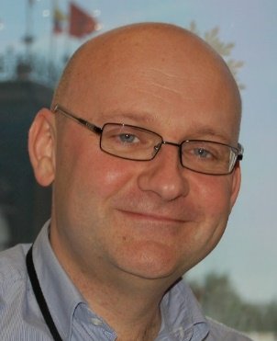
Head of Project Delivery Standards, Capability and Expertise
What do we do?
Engage and connect our profession across the both the department and government to build our identity
Give our professionals the tools they need to do the job well and develop a learning culture
Build professional capability across our Profession and provide unique and targeted learning opportunities
Deliver an efficient and effective service to the Head of Profession and wider Function
Develop and design opportunities to improve our professional maturity in collaboration with our people and others across government
Vacancy
Chief Operating Officer
What do we do?
Providing project professionals and project delivery services to the business
Recruiting and developing project professionals, enhancing their careers, and enrolment in the PD academy, Project Leadership Programme and Major Project Leadership Academy
Managing talent, succession and the deployment of professionals to projects
Managing the use of project delivery consultants and contractors
Kris Barnfield
Kris.Barnfield@Justice.gov.uk
07973 899435
Head of Portfolio and Assurance
What do we do?
We work alongside the department’s key projects as business partners to help them deliver and provide second line assurance. We constructively challenge plans, identify key blockages to delivery, and make sure that effective governance and controls are in place.
We have a whole portfolio perspective, so are uniquely positioned to help projects identify and manage risks and dependencies. We lead the keyholder assurance and gateway review processes so can give advice and help set up reviews. We can advise on the assurance that a project needs in order to help senior leaders make decisions, and can coordinate external assurance and approvals given our strong ties with the IPA.
We use our knowledge of the projects to provide assurance to senior leaders that these projects are on track to meet the MoJ’s strategic objectives and reporting on the performance of the departments’ projects portfolio.
We set the principles and standards for the successful delivery of change
Rob Nicholas
Robert.Nicholas@Justice.gov.uk
07973 728857

Slide 12


Project Delivery Function organisational chart
Jenni Borg
Interim Director
MoJ Project
Delivery Function
Lyndsay Rooney
Deputy Director Programme Director
Vacancy
Deputy Director
Head of Project Delivery Standards, Capability and Expertise
Kris Barnfield
Deputy Director
Chief Operating Officer
Rob Nicholas
Deputy Director
Head of Portfolio and Assurance
SCS
G6
G7
B
C
D
 | Sean Harvey Head of Professional Development
 | Kelly Jo-James Head of Communication and Capability
 | Carly Blake Head of Learning and Development
 | Sophie Crosse Professional Development Manager
 | Tania Pells Capability Manager
 | Anthony Gale Professional Development
 | Vacancy Project Manager
 | Mick Tubb Project Support Engagement
 | Jashandeep Sidhu Project Support
 | Chyna Loftus-Crawford Project Support
 | Louise Emmerson-Ducasse Head of Resourcing
 | Sam Boden Resourcing and Allocation Lead
 | Rachel Fullerton Business and Corporate Lead
 | Rachael Seymour Project Delivery Function Resourcing Manager
 | Rachael Hayton Project Delivery Function Business Manager
 | Hope Andryszewska PDFMO Resourcing Support Officer
 | Matilda Sloley PDFMO Business and Capability Support Officer
 | Chris Netherwood PDFMO Business Support Officer
 | Vacancy PDFMO Resourcing Support
 | Derrick Nti PDFMO Resourcing Support
 | Ingrid Boyd PDFMO Business Support
 | Mike Rae Head of Assurance
 | Vacancy Portfolio Manger
 | Vacancy Head of Portfolio Management Office
 | Helen Glassey Portfolio Business Partner (Corp)
 | Anita Skates Portfolio Business Partner (HMCTS)
 | Bettina Von-Hornhardt Assurance Manger
 | Rebecca Downer Portfolio Business Partner
 | Vacancy Approvals Lead
 | Amy Wardale Assurance Lead
 | Samantha Bowden Portfolio Analyst
 | Yilsen Ahmet Assurance and Approvals Co-Ordinator
 | Vacancy Office Manager

Slide 13






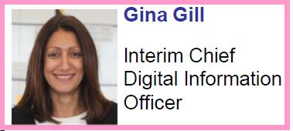






Group organisational chart
James McEwen
Interim Chief Financial Officer, and Head of the Government Finance Function
Strategy, Planning & Performance
Commercial and Contract Management
Project Delivery
Legal Aid Agency
Caroline Patterson
Interim Finance Director,
Strategy, Planning & Performance
Barry Hooper
Chief Commercial Officer
Jenni Borg
Interim Director, Project Delivery Function
Jane Harbottle
Interim CEO, LAA
Business Partnering
Digital and Technology
Risk and Assurance
Office of the Public Guardian, and Official Solicitor & Public Trustee
Lorna Maden
Finance Director,
Business Partnering
Mark Ripley
Risk and Assurance Director, Government Finance Function
Nick Goodwin
Public Guardian and CEO, OPG
Management and Control
Property
Departmental Operations Centre
Criminal Injuries Compensation Authority
Ian Haworth
Interim Finance Director,
Management & Control
Andy Mills
Chief Property Officer
Shaun McNally
Senior Responsible Owner - DOC
Linda Brown
CEO, CICA
Group information
The group is responsible for:
Finance
Digital and Technology
Risk and Assurance
Project Delivery Function
Commercial
Estates
LAA
OPG
CICA

Slide 14

Jenni Borg
Project Delivery Function Director (Interim)
Our Mission
We provide projects with the skills, tools, support, standards and guidance to succeed, and create an operating environment that lets them get on and deliver. We deploy project professionals to departmental change activity, and take actions to improve project performance. We provide second-line assurance to projects, including keyholder and gateway reviews, and act as a business partner to Senior Responsible Officers, providing constructive challenge and support. We provide a clear line of sight of project and portfolio performance to Investment Committee, Executive Committee and the Permanent Secretary
Our Vision
To secure and build the Ministry of Justice's reputation for excellence in project delivery.
We want to build on our success in delivering projects and use our influence to improve the quality of projects both across the Ministry of Justice and cross Government.
INSERT HERE
XXX
XXX
Creating vital new XXX
Keeping our XXXX
Provide modern, fit-for-purpose XXX
XXXX
XXXX
Improving efficiency and maximising value
Meeting user needs

Slide 15





Our Objectives
Set clear strategy and standards for excellence in project and programme delivery and provide the tools, targeted development and support for those running and delivering major projects.
Build and maintain our reputation as a place where people want to work, which actively supports and rewards individuals in developing their skills and capabilities to succeed in a career in project delivery. Providing the MoJ with access to high quality resources and expertise in delivering projects and programmes across all grades.
Evolve the right operating environment and model to optimise functional collaboration across the department to ensure projects and programmes are initiated, structured and resourced to increase chances of success and delivery. Engaging with the business at the earliest opportunity to improve organisational capability.
Provide appropriate levels of scrutiny, challenge, governance and assurance across the portfolio to improve chances of success and delivery and identify and escalate risks, issues and dependencies.
Advocate for positive transformational change including enhancing our use of data to drive up standards and performance.
XXX Priorities
XXX – Improve the MoJ’s XXX

Slide 16
Induction Materials
All information for you are on the following slides.

Slide 17




Your key Information
A mixture of tools and guidance have been provided to you to support your transition.
 | By 21st June you will have received new MoJ IT kit, SMART phones, access to our Intranet, SOP systems and Justice email accounts. This will allow access to email communications and the opportunity to start familiarising yourself with our key systems and learning. More information is set out here: Technology rollout – Welcome Hub (hmppsintranet.org.uk) Preliminary employee checks and security vetting will be completed before Day 1 of transfer. HRBP’s will work with areas of the business where any further actions are required following this stage. Further information including FAQ’s can be found here: Vetting – Welcome Hub (hmppsintranet.org.uk) The Welcome Hub induction pages cover some of the high level induction materials and information that you will need. This information is already available to all and widely used. The hub contains information on: Your Probation Service Induction Your MoJ Induction – this includes a corporate induction guide Your Civil Service induction The Welcome Hub contains a wealth of other information about the staff transfer and about the new Probation Service. The New Starter Checklist is available on the Welcome Hub to ensure you understand the important actions that they should complete before and after your transition. These are the actions that are relevant to you and doesn’t cover any actions that may be specific to your team.
Equipment
Employee checks & security vetting
Induction & information
Checklist of actions

Slide 18
Your key Information
A mixture of tools and guidance have been provided to you to support your transition.
 | All employees have access to SOP employee or manager self-service. SOP holds your absence records and personal details, such as emergency contacts and next of kin. It is a fast and accurate way to make pay claims for overtime or expenses. Line Managers can also process actions online via SOP such as absence, temporary promotion and changes of line management. Any diversity information entered is not visible to your line manager – it will remain confidential. You will be able to access SOP after transfer, using your Ministry of Justice technology. You can find guidance for how to log into SOP on myHub (on the Intranet) by searching for ‘SOP Log in and set up.’ myHub is an information portal which holds advice and guidance, such as job aids, process advice and forms used in conjunction with Shared Service transactions and SOP. myHub also includes ‘How To’ guidance and full contact details – telephone and email – for the SSCL Contact Centre and all transactional teams. You will be able access myhub here: https://hmpps.myhub.sscl.com/ when you receive your ministry of justice technology. Please familiarise yourself with it so you know where to go for information and we recommend we save it to your favourites.
SOP & MyHub
 | Should you need to travel for work purposes you can book rail, accommodation, air travel, car hire etc through Digital Travel Solution (DigiTS), our online travel booking system. You will need to register for an account using your work email address if you do not already have one, and you will need to know the correct Cost Centre Code. Your cost centre will vary with each assignment, the PDFMO can confirm this for you. .
Booking travel

Slide 19


Your key Information
A mixture of tools and guidance have been provided to you to support your transition.
 | Due to the current outbreak of COVID and the unprecedented times we are all living through, the position related to working from home continues to be updated in line with the Government's roadmap for lifting lockdown. You may wish to visit the COVID guidelines and familiarise yourself with the latest guidance and policies in place. Staff in the MoJ Project Delivery Function work flexibly following the Smarter Working principles. Our staff are based all over the country and colleagues regularly travel to different locations for their work. For a list of all MoJ buildings, including our 4 HQ buildings (102 Petty France, 10 South Colonnade (at Canary Wharf), Southern House (Croydon) and 5 Wellington Place (Leeds), and details of our Commuter Hubs (shared spaces in Government property where you can work from) visit our Buildings and Facilities web pages. The MoJ Project Delivery Function works flexibly and has multiple office locations – its current main HQ locations are: 10 South Colonnade, London – We are located on the 3rd floor 5 Wellington Place, Leeds – We are located on the 1st floor
Staff Locations
 | Before your arrival, arrangements would have been made to ensure you are added to the relevant ZZ email distribution lists – this will ensure you receive all appropriate team and corporate news and invites. If you think you have not been added please contact PDFMO@justice.gov.uk who will ensure that you are added straight away. The MoJ Project Delivery Function have various channels and ways to communicate information about what’s going on in the Function; Intranet PD Bulletin MS Teams Weekly Thoughts Email from Chief Operating Officer Project Delivery Monthly Stand Up .
Communication

Slide 20

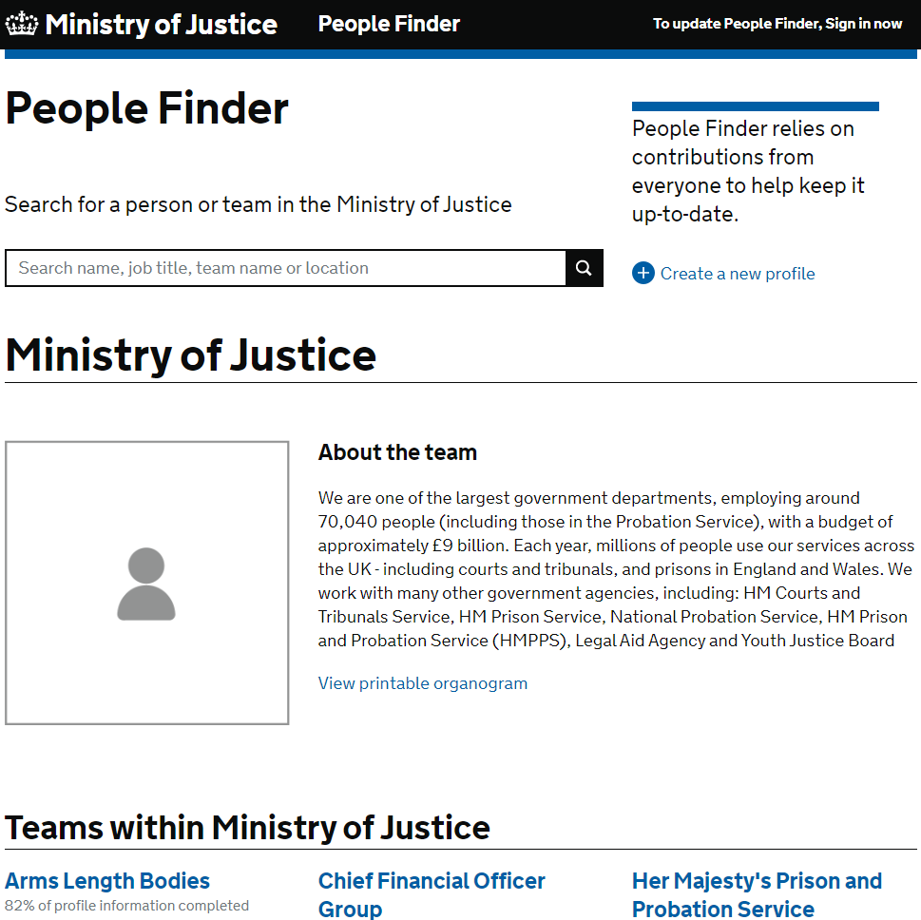
Your key Information
A mixture of tools and guidance have been provided to you to support your transition.
 | People Finder is a tool for MoJ family colleagues to be able to find and contact you. It is an enabling tool to support us to make connections and it is important that all staff keep their profiles updated. You can make changes here: https://peoplefinder.service.gov.uk/
People Finder

Slide 21
Your key Information
A mixture of tools and guidance have been provided to you to support your transition.
 | New email signature templates can be found on the Intranet
E-Mail Signature
To create your own email signature:
1. Edit the contact details in the right-hand column of the table above: give your name, job title, team name or other business area, your address, your work mobile phone number and/or your work landline number, and your working patterns (deleting options that are not applicable).
Also link to your People Finder profile: highlight ‘People Finder’, right-click, select ‘Hyperlink…’, enter your People Finder link into the Address field and click on OK. Visit People Finder to get the link to your own profile. Enter your name into the search box and click on your name to go to your profile. Once in your profile copy the URL and paste it into the hyperlink field. If you don’t yet have a People Finder profile you first need to create one.
2. Once your details have been added above, select the table which holds the signature by clicking on the crosshairs icon on the top left of the table (this appears when you hover the mouse over the table), and copy the table by selecting ‘Ctrl’ and ‘C’ on your keyboard.
3. Go to Outlook and on the Home ribbon click on ‘New Email’.
4. In the new email, on the Message ribbon click on the Signatures drop-down menu and select ‘Signatures…’
5. Click ‘New’ to create a new signature, type in a name for the signature and click on ‘OK’.
6. Right-click in the text field at the bottom of the Signatures and Stationery window and select Paste Options: Keep Source Formatting (the second icon from the left).
7. Click OK
8. To select the new email signature as the default for future emails, select it using the ‘New messages’ drop-down menu
9. Click OK

Slide 22
Useful Links to Important Information
National Agreement
Pension
Pay
Role Alignment process
Induction

Slide 23

Further information about the transfer that you may find useful
The Welcome Hub was created as a channel to enable the Probation Service to communicate with incoming staff before the 26th June 2021. It has been a popular resource with many staff having accessed it to date.
In particular we suggest you refer to the following information:
The staff transfer explained
Understanding the role alignment process
Understanding role alignment for corporate and support service staff
Understanding the National Agreement
Employee checks and security vetting
Pre-transfer learning requirements
Induction for incoming staff
Checklist of actions for staff
Actions for transferring line managers
Changes to pension
Understanding pay

Slide 24
Learning and Development
Learning and development
Mandatory training

Slide 25
Your key Information
A mixture of tools and guidance have been provided to you to support your transition.
 | The MoJ values learning and development and offers all employees a Minimum of 5 Days learning. You and your line manager should discuss your personal development at monthly touch point meetings and develop a learning plan using your Training Contract. Your line manager should also give you reasonable time to complete your training. We strongly encourage you to prioritise your development Some of you will already have myLearning accounts and you should continue to use those accounts. If you need to sign up for a new account, it is important that you DO NOT use your @justice email address but continue to use your current organisation emails to create the account. There is training that our organisation requires us to complete. The training is available on Civil Service Learning. If you don’t have an account already, you will need to create one using your work email address. You are required to complete the following online modules and refresh them yearly : (AI) Responsibility for Information Health & Safety Awareness for Managers or Health & Safety Awareness, for all Non-Managers Wellbeing, Resilience and Stress Basic Fire Awareness Equality and Diversity Essentials Counter Fraud, Bribery and Corruption Diversity & Inclusion
Learning

Slide 26
Wellbeing, Health and Safety
Health and Safety
Health and Safety Co-Ordinator
Emergency evacuations
First aid assistance
Employee Assistance
Occupational Health
Staff Wellbeing
Unions
Staff Networks
D&I
Useful Contacts

Slide 27


Your key Wellbeing Information
A mixture of tools and guidance have been provided to you to support your transition.
 | Please read and familiarise yourself with the Fire Health & Safety Policies. Local HMPPS Fire, Health and Safety Policies will apply to Establishments. The H&S Co-ordinator for you is your Line Manager. Should you have any queries relating to health and safety,, please email them.
Health & Safety
 | For details on emergency evacuations and in-house evacuations you should refer to the relevant building on the Buildings and Facilities web page. If you think you may need assistance during an emergency evacuation, please fill out a Personal Emergency Escape Plan (PEEP) and share it with your line manager straight away. This will detail the procedures for your safe evacuation. Details about accessing first aid assistance for the building you are based in can also be found on the Buildings and Facilities page. Please advise your line manager if you have a medical condition that may impact you at work, for example, if you suffer from allergies and carry an epi pen. Such conditions can be conveyed in written/electronic format as “Workplace Adjustment Passports” (WAP), and individuals can carry them forward between different jobs. The HMPPS and MoJ Employee Assistance provider (EAP) is PAM Assist. EAP services will continue to offer a wide range of support to staff including confidential advice on personal, social or work-related problems. Please visit the Intranet for further details. Relevant information on Occupational Health can be found on MyHub: Her Majesty's Prison and Probation Service | Occupational Health (HMPPS Connect) (sscl.com)
Emergency Evacuations
First Aid Assistance
Employee Assistance & Occupational Health

Slide 28

Your key Wellbeing Information
A mixture of tools and guidance have been provided to you to support your transition.
 | The MoJ aims to create a work environment that supports employee health and wellbeing. Please visit the MoJ's wellbeing pages to find out about the support that is on offer. You can find additional information about other benefits available to staff such as the ‘cycle to work’ scheme and deals on travel, food and entertainment here.
Staff wellbeing
 | Further information on the recognised Trade Unions can be found here: NPS: Learning about our Trade Unions – Welcome Hub (hmppsintranet.org.uk) An overview of all staff networks can be found here: MOJ and HMPPS staff networks – Welcome Hub (hmppsintranet.org.uk) MoJ is striving to build a world class organisation that is open and inclusive and truly values and celebrates the diversity of its workforce and can understand and serve the needs of the diverse society of which we are a part. This is regardless of social background, gender, age, ethnicity, sexual orientation, beliefs, disabilities or long-term illness or caring responsibilities. Our aim is to build a strong and successful workplace with a workforce that at every level reflects the diversity of the society in which we deliver our services. Further information can be found here: https://intranet.justice.gov.uk/guidance/equality-and-diversity/
Unions
Staff Networks
Diversity & Inclusion

Slide 29
Useful Contacts
Issue | Contact
Link to all SSCL contacts (HR, Finance etc.) | Ministry of Justice | Contacting Shared Services Connected Limited (SSCL)
FAQ | FAQs – Welcome Hub (hmppsintranet.org.uk)
Where can you direct questions, comments or concerns?
Please email:
PDFMO@justice.gov.uk

Slide 30
Staff Checklist
Checklist of actions for their first day and beyond
Check that you have received your MoJ equipment and that you are comfortable with accessing the intranet, SOP & MyHub – information on these systems is part of your central induction but it is always good to check.
Ensure you have access to any systems required to carry out your role
Ensure you are aware of your cost centre
Complete the workstation assessments if necessary
Allocate time to read your teams Corporate Services Onboarding Pack & complete any essential learning
Ensure your New Starter Induction Checklist is completed within your initial induction period (Welcome Hub will host the latest staff checklist)
If you are an EU National and have not applied for the pre-settled/settled status, to do so before 30 June 2021 to be able to continue to live and work in the UK.

Slide 31



