Slide 1
Ministry of Justice
Functional Leadership Onboarding Pack
Your Welcome Guide
May 2021

Slide 2



Contents
2
Page | Content
Page 3 | Welcome
Page 4 | MoJ Overview
Page 10 | MoJ Property Function Overview
Page 17 Page 24 Page 26 Page 28 | Induction Materials Other useful information Learning & Development Wellbeing, Health & Safety

Slide 3
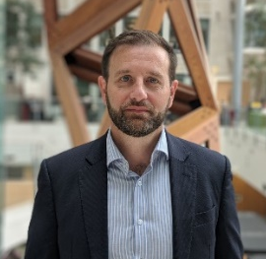

Welcome
3
Message from Andy Mills, Chief Property Officer
Hello, and welcome to the MoJ. The MoJ Property Function is a customer focused organisation that exists to enable our customers to perform to their very best. As a function we are responsible for managing one of the largest, most diverse and complex estates in Government – this is hosted by the Ministry of Justice, and includes the estate of the Probation Service, the Home Office, MoJ HQ, Arm’s Length Bodies, Prisons, and now Prisons Facilities Management, too.
We provide specialist services including facilities management, health & safety, fire safety and security, technical design expertise, and sustainability. We also have business management teams who work in support of the entire Function. Each of our partners is supported by Account Management teams; we are responsible for a great deal - our portfolio consists of properties valued at £8.5bn for the MoJ alone.
We work closely with our cluster partners and the Government Property Agency, encouraging healthy collaboration and driving a professional service delivery approach. We strive for professional membership in our Function, encouraging our people to join the Government Property Profession.
We continue to deliver new ways of working across the estates cluster – leading on the scale and pace of activity for central government – proposing ways to achieve, and then providing, more dynamic and flexible work spaces, while driving down the cost of the estate.
I hope that this Welcome Guide will help you settle into the Function and provide simple access to detail you may require. I look forward to meeting you and to us working together.

Slide 4

MoJ overview
The Justice Story
Our Ministers
Our Values
Our Executive Committee
MoJ strategy

Slide 5

7
The Justice Story
We are the Ministry of Justice.
We believe justice is the foundation of a safe, fair and prosperous society. It enables people to plan their futures, do business with confidence and go about their lives in safety. We are proud of our country’s reputation for justice. Its powerful principles run deep through our shared history and across our nation, underpinning how we all live and work together. Principles like the rule of law and the independence of our judiciary; accessibility, openness and fairness.
We are at the heart of the justice system, an organisation working together to bring the principles of justice to life for everyone in society. From our civil courts, tribunals and family law hearings, to criminal justice, prison and probation services. From seeing to it that sentences are served and offenders are encouraged to turn around their lives and become law-abiding citizens, keeping the public safe. From safeguarding victims and the vulnerable to regulating our legal services.
We believe the principles of justice are pivotal and we are steadfast in our shared commitment to uphold them. It is up to all of us across the justice system to use our experience and expertise, our empathy and judgement, our energy and determination, to bring to life the principles of justice, every day, without fear or favour.
We are the guardians of our justice system and of its global reputation for being fair, open and dynamic. Our justice system has led the world thanks to the strength of its institutions, its professionals and our common law itself. We will uphold this reputation by responding to changing times and attitudes, being bold, outward-looking, and committed to keeping the principles of justice alive and vibrant.
Together we create the circumstances for our country to prosper and for our citizens to thrive. This has never been more important than it is today. We live in an age of extraordinary change. New global opportunities and national responsibilities. New technologies, new lifestyles, new public needs. We recognise the challenges set by the pace and scale of this change.
We know that advances and innovations can help us make justice more accessible and resilient. We will advance the principles of justice, building a system that puts citizens and their needs first, inspiring our people and our partners to join together to find ever more effective ways to uphold the principles of justice. To make sure justice works for everyone today and in the future.
Protecting and advancing the principles of justice
We will deliver a modern courts and justice system; create a prison and probation service that reforms offenders; promote Global Britain and protect the rule of law; and create a transformed department that delivers excellent services.
Watch the animation and see how the Justice Story has been brought to life.

Slide 6


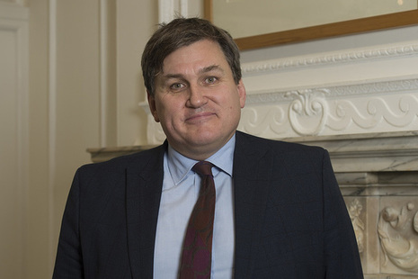



8
Our Ministers
Here are our Ministers in office, details on their responsibilities can be found on the Intranet.
Lord Chancellor and Secretary State for Justice
Robert Buckland QC MP
Kit Malthouse MP
Minister of State
Parliamentary under Secretary of State
Chris Philp MP
Alex Chalk MP
Alex Chalk
Parliamentary under Secretary of State
Lord David Wolfson of Tredegar, QC
Parliamentary under Secretary of State
Lucy Frazer QC MP

Slide 7
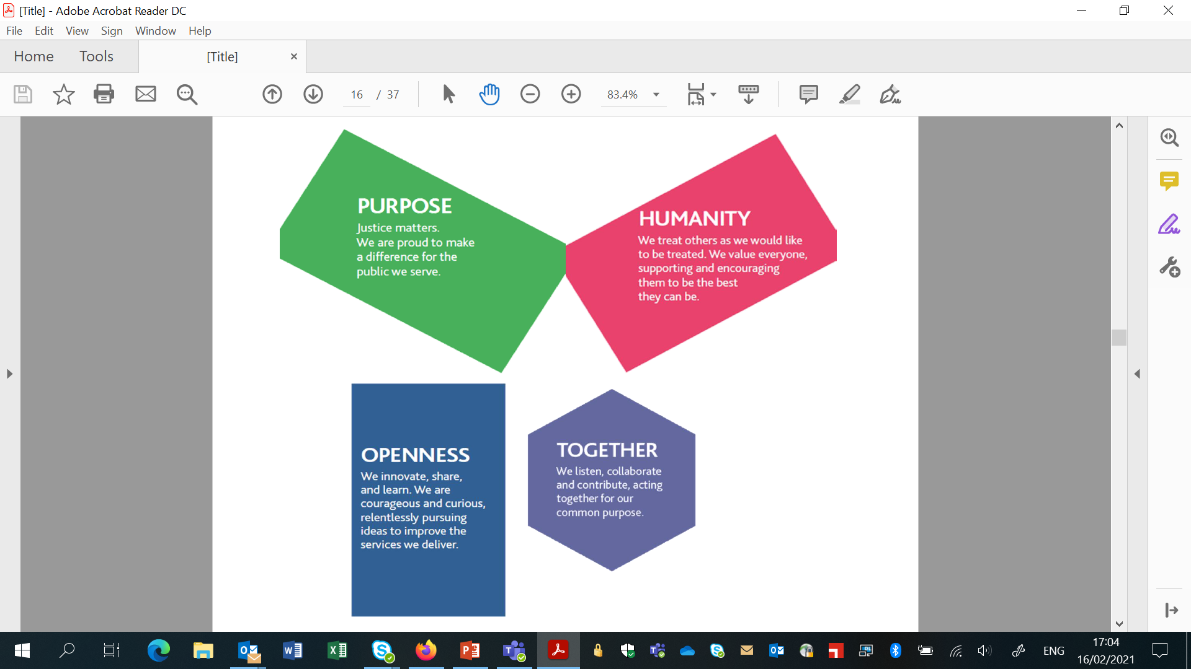
MoJ vision & core values
Our vision is to deliver a world-class justice system that works for everyone in our society and our values are how we bring principles of justice to life. We defined our values together – they can unite us as we fulfil our shared purpose. They will guide our actions as individuals and inspire us to be the best we can be, as we deliver excellent public services.
5
Civil Service Values
The Civil Service Code sets out our core values and the standards of behaviour expected of all Civil Servants in upholding these values:
‘integrity’ is putting the obligations of public service above your own personal interests
‘honesty’ is being truthful and open
‘objectivity’ is basing your advice and decisions on rigorous analysis of the evidence
‘impartiality’ is acting solely according to the merits of the case and serving equally well governments of different political persuasions
The Leadership Statement explicitly sets out the behaviour that is expected from all leaders across the Civil Service.

Slide 8
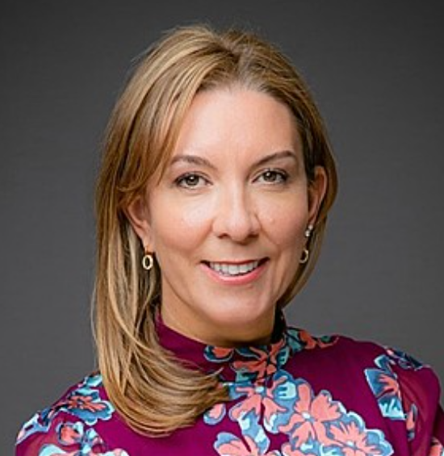


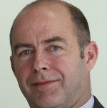

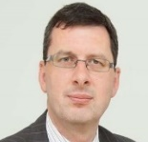
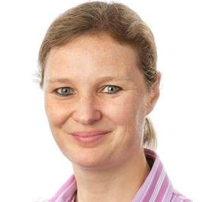

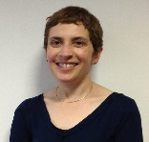
Our Executive Committee
Purpose and Authority
The Executive Committee is the senior executive leadership team for the Ministry of Justice. It also supports the Permanent Secretary in his duties as principal adviser to the Secretary of State and as the department’s Principal Accounting Officer. Its remit is:
- Develop and maintain the department’s strategy and plans for the future.
- Take a balanced view of the department’s approach to managing opportunity and risk.
- Prioritise and allocate financial and other resources.
- Provide assurance that internal controls operate properly.
- Provide support and assurance for major policies and projects.
- Develop and promote the department’s culture, values, approach to diversity & inclusion.
Full members:
Permanent Secretary (Chair)
Director General, Prisons
Chief Executive Officer, HM Prison & Probation Service
Interim Director General, Policy and Strategy Group
Director, MoJ Legal Advisers
Interim Chief Financial Officer
Director General, Probation and Wales
Interim CEO, HM Courts and Tribunals Service
Chief People Officer
Executive Committee
Antonia Romeo
Permanent Secretary
James McEwen
Interim Chief Financial Officer
Jerome Glass
Interim Director General
Policy and Strategy Group
Kevin Sadler
Acting Chief Executive
Her Majesty’s Courts and Tribunals Service
Jo Farrar
Second Permanent Secretary & Chief Executive
Her Majesty’s Prison and Probation Service
Phil Copple
Director General Prisons
Her Majesty’s Prison and Probation Service
Amy Rees
Director General, Probation and Wales
Her Majesty’s Prison and Probation Service
Mark Adam
Interim Chief People Officer
Naomi Mallick
Director
MoJ Legal Advisors

Slide 9
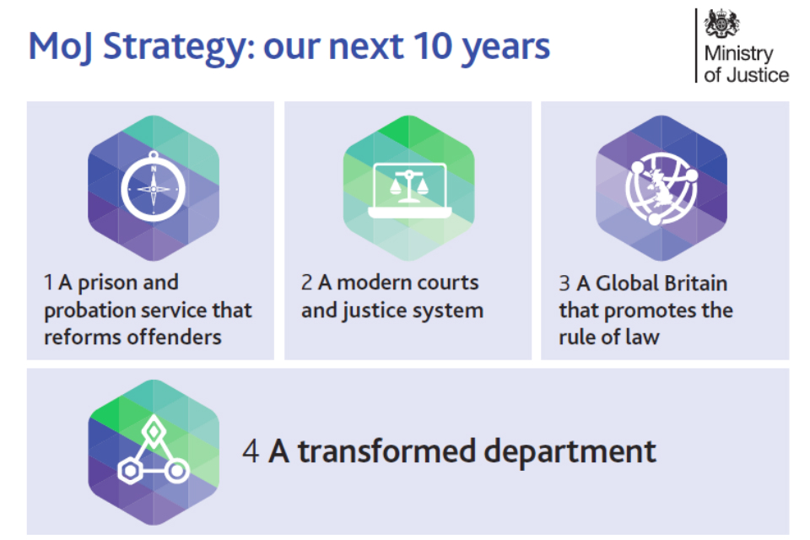
Strategy for the next 10 years
We are at the heart of the justice system, an organisation working together to bring the principles of justice to life for everyone in society. From our civil courts, tribunals and family law hearings, to criminal justice, prison and probation services. From seeing to it that sentences are served and offenders are encouraged to turn around their lives and become law-abiding citizens, keeping the public safe. From safeguarding victims and the vulnerable to regulating our legal services.
We will
- deliver a modern courts and justice system
- create a prison and probation service that reforms offenders
- promote Global Britain and protect the rule of law, and
- create a transformed department that delivers excellent services.

Slide 10
MoJ Property Function Overview
Senior Management Team (SMT)
High Level Organisation Chart
MoJ Property Function Business Plan 2020/21
MoJ Property Objectives – project priorities

Slide 11
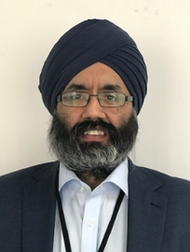
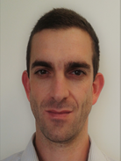
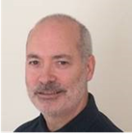
Senior Management Team (SMT)
The MoJ Property Function, sits within the (CFOG) of the Ministry of Justice. Andy Mills has overall responsibility for the entire MoJ Property Function which is made up of the following areas:
 | Suky Atwal is the Director for the Prisons Infrastructure Team which is responsible for the delivery of new prisons, 10k and 3k programmes, the Rapid Cell Deployment Plan, Modern Methods of Construction, and the Technical Standards Team. As an area that delivers construction projects the team focus on Health & Safety, Time, Quality and Cost. This area works closely with HMPPS and broadly with other government departments on Construction Strategy.
 | Belinda Mather-Derrick leads the Prisons Account Management team who provide support to HMPPS across a number of different areas. They provide a management service for the custodial estate outside the wire as well as acting as a conduit between HMPPS strategy and MoJ programme delivery to effectively support the services that MoJ Property delivers to HMPPS as part of the Property function.
 | Carl von Reibnitz leads our Sustainability Team, which is responsible for embedding environmental sustainability across the MoJ and its agencies’ business areas; coordinating activity to deliver Net Zero Carbon and Greening Government Commitments; and holding the organisation to account for its environmental performance.
 | Chief Operating Officer – Vacant. Leads Corporate Operations for the Directorate including finance, planning & performance, risk and our people agenda, ensuring that the function is plugged into the wider corporate agenda. Will also be responsible for MoJ Account Management including Probation, CICA, LAA, OPG, HQ and Judges Lodgings.
 | Tony Fletcher leads project delivery and is responsible for the design, development and timely delivery of capital maintenance, investment and change programmes, portfolios and projects that meet the objectives and requirements of the business areas across the MoJ family: probation, prisons, courts and Home Office assets.

Slide 12

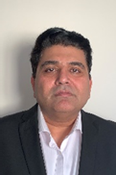



Senior Management Team (SMT) cont.
 | Rebecca Scaglione is the interim lead for capital construction for the 10k and 3k Expansion Programmes and oversees the Technical Standards Team. Her project teams deliver additional capacity in existing prisons overseeing house block builds, major refurbishments, and the expansion of the open prison and the female estate. The Technical Standards team sets the standards for construction in the custodial estate and is developing our future construction strategy including BIM and MMC.
 | Israr Shah, Director of Facilities (Prisons) is responsible for overseeing the prisons FM transfer into the MoJ on 2 April 2021 and will have overall responsibility for FM delivery in prisons thereafter. Israr leads on the formulation of the next generation of FM service delivery models (to deliver FM services to beyond the expiry of the current FM models/contracts in 2023).
 | Keith Maddison, Director of Facilities Management (Probation, MoJ HQs and Home Office) is responsible for the maintenance of the Probation, MoJ HQs and Home Office estate providing the contract management for the hard (maintenance) and soft (catering and cleaning) facilities management service to over 15 other government departments. He is also responsible for Corporate Health and Safety across the Ministry of Justice estate. Jo Weaver leads the Directorate’s people agenda, and is responsible for recruitment and retention, workforce information and planning, diversity and inclusion, staff engagement and wellbeing, and learning and development. Additionally, in leading the Chief Property Officer's team, she provides strategic leadership to the Office team ensuring key stakeholders in MoJ, partner organisations and staff within the Directorate have clarity related to the role of the Directorate, the People Team, and our key priorities.
Chris Ollier leads MoJ’s Estates Shared Service to the Home Office, its Agencies and ALBs; including developing estates solutions to drive value, meet business need and respond to the Government Estates
Strategy; and overseeing the full range of property services and performance reporting for Home Office.
To view the complete MoJ Property organogram chart, please visit our Property Trello Board. You will need to register for an account using your work email address. Please note, Trello is only accessible through the Firefox browser.

Slide 13
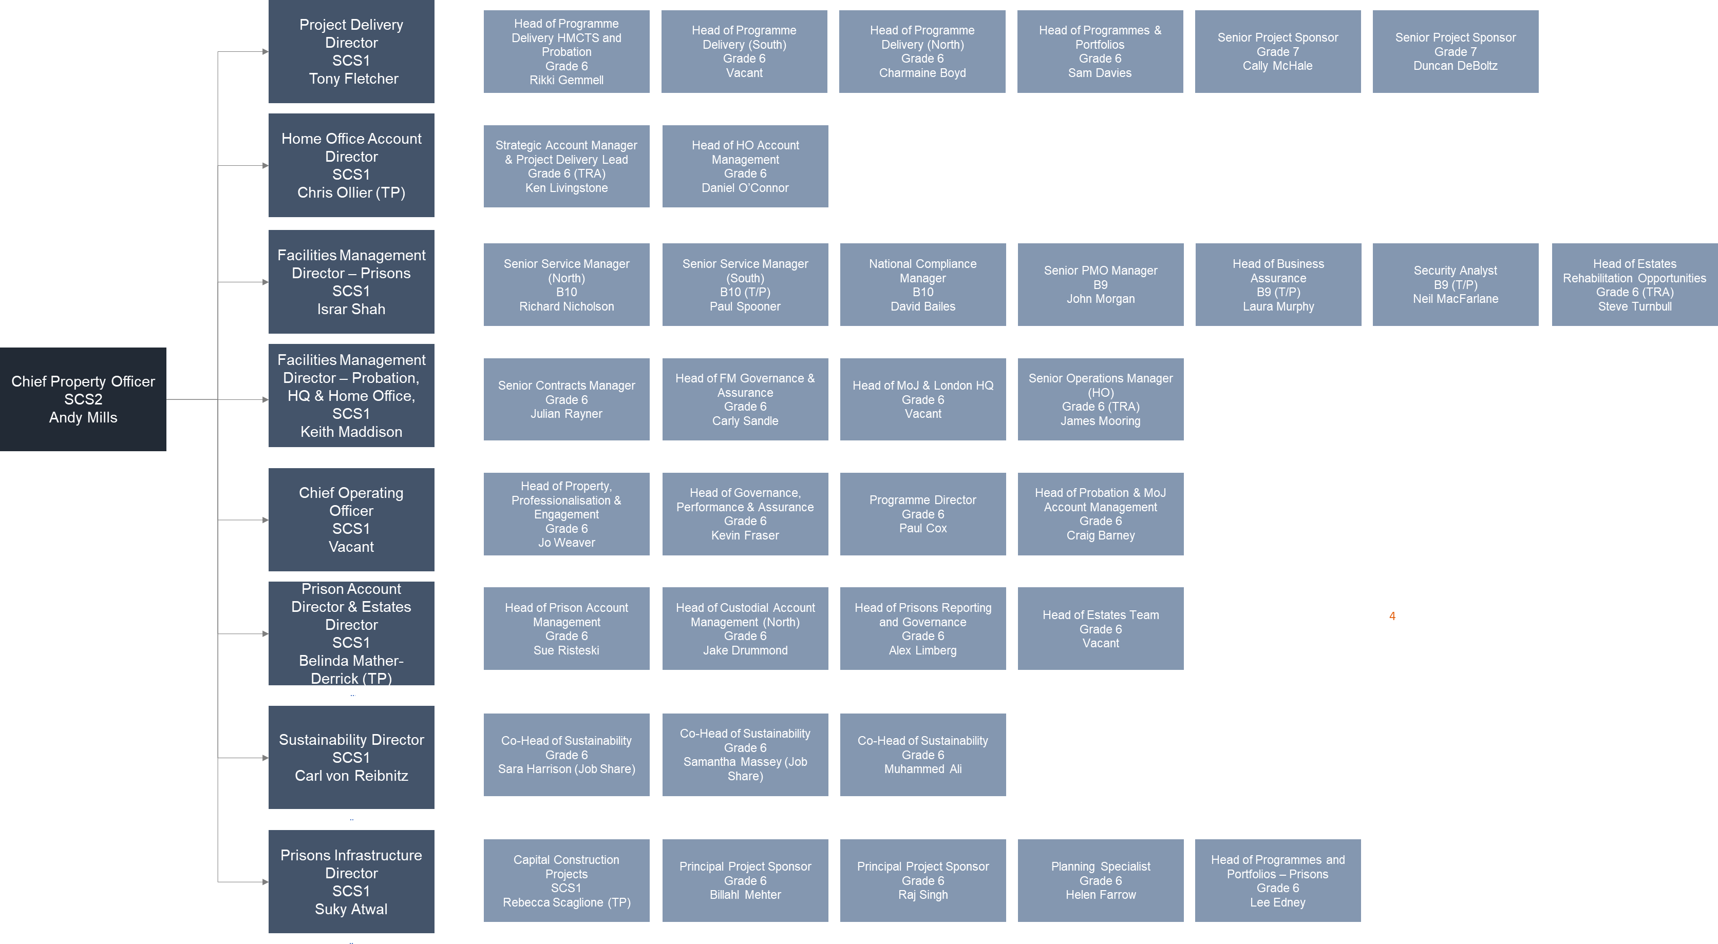
High Level Organisation Chart

Slide 14

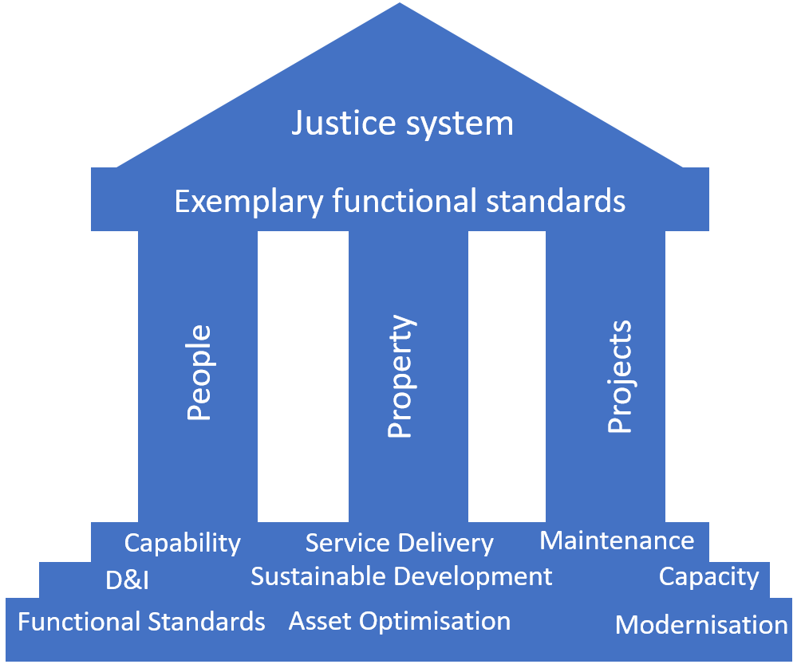

Business Plan 2020-21 (2021/22 Plan being prepared now)
Chief Finance Officer Group
Property (Andy Mills)
Mission Statement
We manage the second largest estate in government, providing a range of property services including environmental sustainability, property management, project delivery, facilities management, fire, health and safety, business continuity, and asset disposal. We work in functional partnership across a diverse customer base, including HMPPS, HMCTS, LAA, OPG, CICA and a range of ALBs. We also provide property services to the Home Office.
Our Vision
Our vision is to build a government leading property function, where our customers benefit from exemplary standards of service and where our people thrive and progress in a diverse and inclusive culture based on wellbeing, professionalisation, innovation and looking out for one another.
Our Strategy
We have three key pillars that underpin our vision – People, Property and Projects. Our strategy directly supports the MoJ Departmental and cross-government priorities. We are also committed to achieving our full potential by delivering the CFOG people, diversity and capability objectives. We have six key priorities
which set out what we need to continue to deliver in 2020/21 and what we need to change to achieve our vision:
Capacity
Maintenance
Modernisation
Creating vital new capacity through investment
Keeping our property portfolio compliant
Provide modern, fit-for-purpose accommodation
Sustainability
Asset Optimisation
Service Delivery
Improve the MoJ’s environmental sustainability
Improving efficiency and maximising value
Meeting user needs

Slide 15





Our Objectives
Project Priorities
Capacity – Creating vital new capacity through investment
 | Construct two new prisons at Wellingborough and Glen Parva |  | Feasibility and design of new prison at Full Sutton
 | Feasibility and agree location of three new prisons |  | Increase capacity in the female Approved Premises estate, focussing on areas with no current provision
 | Deliver an additional 200 Approved Premises beds by 2023 |  | Support HMCTS to better utilise its estate
Maintenance – Keeping our property portfolio compliant
 | Maintain the quality and functionality of our asset |  | Provide services to our users
Modernisation – Provide modern, fit-for-purpose accommodation
 | Support Probation Colleagues in delivering a new Unified Model for Offender Management |  | Improve the Branston Registry to provide increased capacity and a more productive working environment for staff
 | Accommodation for the newly established Independent Monitoring Authority |  | Relocate the Office of the Official Solicitor and Public Trustee
Property Priorities
Sustainability – Improve the MoJ’s environmental sustainability
 | Deliver the 2025 Greening Government Commitment targets |  | Continue to embed Environmental Sustainability across MoJ
 | Net Zero Carbon by 2050 and de-carbonise heat by 50% by 2032 |  | Fully implement MoJ’s BREEAM Policy and baseline MoJ’s Biodiversity and Natural capital

Slide 16






Asset Optimisation – Improving efficiency and maximising value
 | Transfer agreed office assets to the Government Property Agency |  | Enable efficient and effective use of our office space
 | Dispose of Reading prison |  | Design new ways of working in terms of how, where and when we work
 | Review the prison estate outside the wire as well as our heritage estate both in and outside the wire – Hewell Grange being our most costly Heritage asset
Service Delivery – Meeting user needs
 | HMPPS FM functional leadership |  | Increase user satisfaction
 | Appropriate health and safety guidance in a post-COVID19 estate
Note:
A new 21/22 business plan is imminent.

Slide 17
Induction Materials
All information for you are on the following slides.

Slide 18




Your key Information
A mixture of tools and guidance have been provided to you to support your transition.
 | By 21st June you will have received new MoJ IT kit, SMART phones, access to our Intranet, SOP systems and Justice email accounts. This will allow access to email communications and the opportunity to start familiarising yourself with our key systems and learning. More information is set out here: Technology rollout – Welcome Hub (hmppsintranet.org.uk) Preliminary employee checks and security vetting will be completed before Day 1 of transfer. HRBP’s will work with areas of the business where any further actions are required following this stage. Further information including FAQ’s can be found here: Vetting – Welcome Hub (hmppsintranet.org.uk) The Welcome Hub induction pages cover some of the high level induction materials and information that you will need. This information is already available to all and widely used. The hub contains information on: Your Probation Service Induction Your MoJ Induction – this includes a corporate induction guide Your Civil Service induction The Welcome Hub contains a wealth of other information about the staff transfer and about the new Probation Service. The New Starter Checklist is available on the Welcome Hub to ensure you understand the important actions that they should complete before and after your transition. These are the actions that are relevant to you and doesn’t cover any actions that may be specific to your team.
Equipment
Employee checks & security vetting
Induction & information
Checklist of actions

Slide 19
Your key Information
A mixture of tools and guidance have been provided to you to support your transition.
 | All employees have access to SOP employee or manager self-service. SOP holds your absence records and personal details, such as emergency contacts and next of kin. It is a fast and accurate way to make pay claims for overtime or expenses. Line Managers can also process actions online via SOP such as absence, temporary promotion and changes of line management. Any diversity information entered is not visible to your line manager – it will remain confidential. You will be able to access SOP after transfer, using your Ministry of Justice technology. You can find guidance for how to log into SOP on myHub (on the Intranet) by searching for ‘SOP Log in and set up.’ myHub is an information portal which holds advice and guidance, such as job aids, process advice and forms used in conjunction with Shared Service transactions and SOP. myHub also includes ‘How To’ guidance and full contact details – telephone and email – for the SSCL Contact Centre and all transactional teams. You will be able access myhub here: https://hmpps.myhub.sscl.com/ when you receive your ministry of justice technology. Please familiarise yourself with it so you know where to go for information and we recommend we save it to your favourites.
SOP & MyHub
 | Should you need to travel for work purposes you can book rail, accommodation, air travel, car hire etc through Digital Travel Solution (DigiTS), our online travel booking system. You will need to register for an account using your work email address if you do not already have one, and you will need to know the correct Cost Centre Code – 10208045 .
Booking travel

Slide 20


Your key Information
A mixture of tools and guidance have been provided to you to support your transition.
 | Due to the current outbreak of COVID and the unprecedented times we are all living through, the position related to working from home continues to be updated in line with the Government's roadmap for lifting lockdown. You may wish to visit the COVID guidelines and familiarise yourself with the latest guidance and policies in place. Staff in the MoJ Property function work flexibly following the Smarter Working principles. Our staff are based all over the country and colleagues regularly travel to different locations for their work. For a list of all MoJ buildings, including our 4 HQ buildings (102 Petty France, 10 South Colonnade (at Canary Wharf), Southern House (Croydon) and 5 Wellington Place (Leeds), and details of our Commuter Hubs (shared spaces in Government property where you can work from) visit our Buildings and Facilities web pages. The MoJ Property Directorate works flexibly and has multiple office locations – its current main HQ locations are: 102 Petty France, London - We are located on the 10th floor, in the area outside room 10.41. 10 South Colonnade, Canary Wharf, London - We are located on the 3rd floor near room 3.14.
Staff Locations
 | Before your arrival, arrangements would have been made to ensure you are added to the relevant ZZ email distribution lists – this will ensure you receive all appropriate team and corporate news and invites. If you think you have not been added please contact Michelle Mararike. who will ensure that you are added straight away. The MoJ Property function have various channels and ways to communicate information about what’s going on in the Function; The MoJ Property Function Trello Board The Chief Property Officer’s Weekly Blog MoJ Property Function Huddle Events MoJ Property Function Yearbook .
Communication

Slide 21
Communications
The MoJ Property Function have various channels and ways to communicate information about what’s going on in the Function;
The MoJ Property Function Trello Board
  Trello is an online platform which is updated regularly with all information relating to Property, MoJ and beyond, including corporate news, the Function organogram, cost centre codes, business plan, health and safety news, etc.
The Chief Property Officer’s Weekly Blog
  This is Andy’s reflection on the working week, providing updates to Property colleagues on everything from corporate news, to learning and development events, recruitment opportunities, staff news and more. Andy’s blogs are also published to Trello.
MoJ Property Function Huddle Events
  A meeting for the entire Function where we talk about corporate news, learning and development opportunities, wellbeing issues etc and often have guest speakers join us, too. These meetings were initiated after the first pandemic-related lockdown, with a more informal approach – to encourage conversations around COVID-19, and as a change to talk about our working from home experience and more. Following its success, we have continued these meetings. You can join the meeting via MS Teams (voice or video) and the meeting is recorded, in case you miss the event on the day.
MoJ Property Function Yearbook
  The Function Yearbook is published quarterly and celebrates the hard work and successes of our Function and includes case studies from across our teams. It provides a spotlight on our well-deserving unsung heroes, as well as other articles such as “A Focus On…” and “You Said, We Did”. Previous editions can be found on Trello.

Slide 22

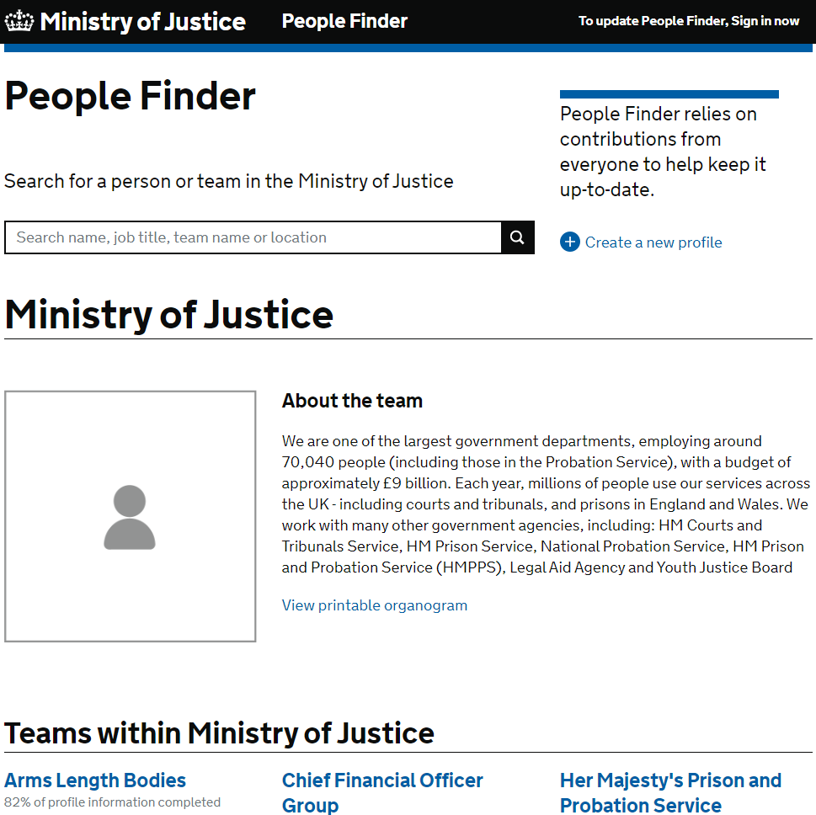
Your key Information
A mixture of tools and guidance have been provided to you to support your transition.
 | People Finder is a tool for MoJ family colleagues to be able to find and contact you. It is an enabling tool to support us to make connections and it is important that all staff keep their profiles updated. You can make changes here: https://peoplefinder.service.gov.uk/
People Finder

Slide 23
Your key Information
A mixture of tools and guidance have been provided to you to support your transition.
 | New email signature templates can be found on the Intranet
E-Mail Signature
To create your own email signature:
1. Edit the contact details in the right-hand column of the table above: give your name, job title, team name or other business area, your address, your work mobile phone number and/or your work landline number, and your working patterns (deleting options that are not applicable).
Also link to your People Finder profile: highlight ‘People Finder’, right-click, select ‘Hyperlink…’, enter your People Finder link into the Address field and click on OK. Visit People Finder to get the link to your own profile. Enter your name into the search box and click on your name to go to your profile. Once in your profile copy the URL and paste it into the hyperlink field. If you don’t yet have a People Finder profile you first need to create one.
2. Once your details have been added above, select the table which holds the signature by clicking on the crosshairs icon on the top left of the table (this appears when you hover the mouse over the table), and copy the table by selecting ‘Ctrl’ and ‘C’ on your keyboard.
3. Go to Outlook and on the Home ribbon click on ‘New Email’.
4. In the new email, on the Message ribbon click on the Signatures drop-down menu and select ‘Signatures…’
5. Click ‘New’ to create a new signature, type in a name for the signature and click on ‘OK’.
6. Right-click in the text field at the bottom of the Signatures and Stationery window and select Paste Options: Keep Source Formatting (the second icon from the left).
7. Click OK
8. To select the new email signature as the default for future emails, select it using the ‘New messages’ drop-down menu
9. Click OK

Slide 24
Useful Links to Important Information
National Agreement
Pension
Pay
Role Alignment process
Induction

Slide 25

Further information about the transfer that you may find useful
The Welcome Hub was created as a channel to enable the Probation Service to communicate with incoming staff before the 26th June 2021. It has been a popular resource with many staff having accessed it to date.
In particular we suggest you refer to the following information:
The staff transfer explained
Understanding the role alignment process
Understanding role alignment for corporate and support service staff
Understanding the National Agreement
Employee checks and security vetting
Pre-transfer learning requirements
Induction for incoming staff
Checklist of actions for staff
Actions for transferring line managers
Changes to pension
Understanding pay

Slide 26
Learning and Development
Learning and development
Mandatory training

Slide 27
Your key Information
A mixture of tools and guidance have been provided to you to support your transition.
 | The MoJ values learning and development and offers all employees a Minimum of 5 Days learning. You and your line manager should discuss your personal development at monthly touch point meetings and develop a learning plan using your Training Contract. Your line manager should also give you reasonable time to complete your training. We strongly encourage you to prioritise your development Some of you will already have myLearning accounts and you should continue to use those accounts. If you need to sign up for a new account, it is important that you DO NOT use your @justice email address but continue to use your current organisation emails to create the account. There is training that our organisation requires us to complete. The training is available on Civil Service Learning. If you don’t have an account already, you will need to create one using your work email address. You are required to complete the following online modules and refresh them yearly : (AI) Responsibility for Information Health & Safety Awareness for Managers or Health & Safety Awareness, for all Non-Managers Wellbeing, Resilience and Stress Basic Fire Awareness Equality and Diversity Essentials Counter Fraud, Bribery and Corruption Diversity & Inclusion
Learning

Slide 28
Wellbeing, Health and Safety
Health and Safety
Health and Safety Co-Ordinator
Emergency evacuations
First aid assistance
Employee Assistance
Occupational Health
Staff Wellbeing
Unions
Staff Networks
D&I
Useful Contacts

Slide 29


Your key Wellbeing Information
A mixture of tools and guidance have been provided to you to support your transition.
 | Please read and familiarise yourself with the Fire Health & Safety Policies. Local HMPPS Fire, Health and Safety Policies will apply to Establishments. The H&S Co-ordinator for you is Bunmi Johnson. Should you have any queries relating to health and safety, please send them to Bunmi.
Health & Safety
 | For details on emergency evacuations and in-house evacuations you should refer to the relevant building on the Buildings and Facilities web page. If you think you may need assistance during an emergency evacuation, please fill out a Personal Emergency Escape Plan (PEEP) and share it with your line manager straight away. This will detail the procedures for your safe evacuation. Details about accessing first aid assistance for the building you are based in can also be found on the Buildings and Facilities page. Please advise your line manager if you have a medical condition that may impact you at work, for example, if you suffer from allergies and carry an epi pen. Such conditions can be conveyed in written/electronic format as “Workplace Adjustment Passports” (WAP), and individuals can carry them forward between different jobs. The HMPPS and MoJ Employee Assistance provider (EAP) is PAM Assist. EAP services will continue to offer a wide range of support to staff including confidential advice on personal, social or work-related problems. Please visit the Intranet for further details. Relevant information on Occupational Health can be found on MyHub: Her Majesty's Prison and Probation Service | Occupational Health (HMPPS Connect) (sscl.com)
Emergency Evacuations
First Aid Assistance
Employee Assistance & Occupational Health

Slide 30

Your key Wellbeing Information
A mixture of tools and guidance have been provided to you to support your transition.
 | The MoJ aims to create a work environment that supports employee health and wellbeing. Please visit the MoJ's wellbeing pages to find out about the support that is on offer. You can find additional information about other benefits available to staff such as the ‘cycle to work’ scheme and deals on travel, food and entertainment here.
Staff wellbeing
 | Further information on the recognised Trade Unions can be found here: NPS: Learning about our Trade Unions – Welcome Hub (hmppsintranet.org.uk) An overview of all staff networks can be found here: MOJ and HMPPS staff networks – Welcome Hub (hmppsintranet.org.uk) MoJ is striving to build a world class organisation that is open and inclusive and truly values and celebrates the diversity of its workforce and can understand and serve the needs of the diverse society of which we are a part. This is regardless of social background, gender, age, ethnicity, sexual orientation, beliefs, disabilities or long-term illness or caring responsibilities. Our aim is to build a strong and successful workplace with a workforce that at every level reflects the diversity of the society in which we deliver our services. Further information can be found here: https://intranet.justice.gov.uk/guidance/equality-and-diversity/
Unions
Staff Networks
Diversity & Inclusion

Slide 31
Useful Contacts
Issue | Contact
Link to all SSCL contacts (HR, Finance etc.) | Ministry of Justice | Contacting Shared Services Connected Limited (SSCL)
FAQ | FAQs – Welcome Hub (hmppsintranet.org.uk)
Where can you direct questions, comments or concerns?
Please email:
MoJ Property People Team Estates.People@Justice.gov.uk

Slide 32
Staff Checklist
Checklist of actions for their first day and beyond
Check that you have received your MoJ equipment and that you are comfortable with accessing the intranet, SOP & MyHub – information on these systems is part of your central induction but it is always good to check.
Ensure you have access to any systems required to carry out your role
Ensure you are aware of your cost centre
Complete the workstation assessments if necessary
Allocate time to read your teams Corporate Services Onboarding Pack & complete any essential learning
Ensure your New Starter Induction Checklist is completed within your initial induction period (Welcome Hub will host the latest staff checklist)
If you are an EU National and have not applied for the pre-settled/settled status, to do so before 30 June 2021 to be able to continue to live and work in the UK.

Slide 33



