Slide 1
September 2021 Regional Team Briefing
[Region]

Slide 2
Our team’s opportunity to talk
We celebrate our people and our successes
We’re aware of and informed about national and regional changes
We talk about how these changes might affect our team
We agree our team’s big deliverables each month

Slide 3
Today’s conversation – new this month
8 September all staff briefing and engagement event
Probation Change Map
Commissioned Rehabilitative Services – Top Tips and Digital Developments
Estates quarterly update
Digital, Data and Technology update
The Welcome Hub is changing
PQiP internal recruitment campaign
Recruitment and retention
Probation pay
Job Evaluation Scheme update
Attend an HR employee support event
People Survey
Team September areas of focus
Thoughts, questions, feedback
Thank you

Slide 4
Your Probation Change Map: Understanding how Probation will change for you
A document is available for you to identify when change will be experienced locally, where it may come from, and what you might need to do as a result of it. A living document, it articulates how and when change will land across probation.
Available on the Probation Hub (formerly Welcome Hub)

Slide 5
Commissioned Rehabilitative Services – Top Tips and Digital Developments
A Top Tips section highlighting how to get the best out of CRS and the Refer and Monitor Digital Service has been added to the Probation Hub (formerly Welcome Hub)
These Top Tips have been developed in response to some of the most common questions asked by probation staff.
You Said We Did Hub section coming soon!
The latest on Refer & Monitor Service fixes, improvements and new developments are also available (attached separately this month) and will be available on the Probation Hub during September.

Slide 6
8 September live all staff event: 10:00 to 11.30
Save the date
Our next national live all staff Teams event is on 8 September from 10.00 to 11.30
Join us to hear about what we’re doing to reduce reoffending and the latest developments from the Probation Reform Programme and the Probation Workforce Programme
This is your opportunity to ask questions about our Probation Service

Slide 7
Estates quarterly update
Modernising our estate and digital solutions to provide our staff, colleagues from partner organisations and people on probation with modern, safe and enabling environments is one of the key areas of focus in our Target Operating Model for Probation Services in England and Wales
Our four year Estates strategy is delivering this by:
Providing modern work environments
Creating a corporate look and feel, achieved through our Probation Estates Design Guide
Enabling our improved estate to act as a catalyst to change the way Probation Service staff work
Delivering a smaller probation estate
Achieving better value for money
Delivering better buildings to support local communities
Enabling the Probation Service to work toward environmental sustainability and equality compliance

Slide 8
Estates Day 1 delivery to support our unified Probation Service
The Probation Reform Programme Estates workstream delivered the following for Day 1:
2020/21 – 21 capital projects totalling £18m of investment
2021/22 – £37.5m of investment signed off; work started in April
Transferred in 372 holdings to create our unified estate
Completed an asset transfer process
Onboarded facilities management in to 138 sites
Ongoing partner organisation co location opportunities completed
£5m of backlog maintenance delivered
Security works ensured operational continuity
Temporary new branding signage delivered to all sites

Slide 9
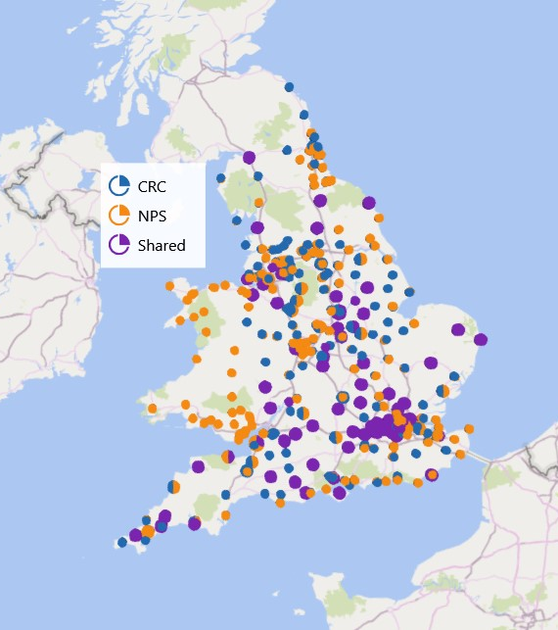
Today’s unified probation estate
Our unified estate includes 766 holdings across our 11 regions and Wales
We will continue to exit holdings through 2023, where it makes sense to do so, achieving a 22% reduction in our estate
A smaller probation estate will help us to achieve better value for money

Slide 10
Estates – unifying our security standards
The Probation Service Estates Team is currently working to develop a new set of security standards which will apply to the whole estate, to help support the rollout of delivering mixed caseloads
We have secured new investment to complete any necessary works to the estate once the standards have been agreed
We have surveyed the estate to understand any works required to achieve these security standards
This survey will identify properties in our estate which require work as a result of both the new standards and the surveys
Targeted properties will be equipped with all necessary security installations through a two year programme of work, beginning in April 2022

Slide 11
Estates 2021 – 2022 high level focus
Security and accessibility: produce national standards, assess all sites for mixed caseloads, obtain necessary funding, deliver required works
Deliver £37.5m capital projects during year two of the Estates strategy
Agree capital projects for years three and four of the Estates strategy; obtain funds
Deliver £15m backlog maintenance in years two, three and four
Unpaid Work: work with the Probation Reform Programme Unpaid Work design team to understand Estates requirements
Roll out permanent new signage to existing and new sites
Establish the capacity of our unified estate to support our increased workforce ambition
Continue with lease renewals

Slide 12
Estates – planned delivery
July – September 2021
Four year modernisation plan continues
Upgrade work continues
Longer term planning, which means staff may have opportunities to get involved locally in office refurbishments
Agreed security and accessibility standards, and new standards for our Unpaid Work estate, ready for 2022 delivery

Slide 13
Estates – planned delivery
October – December 2021
The most critical security standards which need attention during the next year, to ensure the safety of all staff, will be agreed
Site surveys begin, to ensure our estate can meet new security and accessibility standards
The review of our future estates capacity is completed; large capital projects to support this begin

Slide 14
Estates – 2022 planned delivery
January – June
Security and accessibility delivery begins
Leases on former CRC sites extended
Future capacity review completed
Capital projects, backlog maintenance and Smarter Working projects continue
July – December
Improvement plan delivery across our estate
Able to deliver a mixed caseload from most sites
Remainder of year three and four delivery shifts to MoJ Estates, as part of closing down the Probation Reform Programme

Slide 15
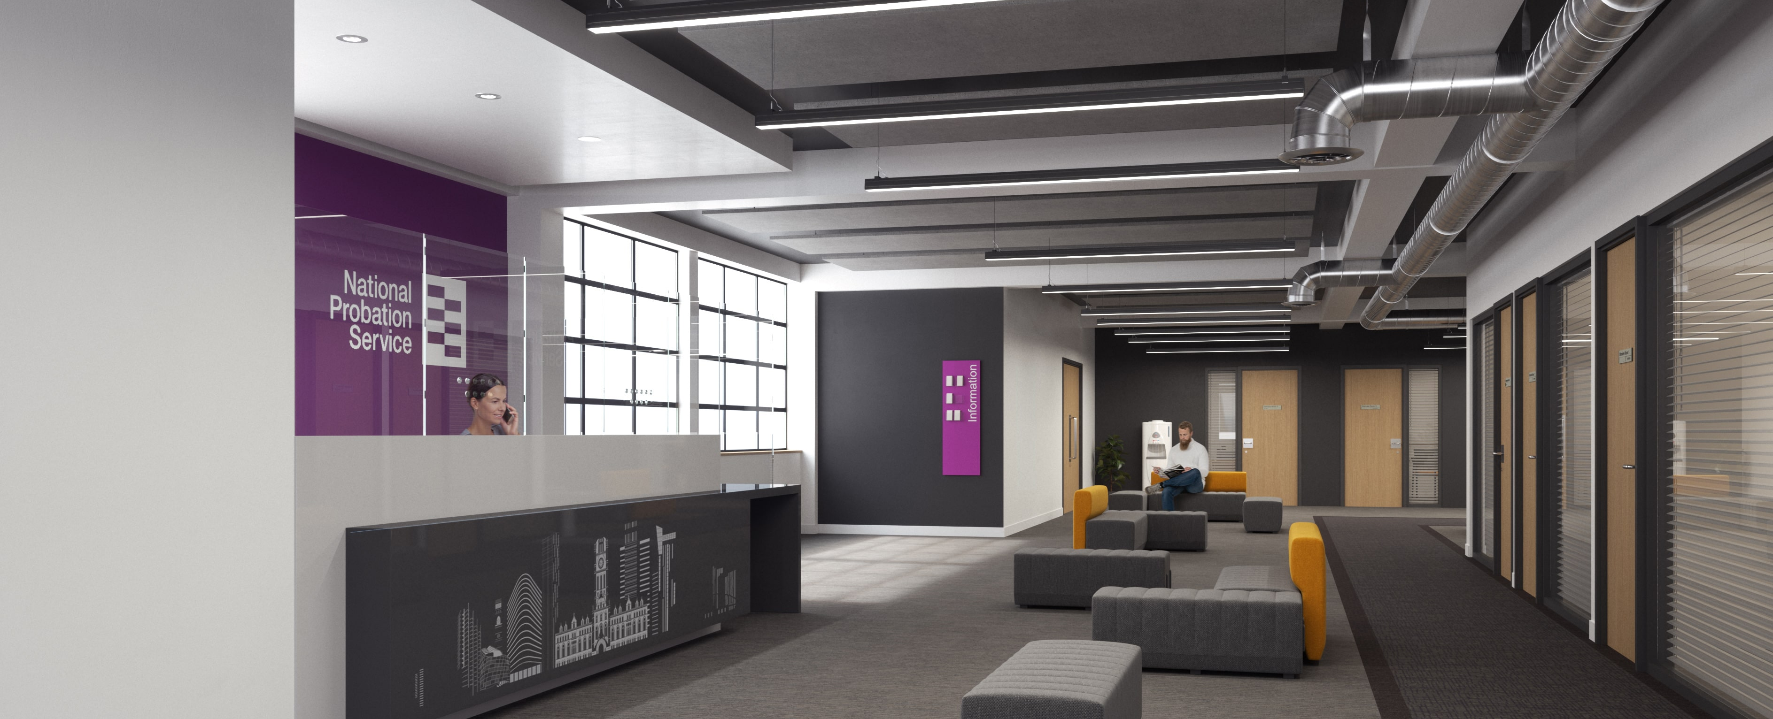
Estates – supporting Smarter Working
The Estates strategy has identified new office space and opportunities to modernise our existing offices to support Smarter Working
There will be an annual budget to support Smarter Working initiatives
Projects over the next four years will consolidate NPS and CRC buildings
Buildings which are not conducive to Smarter Working will see incremental changes through 2024
These small projects will be managed by Business Strategy and Change Heads in locations where there are no major projects
36 business cases have been approved; work began in April

Slide 16
Your questions – regional Estates delivery
Your Regional Probation Director, your manager and your regional Estates team will keep you informed about what our Estates strategy and delivery means at a local office, regional and national level
Please direct local office or regional Estates questions to your manager or regional Business Strategy and Change Team – thank you
If you have a question that can’t be answered by your regional team, please email: ProbationReformEstatesPMO@justice.gov.uk

Slide 17
Digital, Data and Technology update – calling all colleagues
If you haven’t dialled into the benefits of MS Teams Voice, now is your time to make that call
Your personal telephone number offers you a range of call features on your laptop and smartphone: think of it as your office landline number that you can use at home and on the move, helping you to keep your mobile number separate for people who really need it
The MS Teams app gives you the flexibility to
Look up a colleague
Make fast, clear calls inside and outside the Probation Service
Make video calls and share your screen
Turn a 121 call into a group call
Manage your voicemail, do not disturb, delegation and pick up groups
Making MS Teams your telephone solution takes just minutes using the step-by-step guides on the Probation (Welcome) Hub
If you need additional support to use MS Teams Voice, please contact: PRP_TeamsTelephony@justice.gov.uk

Slide 18
Authority systems structure changes
Legacy CRC team structures for all authority systems such as Delius, OASys, Interventions Manager and NDMIS have begun moving into the Probation Service structure through a phased approach which ends in December 2021
The following legacy CRCs are migrating this month
Dorset, Devon & Cornwall & Bristol, Gloucestershire, Somerset & Wiltshire move to our South West region on September 10 to 11
Wales moves to our Wales region on September 10 to 11
London moves to our London region on September 24 to 25
For more information on authority systems and the migration of CRC caseloads please click on the ‘My workplace & Technology’ page on the Probation Hub

Slide 19
The Welcome Hub is changing
We’re updating the Welcome Hub in line with your feedback, to give you an even better experience
What’s changing
A new name: The Probation Hub
New menus for easy navigation
Home: the latest news and features across the Hub
Up to speed: keep up to speed with what’s happening across the Probation Service in one place
My Work: information and quick links to support you to perform at your best and get the most from your role
Working together: showcasing how we work with other teams, stakeholders and partner organisations
Who we are: what it means to be part of our Probation Service
Contact: Hub and specialist area details
OFFICIAL-SENSITIVE

Slide 20
The Welcome Hub is changing
What’s not changing
Short, scannable content, with links to detailed information
Your existing bookmarked pages and links will work in the new structure
You can still search for the information you want
Transition information will remain available
We add new content to the Probation Hub every day, so log on regularly for the latest news and support
OFFICIAL-SENSITIVE

Slide 21
PQiP internal recruitment campaign
Part of the Probation Workforce Strategy’s commitment to attract and retain talented people
Internal only recruitment campaign ran for three weeks from 26 July to 15 August
Two internal routes created to make it easier for employees to train as Probation Officers (PQiPs):
PSO progression with or without a degree
Employees of the MoJ or one its agencies
Graduate applicants in both campaigns also had the opportunity to apply for a part time route for the first time
Coming up – targeted external campaign
Monday 13 September to noon Monday 27 September
Vacancies in seven regions: London, South Central, Kent, Surrey & Sussex, South West, East & West Midlands, East of England
Tell your friends and family we’re a great place to work
Huge success
Exceeded expectations with 729 internal applications
571 of those were PSO progression
158 from MoJ / agencies / arms length bodies
OFFICIAL-SENSITIVE

Slide 22
Recruitment and retention
Attrition rates
Nationally, Probation Officer attrition rates are low at 5.1% (March 2021). However, this is likely influenced by the pandemic, having reduced from peak at 6.5% at end March 2019. We are therefore focussing on areas with higher than average attrition rates.
Hard to fill sites
As part of our commitment in the Recruitment & Retention Strategy, our work is focussed on PDUs with the highest average Probation Officer vacancies greater than 15%, which include:
Essex South
Hertfordshire
Oxfordshire / Buckinghamshire / Milton Keynes
West & East Berkshire
Hammersmith / Fulham / Kensington / Chelsea / Westminster
City of London and Hackney Tower Hamlets
Surrey
Dorset
The Recruitment & Retention Strategy launched in April this year followed extensive engagement with colleagues and stakeholders across HMPPS, who identified the five focus areas:
Increase Probation Officer numbers
Provide manageable workloads
Recruit a diverse workforce and ensure our recruitment principles value and champion difference
Increase recruitment in hard to fill sites
Attract and retain talented people
Part of the Probation Workforce Strategy’s commitment to attract and retain talented people
Official sensitive – not for wider sharing

Slide 23
Recruitment and retention challenges in hard to fill sites
Six common drivers of recruitment and retention challenges across the Hard to Fill sites have been identified
Pay dissatisfaction
Newly Qualified Officer (NQOs) attrition
High Caseloads
Lack of career progression
Wellbeing
Bullying, Harassment and Discrimination (BHD)
Work is underway to these address challenges and reduce attrition, including
Collaborating with new PDU heads post unification to ensure a clear understanding of local challenges and understand immediate need
Engaging with the Effective Practice and Service Improvement Group (EPSIG) and prison colleagues to ensure staff retention is aligned
Improving the retention of newly qualified Probation Offices (NQOs)
Exit interview process updated to monitor factors driving attrition
Launched three career pathways to improve the retention of staff approaching retirement
For more information email: PWPRecruitmentRetentionPolicy@justice.gov.uk
OFFICIAL-SENSITIVE

Slide 24
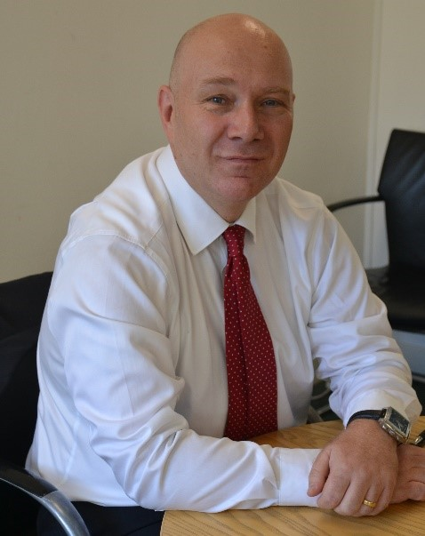
Probation pay
The Probation Workforce team is developing communication around the Probation Pay Award and Pay Reform
This includes:
An intranet blog from Ian Barrow, Executive Director Probation Workforce Programme, about the latest position on the probation pay award
Updates to the Probation Pay intranet page and news articles, all intended to keep staff informed on the latest developments
Part of the Probation Workforce Strategy’s commitment to attract and retain talented people
OFFICIAL-SENSITIVE

Slide 25
Job Evaluation Scheme (JES) update
Background – the JES review
A number of probation roles have been evaluated lower than the anticipated banding with the new unified operation model which has initiated pending appeals and review for a number of roles
A JES process review, undertaken jointly with trade unions, was completed in July 2021 (probation roles)
The review highlighted a number of learning points in relation to different themes and factors
The review generated a range of short and medium term recommendations
The short term recommendations will initially support those roles immediately preparing for appeal / review
Immediate post review activities
The Probation Workforce Programme board agreed the review and its recommendations on 2 August 2021
The review, and its recommendations, were shared with key stakeholders
Briefings to key stakeholders to outline review findings completed in August 2021
Resource, to oversee delivery of the short term recommendations identified
OFFICIAL-SENSITIVE

Slide 26
Job Evaluation Scheme (JES) update
Current activities
A job evaluation management group (JEMG) has been established, centrally led by PWP
JEMG will oversee and co ordinate implementation of the short term recommendations of the recent review
Mapping of all roles operating in probation regions, categorised by JES status, e.g., ‘not required’, ‘awaiting review’ through to ‘high priority job evaluation requirement’; this is aimed at providing co ordinated oversight of JES activity across probation nationally, reassurance to all stakeholders, and a road map to complete all related JES activity to support delivery of the TOM
JEMG is currently focussing on the highest priority roles that are preparing for appeal / review
The ‘high priority job evaluation requirement’ status currently applies to: Head of UPW; UPW Operations Manager; Head of Programmes; Programme Manager; Treatment Manager; Performance Manager
Regular engagement with trade unions is ongoing in a number of forums
Communication activities
RPDs will be kept up to date with progress of appeal and review submissions
RPDs will be invited to provide feedback on key documentation (JD / JDQ) prior to panel submission
A functional mailbox will be created to allow staff to engage directly with JEMG
Consideration is being given to creation of a central repository of JES information
Consideration is being given to using Probation News as another way to share updates and key messages
An update letter, from Jim Barton, will be sent directly to affected staff by the end of August
OFFICIAL-SENSITIVE

Slide 27
Job Evaluation Scheme (JES) update
Next steps
Critical communication activities will be taken forward, e.g., letter to affected staff
Complete appeal / review activity and submit final documentation to the panel
Prioritise and support submissions for all other probation roles, overseen by JEMG
OFFICIAL-SENSITIVE

Slide 28
Job Evaluation Scheme (JES): panel submission timeline, Priority 1 roles
Head of UPW
UPW Operations Manager
Head of Programmes
Programme Manager
Treatment Manager
Performance Manager; (this role is likely to run one week behind other roles
August
September
October
< 03/09/2021
03/09/2021
06/09/2021
07/09/2021
10/09/2021
10/09/2021
10/09/2021
08/10/2021
15/10/2021
WC 18/10/2021
Focus Groups Held with Role Holders
JD / JDQ Drafting Completed by JD Developer & Shared with JES Team
Indicative Banding Provided
Job Evaluation Management Group (JEMG) Sign Off / Give Clearance
Deputy Director Sign Off / Give Clearance
28 Day TU Consultation Commences
Wider Stakeholder Consultation Commences e.g. RPDs
Final Feedback Considered by JD Developer
Final Documentation Submitted to JES Team
Evaluation Panel
OFFICIAL-SENSITIVE

Slide 29
Attend an HR employee support event
Date / time​ of event | Join link​
Mon 6 September​ 1pm – 2.30pm ​ | Click here to join​
Tues 7 September​ 2.30pm - ​4pm | Click here to join​
Weds 8 September​ 10am – 11.30am​ ​ | Click here to join​
Thurs 9 September​ 1pm – 2.30pm ​ | Click here to join​
Fri 10 September​ 1pm – 2.30pm | Click here to join​
During the week commencing 6 September 2021 we are hosting daily HR employee support sessions to explain the HR processes we use in the unified Probation Service. This is in response to a number queries and requests we have received from you asking for additional support in this area.
Anyone can attend these sessions and they will be recorded and saved on MyHub to watch back at any time. Seven topics will be covered over 1.5 hours and will comprise 15 minute ‘mini sessions’ so you can drop in and out of the meeting and attend the sessions that are most relevant to you. Topics covered at each session will include:
Ill health retirement
Employee benefits and childcare vouchers
OH portal and Employee Assistance Programme (EAP)
Business travel
Performance management
Sick absence policy
HR model
A question and answer facility will be available via the chat and we will take away any unanswered questions
Click on the links in the table to join a session or visit the Events Welcome Hub page here.
OFFICIAL-SENSITIVE

Slide 30
People Survey 2021
The People Survey launches on 28th September and runs until 3rd November.
Each team (e.g. Probation Service) will have a code which staff use to log in online. Codes and a link will be provided in the coming weeks.
Probation staff who work in prisons need to identify with their parent PDU/team not the prison.
We want peoples’ honest feedback be that positive or negative, we need a wider picture.
Individuals cannot be identified from their responses, or from recording their demographics – the system clusters data if there are fewer than 10 responses in any chosen group.
There has never been a more crucial time to encourage responses to provide greater insight to inform the development of the unified service and as we recover and rebuild from Covid.
Please encourage your staff to have their say and share their voice.

Slide 31
[Region] September area/s of focus
Team leader to fill in
Team leader to fill in
Team leader to fill in
Team leader to fill in

Slide 32
Team September deliverables
Team leader to fill in
Team leader to fill in
Team leader to fill in
Team leader to fill in

Slide 33
Team discussion
How might these changes affect our team?
Are we clear on our individual and team next steps and delivery?
How are we managing change? Do we need support?

Slide 34
Your thoughts, questions and feedback
Please email [insert your region’s preferred Outlook account]

Slide 35
Thank you

