Slide 1
Mixed caseloads defined
Mixed caseloads refers to the combination of former CRC and NPS caseloads into unified caseloads operating in accordance with our Unified Tiering Model; please see our Staff Guidance and Tiering and Case Allocation Framework in EQuiP for further details
Mixed caseloads involve high risk Tier A and B cases being managed by any Probation Officer grade staff; Tier C cases being managed by a mix of any Probation Officer grade staff and any Probation Service Officer grade staff; and the majority of Tier D cases being managed by any Probation Service Officer grade staff

Slide 2
Mixed caseloads benefits
Managing mixed caseloads in all 11 regions and Wales will deliver many benefits, including supporting improved outcomes for people on probation, and help us to:
Unite our organisation and support cultural integration
Improve continuity for our Probation Practitioners and people on probation
Enhance staff wellbeing by reducing the emotional burden of managing particular cohorts
Develop a more skilled, knowledgeable and flexible workforce, with greater opportunities for career satisfaction

Slide 3
Our journey to mixed caseloads – national overview
The Probation Service’s Target Operating Model defines an end state where former CRC and NPS caseloads are unified
Wales leads the way on our journey to mixed caseloads, having started the process in 2019
Our 11 regions in England began their journeys to mixed caseloads in September 2021, with regions progressing at different paces, subject to programme and regional milestones being met
Our move to mixed caseloads and structural integration depends on enabling functions such as Digital, Data and Technology, which is managing our digital migration, and Estates, which is delivering key milestones on a phased regional basis
All regions will be managing mixed caseloads by December 2022; every Probation Practitioner will have undertaken the relevant learning and development, with administrative integration, digital tools and Probation Delivery Unit structures in place, supported by our Unified Tiering Model and a new Workload Measurement Tool
Full details on our national journey to mixed caseloads are available in our Mixed Caseload Staff FAQ
Your regional leadership team will keep you informed about your region’s move to mixed caseloads

Slide 4
Mixed caseloads operationalised
Following our unification, former NPS staff have continued to manage high risk cases and other cases meeting legacy NPS allocation criteria and former CRC staff have continued to manage low and medium risk cases
Given the imbalance in some caseloads and operational capacity issues, we are keen to distribute cases more evenly across our Probation Service
Initial steps have been agreed to mix caseloads through new case allocations and the movement of existing cases where agreed criteria are met
This will support regions to begin to mix caseloads gradually and to address operational capacity issues
Our Staff FAQ offer you more information

Slide 5
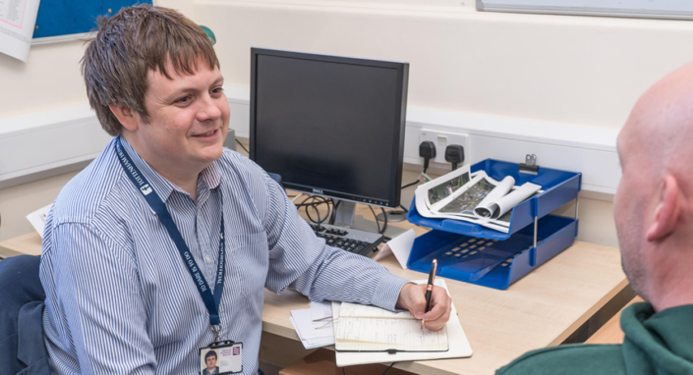
Two main routes to move to mixed caseloads
There are two main routes to move to mixed caseloads:
The allocation of new cases, in line with the Unified Tiering Model, regardless of whether staff are former NPS or CRC staff
Reallocating existing cases across former CRC and former NPS staff groups

Slide 6
Mixing caseloads through the allocation of new cases
Former CRC and NPS staff may begin to take on the management of more mixed and varied caseloads after they have completed and are applying the learning and development modules relevant to the type of case
Line manager assessment of previous experience and the application of learning and development modules is essential for all staff
ViSOR cases may be allocated to a non ViSOR vetted / trained member of staff, provided they can access ViSOR information via a vetted and trained individual within their Probation Delivery Unit, or dedicated ViSOR team, where established
Any decision to allocate a legacy NPS case to a former CRC member of staff, or vice versa, should be agreed by an SPO or above, and a management oversight entry added to nDelius
Regions should consider prioritising the reallocation of cases from PSOs to POs where cases are not held in accordance with the Unified Tiering Model
Implications related to OMiC should be understood and the guidance in our Staff FAQ followed
Regions serviced by the Professional Service Centre will need to take into account specific implications of mixing caseloads; see our Staff FAQ for further guidance

Slide 7
Mixing caseloads through the reallocation of existing cases
Mixing caseloads through the reallocation of existing cases across former CRC and former NPS staff should take place after the CRC team migration into Probation Delivery Unit structures is complete for the region
Guidance outlined in the previous slide on mixing caseloads through the allocation of new cases applies for the reallocation of existing cases
If the reallocation of existing cases is required in response to workload concerns before migration, the reallocation of existing cases across staff groups should only take place before the four week window ahead of digital migration for the region; additionally, a number of controls need to be put in place:
PDU and team structures remain the same
Cases move, not staff
Moves are coordinated by a regional SPOC
The regional SPOC will keep a record of any moves of existing cases ahead of migration
Any such moves should only be undertaken where other dependencies have been addressed, such as learning and development

Slide 8
Learning and development activity enabling staff to manage mixed caseloads
A range of learning and development activity is available for all former NPS and CRC staff to support their ability to take on mixed and varied caseloads; please see the Probation Hub
We expect Multi Agency Public Protection Arrangements (MAPPA) learning and development to be available in the coming weeks
Staff may begin to take on the management of more mixed and varied caseloads after they have completed and are applying the learning and development modules relevant to the type of case
Line manager assessment of previous experience and the application of learning and development modules is essential for all staff taking on the management of more mixed and varied caseloads
Staff will be required to complete learning and development to support the move to mixed caseloads in accordance with regional plans and timescales
Our Staff FAQ offer you more information

Slide 9
ViSOR vetting
ViSOR is a secure national database that supports Multi Agency Public Protection Arrangements (MAPPA) and is used in the joint management of individuals posing a risk of serious harm
The work required to ensure all relevant staff have undergone ViSOR vetting and have access to ViSOR remains a priority for the Probation Reform Programme
A ViSOR vetting and training plan will be released by 24 October 2021, setting out our approach to ensuring staff are appropriately ViSOR vetted, have received training and have access to the system
Our initial national priority nationally is to ensure all Senior Probation Officers are ViSOR vetted and trained
Heads of Public Protection will receive further information soon

Slide 10
Estates – unifying our security standards
We are investing in our estate to ensure that all Probation Contact Centres are safe and secure and enable a high proportion of our locations to deliver mixed caseloads
The Probation Service Estates Team is currently working to develop a new set of security standards which will apply to the whole estate, to help support the rollout of delivering mixed caseloads
We have secured new investment to complete any necessary works to the estate once the standards have been agreed
We are surveying the estate to understand any works required to achieve these security standards
This survey will identify properties in our estate which require work as a result of both the new standards and the surveys
Targeted properties will be equipped with all necessary security installations through a two year programme of work, beginning in April 2022
Your regional leadership will keep you updated about what this means for you, your team and your location

Slide 11
[Insert region]: our journey to mixed caseloads
[Insert RPD name] and our senior leadership team will keep us informed about what our national journey to mixed caseloads means on a regional, local and team level
[Insert lines on any regional mixed caseload communication to date]
Our national Staff FAQ offer you more information
If you have a question that hasn’t been addressed by our regional leadership team or today’s October Regional Team Briefing, please email: mixedcaseloads@justice.gov.uk

