Slide 1
October 2021 Regional Team Briefing
[Insert region]

Slide 2
Our team’s opportunity to talk
We celebrate our team and our successes
We’re aware of and informed about national and regional changes
We talk about how these changes might affect our team
We agree our team’s big deliverables each month

Slide 3
Today’s conversation – new this month
Our journey - Probation Reform (see supplementary slides)
Our journey to mixed caseloads – national overview
Pause for the People Survey
Commissioned Rehabilitative Services – updated top tips and digital developments
Probation Hub update
People update – Managerial role review, learning and development, Competency Based Framework
SOP, Authority system changes
[Insert region], team – October areas of focus, deliverables

Slide 4
Our Journey – Probation Reform
Our Target Operating Model (TOM) is the blueprint for probation services in England and Wales. It establishes a strengthened service that protects the public, reduces reoffending and improves confidence in probation. The TOM draws on best practice and innovation from both CRC and NPS operation as well as lessons learnt from the integration of Sentence Management into the NPS in Wales at the end of 2019.
26th June 2021 - Unification represented a first step towards the ambitions of the new Probation Service
On 26th June 2021 the new Probation Service was launched. Unification ‘Day 1’ priorities focussed on maintaining operational delivery, protecting service continuity and minimising risk of operational failure. COVID-19 restrictions remained in place and we continued to work to EDMs.
September 2021 onwards - implementing the TOM
As we recover from the impacts of COVID-19 and embed the structural changes of unification, we are poised to realise the vision set out in the Target Operating Model

Slide 5
Our Journey – Probation Reform
Reforms include:
Improving sentence management and integrating electronic monitoring - Recruiting additional probation staff to reduce average caseload numbers and using Integrated Offender Management and Electronic Monitoring to drive compliance and help reduce reoffending.
Re-launching unpaid work - Revitalising the delivery of robust and visible unpaid work placements to increase the value they bring to society.
Delivering interventions and harnessing commissioned rehabilitative services - Producing a suite of rehabilitative tools to help change the behaviours of people on probation and commissioning, specialist rehabilitative services from the private and voluntary sector to support reduced reoffending.
Improving resettlement to reduce repeat offending – Ensuring that prison leavers have the foundations they need to turn their backs on crime.
Improving services to the court - Improving the targeting of pre-sentence reports and the Probation Service’s influence in court.
Supporting victims - Improving our approach to the delivery of victims’ services by learning lessons from victims’ experiences
Updating digital tools and harnessing data to improve probation staff experience
Modernising the probation estate
Strengthening the workforce and professional recognition - Improving the learning and development offer for staff to facilitate continued professional development.
Supporting an effective and efficient Probation Service - Implementing a Core Quality Management Framework as we work to the new National Standards.

Slide 6
Our Journey – Probation Reform
Work is being introduced in two phases:
Laying the foundations - between July and Dec 2021 we are focusing on stabilising the service and embedding structural changes.
Building back better - with strong foundations in place, from January to June 2022 we can start to bring alignment to operational processes and ways of working across the Probation Service, introducing elements of the TOM to improve service delivery. By July 2022 the transformation of the Probation Service in line with the end-state vision can begin.
Further information
See our Probation Reform Changes Overview (attached)
See the Probation Hub Delivering Our Service Section (in development)

Slide 7
Mixed caseloads defined
Mixed caseloads refers to the combination of former CRC and NPS caseloads into unified caseloads operating in accordance with our Unified Tiering Model; please see our Staff Guidance and Tiering and Case Allocation Framework in EQuiP for further details
Mixed caseloads involve high risk Tier A and B cases being managed by any Probation Officer grade staff; Tier C cases being managed by a mix of any Probation Officer grade staff and any Probation Service Officer grade staff; and the majority of Tier D cases being managed by any Probation Service Officer grade staff

Slide 8
Mixed caseloads benefits
Managing mixed caseloads in all 11 regions and Wales will deliver many benefits, including supporting improved outcomes for people on probation, and help us to:
Unite our organisation and support cultural integration
Improve continuity for our Probation Practitioners and people on probation
Enhance staff wellbeing by reducing the emotional burden of managing particular cohorts
Develop a more skilled, knowledgeable and flexible workforce, with greater opportunities for career satisfaction

Slide 9
Our journey to mixed caseloads – national overview
The Probation Service’s Target Operating Model defines an end state where former CRC and NPS caseloads are unified
Wales leads the way on our journey to mixed caseloads, having started the process in 2019
Our 11 regions in England began their journeys to mixed caseloads in September 2021, with regions progressing at different paces, subject to programme and regional milestones being met
Our move to mixed caseloads and structural integration depends on enabling functions such as Digital, Data and Technology, which is managing our digital migration, and Estates, which is delivering key milestones on a phased regional basis
All regions will be managing mixed caseloads by December 2022; every Probation Practitioner will have undertaken the relevant learning and development, with administrative integration, digital tools and Probation Delivery Unit structures in place, supported by our Unified Tiering Model and a new Workload Measurement Tool
Full details on our national journey to mixed caseloads are available in our Mixed Caseload Staff FAQ
Your regional leadership team will keep you informed about your region’s move to mixed caseloads

Slide 10
Mixed caseloads operationalised
Following our unification, former NPS staff have continued to manage high risk cases and other cases meeting legacy NPS allocation criteria and former CRC staff have continued to manage low and medium risk cases
Given the imbalance in some caseloads and operational capacity issues, we are keen to distribute cases more evenly across our Probation Service
Initial steps have been agreed to mix caseloads through new case allocations and the movement of existing cases where agreed criteria are met
This will support regions to begin to mix caseloads gradually and to address operational capacity issues
Our Staff FAQ offer you more information

Slide 11
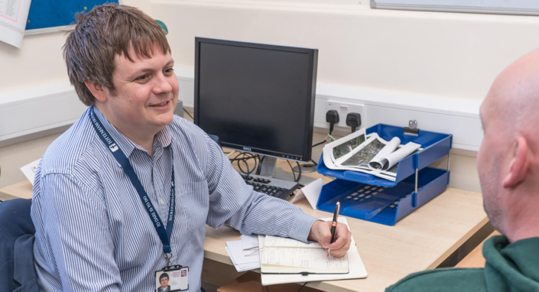
Two main routes to move to mixed caseloads
There are two main routes to move to mixed caseloads:
The allocation of new cases, in line with the Unified Tiering Model, regardless of whether staff are former NPS or CRC staff
Reallocating existing cases across former CRC and former NPS staff groups

Slide 12
Mixing caseloads through the allocation of new cases
Former CRC and NPS staff may begin to take on the management of more mixed and varied caseloads after they have completed and are applying the learning and development modules relevant to the type of case
Line manager assessment of previous experience and the application of learning and development modules is essential for all staff
ViSOR cases may be allocated to a non ViSOR vetted / trained member of staff, provided they can access ViSOR information via a vetted and trained individual within their Probation Delivery Unit, or dedicated ViSOR team, where established
Any decision to allocate a legacy NPS case to a former CRC member of staff, or vice versa, should be agreed by an SPO or above, and a management oversight entry added to nDelius
Regions should consider prioritising the reallocation of cases from PSOs to POs where cases are not held in accordance with the Unified Tiering Model
Implications related to OMiC should be understood and the guidance in our Staff FAQ followed
Regions serviced by the Professional Service Centre will need to take into account specific implications of mixing caseloads; see our Staff FAQ for further guidance

Slide 13
Mixing caseloads through the reallocation of existing cases
Mixing caseloads through the reallocation of existing cases across former CRC and former NPS staff should take place after the CRC team migration into Probation Delivery Unit structures is complete for the region
Guidance outlined in the previous slide on mixing caseloads through the allocation of new cases applies for the reallocation of existing cases
If the reallocation of existing cases is required in response to workload concerns before migration, the reallocation of existing cases across staff groups should only take place before the four week window ahead of digital migration for the region; additionally, a number of controls need to be put in place:
PDU and team structures remain the same
Cases move, not staff
Moves are coordinated by a regional SPOC
The regional SPOC will keep a record of any moves of existing cases ahead of migration
Any such moves should only be undertaken where other dependencies have been addressed, such as learning and development

Slide 14
Learning and development activity enabling staff to manage mixed caseloads
A range of learning and development activity is available for all former NPS and CRC staff to support their ability to take on mixed and varied caseloads; please see the Probation Hub
We expect Multi Agency Public Protection Arrangements (MAPPA) learning and development to be available in the coming weeks
Staff may begin to take on the management of more mixed and varied caseloads after they have completed and are applying the learning and development modules relevant to the type of case
Line manager assessment of previous experience and the application of learning and development modules is essential for all staff taking on the management of more mixed and varied caseloads
Staff will be required to complete learning and development to support the move to mixed caseloads in accordance with regional plans and timescales
Our Staff FAQ offer you more information

Slide 15
ViSOR vetting
ViSOR is a secure national database that supports Multi Agency Public Protection Arrangements (MAPPA) and is used in the joint management of individuals posing a risk of serious harm
The work required to ensure all relevant staff have undergone ViSOR vetting and have access to ViSOR remains a priority for the Probation Reform Programme
A ViSOR vetting and training plan will be released by 24 October 2021, setting out our approach to ensuring staff are appropriately ViSOR vetted, have received training and have access to the system
Our initial national priority nationally is to ensure all Senior Probation Officers are ViSOR vetted and trained
Heads of Public Protection will receive further information soon

Slide 16
Estates – unifying our security standards
We are investing in our estate to ensure that all Probation Contact Centres are safe and secure and enable a high proportion of our locations to deliver mixed caseloads
The Probation Service Estates Team is currently working to develop a new set of security standards which will apply to the whole estate, to help support the rollout of delivering mixed caseloads
We have secured new investment to complete any necessary works to the estate once the standards have been agreed
We are surveying the estate to understand any works required to achieve these security standards
This survey will identify properties in our estate which require work as a result of both the new standards and the surveys
Targeted properties will be equipped with all necessary security installations through a two year programme of work, beginning in April 2022
Your regional leadership will keep you updated about what this means for you, your team and your location

Slide 17
The Probation Hub has landed
The Welcome Hub has transitioned to the Probation Hub to continue to offer you the up to date information you need quickly and easily, with links to information and support
Up to Speed offers you news, videos, publications, slide decks and more from the Probation Service Reform, Workforce and other national programmes
The Probation Hub retains Welcome Hub content that supported us to unification. Pages that are still relevant today may be easily found on the My Work page, with the remainder in the Archive section
Our Who we are pages demonstrate what it means to be part of the Probation Service and our Working together pages will develop to showcase how we work with other teams, stakeholders and partner organisations
We welcome your feedback via the Contact & Support section – thank you

Slide 18
PAUSE FOR THE PEOPLE SURVEY
Set aside time to complete the survey on the National completion days of 1st, 11th & 20th October [or tailor this message to suit your region]
28 September to 3 November
Last year 68% of Probation staff completed the survey – let’s get that number up this year!
Results from the People Survey will be turned into action plans at a local level and MoJ-wide
Probation staff who work in prisons need to identify with their parent PDU/team not the prison.
Code: Speak to your HR lead
Survey link: https://bit.ly/CSPS2021

Slide 19
Commissioned Rehabilitative Services – updated top tips and digital developments
The top tips section highlighting how to get the best out of CRS and the Refer and Monitor Digital Service has been updated on the Probation Hub (formerly Welcome Hub)
Head to the hub for the latest on how to get the best out of our Refer and Monitor tool
These top tips have been developed to respond to your most frequent questions
You Said We Did now LIVE – thank you
Following on from your feedback, the latest news on Refer and Monitor service fixes, improvements and new developments are now available on the Probation Hub

Slide 20
Microsoft Teams calls – calling all colleagues
It’s time for everyone to dial in to the benefits Microsoft Teams calls offers you
Your personal telephone number gives you a range of call features on your laptop and smartphone
It’s your office landline number, that you can also use at home and on the move, helping you to keep your mobile number separate for contacts who really need it
Making Microsoft Teams your go to telephone solution takes minutes – please look at the step-by-step guides on the Probation Hub.
If you need additional support, please contact: PRP_TeamsTelephony@justice.gov.uk

Slide 21
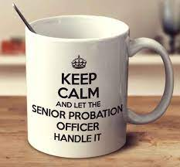
Managerial Role Review (MRR)
The Probation Workforce has commenced work on the Managerial Role Review.
The MRR will commence with a focus on the priority cohort of SPO staff, in particular building on the recommendations of the SPO Review led by Sarah Chand which was completed in 2020.
The initial focus will be on SPOs in Sentence Management and Court Teams
The data collated as part of the Review will allow the examination of current activity being completed by the SPO Roles. The Review aims to inform target staffing, identify areas for continuous improvement and offer recommendations.
Qualitative and quantative data will be obtained to support the recommendations and therefore SPO staff will be approached over the next few months to contribute in various ways such as focus groups, workshops, interviews and surveys.
Part of the Probation Workforce Recruitment and Retention Strategy to make workloads more manageable
OFFICIAL-SENSITIVE

Slide 22
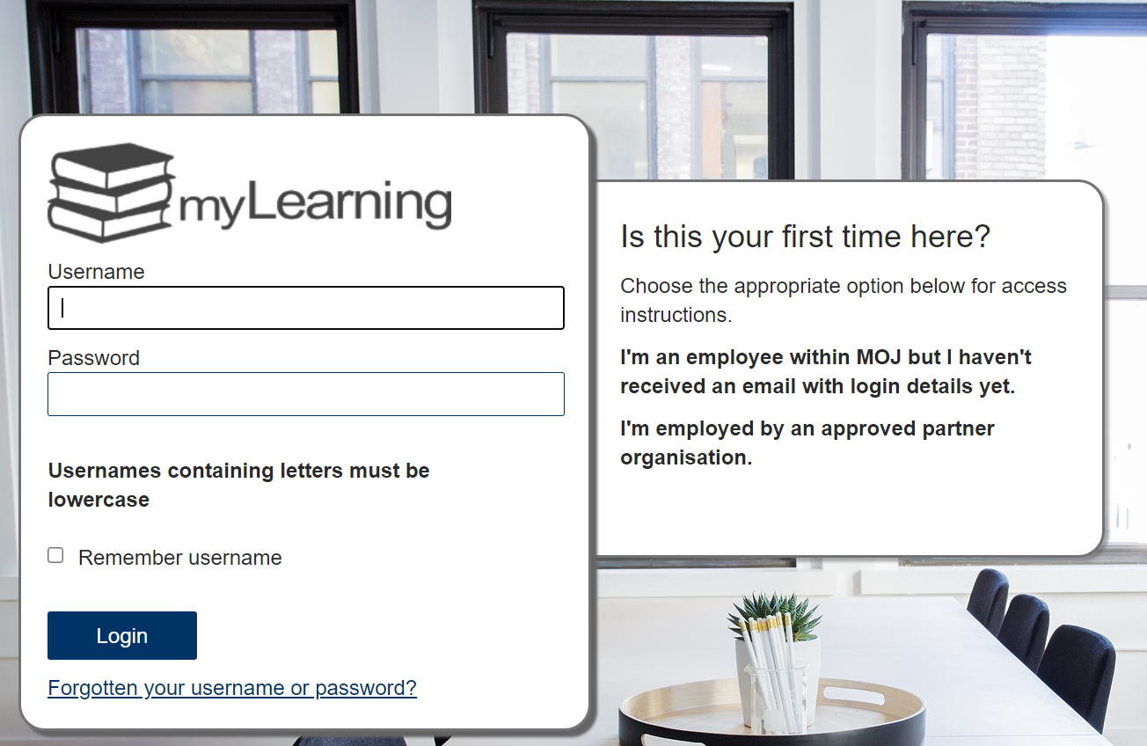
Available spaces in upcoming courses
Learning is an essential part of everyone’s development in the Probation Service
There are spaces available for courses coming up in the next few weeks
Please look at the ‘spares’ page on myLearning
Please check your eligibility with your manager and book yourself in – it’s that easy
How to access myLearning

Slide 23
Competency Based Framework (CBF)
During this current phase record everyday tasks and activities that demonstrate your competence across each of the competence areas and discuss these with your line manager during your routine 1:1 line management conversations
At the end of the year, managers will make a decision on their staff members’ pay progression and update SOP
CBF top tips
Start recording pieces of work to evidence your level of competency against the probation service competency areas; take a look at worked examples on MyHub
Discuss and agree that your examples demonstrate your competence against each area of the framework, during your regular supervisions and 1:1s
It’s not too late to start the CBF process, the trial year is your opportunity to work within the process ahead of it being linked to pay, familiarise yourself with the CBF documents which can be found on MyHub
CBF guidance and helpful information may be found on MyHub

Slide 24
Changes to internal function on SOP
Previous Internal Function Title | New Internal Function Title
 | PS Accredited Programmes
NPS Approved Premises | PS Approved Premises
 | PS Community Integration
NPS Criminal Justice Learners | PS Community Justice Learners
NPS Complaints | PS Complaints
 | PS CorpServiceFL
NPS Courts | PS Courts
NPS Enforcement | PS Enforcement
NPS HQ | PS HQ
NPS Management Structures | PS Management Structures
NPS Multi Agency | PS Multi Agency
NPS Critical Operations Support Unit | PS National Security Division
NPS Offender Management | PS Offender Management
 | PS Performance and Quality
 | PS Personality Disorder Projects
NPS Private Prison | PS Private Prison
NPS Public Prison | PS Public Prison
NPS Divisional Support | PS Regional Corporate Support
 | PS Senior Attendance Centre
NPS Sex Offending Programmes | PS Sexual Offending Programmes
NPS SFO | PS SFO
NPS Other Interventions | PS Structured Interventions
NPS Training | PS Training
 | PS Unpaid Work
NPS Victims | PS Victims
NPS YOS | PS YOS
Following unification, the title of all internal functions on SOP have been updated
The internal function field identifies where in the business an individual works; for example:
Someone working in Courts their internal function prior to unification was ‘NPS Courts’, they will now be ‘PS Courts’
Someone working in Unpaid Work, this is a new internal function post unification and will be ‘PS Unpaid Work’
Someone who is employed by Probation in a Functional Leadership role will be temporarily listed as ‘PS CorpServiceFL’ until consultation and decisions are made about transfer to the MOJ
This helps us to identify how many staff work in different functions in the business and helps us make our recruitment decisions
Changes can be seen in the table to the right. This shows what the previous titles were and what they have now been changed to. The title changes have now been implemented on SOP
What does this impact?
This information is particularly relevant to managers who may need to update a team member’s internal function on SOP, for example, when they move role. Also anyone involved in regional workforce or resource planning should familiarise themselves with this updated list
What you need to do
New internal function titles should be selected for any staff changes made in Probation. If you have any questions, please contact the probationworkforcemodelling@justice.gov.uk mailbox

Slide 25
Authority systems structure changes
Legacy CRC team structures for all authority systems such as Delius, OASYS, Interventions Manager and NDMIS are moving into the Probation Service structure
This is being done using a phased approach until December 2021
The following legacy CRCs will be migrating this month:
Warwickshire and West Mercia & Staffordshire and West Midlands will move to West Midlands region from 15 to 16 October
Derbyshire, Leicestershire, Nottinghamshire and Rutland and Humberside, Lincolnshire & North Yorkshire Part 1 will move to East Midlands region from 29 to 30 October
Kent, Surrey & Sussex will move to Kent, Surrey & Sussex region from 29 to 30 October
More information on authority systems and the migration of CRC caseloads is available in the ‘My workplace & Technology’ page on the Probation Hub
.

Slide 26
[Region] October area/s of focus
Team leader to fill in
Team leader to fill in
Team leader to fill in
Team leader to fill in

Slide 27
Team October deliverables
Team leader to fill in
Team leader to fill in
Team leader to fill in
Team leader to fill in

Slide 28
Team discussion
How might these changes affect our team?
Are we clear on our individual and team next steps and delivery?
How are we managing change? Do we need support?

Slide 29
Your thoughts, questions and feedback
Please email [insert your region’s preferred Outlook account]

Slide 30
Thank you

