Slide 1
December 2021 Regional Team Briefing
[Insert region]

Slide 2
December 2021 Estates update
The Probation Reform Programme Estates workstream supports our Target Operating Model by providing a modern probation estate for England and Wales
Estates 2022 priorities:
Delivering upgrade projects in our 11 regions and Wales
Supporting the delivery of mixed caseloads across all regions
Supporting the investment in Unpaid Work
Assessing our building usage and capacity

Slide 3
Investing in our Estate
Continuing to deliver Estates upgrade projects in our 11 regions and Wales, creating buildings that:
Offer a more positive environment for staff, partner organisation colleagues and people on probation
Support smarter, more flexible ways of working, enabling us to reduce our estate footprint and running costs while ensuring we can accommodate additional probation practitioners and deliver the services outlined in the Target Operating Model without putting security at risk
Deliver benefits to their communities through reduced environmental impacts – for example, heating, cooling, and ventilation will be provided by high efficiency, low carbon emissions methods

Slide 4
Supporting our delivery of mixed caseloads
The Estates team is supporting plans for the expansion of the delivery of mixed caseloads across each region by December 2022 through:
Defining national requirements for security and agreeing these with Regional Probation Directors and Trade Unions
Agreeing with Regional Probation Directors’ their priority sites for the delivery of mixed caseloads
Surveying the entire Probation estate for adherence to the agreed security standards
Undertaking upgrade works at the priority sites in each region
It is expected that critical and high priority sites within regions will be fully compliant with mixed caseload security requirements by December 2022

Slide 5
Supporting operational delivery
Working with the Unpaid Work team to support their operational delivery
Estates support includes:
Working with the team to baseline the Estate for the delivery of Unpaid Work
Assisting in the design of the Unpaid Work future operating model
Preparing to help to deliver the Estates component of the future operating model

Slide 6
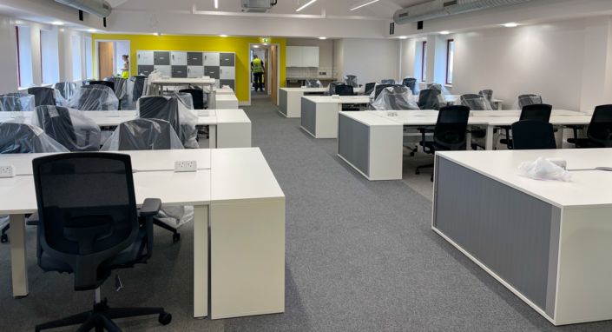
Assessing our building usage and capacity
Completing the assessment of our building usage and capacity:
It’s clear that post Covid building usage will be markedly different to pre Covid usage, which is when the Estates strategy was originally developed
Analysing the utilisation of what we have delivered by summer 2022 will help ensure the future Estates strategy continues to support wider organisational and recruitment planning

Slide 7
Your Estates questions
Your Regional Probation Director, your manager and your regional Estates team will keep you informed about what our Estates strategy and delivery means at a local office, regional and national level
Please direct local office or regional Estates questions to your manager or regional Business Strategy and Change Team – thank you
If you have a question that can’t be answered by your regional team, please email: ProbationReformEstatesPMO@justice.gov.uk

Slide 8
Thank you

