Slide 1
November 2021 Regional Team Briefing
[Insert region]

Slide 2
Our team’s opportunity to talk
We celebrate our team and our successes
We’re aware of and informed about national and regional changes
We talk about how these changes might affect our team
We agree our team’s big deliverables each month

Slide 3
Today’s conversation – new this month
16 November all staff briefing and engagement event
New Prepare a Case for Sentence tool launch
Approved Suite of Probation Practitioner Toolkits
Short explainers available on CRS / CFO services
How to refer a person on probation to the Going Forward into Employment (GFiE) scheme
Key worker housing for probation staff
L&D opportunities:
Prevent e-learning
Young Adults on MyLearning
[Insert region] – November areas of focus, deliverables

Slide 4
16 November all staff briefing and engagement event
Sonia Flynn is hosting an all staff briefing and engagement event from 1.00pm to 2.15pm on Tuesday 16 November
This event will cover a range of topics, including the regular Reform and Workforce updates from Jim Barton and Ian Barrow, with Amy Rees joining us to provide her regular Director General update
Guest speakers Sarah Jackson and Clare Wilson will discuss working with young adults and update on a new platform for accessing learning materials on this topic – also covered in L&D opportunities
Joe Longman will give an overview of all things performance, including the new Integrated Probation Rating System
Please make time in your diary to attend – we look forward to welcoming you
You can access the event on the day by clicking Here

Slide 5
Probation Reform Programme: Advice to Court
We are improving local and national court liaison and engagement, so that the judiciary are:
Aware of the range of effective interventions being delivered or commissioned by probation
Assured of the quality and effectiveness of those services
Confident about probation services and the delivery of community sentences
Improving the quality of our advice to court will ensure that our proposals target specific interventions and treatment requirements, supporting reduced reoffending and promoting judicial confidence

Slide 6
New Prepare a Case for Sentence tool
Our new Prepare a Case for Sentence tool has been developed based on feedback from court staff, so that it meets your needs
Staff feedback will ensure that this tool is continuously updated, in line with your evolving needs, so you are well supported in your roles
Please see our Staff FAQ for further details

Slide 7
Prepare a Case for Sentence tool: background
A new digital tool for probation practitioners and administrators in magistrates’ courts
Provides an overview of all defendants attending court on a given day, including:
Their probation status and probation record
Information about any current orders
Offender manager details, requirements and attendance information
By providing this information in a more accessible and usable format, our staff will be able to provide better advice to the court with less effort and minimise avoidable adjournments

Slide 8
Prepare a Case for Sentence tool: benefits for court staff
Quick identification of potential probation cases of interest
Time saved identifying defendants known to probation and gathering case information such as offender manager details and current order information
Significant reduction in the number of clicks, screens and systems staff have to move between when preparing cases

Slide 9
Prepare a Case for Sentence tool: rollout plan and timings
Trialled and adopted in Greater Manchester and Kent in August 2021 and September 2021, respectively
Trialled in the North East region in November 2021
Regional court lead / Senior Probation Officer briefings in all regions commence from November 2021
Senior Probation Officers and regional operational leadership teams will lead each region’s rollout from December 2021
All court staff in all 11 regions and Wales will have adopted the tool by June 2022
Your Senior Probation Officer and regional operational leadership team will provide you with everything you need to know and do to support our national adoption of the Prepare a Case for Sentence tool

Slide 10
Prepare a Case for Sentence tool: your questions
If you have any questions about our new Prepare a Case for Sentence tool, please speak with your manager or Senior Probation Officer

Slide 11
Approved Suite of Probation Practitioner Toolkits (ASPPT)
Implementation up to December – Need to Know
The implementation phase for the ASPPT runs to the end of December. From January 2022 all toolkits delivery will be from materials contained within the ASPPT
Ahead of December, your region will be identifying any existing cases where non-approved toolkits are being delivered and finish this work and/or switch over to delivery from materials within the ASPPT
The temporary ‘Non-Approved Toolkit NSI, plus the non-approved Murmur to Murder and Diversity Awareness and Prejudice Programme (DAPP) NSI recording options will be removed from Ndelius after 31 December 2021
Probation Practitioners will need to close the above Non-Approved NSIs no later than 31 December 2021. After this date these NSIs will be automatically closed by the Ndelius Team
Continuation/new delivery and recording of non-approved toolkit materials will no longer be supported
You will see a note alerting you to the date of removal for these NSIs on the ‘maintenance banner’ within Ndelius this month and a supporting article placed in Probation News and Probation Hub
Big Picture – Toolkits & Structured Interventions as part of our reforms
This forms part of our Target Operating Model. Our aspiration is to have available a range of in-house interventions:
Provision of sufficient local quality Unpaid Work placements
A suite of Accredited Programmes
A variety of Structured Interventions (approved by the National Effective Interventions Panel)
A portfolio of approved toolkits (approved by the National Effective Interventions Panel)
Check out the Target Operating Model executive summary or the full operating model (page 93 for SIs and Toolkits)

Slide 12
Approved Suite of Probation Practitioner Toolkits (ASPPT)
Activity | Current state | Go-Live
The Approved Suite of Probation Practitioner Toolkits | Launched in June 2021 containing 7 approved toolkits Since increased to 8 in October 2021 with Pathways for Change added | Can be found on EQuiP; EquiP process and guidance – RAR Toolkit
Former CRC Toolkits | Some are currently being revised and developed further These will be considered by the National Effective Interventions Panel process early next year If approved they will be included into the ASPPT as soon as possible thereafter | 2022 subject to approval
Women’s Toolkit | In the later stages of development and is expected to be considered by the National Effective Interventions Panel process early next year If approved it will be included into the ASPPT as soon as possible thereafter | Early 2022 subject to approval
Hate Crime Toolkits | No specific hate crime toolkit is being developed. Expect to see a resource pack launched later in 2022 | 2022 TBC
Toolkit development
Approved toolkit developers will maintain and improve materials as required to ensure they remain responsive to your needs and those of People on Probation.
No new toolkits are being developed except in exceptional circumstances at regional or national level, for example to respond to a swiftly emerging need that is not met by toolkits or other available offers

Slide 13
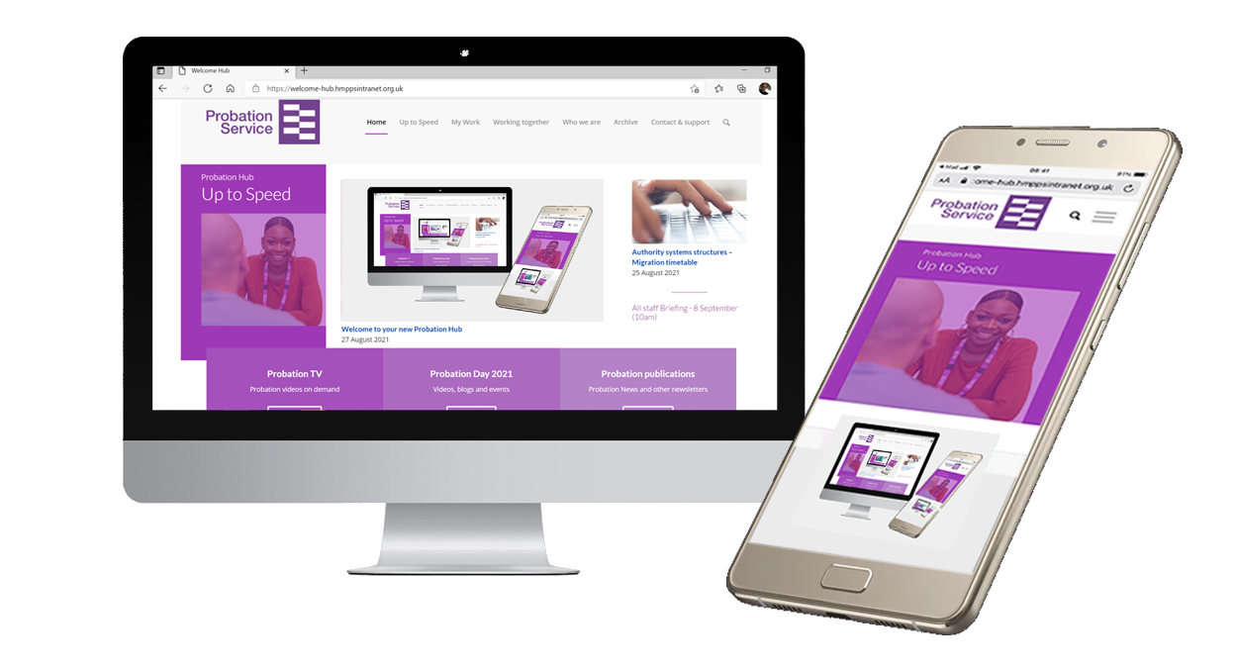
Approved Suite of Probation Practitioner Toolkits – Structured Interventions
Structured Interventions Update
The Probation Reform Programme Team is working with regions to create an Approved Suite of Structured Interventions (SIs)
Aim is to reduce the number of SIs via revision and amalgamation
This work is intended to achieve the ambition of having 10 Structured Interventions available for delivery from April 2022
Further information can be found on the Probation Hub
Delivering our services – Sentence Management
Delivering our services – Interventions
Speak to your line manager about what these changes mean for you and your region

Slide 14
Short explainers on CRS / CFO services
Jargonbuster
Choosing commissioned rehabilitative services, co financing services or both
Region specific CRS / CFO explainers are now available, highlighting the different services on offer through CRS and CFO: CFO3 and CFO Activity Hubs
Online leaflets illustrate how CFO and CRS complement each other, the differences and when each service may be needed
Provide guidance on referrals and key contact details
Click on the Probation Hub for FAQ and access to your region specific explainer
Talk with your team about what these services mean for you
HMPPS co funding organisation: CFO and CFO3
HMPPS CFO is a dedicated co financing organisation
CFO3 is the name of the current programme and targets offenders who have difficulty accessing current mainstream services
CFO Activity Hubs
Provide a safe space for ex offenders to build healthier, more stable and fulfilling lives
Offer a safe space to learn, develop new skills and meet new people by linking community engagement activities with key support
Commissioned Rehabilitative Services (CRS)
A range of services available from specialist external providers to meet key areas of rehabilitative need, including: Accommodation; Employment, Training and Education; Personal Wellbeing; and Women’s Services

Slide 15
How to refer a person on probation to the Going Forward into Employment (GFiE) scheme
Going Forward into Employment (GFiE) is a government endorsed employment scheme which offers opportunities for people on release from prison or under supervision in the community
A new and improved application process makes it easier to refer someone, including:
Step by step guide to what you need to do
Dedicated contact at the New Futures Network, the team who manage the process
Criteria for referring a candidate
Probation Officers can refer people on probation under their supervision who meet the following criteria:
Upcoming for release
Still serving their community sentence
Finished their community or custodial sentence within the past two years; certain conviction exclusions apply
If you are supervising someone who might be right for this scheme, go to the Probation Hub for more information
Got any questions, speak to Michelle.Downer@justice.gov.uk
OGD National Lead Manager, New Futures Network

Slide 16
Key worker housing for probation staff
Frontline probation staff may be entitled to take advantage of key worker housing
The scheme provides support to find accommodation that includes:
Exclusive rental accommodation, typically offered at a reduced price between 20% to 35% cheaper than average market private rentals
Option in some areas to apply for shared ownership schemes on new build properties
Opportunities are available across the country
The following schemes are available in hard to fill sites, including London and the South East, the PDUs within regions that have the greatest probation officer vacancy rates and high cost of living:
NHS Key Worker Living | Swan Housing Association, Essex
Peabody, London
A2Dominion, London and Southern England
Properties are exclusive to key workers and will depend on availability and whether you meet the eligibility criteria
To check availability across the UK, visit your local housing association or get in touch with the local authority
Notes:
NHS key workers sometimes have priority.

Slide 17
L&D: new Prevent e-learning
Prevent is the new mandatory Counter Terrorism learning package that will give staff the baseline knowledge on the Prevent duty within the UK's counter terrorism CONTEST strategy and replaces the previous Wrap 3 learning
The new content has been streamlined to focus on key themes including radicalisation, extremism and terrorism; it explores an individual’s vulnerabilities and risks of being radicalised whilst introducing staff to three key concepts: notice, check and share
The new digital design incorporates varied content that is engaging and will suit different learning styles, such as videos, case studies and key information; it will also test a learner’s understanding through a final knowledge check at the end of the session
What you need to know about the learning
It is mandatory learning and applies to all employees working in the Probation Service and must be completed every three years
If you have already completed ‘Wrap3’ in the past the years, you do not need to complete this training until that learning expires
It will take you approximately 40 minutes to complete and provides useful contact details for the Regional Counter Terrorism teams across prisons and probation
You can access the learning via the Counter Terrorism folder on myLearning here
Notes:
NHS key workers sometimes have priority.

Slide 18
L&D: new Prevent e-learning
What colleagues think of it . . .
‘It was clear, concise and gave you a good understanding of Prevent and the responsibilities of agencies in referring to Prevent…’
‘It’s bite sized and easy to digest…’
‘Well presented – a good balance of reading and videos which I particularly found engaging. I felt that it was really user friendly.’
Notes:
NHS key workers sometimes have priority.

Slide 19
L&D: new Young Adults page on My Learning
On 11 November a dedicated page is being launched on My Learning for content relevant to working with people on probation and those in custody who are aged between 18 and 25
The Young Adults page improves accessibility for all HMPPS staff to existing content, with fresh material to be added on an ongoing basis
It is a collection of literature, infographics, videos and animations as well as e-learning
Easily available digital resources will support staff in their day to day at work and can be accessed and applied immediately or when it’s most convenient
This has been developed in response to feedback from HMPPS staff that we would like to improve knowledge and confidence in working with Young Adults
In line with the commitments made in the Target Operating Model, this content will help the Probation Service work with Young Adults in a holistic, evidence based way
What you need to know about the learning
A mixture of content, including information sheets, videos and e-learning of varying lengths
Available HMPPS wide
Covers Adverse Childhood Experiences (ACES), working with Young Adult Women, Care Experience and much more
You can access the Young Adult on MyLearning here

Slide 20
[Region] November area/s of focus
Team leader to fill in
Team leader to fill in
Team leader to fill in
Team leader to fill in

Slide 21
Team November deliverables
Team leader to fill in
Team leader to fill in
Team leader to fill in
Team leader to fill in

Slide 22
Team discussion
How might these changes affect our team?
Are we clear on our individual and team next steps and delivery?
How are we managing change? Do we need support?

Slide 23
Your thoughts, questions and feedback
Please email [insert your region’s preferred Outlook account]

Slide 24
Thank you

