Slide 1
Guidance for use
  Please find attached the December Regional Team Briefing Pack
  The Probation Programmes Comms Team have worked with programme workstream design leads to consolidate several packs / correspondence into a one-stop-shop which hopefully makes handling a little easier.
  These packs have been designed as a prompt to support you in communicating Reform and Workforce Programme updates and changes in team meetings/events over the next month.
  In line with the Fixed, Flexible, Free model it has sections for you to add any specific regional updates
  Please do also use the content in your regional communications channels as you feel appropriate.
  Your feedback on design, content, language always welcome: paul.darby@justice.gov.uk

Slide 2

December 2021 Regional Team Briefing
[Insert region]

Slide 3
Our team’s opportunity to talk
We discuss how change might impact our team
We celebrate our team and our successes
We agree our team’s big deliverables
We’re aware of and informed about change

Slide 4
Today’s conversation – new this month
Pay Award 2021/22
Investing in our estate
Home Visits – new framework to support staff
Commissioned Rehabilitative Services – updated Refer and Monitor top tips
JitBit – connecting our administrative functions
ViSOR – access, use, vetting and training
Update – Approved Suite of Probation Practitioner Toolkits
People: new L&D opportunities, PQiP internal recruitment campaign and more . . .
[Insert region] – December areas of focus, deliverables

Slide 5
Pay Award 2021/22
HMPPS has now provided the final offer to the recognised Trade Unions for the Probation Service pay award for 2021 / 2022
The Probation Service pay award applies to former National Probation Service (NPS) staff with effect from 1 April 2021, with the intent to pay the award and necessary backdating in December’s salaries.
Award details:
pay progression to the next pay point for eligible staff who are below their pay band maximum as at 31 March 2021 and were in grade before 1 October 2020
a £250 consolidated uplift of all pay points under £24,000 (on full-time equivalent basis), effective 1 April 2021
Information can also be found on the HMMPS Intranet covering:
Approved Premises Residential Workers (APRW) re-band
Targeted increases in overtime rates to aid HMCTS recovery
Also on the HMMPS Intranet :
Probation Pay update Q&A
A ‘Pay Scales Effective April 2021’ document
Contact
If you have any specific questions about your pay in relation to this pay award, contact moj-hr-enquiries@gov.sscl.com

Slide 6

December 2021 Estates update
The Probation Reform Programme Estates workstream supports our Target Operating Model by providing a modern probation estate for England and Wales
Estates 2022 priorities:
Delivering upgrade projects in our 11 regions and Wales
Supporting the delivery of mixed caseloads across all regions
Supporting the investment in Unpaid Work
Assessing our building usage and capacity

Slide 7

Investing in our Estate
Continuing to deliver Estates upgrade projects in our 11 regions and Wales, creating buildings that:
Offer a more positive environment for staff, partner organisation colleagues and people on probation
Support smarter, more flexible ways of working, enabling us to reduce our estate footprint and running costs while ensuring we can accommodate additional probation practitioners and deliver the services outlined in the Target Operating Model without putting security at risk
Deliver benefits to their communities through reduced environmental impacts – for example, heating, cooling, and ventilation will be provided by high efficiency, low carbon emissions methods

Slide 8

Supporting our delivery of mixed caseloads
The Estates team is supporting plans for the expansion of the delivery of mixed caseloads across each region through:
Defining national requirements for security and agreeing these with Regional Probation Directors and Trade Unions
Agreeing with Regional Probation Directors’ their priority sites for the delivery of mixed caseloads
Surveying the entire Probation estate for adherence to the agreed security standards
Undertaking upgrade works at the priority sites in each region

Slide 9

Supporting operational delivery
Working with the Unpaid Work team to support their operational delivery
Estates support includes:
Working with the team to baseline the Estate for the delivery of Unpaid Work
Assisting in the design of the Unpaid Work future operating model
Preparing to help to deliver the Estates component of the future operating model

Slide 10
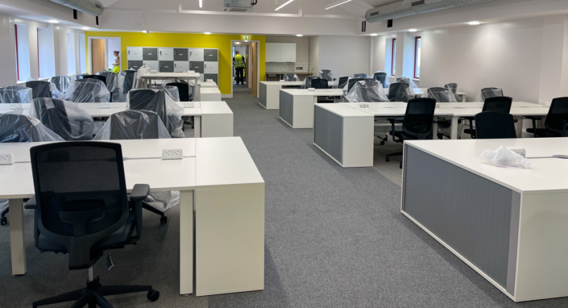
Assessing our building usage and capacity
Completing the assessment of our building usage and capacity:
It’s clear that post Covid building usage will be markedly different to pre Covid usage, which is when the Estates strategy was originally developed
Analysing the utilisation of what we have delivered by summer 2022 will help ensure the future Estates strategy continues to support wider organisational and recruitment planning

Slide 11





Your Estates questions
Your Regional Probation Director, your manager and your regional Estates team will keep you informed about what our Estates strategy and delivery means at a local office, regional and national level
Please direct local office or regional Estates questions to your manager or regional Business Strategy and Change Team – thank you
If you have a question that can’t be answered by your regional team, please email: ProbationReformEstatesPMO@justice.gov.uk

Slide 12
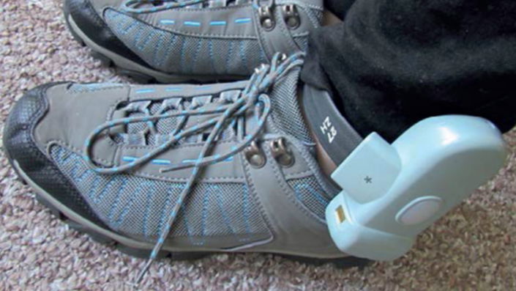
Home Visits: new framework to support our staff
Research shows that people on probation benefit from interactive, engaging supervision
This includes home visits, which is why they are an integral part of our blended supervision model
A new Home Visits Policy Framework has been developed for probation practitioners, victim liaison officers, case administrators and line managers
This Framework highlights when a home visit must occur and provides information on:
    Safeguarding, sentence management, risk assessment and management
    Health and safety requirements you and your line manager are required to complete before, during and after a home visit
Further information
Please click on the Probation Hub
The full Home Visit Policy Framework is available in EQuiP and on GOV.UK

Slide 13
Home Visits – national ‘need to know and do’
Home Visit risk assessment forms
To be completed on NDelius via an NSI – a CRI has been prepared to support this; this provides adherence to health and safety requirements
Where more than one visit is done to the same address, with no changes in circumstances, the form must be updated with just the dates of the visit; the whole form does not need to be completed
Mandatory timescales
A home visit should be conducted within 15 days of the start of supervision for individuals who are a high risk of serious harm / registered S.O. / involved in CSE
A home visit should be conducted within six weeks of the start of supervision for individuals who are a medium risk of serious harm
A home visit should be conducted within 12 weeks of the start of supervision for individuals who are a low risk of serious harm
Where new or escalating concerns arise, a home visit should be undertaken at the earliest opportunity from the identification of concern
Where increased risk or new / escalating safeguarding concerns arise, a home visit should be undertaken at the earliest opportunity, within 10 working days
Where conducting home visits is identified as part of risk management, the frequency of visits should be recorded in the risk management plan

Slide 14

Home Visits – [insert region] ‘need to know and do’
Home Visits
Insert region specific guidance
Insert region specific guidance
Insert region specific guidance
Insert region specific guidance
Insert region specific guidance
Insert region specific guidance

Slide 15


Commissioned Rehabilitative Services – updated Refer and Monitor top tips
Discover how to get the best out of our Refer and Monitor tool with new top tips on the Probation Hub
Out new top tips were developed in response to your feedback and most frequent questions
Please keep on providing your feedback so we can continue to better support you – thank you
This month’s top tips include:
When to make a pre release referral
How to notify CRS if a person is in custody at the time of the referral
How to notify the CRS provider that the referral is urgent or standard timescale
Referral closure without an End of Service report
What to do when you end a referral
How to end the CRS NSI entry in nDelius

Slide 16

JitBit – connecting our admin functions
JitBit nationally adopted
We’re modernising our digital solutions to better support how we work
This involves reviewing tools used in the NPS and CRCs before our unification and adopting and improving them for our new Probation Service
The Probation Reform Programme reviewed how requests for administrative tasks are managed through ticketing solutions such as Jira, JitBit and functional mailboxes
It was decided that JitBit provides the optimum single solution, as it offers the best balance for probation practitioners and administrative staff to track and configure administrative requests and is easy to use
Next steps
A new version of JitBit is being developed to use a single set of case administrative operating processes that will support practice in both Hub and POD models
JitBit will initially be delivered to all former NPS and CRC colleagues in our London, North East and South Central regions before the end of March 2022
Following delivery in these regions, JitBit will be rolled out nationally across the Probation Service. The programme is working with RPDs and their representatives to understand how and when they want to do this.
Online training will be provided to support the roll out schedule
Further information will be available on the Probation Hub

Slide 17
ViSOR
What is ViSOR?
ViSOR is a secure national database that supports Multi Agency Public Protection Arrangements (MAPPA), a key tool in protecting the public
ViSOR is used by multi agency staff to share information and manage individuals posing a risk of serious harm
ViSOR is one of the essential tools of the job for probation staff, enabling effective POD working and mixed caseload management
Who accesses, uses and needs to be ViSOR vetted and trained?
Staff working in LDU based Sentence Management teams:
  Senior Probation Officers
  Probation Officers
  Probation Service Officers
  MAPPA staff
  Case Administrators, MAPPA Administrators and ViSOR Administrator
Regions currently have some staff who are both vetted and trained to use ViSOR and a number of staff who have passed the vetting process but who have not yet been trained
There are other staff who have yet to be either vetted or trained

Slide 18
ViSOR
ViSOR: the big picture
Our Target Operating Model highlights the increased use of ViSOR and good working relationships with statutory agencies as targets
Over the coming years our aims are to:
  Establish ViSOR as a business as usual IT system for sentence management in the Probation Service
  Improve probation’s ability to asses risk of serious harm and put in place appropriate risk management plans to protect the public
  Contribute towards putting the right information in front of the right people at the right time
  Continue to work in collaboration with partners on the Multi Agency Public Protection System (MAPPS), the eventual replacement for ViSOR
  Provide training, support, quality assurance and monitoring of the use of ViSOR to embed its use as an everyday task
  To train all current probation staff at all grades who need to use the system by Spring 2023
Training and vetting next steps
Our current national priority for vetting and training is SPOs and other business critical staff, as this enables regions to continue to create records and upload Arms Informed OASys and to access information
Training events launch from January 2022
Vetting of all SPOs and other business critical staff will be completed by March 2022, with other staff vetted post March
Physical access
All probation buildings, including former CRC sites, are able to access ViSOR

Slide 19
Update – Approved Suite of Probation Practitioner Toolkits (ASPPT)
Implementation up to December – required action
The implementation phase for the ASPPT runs to the end of December
From January 2022 all regional toolkits will be from materials contained within the ASPPT
Time is nearly up for the availability of the temporary Non Approved Toolkit NSI, plus the non approved Murmur to Murder and Diversity Awareness and Prejudice Programme (DAPP) NSI recording options, which will be removed from nDelius after 31 December 2021
Continuation / new delivery and recording of non approved toolkit materials will no longer be supported
There is now a note alerting you to the date of removal for these NSIs on the ‘maintenance banner’ within nDelius and a supporting article in Probation News and on the Probation Hub
Your region should have identified any existing cases where non approved toolkits are being delivered and now be finishing this work and / or switching to delivery from materials within the ASPPT
Probation practitioners will need ensure they close the above Non Approved NSIs no later than 31 December 2021
After this date these NSIs will be automatically closed by the nDelius Team
This includes use and recording of non approved toolkits and also where the NSI has been used to record ‘other’ types of RAR delivery
An update will be provided ahead of January 2022 on guidance and recording for ‘other’ RAR delivery
Toolkits and Structured Interventions as part of our reforms
This forms part of our Target Operating Model. Our aspiration is to have available a range of in-house interventions:
Provision of sufficient local quality Unpaid Work placements
A suite of Accredited Programmes
A variety of Structured Interventions (approved by the National Effective Interventions Panel)
A portfolio of approved toolkits (approved by the National Effective Interventions Panel)
Check out the Target Operating Model executive summary or the full operating model, see page 93 for SIs and Toolkits

Slide 20
Approved Suite of Probation Practitioner Toolkits – ASPPT
Implementation up to December – preparation to deliver Approved Toolkits
From January 2022 only delivery and recording of Approved Toolkits is supported
SPOs will need to ensure that, where relevant, probation practitioners are familiar with the Approved Suite of Probation Practitioner Toolkits and have undertaken any toolkit specific required familiarisation, briefing or training ahead of delivery
Each of the Approved Toolkits details what the learning opportunities for probation practitioners are and what is required ahead of delivery
These learning opportunities range from and include the following activities:
  Undertaking manual familiarisation
  Watching content / delivery related videos
  Attending / watching a briefing event
  E-learning
  Practitioner workbook completion
  Formalised / assessed training attendance
For more information about what learning and development support is available for each Approved Toolkit within the Suite, please refer to the relevant Approved Toolkit’s manual / information within EQuiP
Toolkit development
Four new toolkits will be taken through the National Effective Interventions Panel in January 2022
If successful, they will join the Approved Suite of Probation Practitioner Toolkits and be made available in EQuiP from February onwards

Slide 21

New MAPPA learning available
New MAPPA – multi agency public protection arrangements – learning is now available on myLearning at: Enter your username and password (kineodns.com)
Who should complete?
Relevant to all legacy CRC staff working in sentence management and forms part of your transition learning
Applicable to all practitioners and is of relevance to:
  PQiPs: trainee probation officers
  NQOs
  Those moving in to or returning to sentence management.
Also relevant as an up to date refresher for those already experienced in managing people on probation where MAPPA applies
Read the full article on the intranet
Top tip
Information on how to access myLearning can be found on the Probation Hub

Slide 22
New SEEDS2 learning available in January
New SEEDS2 learning products from the Design Faculty launch in 2022
These SEEDS2 learning products focus on the person centred and relational approaches that are key to our everyday interactions with staff and people on probation
SEEDS2 for SPOs bookings open in January 2022 with delivery starting in March 2022
Learning products for probation practitioners and senior managers / leaders will follow, meaning that SEEDS2 can be embedded across the organisation at all levels
Further updates will be provided as each learning product launches
‘We live SEEDS2 every day – it’s the coat we wear.’
Sonia Flynn
22

Slide 23

January PQiP internal recruitment campaign
Find out whether training to be a probation officer is for you? Join a December introductory webinar
PQiP internal recruitment campaigns open in January
In preparation we’re running a series of webinars in December to explain the different internal paths to becoming a trainee probation officer, and hints and tips to the application process
Introduction to becoming a trainee probation officer: two identical sessions – you only need to attend one of them
    Wednesday 8 December – 9.30am to 10.30am – click here to register
    Thursday 9 December – 2pm to 3pm – click here to register
  Hints & Tips to the PQiP application and interview process: as above
  Wednesday 15 December – 9.30 to 10.30am – click here to register
  Thursday 16 December – 2pm to 3pm – click here to register
Tuesday 4 January 2022
Next PQiP PSO Progression internal recruitment opens to all existing Probation Service Officers, with or without a degree, who have passed their probationary period
Monday 17 January 2022 Applications from all other internal staff with graduate degrees opens

Slide 24

Calling vacancy managers
Going Forward into Employment (GFiE) is a government endorsed employment scheme which offers opportunities for people on release from prison or under supervision in the community
Since 2016, candidates have been placed in roles across the Civil Service
The Life Change Resourcing Team, MoJ People Group, can help you to directly recruit candidates with lived experience of the criminal justice sector, to roles that fit the following criteria:
    Graded at Probation Band 2 to 3, MoJ Band F to D or HMPPS Band 2 to 4
    Fixed term appointment for up to 24 months that can be made permanent after 12 months
    Not require National Security Clearance – CTC,SC,DV
    Approved and supported by the Business areas Deputy Director / Regional Probation Director
A quick and easy process
    Life Chance Resourcing Team, MoJ People Group, will manage the appointment of your successful candidate, including uploading vacancy / candidate details to Oleeo and commencing the vetting process, including Right to Work
    New Futures Network (NFN), HMPPS, will advertise the vacancy, support candidates with applications and sift applications to provide you with a small pool of eligible candidates
Go to our new page on the Probation Hub for full details
Any questions speak to Head of Life Chance Resourcing Anthony.Andrews5@justice.gov.uk who will be happy to address any queries or talk through a role you’d like to fill

Slide 25
Next steps for the Workforce Strategy – book your spot
Get involved in setting our course
We need to make sure that our workforce strategy meets the needs of the organisation and our people, especially following unification and Covid-19
We’re inviting staff to get involved in setting our course and evaluating and updating the strategy by Summer 2022 taking us through until 2025
There’ll be a couple of ways you can get involved including a short survey and workshops
The workshops will take place in the new year and will be an opportunity to hear from people directly about the current challenges faced by our workforce and what the future challenges might be, so that we can make sure our strategy continues to focus on the right things
Book your spot
If you’d like to take part in the workshops please check with your manager first and then send us an email at probation.workforce@justice.gov.uk
Please ensure your email signature specifies your team
We’ll come back to you with all the details
Even if you just have a thought, question or suggestion, use the same mailbox to get in touch
25

Slide 26
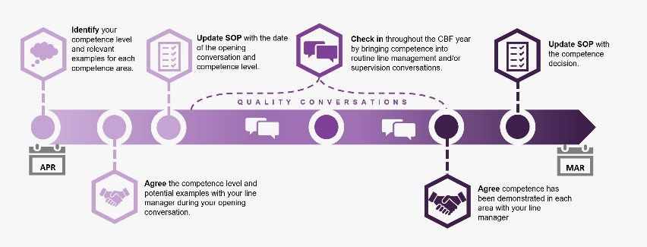
January webinars on Competency Based Framework ‘closing conversations’
Entering the last phase of the trial year of the Competency Based Pay Progression Framework, or CBF
‘All staff sessions’ taking place to support preparations for ‘closing conversations’ between employees and line managers; follow the links below to join the events:
    January 13th CBF session
    January 18th CBF session
A reminder
The CBF is for all staff on Probation Service terms and conditions, regardless of whether you are former NPS staff, former CRC staff or new joiners
This is a process to move you through your pay band, it is not required of staff who are already at the top of their pay band – although it is recommended that you engage with the CBF this year in case you need to use it in future
For more information on the CBF go to myHub
26

Slide 27
[Region] December area/s of focus
Team leader to fill in
Team leader to fill in
Team leader to fill in
Team leader to fill in

Slide 28
Team December deliverables
Team leader to fill in
Team leader to fill in
Team leader to fill in
Team leader to fill in

Slide 29
Team discussion
How might these changes affect our team?
Are we clear on our individual and team next steps and delivery?
How are we managing change? Do we need support?

Slide 30


Your thoughts, questions and feedback
?
Please email [insert your region’s preferred Outlook account]

Slide 31
Thank you

