Slide 1
January 2022 Regional Team Briefing
[Insert region]

Slide 2
Mixed caseloads: background
What do we mean by mixed caseloads?
The Probation Service’s Target Operating Model defines an end state where former CRC and NPS caseloads are unified, enabling probation practitioners to hold mixed and varied caseloads, in accordance with our Unified Tiering Model
Please see our Staff Guidance and Tiering and Case Allocation Framework in EQuiP for details
What are the benefits of mixed caseloads?
Achieving unified caseloads will deliver many benefits, including supporting improved outcomes for people on probation, and help us to:
Improve continuity for our probation practitioners and people on probation
Enhance staff wellbeing by reducing the emotional burden of managing particular cohorts
Develop a more skilled, knowledgeable and flexible workforce, with greater opportunities for career satisfaction
Unite our organisation

Slide 3
Mixed caseloads: context
We recognise that, while caseloads have begun to mix in most regions, most staff will not yet be experiencing the full benefits associated with holding a varied caseload, which will likely be realised incrementally
Staffing gaps in the workforce have hindered the ability to provide Probation Officers with more varied risk levels within their caseloads – i.e., managing Tier C cases
Work is underway to recruit to Probation Officer vacancies alongside the increased targets for PQiP recruitment
However, given the staffing position inherited by the new Probation Service and the time it will take to recruit and train Probation Officers, we anticipate reaching target staffing levels in 2025
The experience of staff will be different in Probation Delivery Units across the country, depending on staffing profiles
The Probation Reform Programme is focused on ensuring that the enablers for mixed caseloads are fully delivered in regions
These enablers include: the release of relevant Learning & Development modules and ViSOR vetting, to enable regions to deliver mixed caseloads and digital migration which has now been completed in all regions
Timescales for delivery will vary and should be communicated to staff by regional leadership
The impacts of these changes on operational staff have been reviewed and will remain under review as implementation progresses

Slide 4
Probation Reform Programme: areas of focus
Completion of digital migration enabling new allocations across staff groups
All relevant Learning & Development to be made available, and to be completed by relevant staff groups in the region
Enabling regions full control over allocation of cases to probation practitioners; please note that this is only relevant to regions serviced by the Probation Service Centre
New cases can be allocated across historic staff group split
Existing caseloads can be re allocated across historic staff group split
The majority of probation estates are equipped to facilitate contact with individuals of all risk levels
A ViSOR Vetting & Training plan is in place

Slide 5
Probation Reform Programme: delivery to support mixed caseloads
Overall
Most regions have started the move to mixed caseloads and anticipate the completion of relevant Learning & Development and Professional Service Centre regionalisation, where relevant, by June 2022
Your Senior team will confirm timescales for your region
Learning & development
MAPPA Learning & Development launched in November 2021
SEEDS2 Learning & Development for Senior Probation Officers will be available in early 2022, followed by SEEDS2 for probation practitioners and senior managers
Professional Service Centre
Where relevant, allocation activity, except stand alone unpaid work, was regionalised in October 2021, allowing regions full control over allocations
ViSOR
Vetting & Training plan has been published setting out our approach to ensuring all relevant staff are appropriately vetted and trained
Estates
New security standards are currently in consultation with Trade Unions

Slide 6
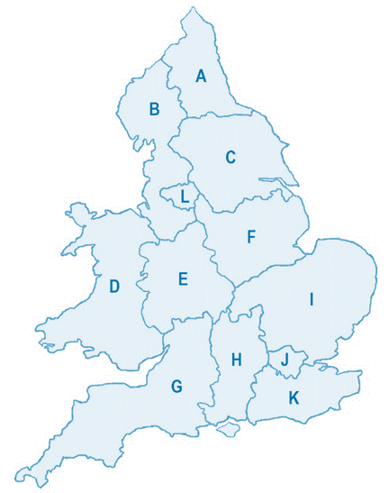
[insert region]: mixed caseloads picture
Region to insert appropriate information, e.g.:
Staffing profile
Learning & Development status
Delivery timescales

Slide 7
Mixed caseloads: your questions
Your Regional Probation Director, your team leader and your manager will keep you informed about what mixed caseloads means at a local, regional and national level
Please direct your questions to your manager, team leader or Regional Probation Director – thank you
If you have a question that can’t be answered by your regional team, please email: mixedcaseloads@justice.gov.uk

