Slide 1
Presenter’s notes
The March Regional Team Briefing is attached
The PPCET* team work with Probation Programmes workstream design leads to consolidate several communication products into one monthly cascade deck, to support clear and consistent communication with our staff in all regions, roles and functions
These packs have been designed as a prompt to support you and your management teams in communicating updates and changes in team meetings/events over the next month
In line with our Fixed, Flexible, Free model, this deck includes sections for you to add in your team or region specific information.
Please do also use the content in your regional communications channels as you feel appropriate
Your feedback on design, content, language, etc, is valued and welcome – please contact paul.darby@justice.gov.uk
Please delete this slide before you present this deck to your team – thank you
* Probation Portfolio Communication and Engagement Team formerly Communication, Engagement and Marketing Team (CEM)

Slide 2
Probation Programmes
March 2022 Regional Team Briefing
[Insert region]

Slide 3
Our team’s opportunity to talk
We discuss how change might impact our team
We celebrate our team and our successes
We agree our team’s big deliverables
We’re aware of and informed about change

Slide 4
Today’s conversation – new this month
Our priority for 2022 - Delivering Excellent Practice
Prioritising Probation: Prioritisation Framework / Vetting / OASys /
Digital Tools and Systems Roll-Out
UPW Assessment
Effective Proposal Framework 2
Competency Based Framework (CBF)
Learning
Toolkits: New me MOT now available to book
Acquired Brain Injury (ABI) - learning opportunity for operational court staff
Vetting
Change Map – Overview REMINDER
[Insert region] – March areas of focus, core team delivery

Slide 5
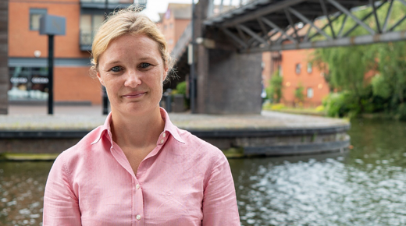
Delivering Excellent Practice
DG Amy Rees has launched a new single priority for the Probation Service
Having delivered a generational change by unifying the Probation Service we are now focussed on a single priority: delivering excellent practice in probation across England and Wales.
Everything we do must be about quality and ensuring the work we are doing is the right work, that we have the right numbers of staff and staff have the right tools and environment to deliver that important work.
This means everything we do is ultimately about supporting you to assess the people we work with, protect the public and support/challenge people on probation to change their lives and move away from crime.
Further information
Amy writes about ‘Delivering Excellent Practice in her ‘all staff message’ published on the on the Hub
Amy will be discussing ‘delivering excellent practice’ in more detail at the next all staff live event on the 30th March. Join the conversation.
Look out this month for further details in Probation News and through your regional channels.

Slide 6
Prioritising Probation
There is a lot going on as part of our initiative to identify and bring together what can be done to
ease the pressures on the front-line and support you in delivering excellent practice. Latest update includes info on:
Prioritisation Framework
OASys
Vetting
To find out more and keep updated on workload support changes as they happen, please visit our
rolling news feed on the Probation Hub:
Prioritising Probation – Welcome Hub (hmppsintranet.org.uk)

Slide 7
Digital Systems and Tools: What’s happening
Digital support
We are modernising your digital tools and systems to better support you with your work and ‘deliver excellent practice’.
We are reducing duplication in systems, streamlining processes and enabling better data recording and analysis, to support you with your workload management and decision making.
We have reviewed tools that were used to good effect in the NPS and CRCs prior to unification, adopting and improving them, or identifying gaps and building new ones.
Built iteratively by digital specialists with ops staff, for ops staff
New Probation tools and systems are being built iteratively by probation programme staff, operational staff and digital specialists working together.
Beta versions of tools are launched, ops staff experiences are tracked, the digital team get a better understanding of what works and what could be changed, and build and develop even better versions of the tools with you
A Digital ‘Show and Tell’ is being held on 4th April
Look out for further information in Probation News, on The Probation Hub and your local channels

Slide 8
Unpaid Work Assessment - Snapshot
What is it?
A new digital unpaid work assessment for all regions and Wales.
Why is it being introduced?
It is important that people on unpaid work are allocated to the most suitable unpaid work project or placement for them, taking account of their risks and needs. There are currently a variety of ways this is done across England and Wales.
To support doing it more effectively and consistently the new digital unpaid work assessment is being launched.
What’s happening when: roll-out
The unpaid work assessment was successfully piloted with a small staff group throughout November and December 2021.
The digital unpaid work assessment tool and process are being rolled out to regions in 4-phases by the end of March 2022
The roll out schedule for the digital Unpaid Work assessment is subject to change, depending on each previous stage being successful and regional requirements.
Phase | Details | Region (s) | Timeframe
1 | Launch to pilot group | 1 in each region | COMPLETED
2 | Launch to 1 region | South Central | COMPLETED
3 | Launch to 4 further regions | EofE, WM, YatH & GM | 3rd March 2022
4 | Launch to 6 further regions and Wales | KSS, NE, NW, Wales, SW, EM & London | 17th March 2022
What do I need to do?
The unpaid work assessment will need to be completed by probation practitioners because they are the experts on identifying and managing risks and needs.
This will not represent a change in most probation regions but in a small number, where the assessment is currently completed by unpaid work supervisors, it will. Speak to your line manager about what this means for you in your region.

Slide 9
Unpaid Work Assessment – How It Works
The new unpaid work assessment is populated with three sources of information - NDelius, OASys and ‘other’ information (i.e. that is not recorded on either of those systems).
The unpaid work assessment is accessed by clicking a link in NDelius. As it opens, it pulls through known risk and needs information from NDelius and OASys, reducing the need for practitioners to re-enter information that has previously been recorded.
If an OASys has not previously been completed, or was completed more than 12 months ago, then a new OASys risk screening (including a full analysis, if triggered) must be completed before commencing the unpaid work assessment. OASys sections 2-13, the RMP and the ISP do not need to be completed.
The practitioner works through the assessment with the person on probation, editing information and answering all questions. Once completed, the form is automatically saved as a PDF in NDelius (in the document list) for the unpaid work placement coordinator to access and use when allocating the PoP to a project.
Once the probation practitioner has completed the digital unpaid work assessment it is automatically converted into a PDF document and saved to the ‘document list’ tab in NDelius.
Placement coordinators will need use professional judgement and access the PDF at the most relevant time in order to inform decision making when allocating the individuals to the most suitable project.
Placement coordinators should only have to access the digital unpaid work assessment rather than searching for risk and needs information in NDelius, OASys and a separate unpaid work assessment.
Further information …is available on the Probation Hub.
The Hub includes a Video, FAQ, a walkthrough of the digital unpaid work assessment and a copy of the digital unpaid work assessment guide
Look out for more Information in your region

Slide 10
Unpaid Work Assessment - Benefits
What are the benefits?
The digital assessment has been designed to save practitioner time by removing the need to duplicate information previously entered into case management systems.
It will improve the consistency and accuracy of recorded information will lead to unpaid work teams getting more relevant information so they can ensure people of probation are placed on the most suitable projects.
Probation Practitioners
The UPW assessment extracts known information from NDelius to pre-populate the form. This will removing the need to duplicate information previously entered. It will also improve consistency and accuracy of recorded information.
Probation practitioners will be able to correct any errors in the form.
The EASU code (used to confirm completion of an unpaid work assessment on NDelius) will no longer need to be manually entered once the new unpaid work assessment is in use.
Placement Coordinators
There should little impact of the introduction of the digital unpaid work assessment on the work of Placement Coordinators. However, the improvement in the range, consistency and quality of information you receive, should improve.
Once complete, the assessment will be converted into a PDF document and saved in NDelius for unpaid work staff to use when allocating individuals to the most suitable project
Placement coordinators will only have to access this one document rather than searching for risk and needs information in NDelius, OASys and a separate unpaid work assessment.

Slide 11
Effective Proposal Framework 2
Who needs to know?
Community based Regional Managers, PSOs, POs and SPOs
What is it?
The EPF 2 (Effective Proposal Framework 2) is a digital tool which helps create shortlists of interventions and licence conditions to assist the pre-release planning process.
The suggestions offered by EPF 2 are tailored to the Person on Probation based on the information input by COMs.
By entering information on offending behaviour, individual profile, and risk and need, the tool will shortlist the most relevant licence additions and available interventions, locally and nationally.
The shortlist enhances professional judgement, requiring COMs to make nuanced decisions around necessity and suitability when choosing options
The use of EPF 2 in pre-release planning is a mandatory requirement for COMs working with People on Probation being released from custody (s3.3 Licence Conditions Policy Framework), but it is not required for those released On-the-Day from Court, PSS only releases or ROTL (Release on Temporary Licence).

Slide 12
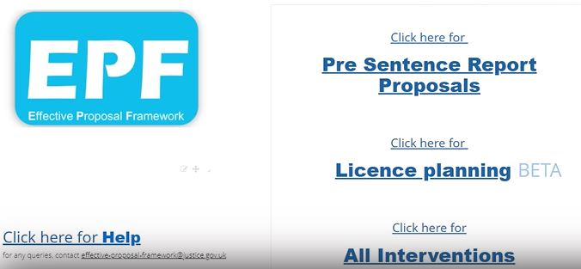
Effective Proposal Framework 2
What’s happening when?
The roll out of EPF 2 is now complete. EPF 2 live briefings have been completed across all regions and EPF 2 accounts created for all COMs.
Live briefings will continue for the new PQiP cohorts in 2022 (EPF Leads will be given more details about this shortly).
What do I need to do?
Use EPF 2 in pre-release planning.
EPF 2 plans are required for PAROM, PD1, and can be used to support pre-release case discussions at MAPPA and MARAC meetings.
More information
Watch the EPF2 ‘Pre-Release Planning’ video it’s only 6mins long and showcases how the EPF and EPF2 works and how it can benefit you, your team and people on probation
Watch the EPF2 ‘How to create a plan’ video if you’re new to EPF 2 or need a refresher on how to complete a plan
Read the EPF User Guides and FAQ in EQUIP Login in to the EPF Home page (you’ll need your login and password)
Each region has an EPF 2 Lead or Champion to assist with the continued work of supporting colleagues in using the tool. Ask your SPO for more information

Slide 13
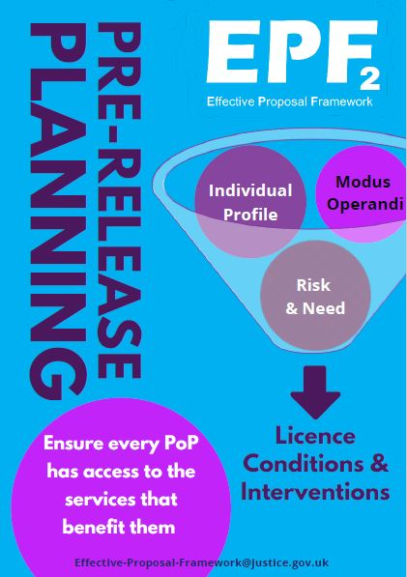
Effective Proposal Framework 2
What’s the benefit…
Planning for pre-release using EPF 2 reduces unconscious bias and ensures that those released from custody have access to the interventions that most benefit them, and licence conditions that effectively manage risk and protect the public
The ability to have sight of all that’s available to impose via EPF 2 and using professional judgement to make definitive choices enables COMs to plan for pre-release efficiently, consistently, and in line with policy (s3.3 Licence Conditions Policy Framework ), whilst reducing the likelihood of post-release licence amendments.
Stay up to date with 189 interventions and licence conditions currently available, and access all the guidance, eligibility and policy information for every intervention and licence condition.
Access information on eligibility and availability of interventions nationally.

Slide 14
Learning - Toolkits: ‘New me MOT’ now available to book
It’s important that any person who completes an accredited programme - either in prison or on probation - is supported by Probation Practitioners who understand the programmes they have graduated from and how to provide ongoing support.
‘New Me MOT’ training is available for booking and provides support for Probation Practitioners in helping aligned accredited programme graduates to translate their learning into everyday use, and beyond the lifetime of the programme. This learning in turn also supports the risk management responsibilities of practitioners - ensuring people in prisons and on probation understand how to play a proactive role in managing their own risk.
Designed with the support of probation staff, this learning package is now available on myLearning and required learning as part of an induction for all probation practitioners new to managing a caseload. It is desirable learning for all those currently managing a caseload. It will particularly beneficial for:
• Staff who recently transitioned into the organisation (part of your transition learning)
• Trainee (PQiP) and graduate (NQO) probation officers
• New joiners and those returning into sentence management roles
• A refresher for those already experienced in managing people on probation
‘Required’ learning
for new staff
‘Desirable’ learning for those already in post
More information
Visit the Probation Hub for more information on toolkits

Slide 15
Acquired Brain Injury (ABI) - learning opportunity for operational court staff
Fantastic opportunity for operational court staff to access bespoke learning to further their understanding of Acquired Brain Injury and the impact this may have on cognitive functioning.
Research indicates that more than half of people in custody have sustained a traumatic brain injury.
Sentencing Council Guidelines (October 2020) require the court to consider any neurological impairment that the
offender was suffering from at the time of the offence. Thus essential that staff producing pre-sentencing reports
understand the impact of Acquired Brain Injury (ABI).
Two-hour virtual briefings 2pm- 4pm on a variety of dates throughout March –see below.
Highly relevant CPD offer to engage in accessible learning to greatly improve the quality of PSR proposals and subsequent sentencing. Great opportunity for staff to demonstrate additional competency and skills, create quality completions of objectives and enhance the value of interactions across court settings.
Mental Health champions based in Offender Management roles can also access this exceptional offer exclusively on the 9th and 10th of March only. SPOs should follow the format below for registration including the learner’s role.
SPOs can book by e-mailing national.delivery.team@justice.gov.uk with the staff learner’s name, staff ID number and e-mail address.
Wednesday 9th March | Wednesday 16th March | Tuesday 22nd March | Tuesday 29th March
Thursday 10th March | Thursday 17th March | Thursday 24th March | Wednesday 30th March
 |  | Friday 25th March | Friday 1st April

Slide 16
Competency Based Framework (CBF) –the fair and simple process to support your pay progression
CBF is the new mechanism that probation staff will use to move through the pay points on your pay band. CBF is entirely separate to reward and recognition and performance management - the SPDR process is currently suspended, BUT this is not to replace it.
Pay progression on 1 April 2022 will remain contractual and automatic, without reference to CBF for all Probation Service staff. This means that from April 2023, your pay progression will be dependent upon you having engaged with CBF during 2022/2023.
We have come to the end of the 2021/2022 CBF trial year - we have been listening to staff feedback we have received and the headline completion data from SOP and will review and act on it ahead of the start of the new CBF year.
The new CBF year commences on the 1st April for all staff who are on Probation Service terms and conditions.
Between April and June, line managers and staff will need to hold their opening conversations, discuss the competence areas and record their competence level on SOP.
Staff impacted by harmonisation will become in scope for CBF once terms and conditions are aligned to those of the Probation Service. As such, you are encouraged to familiarise yourself with CBF.
Further staff events are scheduled ahead of the new CBF year - March 24th and March 28th
Further information
To find out more, please visit the Probation Hub and the My Hub

Slide 17
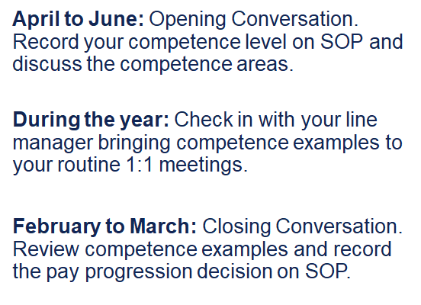
Competency Based Framework (CBF) –what do I have to do?
TEAMWORK
DECISION MAKING
LEGISLATION, POLICY & PROCEDURE
RISK
SERVICE DELIVERY
LEADERSHIP & MANAGEMENT
To find out more, please visit Probation Hub and the My Hub

Slide 18
Vetting - Completing security vetting for legacy CRC staff
As part of the 2021 unification process all legacy CRC, Parent Organisation and partnership staff who were joining the new Probation Service were required to complete an abridged vetting process.
This was to ensure that all staff met the Civil Service vetting requirements and had the necessary clearance for their new role.
Given that there remains a significant amount of outstanding vetting cases, all Regions and Wales are now starting regular assurance checks with SSCL to ensure that our organisational commitments to uphold personnel security are met. If vetting has not been progressed, staff will be contacted by their region and SCCL.
Further information
If staff have any questions about the process, or the stage of vetting that they are in, they should contact SSCL via:
Telephone: 0345 241 5359
Email: MoJ-recruitment-vetting-enquiries@gov.sscl.com
There is also a live chat function available within the system, accessible from each section of the vetting questionnaire.
Vetting guidance can also be found on the Probation Hub

Slide 19
Reform and Workforce Programmes Change Map - Overview
The Probation Change Map has been developed to help you understand the changes that will affect your role, what the changes mean and when you can expect them.
It provides a forward look, as well as a section that shows changes that have already taken place.
It provides the national high-level overview. There will be some regional differences that will be communicated in your region.
The Full Change Map is available as a downloadable document on the Probation Hub
For a brief snapshot see the March 2022 - June 2022 overview
Again, there will be some regional differences that will be communicated in your region.

Slide 20
[Region] March area/s of focus
Team leader to fill in
Team leader to fill in
Team leader to fill in
Team leader to fill in

Slide 21
Team discussion
How might these changes affect our team?
Are we clear on our individual and team next steps and delivery?
How are we managing change? Do we need support?

Slide 22
Your thoughts, questions and feedback
Please email [insert your region’s preferred account]
Thank You

