Slide 1
Presenter’s notes
The April Regional Team Briefing is attached
The PCET* team work with Probation Programmes workstream design leads to consolidate several communication products into one monthly cascade deck, to support clear and consistent communication with our staff in all regions, roles and functions
These packs have been designed as a prompt to support you and your management teams in communicating updates and changes in team meetings/events over the next month
In line with our Fixed, Flexible, Free model, this deck includes sections for you to add in your team or region specific information.
Please do also use the content in your regional communications channels as you feel appropriate
Your feedback on design, content, language, etc, is valued and welcome – please contact paul.darby@justice.gov.uk
Please delete this slide before you present this deck to your team – thank you
* Portfolio Communication and Engagement Team formerly Communication, Engagement and Marketing Team (CEM)

Slide 2
Probation
April 2022 Regional Team Briefing
[Insert region]

Slide 3
Our team’s opportunity to talk
We discuss how change might impact our team
We celebrate our team and our successes
We agree our team’s big deliverables
We’re aware of and informed about change

Slide 4
Today’s conversation – new this month
Ukraine Information Pack
Prioritising Probation – speeding up recruitment
Vetting
Equalities Monitoring
Estates
New Toolkits launching
Competency Based Framework
Digital Spotlight
Create and Vary a Licence
Help shape the new HMPPS Intranet
Learning and Development
Managing Violence & Aggression in the Workplace - NEW
Child Safeguarding - NEW
New Me MOT learning / SEEDS2 – UPDATE
Insights Festival
Stalking awareness events
Probation in Court - EM Curfew requirement mandatory enquiries (checks)
Expansion of the victims contact scheme to stalking/harassment offences
[Insert region] – April areas of focus, core team delivery

Slide 5
Ukraine Information Pack
A ‘Ukraine Pack’ is now available with information for staff and people on probation
Details include:
Various Ukrainian support schemes
Information on services accessible to Ukrainians coming to the UK
Information for staff on the Homes for Ukraine scheme.
The Ukraine Information Pack can be found on the Probation Hub

Slide 6
Prioritising Probation - ‘protecting the frontline’ UPDATE
Areas of focus
Speeding up recruitment and increase the number of staff
Give regions more flexibility to pause or stop non-essential activity
Simplify or stop some processes
Lessen the amount of changes or spread them out more during 2022
Reduce or better manage requests from HQ to regions
Reducing workloads by speeding up recruitment
Findings within the ‘speeding up recruitment’ focus area have resulted in several solutions:
Post-employment vetting: Making conditional offers shaves time off the recruitment processes as people can start work before vetting is complete. Over 400 candidates have now been offered roles subject to passing the final stage of vetting post-employment
Existing candidates stuck in the recruitment system: These potential recruits have been identified and currently being targeted to push them through the system faster
Single Point of Contact: MoJ Resourcing are establishing bespoke support for several regions with the greatest recruitment needs
Improved agency staff provider support: Where an agency is unable to fill a post immediately, they will go to other agencies to source candidates
Identifying further blockages: A Recruitment Task Force has been stood up. It has started a process mapping exercise across the recruitment system to further identify delays and blockages in an effort to reduced them
Regular updates available on the Probation Hub

Slide 7
Completion of vetting – former CRC, parent organisation & supply chain staff
During March, many former CRC, parent organisation and supply chain staff have been contacted by SSCL to complete their outstanding vetting requirements. Significant efforts have been taken across regions to correct staff contact details and remind everyone of the vetting requirements and steps needed to complete these.
We have seen a significant reduction in the number of outstanding vetting cases with a combination of over a 1,000 individuals either progressing, completing or being correctly identified and communicated with across the vetting steps. Thank you all for your attention so far.
Over the last few weeks, a number of common questions have arisen. We have updated the vetting information on the Probation Hub –read the updated FAQs here.
Please do not hesitate to contact SSCL if you are unsure of your current status. Details below
SSCL
Telephone: 0345 241 5359
Email: MoJ-recruitment-vetting-enquiries@gov.sscl.com
There is also a live chat function available within the system, accessible from each section of the vetting questionnaire.

Slide 8
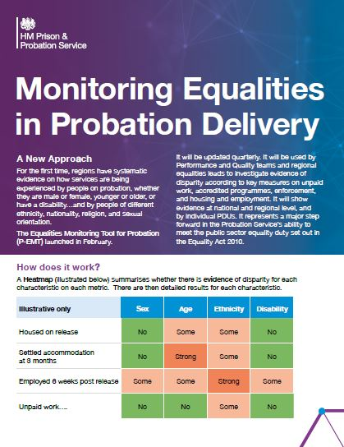
Equalities Monitoring - Update
The Equalities Monitoring Tool for Probation (P-EMT) was launched in February.
It is being used by Performance and Quality teams and regional equalities leads to investigate evidence of disparity according to key measures on unpaid work, accredited programmes, enforcement, and housing and employment.
For the first time, regions have systematic evidence on how services are being experienced by people on probation, whether they are male or female, young or old, or have a disability and by people of different ethnicity, nationality, religion, and sexual orientation.
How can you help?
Please support the work of your regional colleagues by using the new diversity and inclusion form.
The P-EMT needs accurate data. Using the new form improves how people on probation are asked about their protected characteristics so these can be recorded accurately on the Equalities Monitoring Pane in nDelius.
Further information
Search for ‘Equality and Inclusion’ in Equip to access the short Equality Monitoring Leaflet for all you need to know

Slide 9
Estates
We’re modernising our estate to provide you, colleagues from partner organisations and people on probation with modern, safe and enabling environments.
It is one of our key priorities highlighted in our Target Operating Model for Probation Services in England and Wales (pages 155-157)
Our Estates strategy is focussed on:
Providing a modern workplace
Enabling our estate to act as a catalyst to change the way Probation Service staff work
Enabling the Probation Service to work toward environmental sustainability and equality compliance
Creating a corporate look and feel (see our Probation Estates Design Guide)
We also aim to deliver a smaller probation estate and achieve better value for money

Slide 10
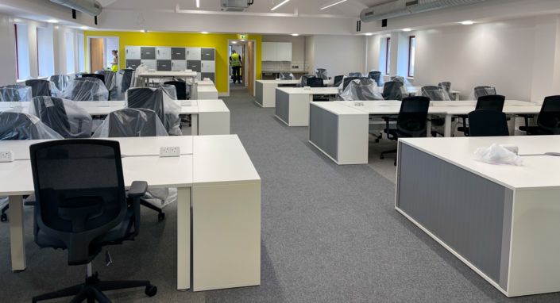
Estates – The National Picture
In the first two years of our strategy, over £60m has been invested to upgrade our buildings.
Following completion of our Year 2 projects, the Estates Team will have delivered 22 new properties, significantly refurbished 36 sites, carried out 36 Smarter Working projects and addressed backlog maintenance works at over 100 properties.
In Years 3 and 4 of the strategy we will invest a further £39m in our estate.
Up to 15 new properties and 7 refurbishments are planned for delivery in April 2022 – April 2023, with security upgrades included at each site to facilitate mixed caseloads.
Over the coming months we will also complete the remaining Smarter Working initiatives that were approved in 2021/22 and undertake a further round of backlog maintenance activities.
Projects to be delivered in 2023-2024 will be confirmed towards the end of 2022-23.
The Estates Team continue to work with the Unpaid Work Team to support operational delivery, including assisting with the design of the Community Payback future operating model.

Slide 11
Estates – Your Region
What’s Happening
Region to fill in - Projects completed in first years of strategy
Region to fill in - Projects underway that will be wrapping up in the next 6 months
Region to fill in - Any additional projects for 2022/23
Your region
Please direct local office or regional Estates questions to your Estates Team or Business Strategy and Change Team contacts
Your leadership team and your regional Estates team will keep you informed about what all this means for your local office and region
Further information
Check out the Estates and Facilities Management section on the Probation Hub

Slide 12
Approved Suite of Probation Practitioner Toolkits (ASPPT) Update April 2022
The National Effective Intervention Panel concluded ASPPT approvals in January 2022
The panel approved a further 4 toolkits First Steps to Change (women), Moving On, Creating Positive Connections and Responsibly Aware (refer to next slide for further details)
These Toolkits will be available from 25th April 2022 (represented on the EPF Tool and each have specific Ndelius NSIs for recording)
Additional guidance and a ASPPT briefing video will also be available to support the implementation of the now completed suite from 25th of April 2022.
No new toolkits are planned for development for the foreseeable future with resource focussed on implementation and promotion and undertaking of a ASPPT Implementation Review during 2022.
Check out the ASPPT Probation Hub page for a summary. Full information and guidance is available and homed in EQuiP.
All queries and feedback should to be directed to NEIP@justice.gov.uk
Toolkit development
All Toolkits are National Effective Intervention Panel approved and endorsed by Accredited Programmes and Interventions Delivery Strategy Board.
Approved toolkit developers will maintain and improve materials as required to ensure they remain responsive to Practitioners needs and those of People on Probation.
New Toolkits to have branding and formatting work undertaken by professional design studio.

Slide 13
Approved Suite of Probation Practitioner Toolkits (ASPPT) Update April 2022
Toolkits | Suite Update | Go-Live
The Approved Suite of Probation Practitioner Toolkits as launched June 2021 | New Me MOT Constructive Conversations (replaces Developing Dialogues) Stepping Stones Skills for Relationships - A new version of the Skills for Relationships Toolkit is set to be released in May following a content refresh and design work to align it with Structured Interventions. Choices and Changes Maps for Change Pathways for Change (added October 2021) Connection and Community – Chemsex (London Only) will be discussed at Accredited Programme Interventions and Strategy Board in April 22 for decision on continuation and format of materials as well as consideration of the availability of the agreed product nationally in the future. | Can be found on EQuiP; EquiP process and guidance – RAR Toolkit

Slide 14
Approved Suite of Probation Practitioner Toolkits (ASPPT) Update April 2022
Toolkits | Suite Update | Go-Live
Former CRC Toolkits | Moving On - Men 18+ who are experiencing emotional or psychological blocks that prevent them from moving forward positively with their lives, potentially hindering desistance. These individuals are likely to be emotionally ‘stuck’, grappling with shame feelings or other negative self-directed thoughts, Will have an initial 3 month soft launch in 2 regions (London plus 1 TBC) before full national roll out. Positive Connections - Men 18+ where it has been identified that they could benefit from developing skills to identify support networks, build self esteem and confidence to support development of social capital and personal connections. Responsibly Aware - Men 18+ developed as an early intervention toolkit for males who have started to experience problems in relation to their substance misuse. It takes a harm reduction approach encouraging the participant to develop safe and responsible use. It is not for people who substance use has reached addiction where alternative intervention would be required. | 25th of April Will be available at; EquiP process and guidance – RAR Toolkit
Women’s Toolkit | First Steps to Change - Women 18+ intends to support engagement and compliance during the early stages of an Order/Licence by providing practical activities focused on building skills, strengths and strategies to encourage them to desist from offending and have a positive future, taking into account that for a woman to be motivated, she needs to feel safe and supported by someone with a genuine interest in her story. | 25th of April Will be available at; EquiP process and guidance – RAR Toolkit

Slide 15
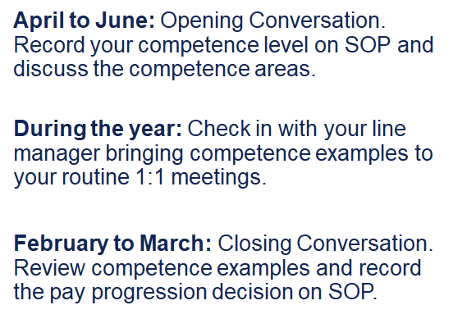
Competency Based Framework (CBF) –what do I have to do?
TEAMWORK
DECISION MAKING
LEGISLATION, POLICY & PROCEDURE
RISK
SERVICE DELIVERY
LEADERSHIP & MANAGEMENT
To watch the recent CBF staff event, please click on the Event Recording
To find out more, please visit Probation Hub and the My Hub

Slide 16
Digital Systems and Tools: What’s happening
Digital support
We are modernising your digital tools and systems to better support you with your work and ‘deliver excellent practice’.
We are reducing duplication in systems, streamlining processes and enabling better data recording and analysis, to support you with your workload management and decision making.
We have reviewed tools that were used to good effect in the NPS and CRCs prior to unification, adopting and improving them, or identifying gaps and building new ones.
Built iteratively by digital specialists with ops staff, for ops staff
New Probation tools and systems are being built iteratively by probation programme staff, operational staff and digital specialists working together.
Beta versions of tools are launched, ops staff experiences are tracked, the digital team get a better understanding of what works and what could be changed, and build and develop even better versions of the tools with you

Slide 17
Digital Spotlight: Create and Vary a Licence (CVL) Service
What is it?
Create and vary a licence is a new digital service that allows probation practitioners to create licences for prison leavers, prisons to approve, print and share the licences, and probation practitioners to vary active licences (with PDU Heads approving the variations) for those already released
Who needs to know in Probation?
Probation practitioners who currently send licence conditions to prison.
Case administrators in prison OMU teams.
Head of PDU’s who sign variations
What’s happening?
The early adopter region is Wales – excluding HMP Berwyn – and all Welsh probation areas and South Wales prisons have been included in the current roll-out going on right now.
Engagement is currently taking place with all other regions to discuss implementation plans and timescales. A timetable will be issued shortly.
What do I need to do?
Local training will be available for VLOs in pilot areas by VLO managers.
Look out for local briefings in VLUs by VLO managers
Further information
Further information on the Create and Vary a Licence (CVL) Service is available on the Probation Hub including an intro video and two-page explainer

Slide 18
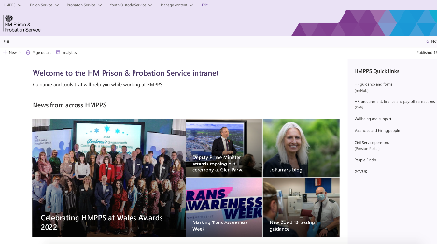
Digital Spotlight: Help shape the new HMPPS Intranet redesign
Are you interested in getting involved in what the new HMPPS intranet looks like and how information is structured and labelled?
We are looking for staff from the Probation Service who are interested in taking part in some user research with MOJ Digital & Technology.
You’ll be asked to complete an online exercise which involves sorting various information that you might find on the intranet into categories that make sense to you.
If you would like to take part register your interest by completing this form by 15 April.
You will then be sent an invite for an online exercise on the 18 April for completion by 22 April.
You will also have the chance to express your interest in being involved in future research.

Slide 19
New learning - Managing Violence & Aggression in the Workplace
NEW Managing Violence & Aggression in the Workplace – new digital learning product now available
Understanding and managing the risk of violence and aggression is required learning for any frontline member of staff in the Probation Service.
This redesigned learning product will help learners understand the behaviours and triggers that can lead to violence and aggression as well as providing an understanding of the techniques for reducing risk.
Access the course
For more information and to access the course go to the Probation Hub.
Who should complete it?
The new Managing Violence & Aggression in the Workplace learning package is designed for all frontline probation staff who have face to face contact with people on probation. This includes reception/administrative staff, sentence management probation practitioners, unpaid work, programme staff and those working in Approved Premises.
For experienced staff it will be beneficial for refreshing skills and knowledge and remaining up to date with practice in this area.

Slide 20
New learning - Child Safeguarding
Designed to support the new Policy Framework this session provides an opportunity to explore professional practice through a range of case studies, supporting the messaging of the upcoming ‘Think Child’ campaign whilst dispelling some of the common myths associated with the safeguarding of children.
Title: Child Safeguarding
Audience: All Probation Practitioners*
Type: ‘Required’
Time: Four-hour face to face MS teams
Two steps to booking
Before booking on the Child Safeguarding session you must first complete Child Protection & Safeguarding eLearning (1 hr)
2. Once you’ve completed the above course email national.delivery.team@justice.gov.uk confirming your name, employee number and preferred date from the list below and they’ll book you on to the face to face Child Safeguarding session:
Tuesday 10/05/22
Thursday 19/05/22
Monday 23/05/22

Slide 21
Updates on existing learning - New Me MOT learning / SEEDS2
New Me MOT learning – complete consent/disclaimer first
Prior to accessing the New Me MOT training you must first complete the consent/disclaimer for interventions.
Once you’ve completed, please wait 30 minutes before accessing the course either by searching on New Me MOT or NMMOT, or following this link New Me MOT – modular training package (mydevelopment.org.uk).
NB: If you have ‘admin’ rights you must put yourself in ‘learner’ mode to complete the disclaimer.
Further details on the consent form can be found on the Probation Hub.
SEEDS2 for Managers – are your part of the evaluation process?
There is an evaluation process taking place as part of the SEEDS2 for Manager learning package. As a result, staff are being asked to undertake this learning at specific times. The course is now available to book, but before you do please double check when you should book on.
For more information on all learning visit the Probation Hub

Slide 22
INSIGHTS 22 Festival – what are you going to do?
The INSIGHTS22 festival is back, bigger and better running from 9 May until 20 May. There are over 500 free learning and development opportunities.
Fancy shadowing the Director General of Prisons or Director General of Probation, Wales and Youth? Training a prison dog for the day? How about afternoon tea with a judge? Maybe you’d like to find out how prison documentaries are made? Or, maybe you’d like to go out on patrol with the Metropolitan Police? Please check individual events for further details and deadlines.
Open to everyone working or volunteering across the criminal justice sector including third sector, partners, arms length bodies.
Visit the Insights website to book your tickets now
www.hmppsinsights.co.uk
Deadlines for tickets
VIP events – 19 April 2022
In-person events – 22 April 2022
Online event – 6 May 2022
Please check individual events for full details.
Watch the Insights video now

Slide 23
Date for your diary – National Stalking Awareness Week Events
This year the National Stalking Awareness Week 2022 takes place from 25 – 29 April 2022.
HMPPS will be running three events that examine:
stalking behaviours
cyber stalking, and
the impact on victims from respected experts in the field.
Look out for further information and booking details in issue 58 of Probation News and don’t miss out.

Slide 24
Probation in Court - EM Curfew requirement mandatory enquiries (checks)
From 4th April 2022, before making a recommendation for an electronic monitoring curfew requirement, it will be mandatory for a probation practitioner to collate information from police (domestic abuse), the local authority (safeguarding) and the main property occupier to formulate a risk assessment.
Why the change?
This is being introduced to ensure we only recommend electronic monitoring curfews where it is safe to do so. This is in line with our public protection responsibilities and in response to a recommendation from HM Inspectorate of Probation.
Information sharing
If Probation practitioners do not receive the relevant information requested from the police or local authority they will not be permitted to recommend an electronic monitoring requirement.
Time
Court Probation practitioners will need use current processes for making the information enquiries and will need to notify the court of any adjournment period required for this to be undertaken.
In summary
Pre-sentence report authors will be required to secure information from three sources: police, local authority and main property resident before recommending an EMC requirement to Court.
For same day sentencing and where the court have identified EMC as an option probation staff will need to notify the court of any adjournment period needed to secure all the information required.
Further information Full operational guidance and an FAQ on this can be found at Probation Court Guidance - EM Curfew Requirement and Conduct Address Checks / Complete HDC Report on EQUIP.
If you have any questions or concerns, please refer to your line manager in the first instance.

Slide 25
Expansion of the victims contact scheme to stalking/harassment offences
What is it?
Victims of offences characterised by stalking and harassment offences will be offered information about the offender’s sentence and be notified of their release
For this reason, the Victim Contact Scheme is expanding to provide information to victims of specified stalking and harassment offences, where the offender receives a custodial sentence.
Who needs to know?
Victim Liaison Units (VLOs, VLO managers and administrators), probation practitioners who work with victims, staff based in court and prison; intervention staff.
What do I need to do?
Local training will be available for VLOs in pilot areas by VLO managers.
Look out for local briefings in VLUs by VLO managers
What’s happening - Pilot Scheme
A pilot of the Probation Victim Contact Scheme (VCS) to victims of stalking and harassment including those where the sentence is less than 12 months
The pilot will start in Hampshire and the whole of Kent, Surrey and Sussex on the 4th April and Northumbria and Thames Valley on the 3rd May. The pilot will run for a minimum of 6 months.
The pilot will be evaluated with the aim of the scheme being rolled out nationally in England and Wales from November 2022
Expansion details are available on the probation hub

Slide 26
[Region] : Our April area/s of focus
Team leader to fill in
Team leader to fill in
Team leader to fill in
Team leader to fill in

Slide 27
Team discussion
How might these changes affect our team?
Are we clear on our individual and team next steps and delivery?
How are we managing change? Do we need support?

Slide 28
Your thoughts, questions and feedback
Please email [insert your region’s preferred account]
Thank You

