Slide 1
Presenter’s notes​
This month’s Regional Team Briefing is attached​
The Probation Portfolio Communications and Engagement Team work with Probation Programmes workstream design leads to consolidate several communication products into one monthly cascade deck, to support clear and consistent communication with our staff in all regions, roles and functions​
These packs have been designed as a prompt to support you and your management teams in communicating updates and changes in team meetings/events over the next month​
In line with our Fixed, Flexible, Free model, this deck includes sections for you to add in your team or region specific information.​
Please do also use the content in your regional communications channels as you feel appropriate​
Your feedback on design, content, language, etc, is valued and welcome – please contact Peter Lamb​
​
Please delete this slide before you present this deck to your team – thank you

Slide 2
Region Team Briefing August 2022
[INSERT REGION]

Slide 3
Today’s conversation
Change
New intranet for HMPPS employees
Local changes [delete if not used]
Reminder
Case administrative support for SPOs (CASPOs)
Probation Day 2022
Local reminders [delete if not used
Updates
Harmonisation – agreement reached with trade unions
Protected Characteristics Plans update
Changes to the Parole Board Rules: Letter to Probation Staff
Local updates [delete if not used]
Training to become a Probation Officer
Action
Professional registration
Upcoming learning
Local actions [delete if not used]
Team discussion

Slide 4
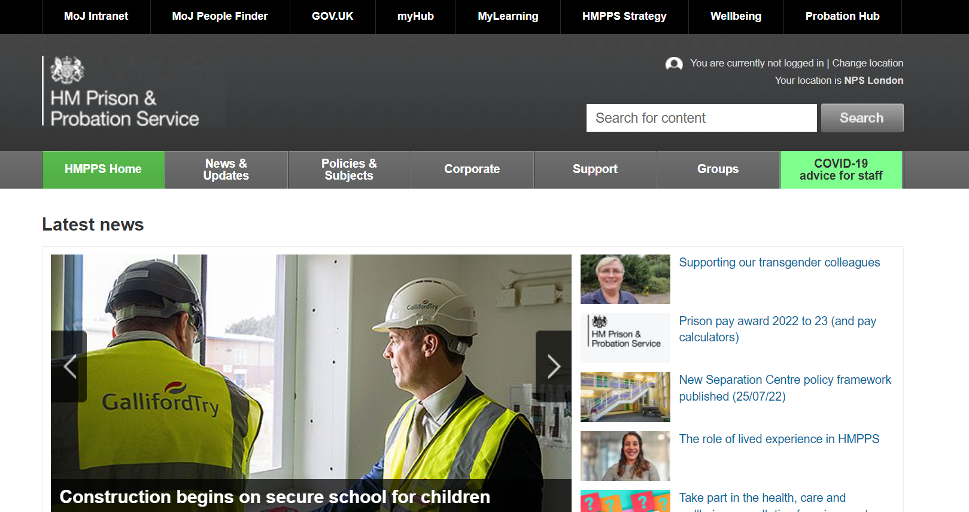
New intranet for HMPPS employees
The central HMPPS Communications team in collaboration with the MOJ Digital Team are working on the development of a new intranet to service employees across HMPPS.
Relevant pages from the Probation Hub will be migrated to the new environment.
Transfer of this content will have no immediate impact on the Probation Hub but when the new environment is tested, stable and contains all relevant content, the Probation Hub will eventually be ‘retired’ – this date has yet to be confirmed.
Before they go live, they need to carry out a final testing phase (known as Beta testing).
More information about the development of the new intranet will be shared via the Probation Hub and the HMPPS intranet.
For more information or to ask a question email us at pcetmailbox@justice.gov.uk

Slide 5
Local changes
Please enter your local change information on this slide.
Please delete this slide if you do not use it

Slide 6
Harmonisation – agreement reached with trade unions
Negotiations have concluded and a proposal has been finalised to align the terms and conditions of former Parent Organisation and Supply Chain colleagues to those of the Probation Service.
We would like to thank all impacted staff for their patience during what we know has been a frustrating and uncertain time.
Members of the three recognised probation trade unions will now be asked to accept or reject the agreed proposal in a ballot. Staff must be a member of a recognised probation trade union to vote.
Trade unions have contacted eligible staff with further information about the ballot process. Trade union members who believe they are eligible to vote but have not received this email should contact their trade union directly.
Find out more
A short FAQ and further details about next steps can be found on the Probation Hub.
General enquiries about harmonisation can be directed to the functional mailbox: HandSTenquiries@justice.gov.uk

Slide 7
Protected Characteristics Plans update
Further Protected Characteristics Plans for the Probation Service have been launched for LGBT+, Gender, Faith and belief, Social Mobility, and Disability, alongside the Black, Asian and Minority Ethnic survey action plan. The plans set out the outcomes we want to achieve to improve diversity and inclusion along with the practical things that will be done to help deliver them.
The Black, Asian and Minority Ethnic survey action plan has also been updated and demonstrates the progress made so far and what we’ll be working on over the next six months. The plan will be discussed in detail at an online all-staff event taking place on 27 September. Full details and a link to the event will follow soon.
You can view the all of the plans on the HMPPS intranet.

Slide 8
Changes to the Parole Board Rules
Letter to Probation Staff
On 28 July Sonia Flynn and Chris Jennings wrote out to all probation staff about the changes to parole board rules that came into effect on 21 July.
You should have received a copy of this letter, if you didn’t please speak to your line manager.
Briefing sessions
Staff briefing sessions took place between 14 and 21 July. Thank you to all those who attended a session.
A recorded session is available for you to watch at your own convenience and weekly sessions are still taking place every Tuesday from 1pm to 2.30pm. Please email Louise Holmes to book a place.
For more information, please read Sonia’s update on the HMPPS intranet.
EQuiP guidance
The Parole Quality Assurance Framework has been updated along with further guidance for staff.
Please log in to EQuiP to access this information.
This guidance will be reviewed as we embed these changes.

Slide 9
Training to become a Probation Officer
Additional recruitment campaign for trainee probation officers (PQiP) runs throughout August (1st – 29th)*
Positions are available in the following regions: Kent Surrey and Sussex, East of England, South Central, South West, East Midlands, West Midlands and London
There is no specific internal route for this campaign but staff who are Level 5 qualified and have been unsuccessful in previous campaigns are welcomed to apply again
We also welcome applications from friends and family looking for a career in probation with level 5 or equivalent
Read more about the role and benefits on the Train to be a Probation Officer website and hear successful PQiP candidates tell their stories.
APPLY HERE
*Candidates offered roles from this campaign will be considered for allocation for the March 2023 intake. Any candidates who are not successfully allocated for the March intake, will be held on the merit list for 12 months and considered for allocation at the next intake.

Slide 10
Local updates
Please enter any local updates here.
Please delete this slide if you do not use it

Slide 11
Case administrative support for SPOs (CASPOs)
Case administrative resource can now be allocated to Senior Probation Officers
Get in touch
If you would like more information or support from the Review Team in the Probation Workforce Programme then please contact laura.donnelly@justice.gov.uk
As a result of the Managerial Role Review (MRR) target staffing has now been amended to allow case administrative resource to be recruited and allocated to SPOs in sentence management and court on a ratio of 1:5.
Target staffing for SAO has also been reflected to support this change
PDUs can structure this how they wish – eg: CA supporting 5 SPOs or CA supporting 4 Probation Practitioners and 1 SPO.
The role is Case Administrator job description so tasks are related to the management of cases and the team’s performance.
Transactional and HR related tasks will continue to be delivered via the Management Co-ordination Hubs.
We have provided some examples here of how the resource could be used for sentence management and for courts.

Slide 12
Probation Day 2022 Launch Event 19 August 10.00am
Probation Day 2022 is coming!
To celebrate our second annual Probation Day Amy Rees and Sonia Flynn, along with other members of the executive team, will be hosting a short celebration launch event and invite you all to attend.
Please come along and join the Probation Day 2022 launch event on teams - we look forward to seeing you there.
Speak to your local staff engagement officer for details of local events happening near you.

Slide 13
Local reminders
Please enter your local reminders here.
Please delete this slide if you do not use it.

Slide 14
Professional registration Recognising the skills and experience of Probation practitioners
Get involved in the conversation
Get in touch
If you would like more information about this topic please contact ProfessionalAgendaFeedback@justice.gov.uk
We’re holding several webinars and inviting employees from across the business to join us. We want to hear from you to get your views on our current proposals on the internal professional register and professional standards as well as help shape the policy framework as it progresses.
Click on a date below to register your interest and you will be sent an email invite. Accept the invite and it will be added to your Outlook calendar
Wednesday 17 August, 11am to 11.30am
Friday 19 August, 11.30am to midday
Tuesday 23 August, 11.00am to 11.30am
Thursday 25 August, 3pm to 3.30pm
Wednesday 31 August, 10am to 10.30am
Friday 2 September, 11.30am to midday
Tuesday 6 September, 11.00am to 11.30am
Thursday 8 September, 3pm to 3.30pm
Monday 12 September, 4pm to 4.30pm
Wednesday 14 September, 10am to 10.30am
Friday 16 September, 11.30am to midday

Slide 15
Upcoming learning
Domestic Abuse
This session explores professional practice through a range of case studies. Developing skills in professional curiosity and promoting effective multi-agency working, this session aims to promote the identification and management of emerging domestic abuse risk as well as considering the intervention framework for perpetrators. This course will also highlight the principles of effective victim safety planning and is underpinned by the Domestic Abuse Policy Framework.
When: Virtual face to face learning session Monday 19 September
Prior to attending you must complete Course: NPS - Domestic Abuse Awareness eLearning* (mydevelopment.org.uk)
Title: Domestic Abuse (New)
Audience: All Probation Practitioners
Type: Required
Format: Virtual face to face (6 hours)
Repeat: Every three years
BOOK NOW
Adult Safeguarding
This course aims to increase confidence and competence in the identification and management of complex risks and vulnerabilities, whilst operating in line with relevant legislative frameworks. A range of case studies are used to explore a series of complex adult safeguarding concerns in the context of probation practice, promoting the application of professional curiosity and person-centred approaches throughout.
When: Virtual face to face learning session Thursday 29 September
Prior to attending you must complete Course: NPS - Adult Safeguarding eLearning* (mydevelopment.org.uk)
Title: Adult Safeguarding (New)
Audience: All Probation Practitioners
Type: Required
Format: Virtual face to face (4 hours )
Repeat: Every three years
BOOK NOW
NB: PQIPs and New Entrant PSOs don’t need to book via this route as they are booked in via the Regional teams.

Slide 16
Local actions
Please enter any local actions here.
Please delete this slide if you do not use it.

Slide 17
Team discussion
How might these changes affect our team?
Are we clear on our individual and team next steps and delivery?
How are we managing change? Do we need support?

Slide 18
Thank you
Your thoughts, questions and feedback…
Please email [insert your region’s preferred email account here]

