Slide 1
Presenter’s notes​
This month’s Regional Team Briefing is attached​
The Probation Portfolio Communications and Engagement Team work with Probation Programmes workstream design leads to consolidate several communication products into one monthly deck, to support clear and consistent communication with our staff in all regions, roles and functions​
These packs have been designed as a prompt to support you and your management teams in communicating updates and changes in team meetings/events over the next month​
In line with our Fixed, Flexible, Free model, this deck includes sections for you to add in your team or region specific information.​
Please do also use the content in your regional communications channels as you feel appropriate​
Your feedback on design, content, language, etc, is valued and welcome – please contact Peter Lamb​
​
Please delete this slide before you present this deck to your team – thank you

Slide 2
Region Team Briefing September 2022
[INSERT REGION]

Slide 3
Today’s conversation
Change
Probation Service pay offer (2022-25) - 5 key components
Pay offer resources
Probation Service Pay Offer – staff events
Probation Service Pay Offer - next steps
Understanding and communicating changes
Smarter working
Local changes [delete if not used]
Reminder
Offender management in custody – decommissioning the Case Allocation System (CAS)
Automated Release and Recall End User Guidance
Local reminders [delete if not used]
Action
Upcoming learning
Professional registration
Local actions [delete if not used]
Team discussion
Updates
New digital solution to case transfer
Recruiting Probation Services Officers & Case Administrators
Local updates [delete if not used]

Slide 4
Probation Service pay offer (2022-25) - 5 key components
Uplifts to all staff salaries
Reform to the pay structure
Linking CBF to pay progression
Top of pay band payments
Increased allowances
Consolidated uplifts to all pay band values meaning uplifts to all staff salaries
Reform to improve spacing within pay bands and between them; reducing pay band lengths
Linking pay progression to the CBF after the successful trial year
Non-consolidated payments for those not eligible for pay progression in year 2 and year 3 as they are already at the top of their pay band
Increasing allowances

Slide 5
Pay offer resources
Staff events
Weekly all-staff live sessions.
Re-cap/Q&A sessions by region for Bands 1-6.
Re-cap /Q&A sessions for Bands A-D.
Session info is available on the Hub and links to the individual Teams meetings are on the next slide.
Pay offer summary
Pay calculator
Pay FAQs
Changes to Allowances summary

Slide 6
Probation Service Pay Offer – staff events
Probation Pay Offer- Staff Support Live Events (for all Probation Service staff)
12 September 10.00 – 10.25 19 September 10.00 – 10.25
Recap/Q&A sessions for staff in Bands 1-6 (by region)
6 September 10.00-10.45 – YaTH 8 September 12.00-12.45 – East Midlands & West Midlands 9 September 10.00-10.45 – North West & Greater Manchester
13 September 10.00-10.45 – Wales 16 September 10.00-10.45 – London 20 September 10.00-10.45 – North East & East of England 21 September 10.00-10.45 – South West & South Central 22 September 10.00-10.45 – Other PS Business Areas & KSS
Recap/Q&A sessions for staff Bands A-D
7 September 10.00-10.45 14 September 10.00-10.45 23 September 12.00-12.45
These sessions are for you to walk through the pay offer and to ask your questions.
You are encouraged to attend the session for your region.
If you can’t attend, feel free to attend an alternative session.

Slide 7
Probation Service Pay Offer - next steps
Ballots close
TUs likely to return ballot outcomes
Ballots open
1 Sept
23 Sept
30 Sept
Autumn
Process pay award
Communicate ballot outcomes
Staff engagement sessions
If agreed at ballot

Slide 8
Understanding and communicating changes
Several products have been developed to help managers and front-line staff to understand the changes and when they are happening. These include:
The Change Map – issued quarterly, it shows high level changes by theme such as sentence management, unpaid work, programmes and courts. To help plan for and understand the changes across all workstreams.
My Role Maps –They show what the changes mean by role. A useful tool for line managers when planning inductions for new staff, in planning team meetings and supporting staff to navigate each change
Probation Hub – Dedicated workstream pages go into a little more detail e.g. Here’s one on the roll-out of the JitBit admin tool.
The hub is being wound down and the new intranet will include dedicated probation change pages
Region Team Briefing – This deck! Issued monthly and has been developed to support leaders and middle managers in communicating changes at team meetings. Same info…different way of communicating it and receiving it. Also stored on the Hub
Our Probation Service changes illustrated on a page - An articulation of changes through an illustration/poster
The Change Map, My Role Maps, Probation Hub and Region Team Briefing all link to detailed guidance, process maps and learning requirements on EQuiP and MyLearning.

Slide 9
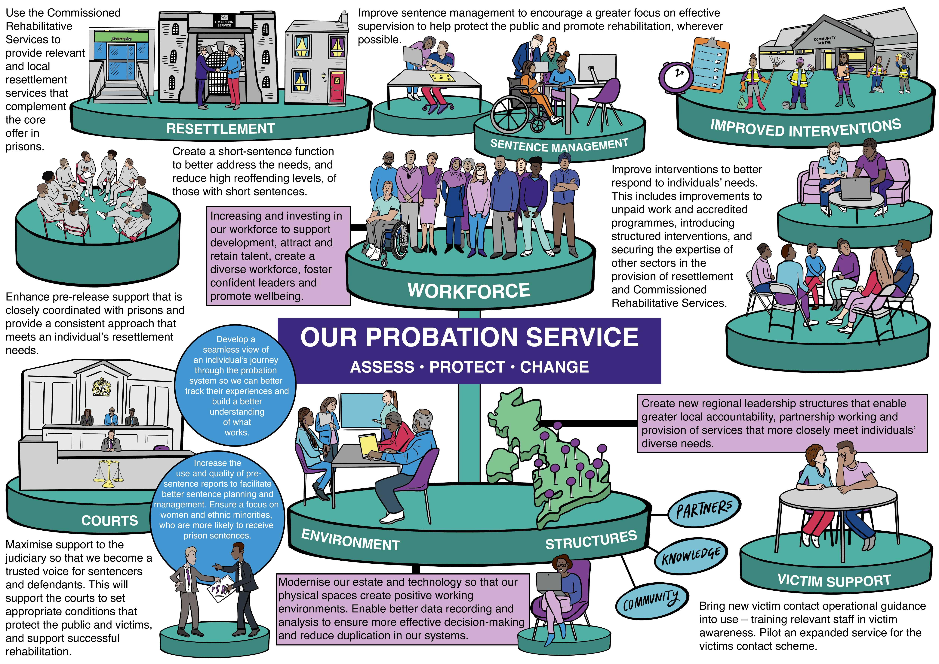
Understanding and communicating changes (cont’d)
New this month
Role maps
Changes affecting Programme Managers
Changes affecting Domestic Abuse Support Officers
Changes affecting Treatment Managers
Changes affecting Facilitators
Changes affecting various unpaid work roles
Our Probation Service illustration on a page (see right)
September 2022 version available
Probation Hub / New HMPPS intranet workstream pages
Case Transfers
Regional team briefing
September issue - here it is! Also available on the Hub
The Change Map, My Role Maps, Probation Hub and Regional Team Briefing all link to detailed guidance, process maps and learning requirements on EQuiP and MyLearning.

Slide 10
Smarter working
The revised Smarter Working Toolkit has been launched
The new toolkit has been developed using the lessons learned from the pandemic and period of recovery to make better use of our estates and technology, as well as clarifying the ways we can work together.
The toolkit is separated into four elements:
Leaders
Technology
Estates
People
It allows for quick and easy access, focussing on practicalities and how you can implement Smarter Working into your day.
Further information
You can find the revised Smarter Working Toolkit on Equip.
For an introduction see Sonia Flynn’s smarter working blog on the intranet.

Slide 11
Local changes
Please enter your local change information on this slide.
Please delete this slide if you do not use it

Slide 12
New digital solution to case transfer 1 of 6
Who needs to know?
Practitioners, SPOs and Case Administrators
What is happening
In October (exact date to be confirmed) two new NSIs will launch to support you with case transfers and temporary moves.
A small change in practice, they will improve your ability to safely transfer and manage cases of people on probation.
Key features include a slimmed down transfer form and ‘Action List’ attached to the NSI
You will also have access to a National PDU locator to identify the team or contact you should transfer the NSI to.
*A case transfer is defined as where a person on probation is moving to a different geographical boundary that is covered by a different team
More information
Probation hub
Case Transfer FAQs
CT Framework In Full
Role maps – changes in case transfer by role
NDelius Advice Note

Slide 13
New digital solution to case transfer 2 of 6
Benefits to you, your person on probation and your region
The new digital solution will provide:
correct, sufficient, and consistent information
clear lines of responsibility and the ability to locate a single point of contact
visibility for all involved
time savings
It does not replace the need to conversation and best practice.
Using an NSI will also help on a regional level to identify and monitor patterns of issues such as continual delays in returning police checks in a particular area.
What is changing (and what is not changing)
Staff should continue to follow the Case Transfer process outlined in the Case Transfer Policy Framework relaunched in March 2022.

Slide 14
New digital solution to case transfer 3 of 6
Practitioner (Transferring)
To support a timely and safe transfer process within the required 20 working days, transferring practitioners will be responsible for raising an NSI when they want to:
transfer a case
request support from another PDU or region when a person on probation will be temporarily residing in their area
The NSI includes a new, shorter transfer form and ‘Action List’ to better support:
the capture of all relevant risks of serious harm
up to date assessments
a single view of all activity related to the transfer
You will also have access to a National PDU locator to identify the team or contact you should transfer the NSI to.
You can track the transfer by looking at the NSI status and utilising the MIS (Management Information System) report and tracker.
Where your person on probation needs to reside for a short period at an address other than their home address, you will need to notify the local PDU team of a Temporary Move by raising an NSI.
Whilst the team in the person on probation’s temporary location can support, you will remain responsible for that case. If you are concerned about the progress of a case transfer, you should escalate the issues reflected in the NSI to your SPO.

Slide 15
New digital solution to case transfer 4 of 6
Practitioner (Receiving)
Receiving practitioners will receive transferred cases or cases on a temporary move, via the NSI.
For case transfers, following receipt of the NSI, your SPO will allocate the case to you, and you must review and complete an address assessment within 10 working days.
The address assessment should be completed online with the Home Visit PF (Policy Framework) and could be a home visit or a desktop assessment depending on.
the type of accommodation or more likely who else lives in the property
any restrictions in place, level, or risk which an NSI raised for home visits.
You will also receive a completed, nationally standardised transfer form and be prompted via an Action List to review the case and make the usual checks including:
attending a three-way hand over session arranged by the practitioner responsible for the transfer
support the practitioner responsible for the transfer, with any police checks if required

Slide 16
New Digital Solution to case transfer 5 of 6
Practitioner (Receiving) continued
It is assumed that you will accept the case and it is your responsibility to raise any challenges to the transfer pertaining to risk. The transferring practitioner can enforce, or recall should the person on probation present a danger to themselves or the public.
You can track the transfer by looking at the NSI status. If you receive an email from another area or region informing you of an incoming case transfer, you should request the practitioner raise the required NSI and follow the process.
A person on probation may be released or allowed to live for a short period at an address other than their home address.
You would expect to be notified by the practitioner of a temporary move via an NSI, which may be allocated to you. You will need to support both the responsible practitioner and the person on probation with appointments to ensure the sentence or license requirements are still met, however you will not be responsible for the management of the case. The case should be reviewed when the person on probation returns to their original address.
If a person on probation is released and wishes to reside in the receiving area this is a Case transfer. It is only a temporary move if the accommodation made available post release in temporary

Slide 17
New digital solution to case transfer 6 of 6
SPO
You will be required to provide management oversight for all cases transferring in and out, in line with the Touch Point Model. For cases transferring in you will need to allocate the PoP and NSI to a PP for review and address assessment.
The address assessment must be completed within the first 10 days of receiving the NSI.
The NSI includes a new, slimmed down Transfer Form and an Action List detailing the usual, required activity your practitioner and team need to complete.
You will be the escalation point should your practitioner have any concerns over the transfer.
Case Administrators
[Region process may vary. Add process here]

Slide 18
Recruiting Probation Services Officers & Case Administrators
We’re recruiting Probation Services Officers (PSO) and Case Administrators (CA). Both campaigns are now live and will be open until Monday 26 September for all regions apart from North West which closes on Monday 19 September.
Positions are available in the following regions:
Kent Surrey and Sussex
East of England
South Central
North West
Greater Manchester
We also welcome applications from friends and family looking for a career in probation.
Both roles are integral to the work of the Probation Service in supporting people of probation and protecting the public from the effects of crime.
The links to the individual job adverts can be found on the next slide.
Read more about the role and benefits at Probation services officer - Ministry of Justice

Slide 19
Recruiting Probation Services Officers & Case Administrators (cont’d)
Job adverts - Probation Services Officers
Probation Services Officer - Greater Manchester Probation Region - 63665 - Ministry of Justice
Probation Services Officer - Kent, Surrey and Sussex Probation Region - 63723 - Ministry of Justice
Probation Services Officer - Northwest Probation Region - 63722 - Ministry of Justice (exception: closes 19 September)
Probation Services Officer - South Central Probation Region - 63724 - Ministry of Justice
Probation Services Officer - East of England Probation Region - 63720 - Ministry of Justice
Case Administrators
Case Administrator - Greater Manchester Probation Region - 63671 - Ministry of Justice
Case Administrator - Kent, Surrey and Sussex Probation Region - 63714 - Ministry of Justice
Case Administrator - East of England Probation Region - 63744 - Ministry of Justice
Case Administrator - Northwest Probation Region - 63726 - Ministry of Justice
Case Administrator - South Central Probation Region - 63785 - Ministry of Justice
Read more about the role and benefits at Probation services officer - Ministry of Justice

Slide 20
Local updates
Please enter your local updates on this slide.
Please delete this slide if you do not use it

Slide 21
Offender management in custody – decommissioning of the Case Allocation System (CAS)
Find out more
A Q&A document and OMiC Case Allocation Quick Guide are both available on the Probation Hub
Court staff are no longer be required to complete a manual CAS assessment, as this will be undertaken by an automated process
This changes was implemented with the launch of the last nDelius upgrade.
A CAS decision screen exists on nDelius in the same place, but there is no need to complete any questions from the previous CAS tool. The new screen shows the details of any historic recording where a CAS assessment has previously been input

Slide 22
Offender management in custody – decommissioning the of Case Allocation System (CAS)
Find out more
A Q&A document and OMiC Case Allocation Quick Guide are both available on the Probation Hub.
The only fields which will still need to be updated manually by court staff will be the RSR and OSP scores, as appropriate.
nDelius will automatically identify how each case is then to be allocated under the OMiC model rules.
All Wales cases will be shown as “Retained / Enhanced Resourcing” as a result of the calculation and no manual adjustment for Wales Community Supervision responsibility will be required.
There will be very little impact to OMIC cases and OMIC staff, and the process will continue to work as it does now. The ability to differentiate between levels of resource allocation and handover points is retained through the retention of the CAS decision screen, which the MPC digital function will use to communicate allocation information in the same way as it currently does

Slide 23
Automated Release and Recall End User Guidance
From 19 September 2022 most releases from Custody on an Adult Licence will be automatically recorded on the day of release in NDelius, based upon an update in NOMIS.
At this stage, the only thing that will change will be the overall status and the custody location, which will move from a known location to In the Community
While most releases will be captured, not all will be and licence conditions will not be automatically added, so release status should still be checked, and licence conditions should be added once known in NDelius as current practice.
Temporary releases and transfers to Secure Hospitals or to Immigration Detention are currently not covered by this process, although the expectation is that both will be included in due course.
Find out more on the
probation hub
Refer to Advice Note: 01092022 - Automatic Releases and Recall to Custody

Slide 24
Local reminders
Please enter your local reminders on this slide.
Please delete this slide if you do not use it

Slide 25
Upcoming learning
Domestic Abuse
This session explores professional practice through a range of case studies. Developing skills in professional curiosity and promoting effective multi-agency working, this session aims to promote the identification and management of emerging domestic abuse risk as well as considering the intervention framework for perpetrators. This course will also highlight the principles of effective victim safety planning and is underpinned by the Domestic Abuse Policy Framework.
When: Virtual face to face learning session Monday 19 September
Prior to attending you must complete Course: NPS - Domestic Abuse Awareness eLearning* (mydevelopment.org.uk)
Title: Domestic Abuse (New)
Audience: All Probation Practitioners
Type: Required
Format: Virtual face to face (6 hours)
Repeat: Every three years
BOOK NOW
Adult Safeguarding
This course aims to increase confidence and competence in the identification and management of complex risks and vulnerabilities, whilst operating in line with relevant legislative frameworks. A range of case studies are used to explore a series of complex adult safeguarding concerns in the context of probation practice, promoting the application of professional curiosity and person-centred approaches throughout.
When: Virtual face to face learning session Thursday 29 September
Prior to attending you must complete Course: NPS - Adult Safeguarding eLearning* (mydevelopment.org.uk)
Title: Adult Safeguarding (New)
Audience: All Probation Practitioners
Type: Required
Format: Virtual face to face (4 hours )
Repeat: Every three years
BOOK NOW
NB: PQIPs and New Entrant PSOs don’t need to book via this route as they are booked in via the Regional teams.

Slide 26
Professional registration Recognising the skills and experience of Probation practitioners
Get involved in the conversation
We’re holding several webinars and inviting employees from across the business to join us. We want to hear from you to get your views on our current proposals on the internal professional register and professional standards as well as help shape the policy framework as it progresses.
Click on a date below to register your interest and you will be sent an email invite. Accept the invite and it will be added to your Outlook calendar.
Get in touch
If you would like more information about this topic please visit the new HMPPS intranet or contact ProfessionalAgendaFeedback@justice.gov.uk
Monday 12 September, 4pm to 4.30pm
Wednesday 14 September, 10am to 10.30am
Friday 16 September, 11.30am to midday

Slide 27
Local actions
Please enter any local actions here.
Please delete this slide if you do not use it.

Slide 28
Team discussion
How might these changes affect our team?
Are we clear on our individual and team next steps and delivery?
How are we managing change? Do we need support?

Slide 29
Thank you
Your thoughts, questions and feedback…
Please email [insert your region’s preferred email account here]

